Slide 1
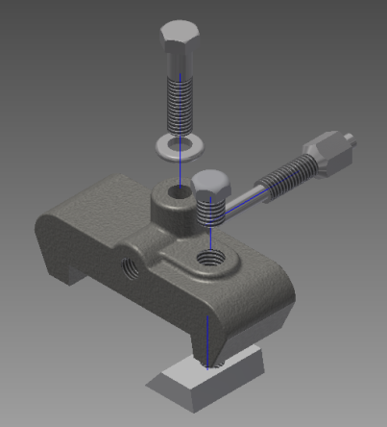
Advanced Engineering Design and Presentation
The Stop Clamp Parametric Modeling Skill Builder
Copyright © Texas Education Agency, 2014. All rights reserved.

Slide 2
Creating a Stomp Clamp
Create it to the specifications given.
Make sure that you use the correct threads on the screw.
You will be given little instruction on how to create this one.
Use this slide presentation to help guide you through the steps.
Copyright © Texas Education Agency, 2014. All rights reserved.

Slide 3
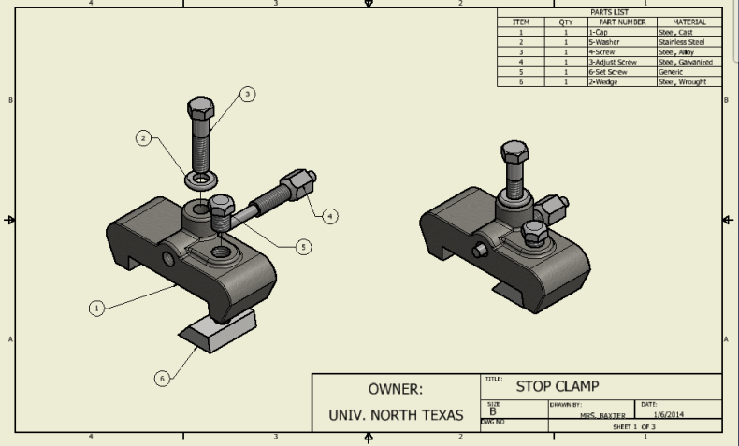
Layout Page 1
Copyright © Texas Education Agency, 2014. All rights reserved.

Slide 4
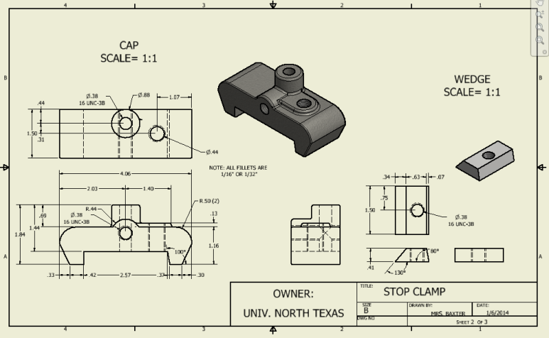
Layout Page 2
Copyright © Texas Education Agency, 2014. All rights reserved.

Slide 5
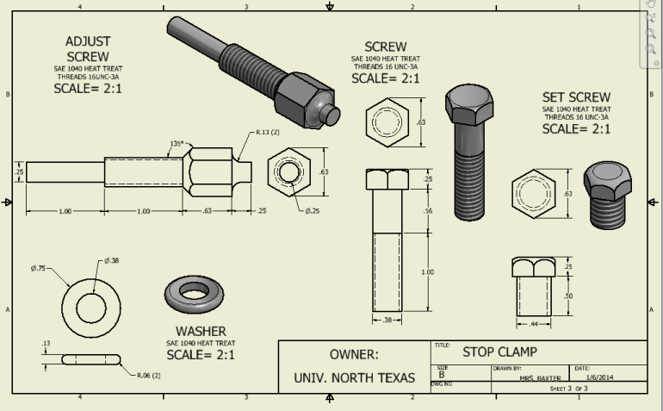
Layout Page 3
Copyright © Texas Education Agency, 2014. All rights reserved.

Slide 6
How to Create the Parts
Create a folder on your drive for all of the Stop Clamp parts and assemblies.
Make sure you save to this folder only!
The following slides will help you figure out how to create the parts.
    Part #1 – Cap
    Part #2 – Wedge
    Part #3 – Adjust Screw
    Part #4 – Screw
    Part #5 – Set Screw
    Part #6 – Washer
Copyright © Texas Education Agency, 2014. All rights reserved.

Slide 7
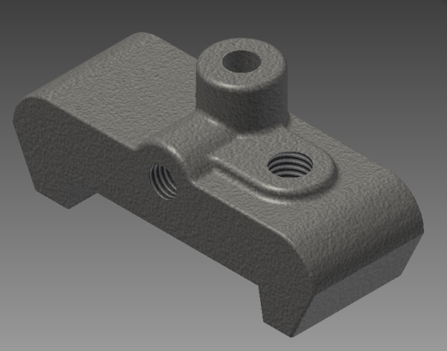
Part #1- Cap
Copyright © Texas Education Agency, 2014. All rights reserved.

Slide 8
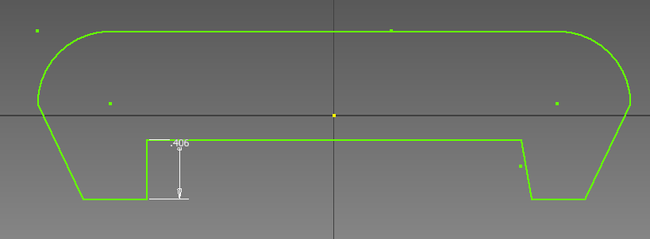
Part #1- Cap
Draw this and extrude it.
Copyright © Texas Education Agency, 2014. All rights reserved.

Slide 9
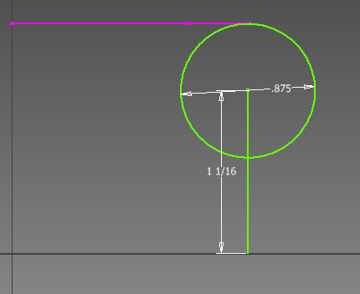
Part #1- Cap
Draw and extrude.
Copyright © Texas Education Agency, 2014. All rights reserved.

Slide 10
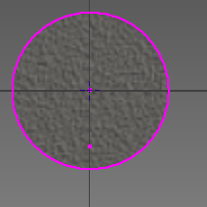
Part #1- Cap
Find the center and create the hole.
Copyright © Texas Education Agency, 2014. All rights reserved.

Slide 11
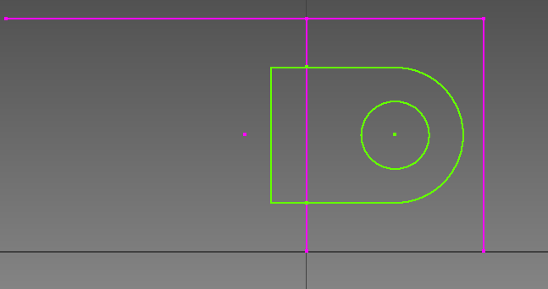
Part #1- Cap
Draw and extrude.
Copyright © Texas Education Agency, 2014. All rights reserved.

Slide 12
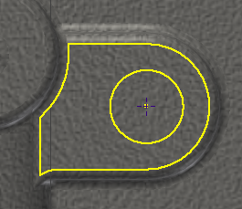
Part #1- Cap
Find the center and create the hole.
Copyright © Texas Education Agency, 2014. All rights reserved.

Slide 13
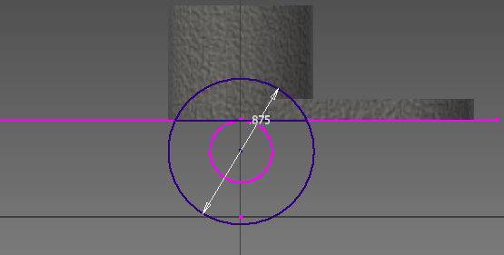
Part #1- Cap
Draw and Extrude.
Copyright © Texas Education Agency, 2014. All rights reserved.

Slide 14
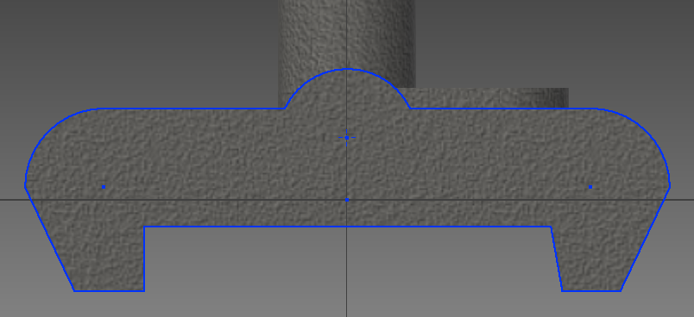
Part #1- Cap
Find the center and create the hole.
Copyright © Texas Education Agency, 2014. All rights reserved.

Slide 15
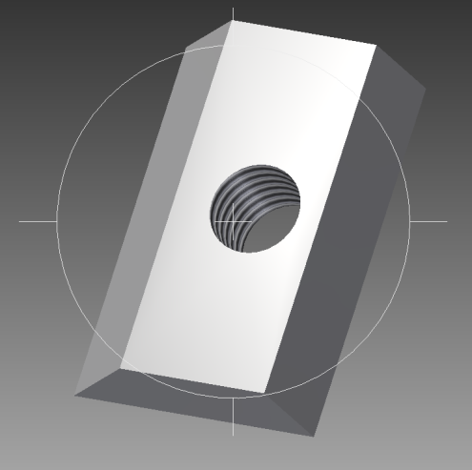
Part #2 - Wedge
Copyright © Texas Education Agency, 2014. All rights reserved.

Slide 16
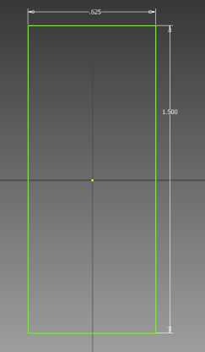
Part #2 - Wedge
Draw and then extrude this.
Copyright © Texas Education Agency, 2014. All rights reserved.

Slide 17
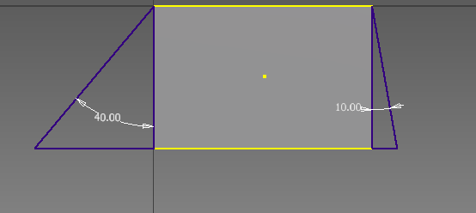
Draw and extrude.
Part #2 - Wedge
Copyright © Texas Education Agency, 2014. All rights reserved.

Slide 18
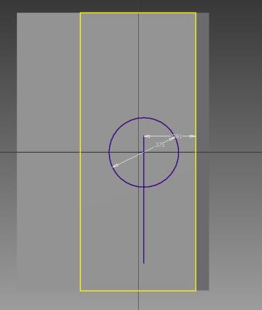
Find the center point and create the hole.
Part #2 - Wedge
Copyright © Texas Education Agency, 2014. All rights reserved.

Slide 19
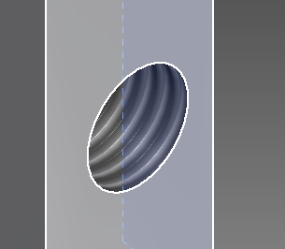
Add the correct threads.
Part #2 - Wedge
Copyright © Texas Education Agency, 2014. All rights reserved.

Slide 20
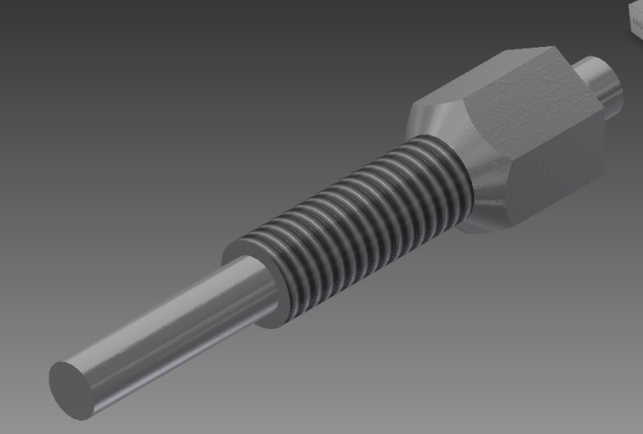
Part #3 – Adjust Screw
Copyright © Texas Education Agency, 2014. All rights reserved.

Slide 21
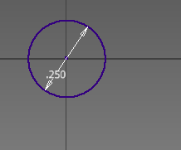
Part #3 - Adjust Screw
Draw and extrude this.
Copyright © Texas Education Agency, 2014. All rights reserved.

Slide 22
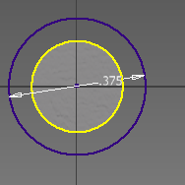
Draw and extrude this.
Part #3 - Adjust Screw
Copyright © Texas Education Agency, 2014. All rights reserved.

Slide 23
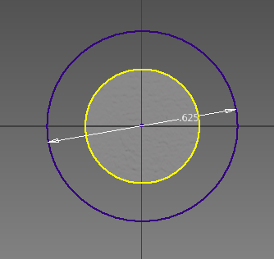
Draw and extrude this.
Part #3 - Adjust Screw
Copyright © Texas Education Agency, 2014. All rights reserved.

Slide 24
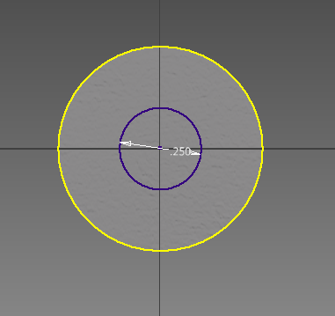
Draw and extrude this.
Part #3 - Adjust Screw
Copyright © Texas Education Agency, 2014. All rights reserved.

Slide 25
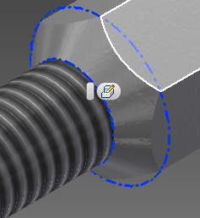
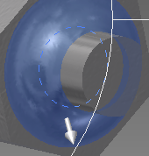
Add the chamfer and fillet.
Part #3 - Adjust Screw
Copyright © Texas Education Agency, 2014. All rights reserved.

Slide 26
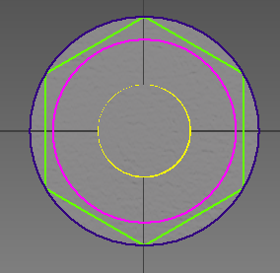
Draw and then cut extrude.
Part #3 - Adjust Screw
Copyright © Texas Education Agency, 2014. All rights reserved.

Slide 27
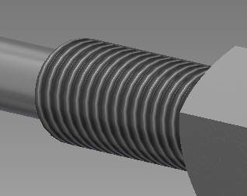
Add the correct threads.
Part #3 - Adjust Screw
Copyright © Texas Education Agency, 2014. All rights reserved.

Slide 28
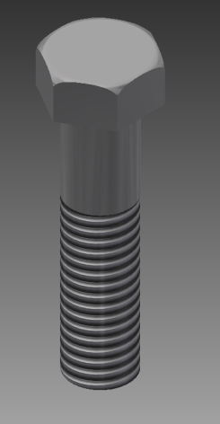
Part #4 - Screw
Copyright © Texas Education Agency, 2014. All rights reserved.

Slide 29
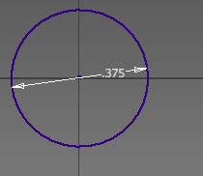
Part #4 - Screw
Draw and extrude this.
Copyright © Texas Education Agency, 2014. All rights reserved.

Slide 30
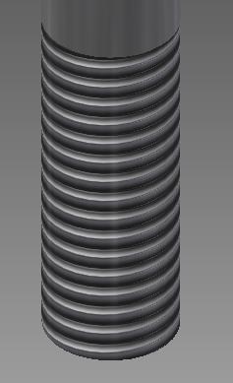
Add the correct threads.
Part #4 - Screw
Copyright © Texas Education Agency, 2014. All rights reserved.

Slide 31
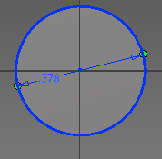
Draw and extrude this.
Part #4 - Screw
Copyright © Texas Education Agency, 2014. All rights reserved.

Slide 32
Draw and extrude this.
Part #4 - Screw
Copyright © Texas Education Agency, 2014. All rights reserved.

Slide 33
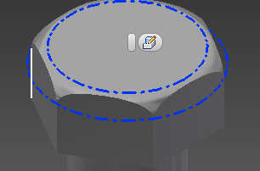
Add the fillet.
Part #4 - Screw
Copyright © Texas Education Agency, 2014. All rights reserved.

Slide 34
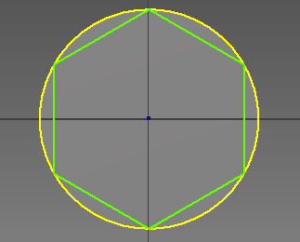
Draw and then cut extrude.
Part #4 - Screw
Copyright © Texas Education Agency, 2014. All rights reserved.

Slide 35
Add the correct threads.
Part #4 - Screw
Copyright © Texas Education Agency, 2014. All rights reserved.

Slide 36
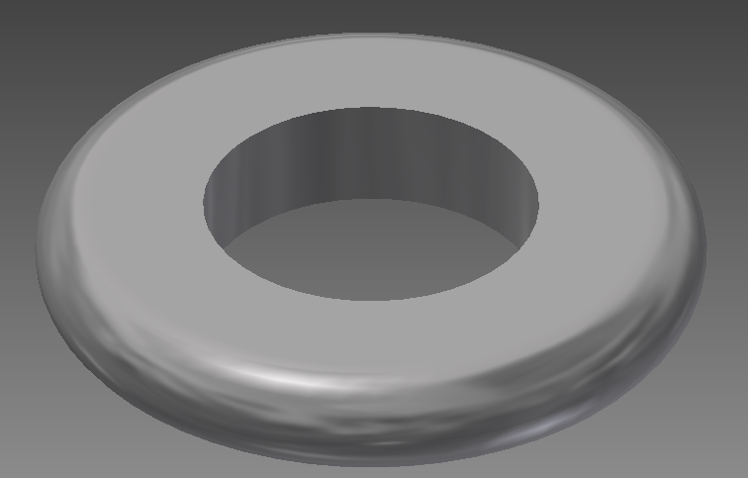
Part #5 - Washer
Copyright © Texas Education Agency, 2014. All rights reserved.

Slide 37
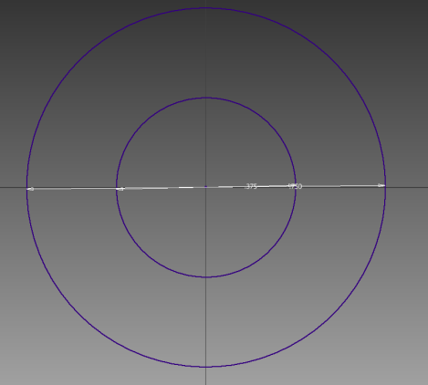
Part #5 - Washer
Draw and extrude this.
Copyright © Texas Education Agency, 2014. All rights reserved.

Slide 38
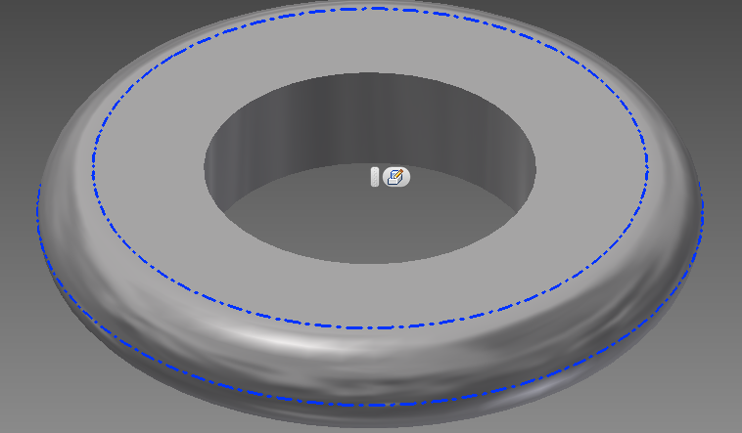
Add fillet to both sides.
Part #5 - Washer
Copyright © Texas Education Agency, 2014. All rights reserved.

Slide 39
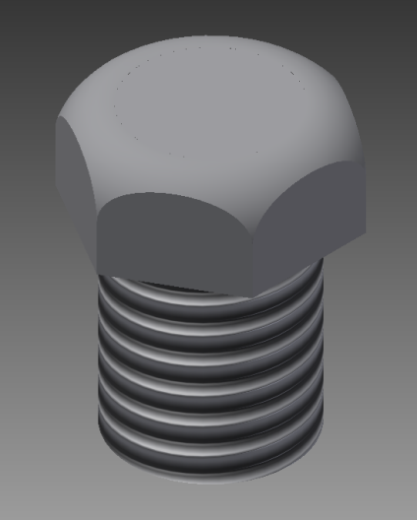
Part #6 - Set Screw
Copyright © Texas Education Agency, 2014. All rights reserved.

Slide 40
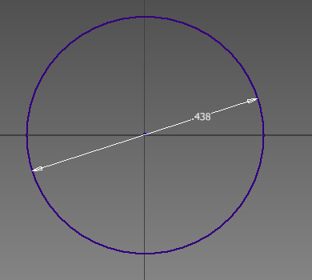
Part #6 - Set Screw
Draw and extrude this.
Copyright © Texas Education Agency, 2014. All rights reserved.

Slide 41
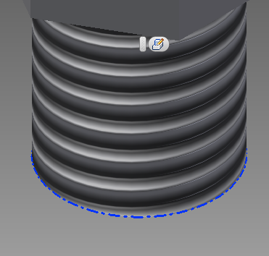
Add the correct threads.
Part #6 - Set Screw
Copyright © Texas Education Agency, 2014. All rights reserved.

Slide 42
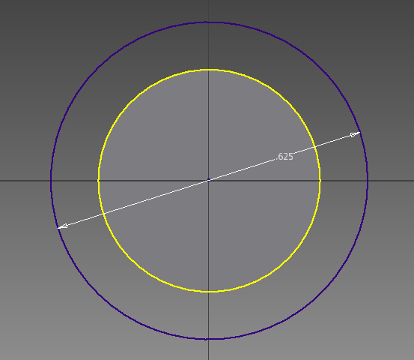
Draw and extrude this.
Part #6 - Set Screw
Copyright © Texas Education Agency, 2014. All rights reserved.

Slide 43
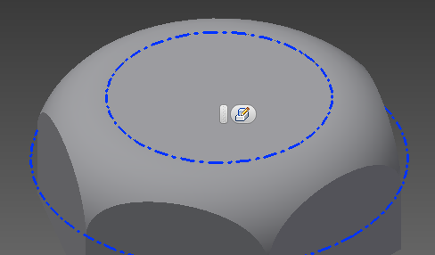
Add the fillet.
Part #6 - Set Screw
Copyright © Texas Education Agency, 2014. All rights reserved.

Slide 44
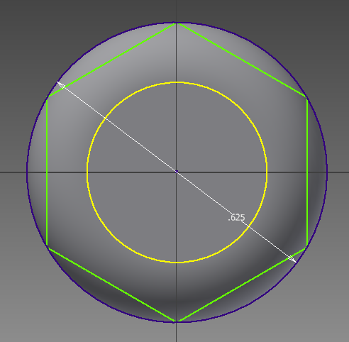
Draw and then cut extrude.
Part #6 - Set Screw
Copyright © Texas Education Agency, 2014. All rights reserved.

Slide 45
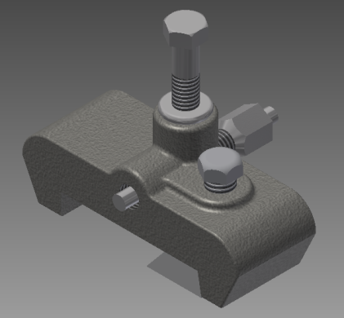
Place your parts and constrain them to look like this.
Assembly
Copyright © Texas Education Agency, 2014. All rights reserved.

Slide 46
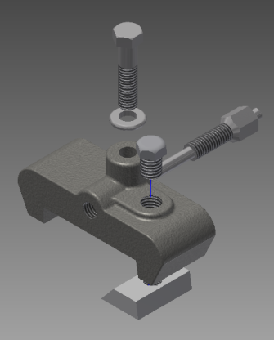
Make an exploded view by tweaking, moving, and rotating, to look like this.
Make an Exploded View
Copyright © Texas Education Agency, 2014. All rights reserved.

Slide 47
Place the exploded and assembled views onto layout page #1; add the parts list and balloon annotations.
Copyright © Texas Education Agency, 2014. All rights reserved.

Slide 48
Place the Stop Clamp Cap and Wedge onto layout page #2; add annotations.
Copyright © Texas Education Agency, 2014. All rights reserved.

Slide 49
Place the Stop Clamp Adjust Screw, Screw, Set Screw and Washer onto layout page #3; add annotations.
Copyright © Texas Education Agency, 2014. All rights reserved.

Slide 50
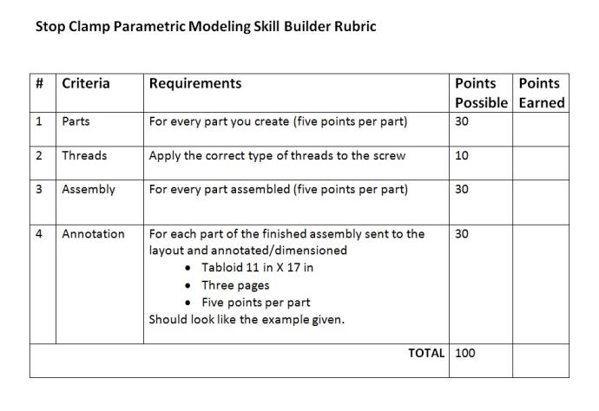
Following the example and rubric given.
Copyright © Texas Education Agency, 2014. All rights reserved.

