Slide 1
A Career Journey
  Famous Careers in Arts, AV Technology and Communications

Slide 3
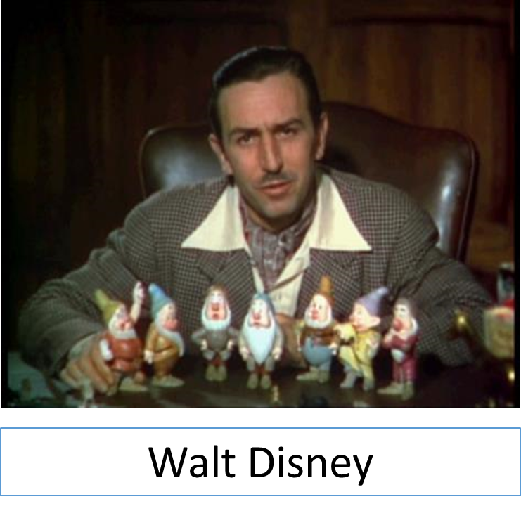
A Career Journey: Walt Disney
  Film Producer and Animator
    Created a variety of popular fictional cartoon characters
    Produced the first feature-length animated film in Technicolor
    Oversaw the growth of his movie studio into one of the most lucrative entertainment companies in the world
Notes:
Walt Disney Snow White 1937 Trailer Screenshot [Digital image]. (1937). Retrieved April 28, 2015, from https://commons.wikimedia.org/wiki/Walt_Disney#/media/File:Walt_Disney_Snow_white_1937_trailer_screenshot_%2812%29.jpg
Walt Disney. (n.d.). In Wikipedia. Retrieved April 28, 2015, from http://en.wikipedia.org/wiki/Walt_Disney

Slide 4
A Career Journey: Walt Disney
  Film Producer and Animator
    His first two studios went bankrupt, but he had wild success with the third studio.
    He designed several amusement parks based on many of the cartoon characters he created.
Notes:
Walt Disney Snow White 1937 Trailer Screenshot [Digital image]. (1937). Retrieved April 28, 2015, from https://commons.wikimedia.org/wiki/Walt_Disney#/media/File:Walt_Disney_Snow_white_1937_trailer_screenshot_%2812%29.jpg
Walt Disney. (n.d.). In Wikipedia. Retrieved April 28, 2015, from http://en.wikipedia.org/wiki/Walt_Disney

Slide 5
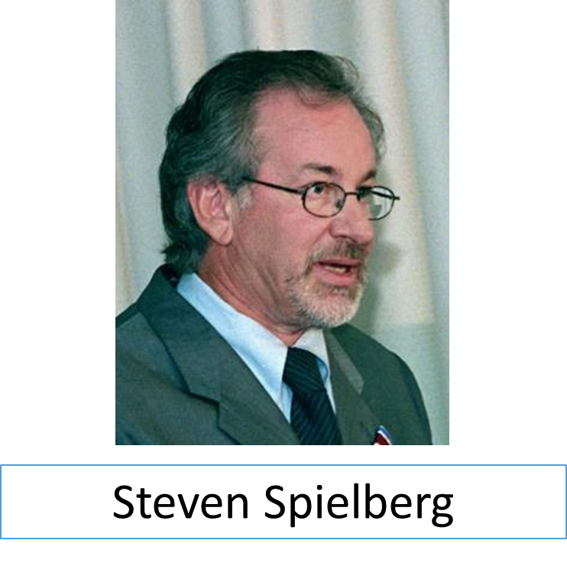
A Career Journey: Steven Spielberg
  Filmmaker, Producer, and Director
    One of the most popular and influential filmmakers in history
    A pioneer in the creation of what are now known as “blockbuster” films
Notes:
Steven Spielberg 1999 3 [Digital image]. (1999). Retrieved April 28, 2015, from http://commons.wikimedia.org/wiki/File:Steven_Spielberg_1999_3.jpg#/media/File:Steven_Spielberg_1999_3.jpg
Steven Spielberg. (n.d.). In Wikipedia. Retrieved April 28, 2015, from http://en.wikipedia.org/wiki/Steven_Spielberg

Slide 6
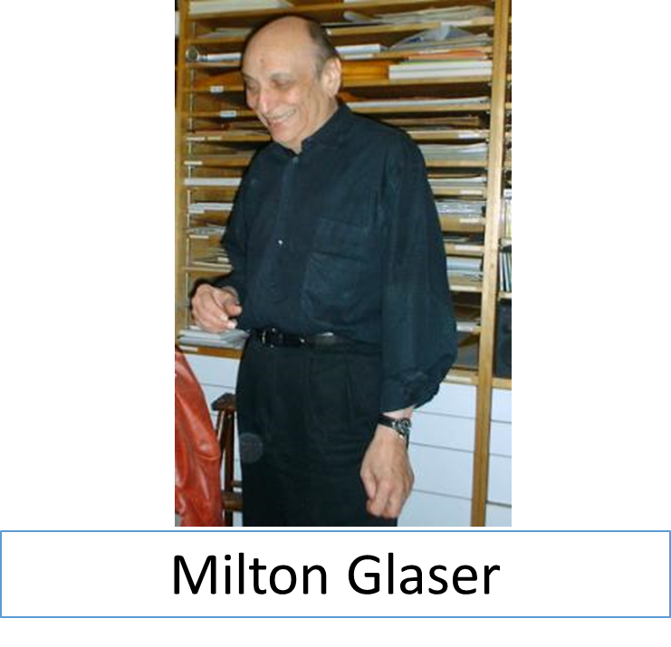
A Career Journey: Milton Glaser
  Graphic Designer and Illustrator
    Created simplified images (signs and symbols) to convey messages
    He was an innovator in the use of typography in graphic design.
Notes:
Milton Glaser [Digital image]. (2003). Retrieved April 28, 2015, from http://commons.wikimedia.org/wiki/File:Milton_glaser.jpg#/media/File:Milton_glaser.jpg
Milton Glaser. (n.d.). In Brittanica. Retrieved April 28, 2015, from http://www.britannica.com/EBchecked/topic/1079800/Milton-Glaser

Slide 7
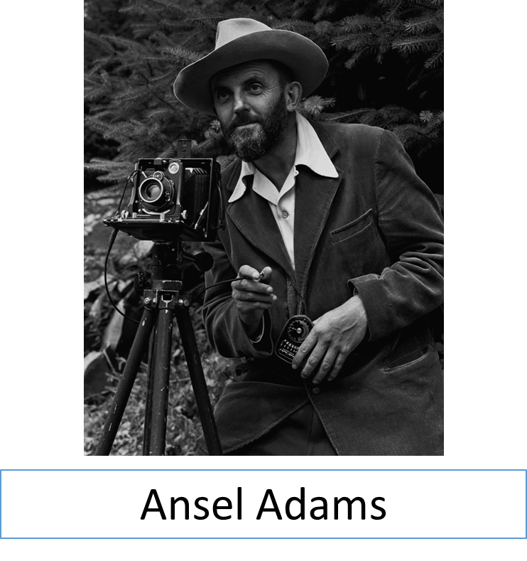
A Career Journey: Ansel Adams
  Photographer
    Best known for his iconic images of the American West (usually in black and white)
    Published essays and instructional books on photography
Notes:
Ansel Adams and Camera [Digital image]. (1947). Retrieved April 28, 2015, from http://commons.wikimedia.org/wiki/File:Ansel_Adams_and_camera.jpg#/media/File:Ansel_Adams_and_camera.jpg
Ansel Adams. (n.d.). In Biography. Retrieved April 28, 2015, from http://www.biography.com/people/ansel-adams-9175697

Slide 8
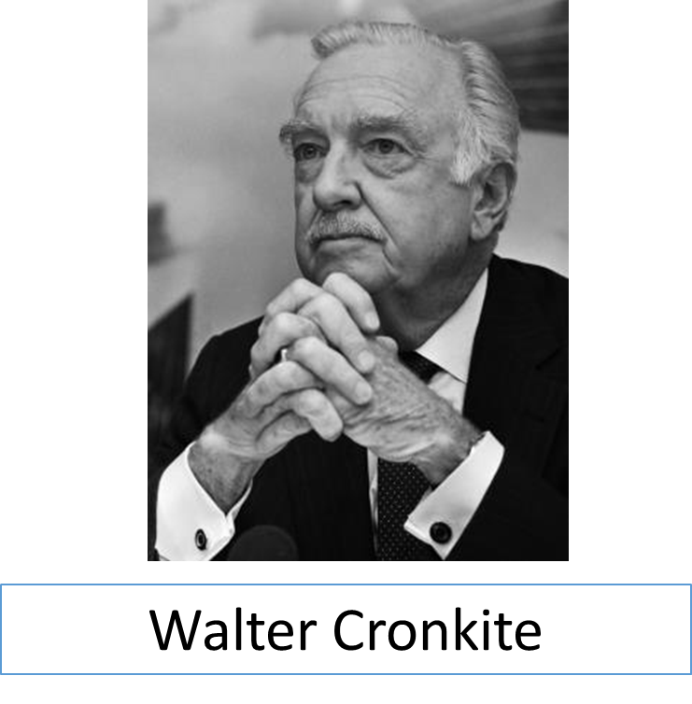
A Career Journey: Walter Cronkite
  Journalist and Broadcaster
    Studied journalism in college
    Reported for various agencies until becoming the anchor for the evening news at a large television network (in 1962)
Notes:
Walter Cronkite [Digital image]. (1985). Retrieved April 28, 2015, from http://commons.wikimedia.org/wiki/File:Walter_Cronkite_(1985).jpg#/media/File:Walter_Cronkite_(1985).jpg
Walter Cronkite. (n.d.). In Notable Biographies. Retrieved April 28, 2015, from http://www.notablebiographies.com/Co-Da/Cronkite-Walter.html

Slide 9
A Career Journey: Walter Cronkite
  Journalist and Broadcaster
    His evening news program consistently led the ratings until his retirement in 1981
    Best known for honest and straightforward reporting
Notes:
Walter Cronkite [Digital image]. (1985). Retrieved April 28, 2015, from http://commons.wikimedia.org/wiki/File:Walter_Cronkite_(1985).jpg#/media/File:Walter_Cronkite_(1985).jpg
Walter Cronkite. (n.d.). In Notable Biographies. Retrieved April 28, 2015, from http://www.notablebiographies.com/Co-Da/Cronkite-Walter.html

Slide 10
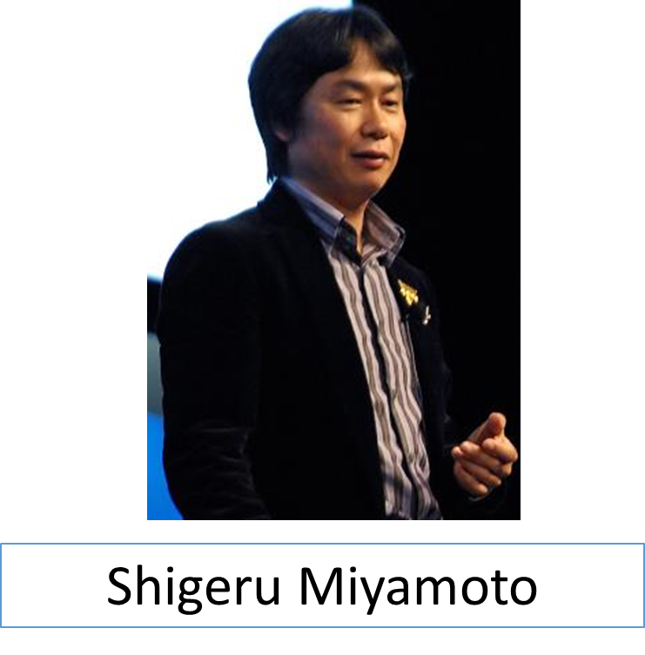
A Career Journey: Shigeru Miyamoto
  Video Game Designer
    Works for the largest video game company (by revenue)
    He has been called “the Spielberg of video games” and “the father of modern video games”.
Notes:
Shigeru Miyamoto GDC 2007 [Digital image]. (2007). Retrieved April 28, 2015, from http://commons.wikimedia.org/wiki/File:Shigeru_Miyamoto_GDC_2007.jpg#/media/File:Shigeru_Miyamoto_GDC_2007.jpg
Shigeru Miyamoto. (n.d.). In Wikipedia. Retrieved April 28, 2015, from http://en.wikipedia.org/wiki/Shigeru_Miyamoto

Slide 11
A Career Journey: Shigeru Miyamoto
  Video Game Designer
    He has created multiple video games, which are extremely popular.
    His philosophy for designing games: Create something you yourself would like to play.
Notes:
Shigeru Miyamoto GDC 2007 [Digital image]. (2007). Retrieved April 28, 2015, from http://commons.wikimedia.org/wiki/File:Shigeru_Miyamoto_GDC_2007.jpg#/media/File:Shigeru_Miyamoto_GDC_2007.jpg
Shigeru Miyamoto. (n.d.). In Wikipedia. Retrieved April 28, 2015, from http://en.wikipedia.org/wiki/Shigeru_Miyamoto

Slide 12
What Causes Occupational Changes?
  Possible Factors:
    Changes in occupational interest
    Changes in demand
    Changes in skills
    Other?

