Slide 1
Flexible Manufacturing
  Abrasives in Manufacturing

Slide 3
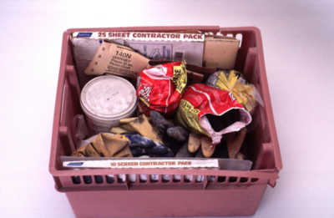
Abrasives
  Any material or substance used for grinding or polishing (i.e., emery, pumice, or sandpaper)

Slide 4
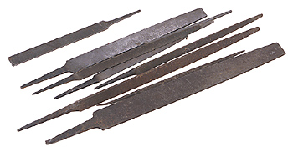
Files
  A tool, usually made of hardened steel, with cutting ridges for forming or smoothing surfaces, especially metal
Notes:
Definition: http://www.merriam-webster.com/dictionary/file

Slide 5
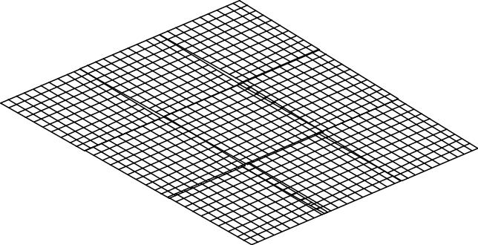
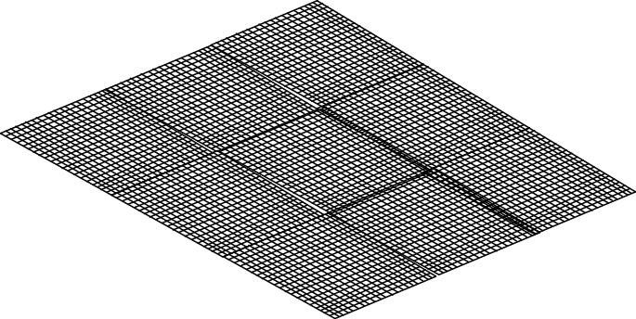
Grit
  The size of abrasive particles usually expressed as their mesh size - the number of openings per inch of mesh
100 Grit Mesh
200 Grit Mesh
Notes:
Definition: http://www.merriam-webster.com/dictionary/

Slide 6
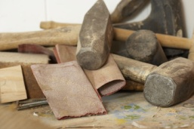
Sandpaper
  Strong paper coated with a layer of sand or other abrasive, used for smoothing or polishing

Slide 7

Files

Slide 8
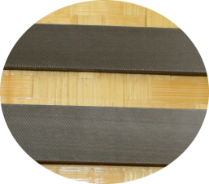
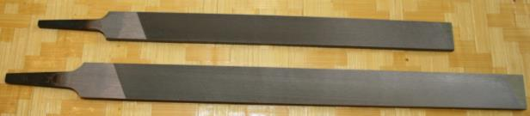
Sizes of Files
  Files are made with lengths from four inches to eighteen inches long. The length increases by two inches at a time (4”, 6”, 8”… 18”).
  The teeth spacing increases with size change. A four inch smooth mill file has finer teeth than the teeth of an eighteen inch smooth mill file

Slide 9
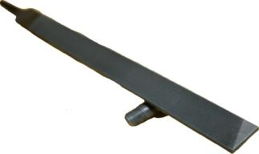
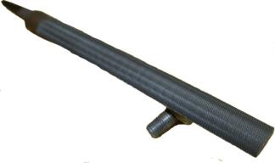
Types of Files
Flat
  used on flat surfaces only
Half Round or Cabinet
  used on curved or flat surfaces

Slide 10
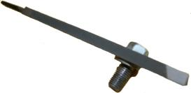
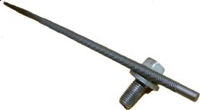
Types of Files
Three Square
  used on inside angles
Round
  used on inside holes

Slide 11
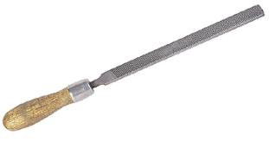

Types of Files
Rat tail
  used on small, inside holes
Rasp
  used on wood
4 in hand file
  used on wood
  combination of file and rasp
Tapered
All Shapes

Slide 12

Parts of a File
Edge
Face
Heel
Tang
Toe
Length

Slide 13
File Cuts
  This is the coarseness of the teeth on a file
  The cuts from coarse to fine are as follows: rough, middle, bastard, second cut smooth, and dead smooth
Notes:
The term “Bastard” is old English for odd or different.

Slide 14
File Cuts
SINGLE CUT
DOUBLE CUT
BASTARD
SECOND
SMOOTH
BASTARD
SECOND
SMOOTH
  The teeth are cut in only one direction
  The difference between same size files is that there are more cuts per inch
  The teeth are cut in two directions or angles

Slide 15
Using a File
  Filing– pushing the file across the surface of the metal being cut
  Draw filing– pushing the file down the length of the metal being cut
  Lathe filing– pushing the file against the rotation of the metal being turned on the lathe

Slide 16

How to Hold a File
Hold the file with the handle in your dominant hand, placing your other hand on the toe end of the file

Slide 17

Directions to Cross File
  The metal should be held in a vise for filing
  Place the file on the metal, apply pressure, and push the file across the surface of the metal
  Lift the file from the metal on the return stroke
      -Dragging the file back across the metal will dull the file
  The file can be turned at an angle to the metal to make the filing easier

Slide 18
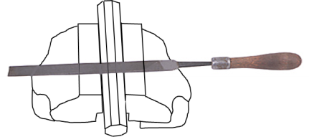
Directions to Draw File
  The metal should be held in a vise for filing
  Place the file on the metal, apply pressure, and push the file down the length of the metal
  Lift the file from the metal on the return stroke
      -Dragging the file back across the metal will dull the file
  The file can be turned at an angle to the metal to make the filing easier

Slide 19
Directions to Lathe File
  The metal should be held mounted in the lathe
  Place the file on the metal, apply pressure, and push the file across the surface of the metal
  Lift the file from the metal on the return stroke
      - Dragging the file back across the metal will dull the file
  The file can be turned at an angle to the metal to make the filing easier

Slide 20
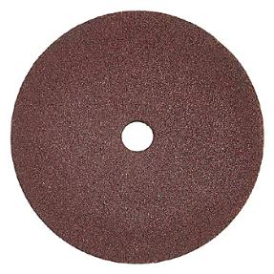
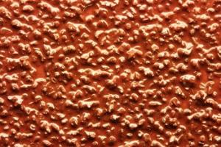
Sandpaper

Slide 21
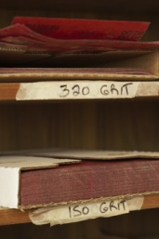
Sandpaper Grit
  Grit sizes used in metal working are from 60 grit to 2,000 grit
  Course grits 60 to 120
  Medium grits 180 to 320
  Fine grits 400 to 600
  Super fine grits 1000 and up

Slide 22
Sanding Metal
  Machine sanding can be done using an angle grinder with a sanding disk attached
  When sanding metal by hand, wrap a section of sandpaper around a file, and use the draw filing method to sand the material
  Start sanding the metal with the coarsest grit paper to remove the imperfections from the surface
  When the imperfections are removed, switch sanding grits to a finer grit and sand the scratches made by the courser sandpaper

Slide 23
Sanding Metal
  The project should be free of all surface scratches and imperfections when you finish sanding
  Sanding through the different grits will make smaller scratches on the surface of the materials
  Sand in a sequence from 80, 120, 200, 400, 600, 800, to 1,000 grit; then, finish with 2,000 grit. This will give the project a luster that can be polished to a high luster

Slide 24
Resources
  http://www.merriam-webster.com/dictionary/file
  http://dictionary.reference.com
  http://www.osha.gov/pls/oshaweb/owadisp.show_document?p_table=STANDARDS&p_id=9839

