Slide 1
Advanced Graphic Design & Illustration
Large Format Printing

Slide 3
What are your options when making large format presentations?
Service bureau
Investment in a large format color plotter

Slide 4
Do we need to print large format pieces for presentations?
Large format printing is an important part of a professional presentation.
Many presentation materials are now digital, but there are times when a large poster is the best option.

Slide 5
Service bureaus:
Many online service bureaus take orders
Short-run color printing
Great solution for the short-term.
Disadvantages:
Costly – charges a minimum of about $10 for an 11” x 17” poster and it increases exponentially from there.
At their mercy with regard to print timing.
No way to “hurry up” a service bureau. They have limited turnaround times.

Slide 6
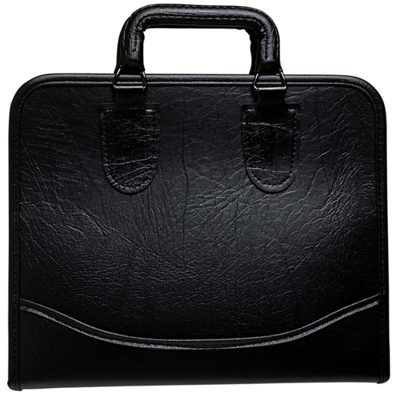
Large format printers run into the thousands of dollars to purchase.
Best option if the funds are available:
Allows the artist to understand the importance of resolution issues
Allows the artist to see flaws in their work that may not be as apparent in smaller portfolio prints.

Slide 7
What are resolution issues that arise with large format printing?
Simple rule when enlarging work:
Maximum capability of most large format printers these days is 2400 x 1200 optimized dpi from a 1200 x 1200 dpi input.

Slide 8
What about the presentation itself? Matting or mounting?
Computer-generated Output:
Standard mount on foam core board.
Laminated with a matte laminate to preserve color luminance.

