Slide 1
An Overview of the
Poultry Industry
  Principles of Agriculture, Food, and Natural Resources
  12 – technical knowledge and skills related to animal science
  C- breeds and classes of livestock

Slide 3
Structure of the Poultry Industry
  Vertical integration: all aspects of the industry are owned by the same company
  For example: Tyson or Sanderson Farms own their own feed mill, hatchery, and processing plants, trucking fleet, employ their own veterinarians, etc.
  No middle man; reduces costs of paying a third party

Slide 4
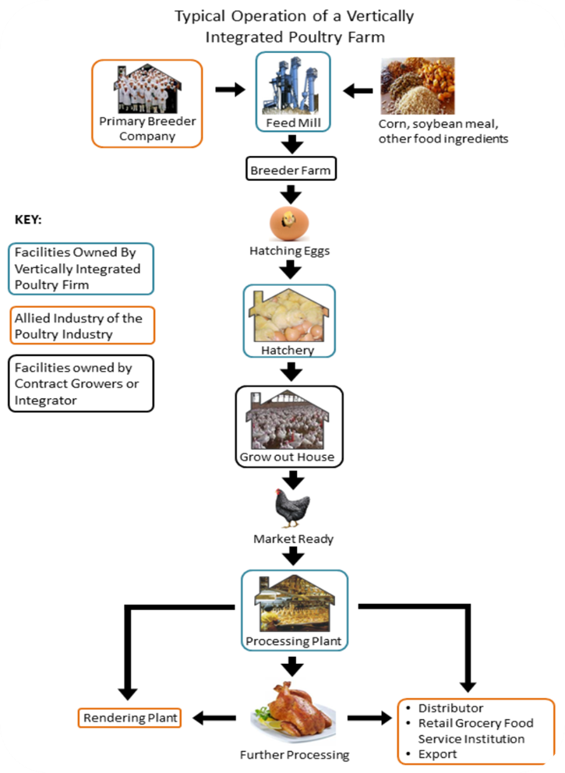

Slide 5
Broiler Industry
  Today, almost all market broilers are raised in large operations
  The term broiler refers to chickens which finish about 7-8 weeks of age and are raised for meat
  Broilers are being developed to finish more quickly

Slide 6
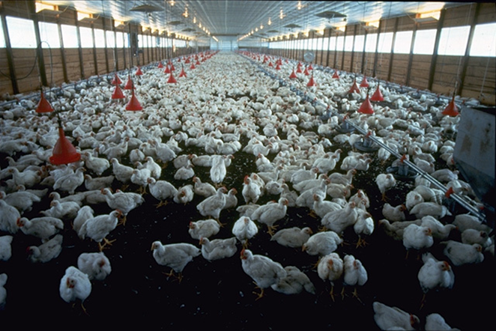
Broiler Houses
  Raised in large houses where the birds spend most of their lives
  Designed to provide the ultimate in environmental conditions for the comfort of the birds.
  Generally lighted 24 hours a day
  Helps cut down on cannibalism

Slide 7
Broiler Production
  Meat-type birds
  Breed cross- White Cornish x White Plymouth Rock
  Go to market at 6-7weeks of age
  Males weigh about 7 lbs
  Females weigh about 5
  Birds are mostly white
  Americans consume about 88 lbs./year of broilers per capita

Slide 8
Egg Production
  White Leghorn breed
  Only used for egg production
  Sexually mature at 20 weeks of age
  Weigh about 3.5 lbs
  Lay 250 eggs a year
  Americans consume about 250 eggs per capita annually

Slide 9
Turkey Industry
  The sale of turkey is second to chicken in the overall sale of poultry meat.
  Turkey represents a high quality, low cost, nutritious source of food protein.
  One third of all turkey sales occur during the weeks around Thanksgiving and Christmas.

Slide 10
Turkey Industry
  The modern market turkey is a descendant of the wild turkey and is result of a mutation which left out the gene for feather and skin pigmentation.
  Heavy muscled, broad breasted birds have been developed.
  Most market turkeys are white-feathered

Slide 11
Turkey Production
  Broad-Breasted White breed or strain
  Meat production
  Market at 20-24 weeks of age
  Males at 45 lbs
  Females at 30 lbs
  Americans consume approximately 20 lbs of turkey per capita annually
  Natural mating is difficult due to the weight of the birds
  Turkey breeder females are bred artificially – AI’ed

Slide 12
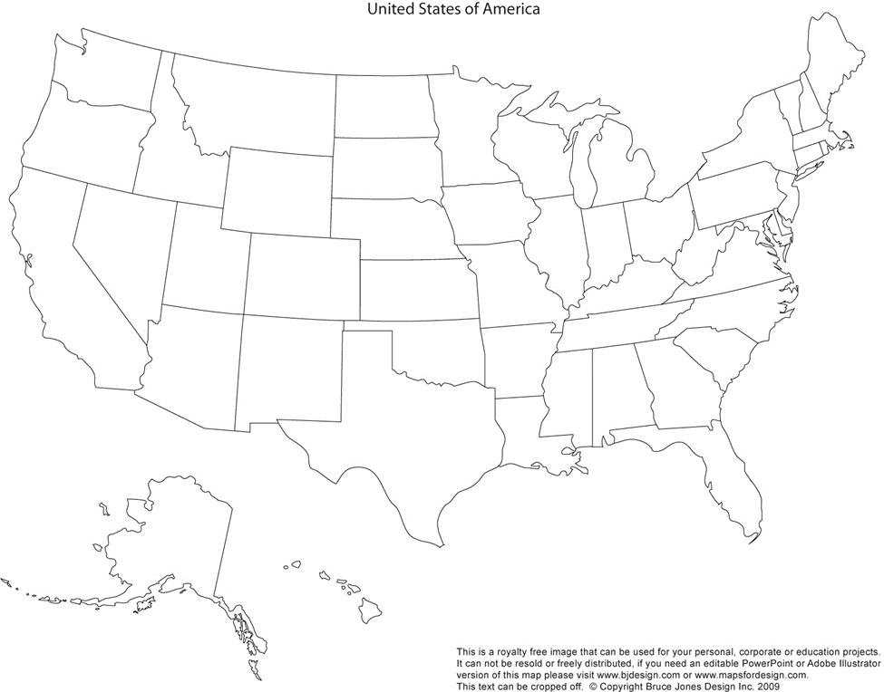
Where are the birds?

Slide 13
Ticket out of the Door
  Mr. Jones just bought a White Leghorn for his chicken operation. What type of production is the White Leghorn used for?
  Your dad just bought a White Cornish male x White Plymouth Rock cross. He’s not sure what he should use this chicken for. What do you think?
  Mrs. Dillon owns a poultry operation. He produces meat type birds that reach about 5-7 lbs. at market weight. What type of operation is this?
  Johnny lives in the top producing broiler state. He always drives around sees chicken houses and long metal buildings. He also smells them quite often. In what state does Johnny live?
  Tiffany lives in the top turkey producing state. Turkeys are always a popular product at Tiffany’s Thanksgiving and Christmas celebrations. In what state does Tiffany live?

