Slide 1
Animation
  Creating the Bouncing Ball:
  Arcs, Easing, and Squash and Stretch

Slide 3

Why Create the Bouncing Ball?
  The bouncing ball exercise is the starting point for all animators. Unless an animator can make a ball bounce in a believable fashion, it would not be wise to try more complex exercises. All animators should have an example of a bouncing ball somewhere in their portfolio (reel).

Slide 4
Three Principles of Animation
  The bouncing ball covers three of the basic principles of animation:
    motion in arcs
    slow in/slow out (easing)
    squash and stretch
  All components are necessary to give the motion the correct look

Slide 5
Motion in Arcs
  The ball falls in an elliptical arc through space. Most objects move in some sort of arc. If the ball was to move in a straight line between the top and bottom points of the bounce, then the action would look very unnatural.

Slide 6
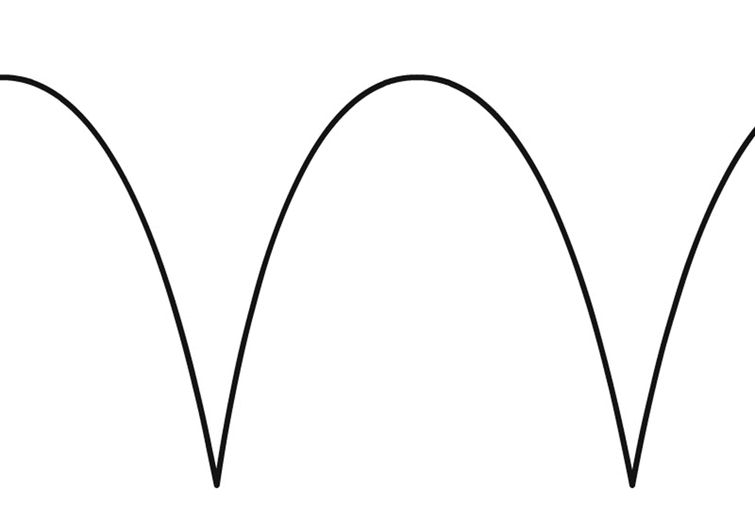
Arched Path for a Bouncing Ball

Slide 7
Linear Motion
  When objects move at an even pace, the motion is referred to as linear. When most objects are in motion, they are slowing down or speeding up. A common mistake of animators is to not change this linear motion. Linear motion is not appropriate for a bouncing ball.

Slide 8
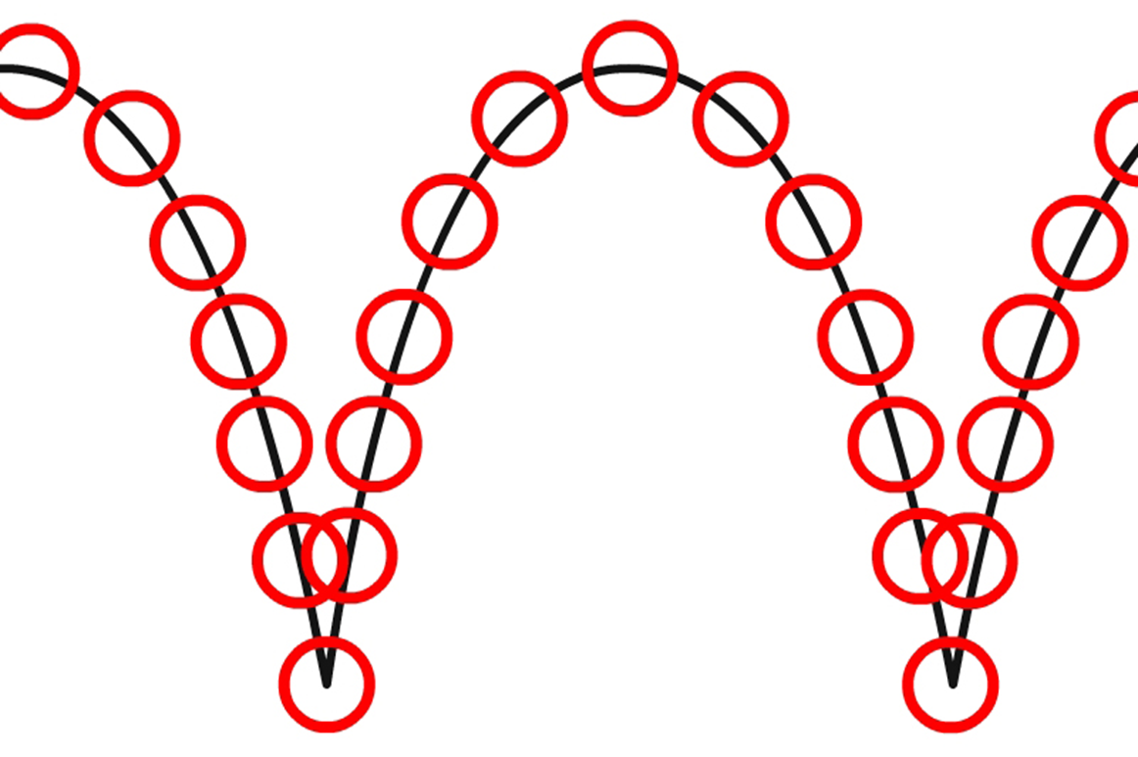
Linear Motion

Slide 9
Slow In / Slow Out (Easing)
  As the ball falls it is accelerated by gravity, the gap between each frame grows all the time until the ball hits the ground. As the ball bounces, the ball moves very fast at first, then slows down by gravity at the high point of its bounce. At the high point of the bounce, the ball is weightless. This speeding up and slowing down of the motion is called “easing.”

Slide 10
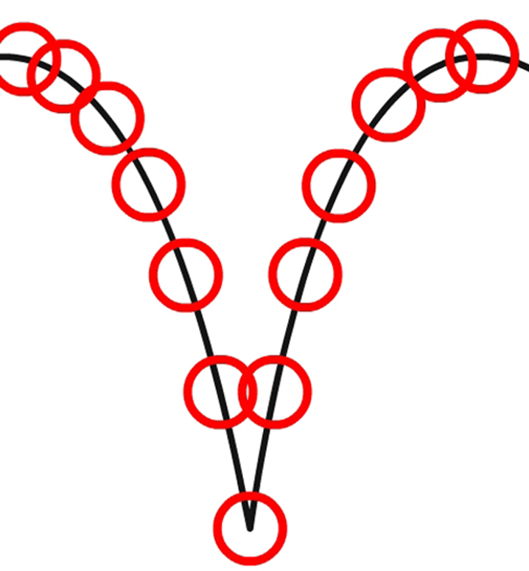
Easing Applied

Slide 11
Squash
  When it impacts the ground, it squashes. The volume must remain the same. If an object becomes wider (squashed) it must also become shorter. Squeezing a balloon illustrates the concept of constant volume while squashing and stretching.

Slide 12

Squash at Impact

Slide 13
Stretch
  At some point as the ball falls, it stretches. When it impacts the ground, it squashes. When it bounces off the ground, it stretches again. Note how quickly the ball regains its circular shape.

Slide 14
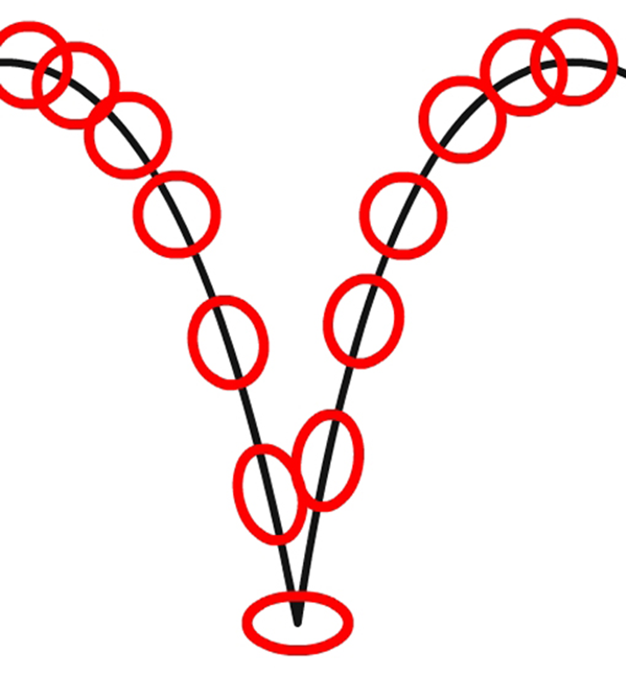
Stretch Before and After Impact

