Slide 1
Architectural Drafting
  Architectural Communication – Architectural Lettering

Slide 3
  Type is one of the most eloquent means of expression in every epoch of style.
  Next to architecture, it gives the most characteristic portrait of a period and the most severe testimony of a nation’s intellectual status.
  -Peter Behrens

Slide 4
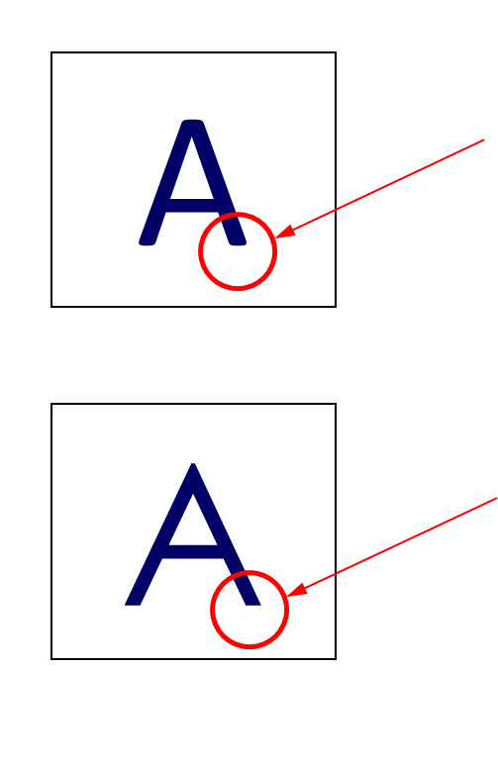
Lettering Terms
  Serif – the finishing stroke at the end of stems and arms of letters, originally made by the flick of the quill or pen
  Sans serif – Latin term used to describe architectural lettering; sans means “without” so the full term is interpreted “without” serifs

Slide 5
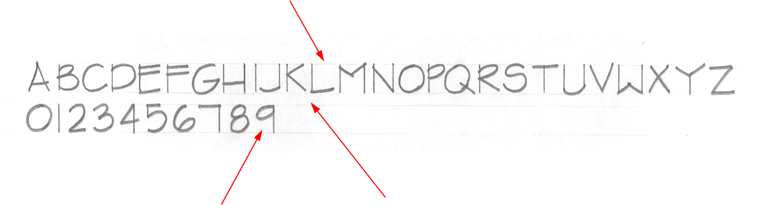
Lettering Terms
  Guidelines – parallel set of lines which define the upper and lower limits of architectural lettering; lightest lines on a drawing

Slide 6
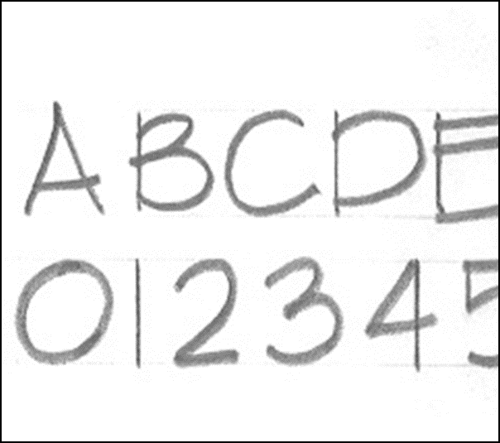
Lettering Terms
  Vertical strokes – used to draw only those parts of letters that are perpendicular to the guidelines; thin lines drawn with a parallel bar, triangle, and the thin edge of a chisel point

Slide 7
Lettering Terms
  Freehand strokes – used to draw those parts of letters that are not perpendicular to the guidelines; thick strokes drawn freehand (without a parallel bar or triangle) with the broad side of a chisel point

Slide 8
Lettering Concepts
  All letters capitalized
  All letters the same height
  All letters with a uniform width (except “I”)
  Sans serif
  All vertical strokes are drafted
  All freehand/horizontal strokes are freehand

Slide 9
Demonstration

Slide 10


