Slide 1
Graphic Manipulations
  Audio Video Production

Slide 3
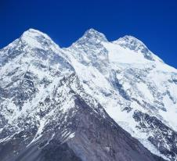
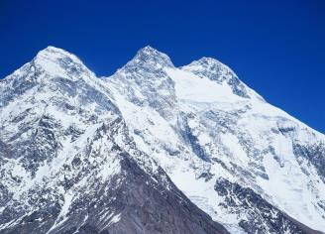
Three Basic Graphic Manipulations
  Photos
    Raster-based images
  Illustrations
    Vector-based images
  Composites
    Combination of both raster and vector images
Ski here

Slide 4
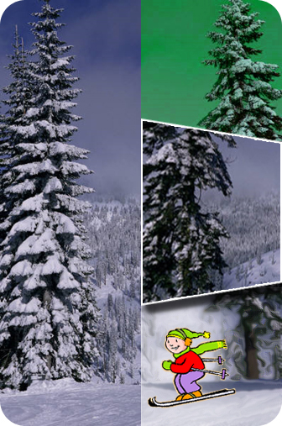

Photographic Graphic Manipulations
  Raster-based images
    Including video stills or frames
  Ways to manipulate
    Color, shape, distortion, artistic effects, add or remove objects, etc.
  Applications (short list)
    Removing red-eye, creating imagery for ads, etc.

Slide 5
Illustrative Graphic Manipulations
  Vector-based images
    Including fonts and text
  Ways to manipulate
    Color, shape, distortion, artistic effects, add or remove objects, etc.
  Applications (short list)
    Creating logos, drawing illustrations for presentations, etc.

Slide 6
Composite Graphic Manipulations
  Using multiple photos
  Using multiple illustrations
  Using a combination of both photos & illustrations
  Applications (short list)
    Magazine ads, newsletters, flyers, posters, CD covers, DVD slip covers, etc.

Slide 7
DVD Slip Cover Project
  Project Requirements
    Create a composite graphic manipulation for a movie DVD slip cover.
    Use at least 3 photos (raster images).
    Use at least 2 illustrations (not including text).
    Slip covers include a front, back, and spine.
    DVD slip cover dimensions:
      Total: width = 10¹¹/16”, height = 7³/16”
      Spine: width = ⁹/16”, height = 7³/16”
front
sci-fi
DVD
back
spine

