Slide 1
Banking Pathways
  Banking and Financial Services

Slide 3
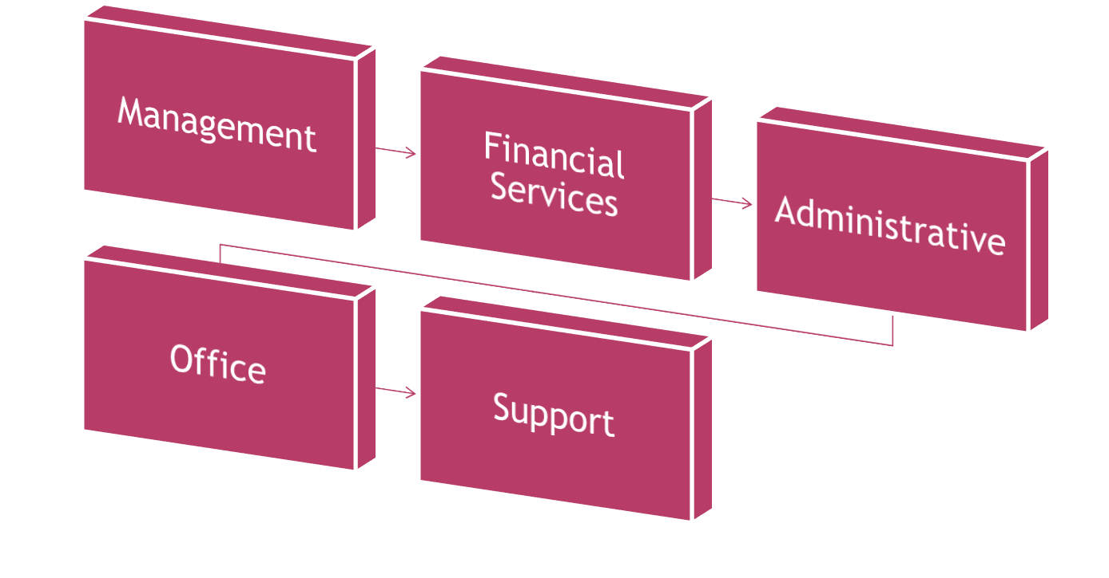
Categories of Banking Jobs

Slide 4
Management
  Financial (branch or operations) managers
    Usually Bachelor’s degree
    Create short- and long-term goals
    Oversee branches
    Resolve customer issues at branch level
    Branch manger-hiring, payroll, oversee departments
  Loan officers/Credit Analyst/Mortgage Banker/Credit Manager/Risk Manager
    At least high school diploma, possibly a license as well
    Review loan applications-car, home, student loans
    Make recommendations to approve or deny applications
  Trust officers
    Handle pensions
    Handle profit-sharing
    Handle estates

Slide 5
Financial Services
  Sales positions
    Selling bank services such as
      Lines of credit
      CDs
      Other banking services
    Handles marketing of the bank
      Promotions
      Credit cards
  Investment banking
    Selling securities and commodities
    Usually Bachelor’s degree
    License required
    Register with FINRA (Financial Industry Regulatory Authority)

Slide 6
Administrative
  Minimum high-school diploma, good communication skills and math skills
  Tellers
    Walk-in
    Drive-through customers
  Customer service-answer customer questions
  New accounts-opening accounts
  Call centers
    Answer customer calls
    Respond to customer emails

Slide 7
Office
  Receptionist
  Secretaries/Administrative Assistants
  Data Entry
  Bookkeepers
  Accountants
    May require CPA (Certified Public Accountant) certification)
    May require Master’s degree to advance
  Supervisors

Slide 8
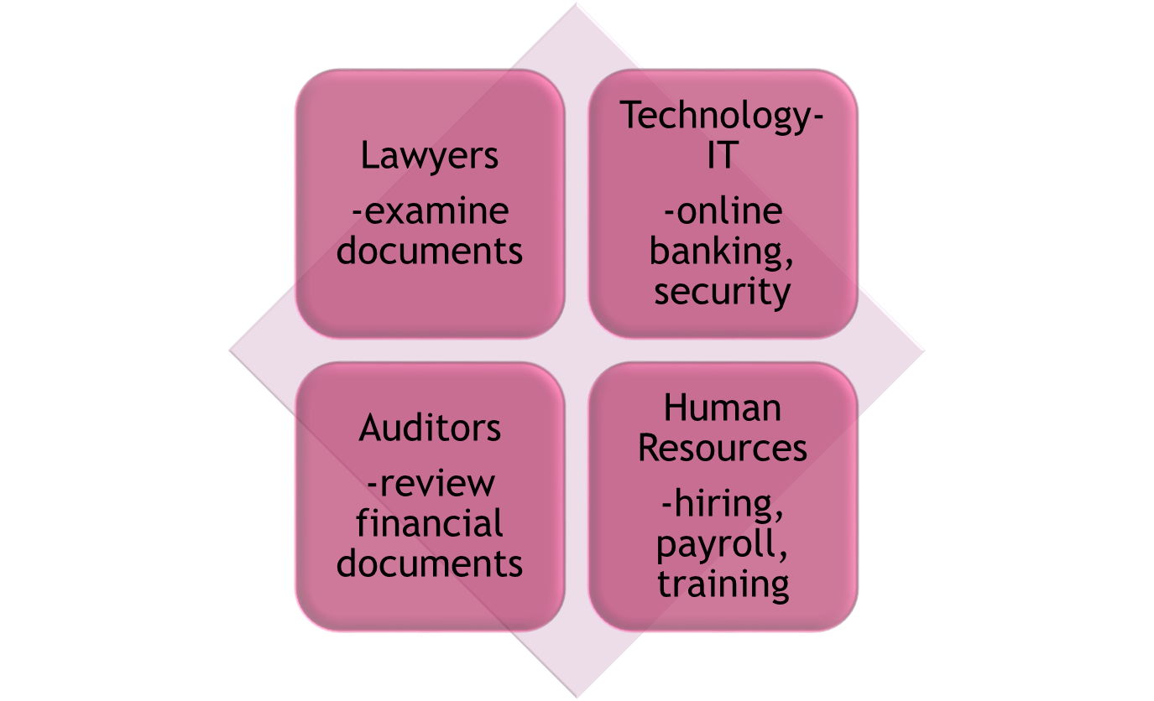
Support

Slide 9
Banking Job Types and Titles
  Check Processors
  Bank Examiners
  Mortgage Loan Originator – commission
  Trust Officer or Administrator
  Bank Teller
  Loan Officer – may earn commission
  Branch Manager
  Investment Banker
  Stockbroker
  Human Resource Manager
  Relationship Manager

Slide 10
Management Trainee Programs
  Generally have at least two parts:
    Classroom-based training
    On-the-job training
  Rotations through various departments
  Usually last from 1-2 years

Slide 11
Average Salary for Common Banking and Financial Service Occupations

Slide 12
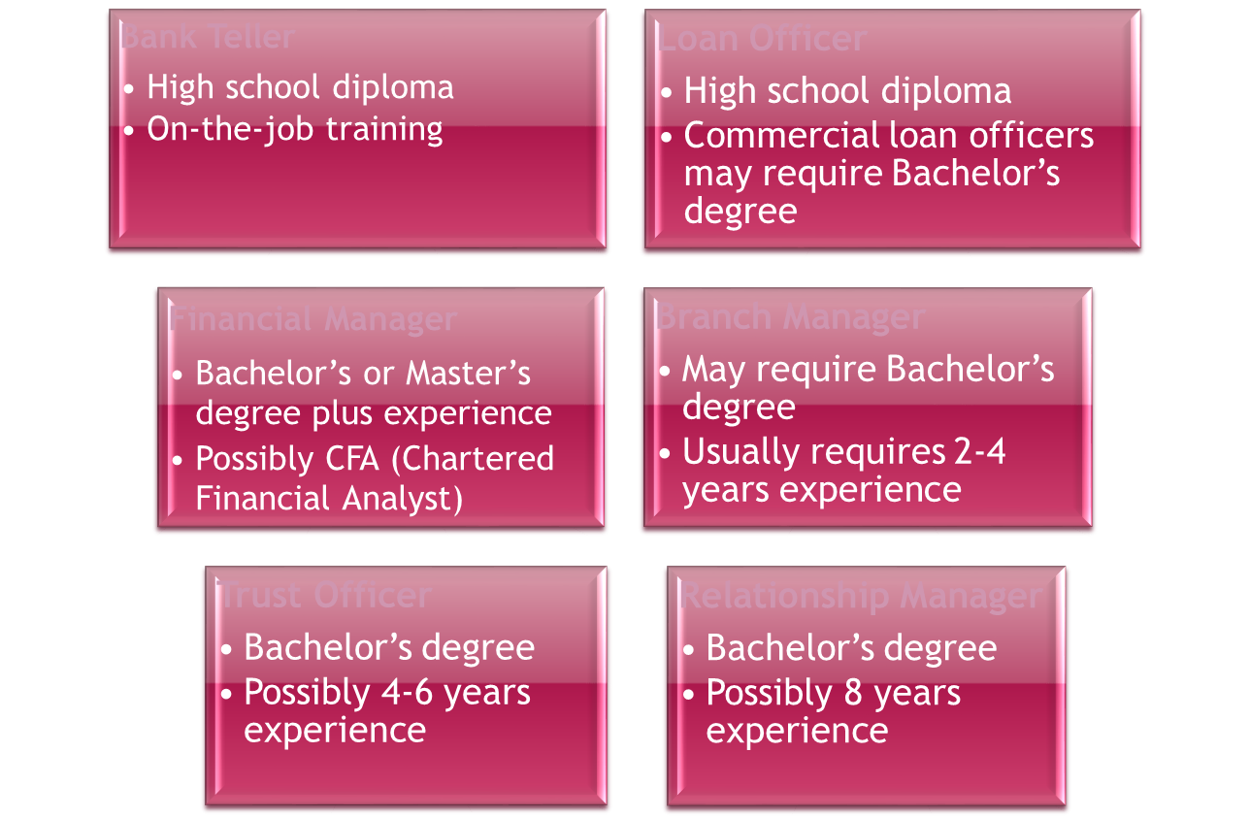
Educational Requirements

Slide 13
Bank Teller Standards
  Cash handling-transaction times
  Customer service-customer feedback, observation, professionalism
  Attention to detail-minimization of error, cash drawer balancing

Slide 14
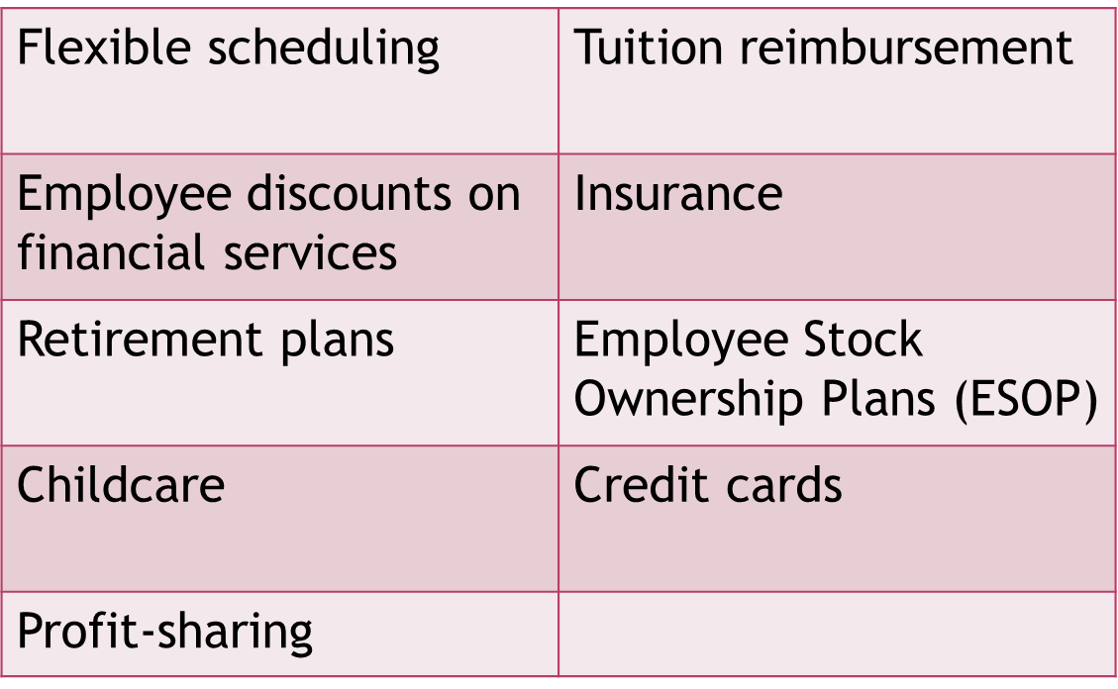
Benefits

Slide 15
Formal Assessment Assignments
  Banking Career Tree Assignment #1 – Students are to go to the following website: http://www.treasury.gov/careers/Pages/careers_bureaus.aspx and select two different bureaus. Determine three different job titles or careers that can be found in these two bureaus. After reading/researching what these different bureaus do, create a tree diagram with each of the two bureaus selected and the three accompanying jobs, all displayed as branches, in addition to including each job description as well as education requirement. Graphics that are relevant to the job descriptions or bureau may be included to enhance the document.
  Mock Job Interview Comic Strip Assignment #2 – Students will create a comic strip portraying a job interview for a bank or financial institution interview. They may use an online comic strip creator. They should include at least five interview questions relating to a specific bank position with appropriate interview responses.

Slide 16
Formal Assessment Assignments (continued)
  Banking Career Scavenger Hunt/QR Code Assignment #3 – Students are to research any financial service/banking job on either the www.bls.gov or www.onetonline.org web sites. They will create a document that they can project on a document camera (or else create a poster so other students can view the information) with clues to which occupation is described. Do not include the job title. This is what students will search for using a QR code. Clues should include information from each section of the web site description for the job such as: tasks or nature of the job, salary, educational requirements, skills, and any other descriptors. Then students will create a QR code with the web address of where to find the solution to the hunt. You can assist them in locating a web site to generate free QR codes. The code can be copied onto their document or printed and affixed to the poster. Posters can be posted around the room. Then students will present their scavenger hunt to the class and the students will download a bar code or QR code reader onto their phones so they can search for the solution to each other’s scavenger hunt.

