Slide 1
Principles of IT
Basic Webpage Design
Vocabulary

Slide 3
Anchor
Internal links within a webpage that allow the user to “jump to” other areas of the page.

Slide 4
Copyright
The legal right granted to an author, composer, playwright, publisher, or distributor to exclusive publication, production, sale, or distribution of a literary, musical, dramatic, or artistic work.

Slide 5
External
A link to another webpage or website.

Slide 6
HTML Editor
A software application for creating webpages using the HTML markup language or a WYSIWYG interface.

Slide 7
Layout
A rough sketch outlining the layout and components of a webpage or website.

Slide 8
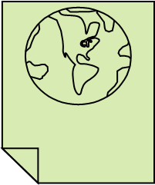
Web page
A document on the World Wide Web consisting of an HTML file and any related files for scripts and graphics, and often hyperlinked to other documents on the Web.

Slide 9
Web Page Designer
Someone who creates well-organized and eye-pleasing pages with text, graphics, and color to convey a message to the viewer.

Slide 10
Web page Layout
Web pages either have a left-hand, right-hand, or top layout.

Slide 11
Website
A set of interconnected webpages usually including a homepage, generally located on the same server, and prepared and maintained as a collection of information by a person, group, or organization.

Slide 12
WYSIWYG
“What you see is what you get” editing that is a graphical interface for the HTML language.

