Slide 1
Byzantine Architecture
  Building Recognition Exam

Slide 3
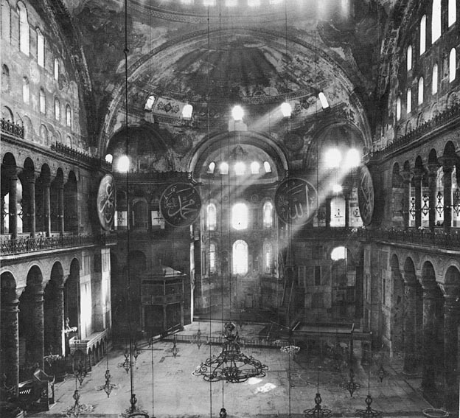
Item 1
© Frim. srl Milano (http://www.thais.it)

Slide 4
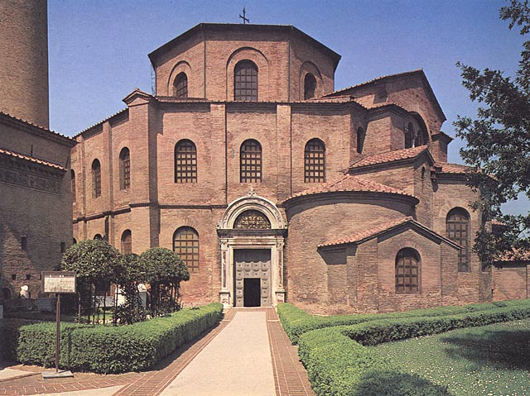
Item 2
© Frim. srl Milano (http://www.thais.it)

Slide 5
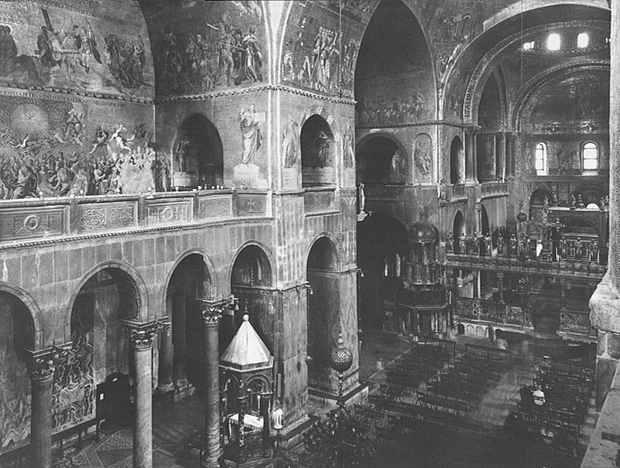
Item 3
© Frim. srl Milano (http://www.thais.it)

Slide 6
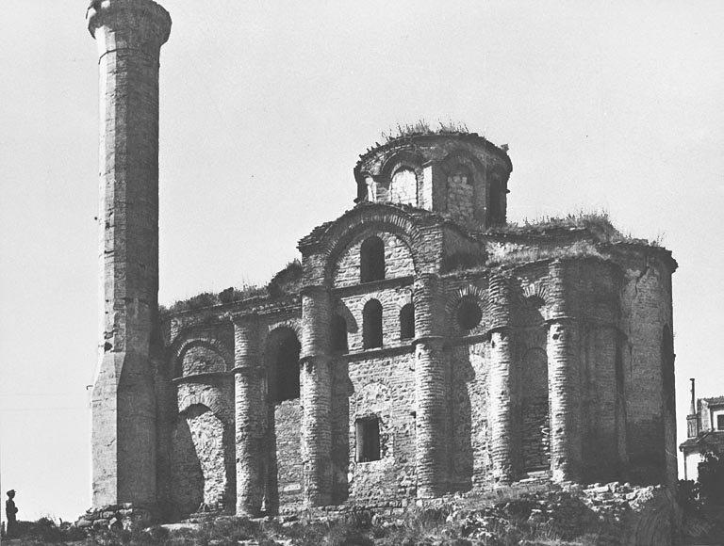
Item 4
© Frim. srl Milano (http://www.thais.it)

Slide 7
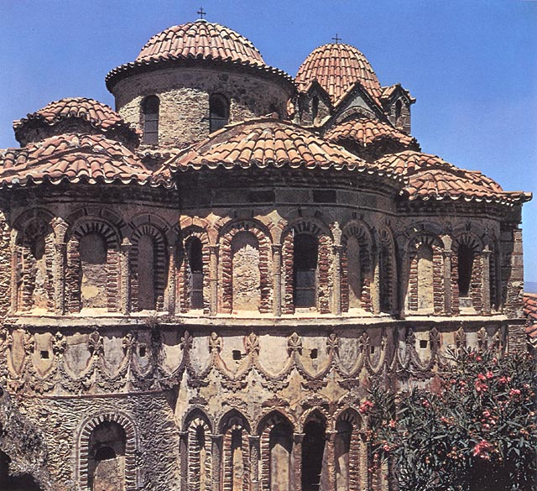
Item 5
© Frim. srl Milano (http://www.thais.it)

Slide 8
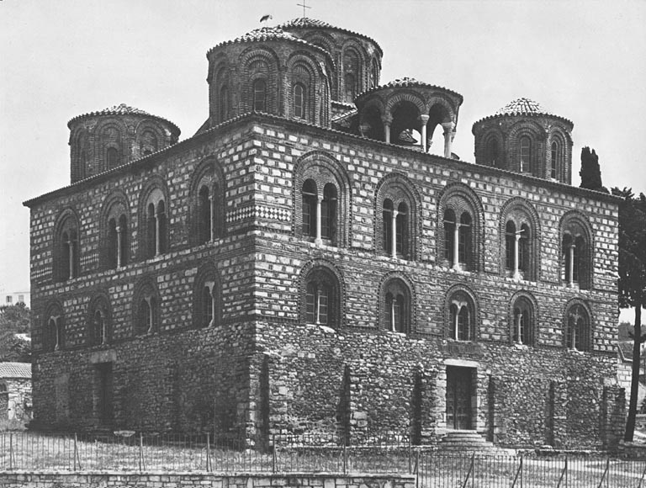
Item 6
© Frim. srl Milano (http://www.thais.it)

Slide 9
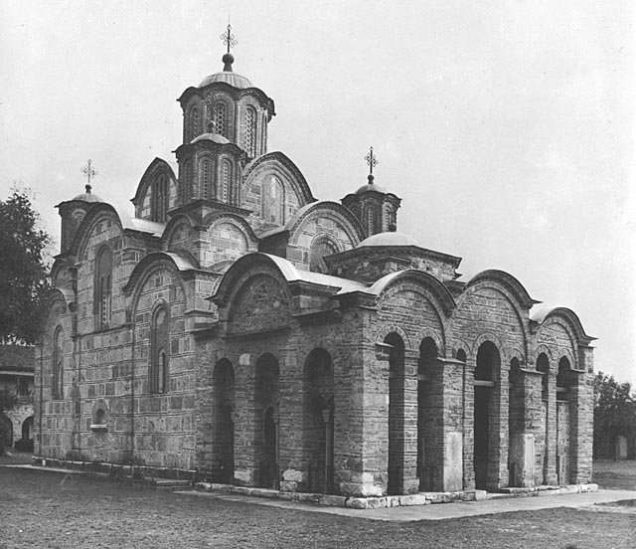
Item 7
© Frim. srl Milano (http://www.thais.it)

