Slide 1
Architectural History
  Architectural History:
  Byzantine Architecture

Slide 3
Objectives
  Outline the background affecting the period.
  Isolate elements associated with Byzantine architecture.
  Identify famous Byzantine buildings.
  Recognize key terms from Byzantine architecture.

Slide 4
Early Byzantine Architecture
  Background
    Western Empire in ruin
      Rome twice sacked
      Italy in hands of Ostrogoths
    Justinian
      Re-conquers Western Empire
      Launches era of Byzantine architecture
      Establishes Constantinople as center of political and architectural renewal

Slide 5
Early Byzantine Architecture
  Architectural Factors
    Central-Plan Structure
      Square central core
      Squared pier forms
    Pendentive Dome
    Lighting and Decoration
      Transcendental effect
      No visible surface left in a natural state

Slide 6
Early Byzantine Architecture
  Architectural Examples
    Hagia Sophia
    Saint Vitale, Ravenna
    Saint Marco, Venice

Slide 7
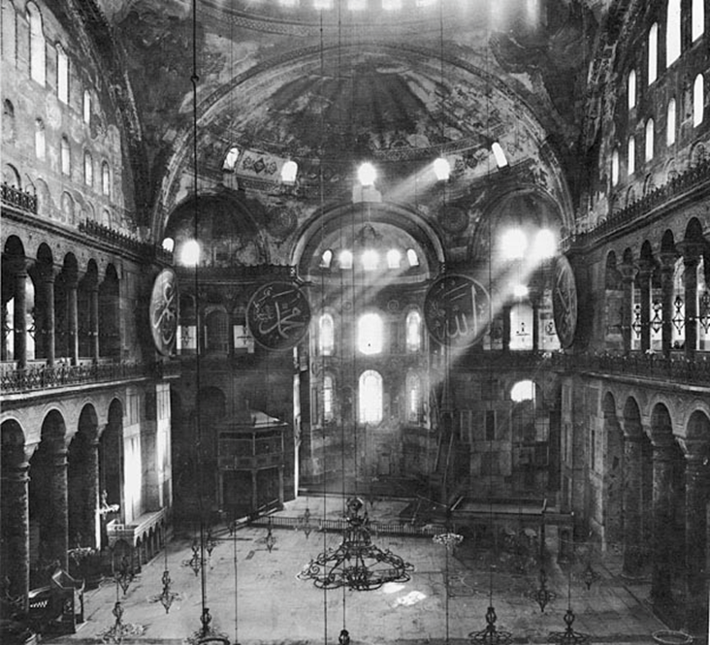
Hagia Sophia

Slide 8
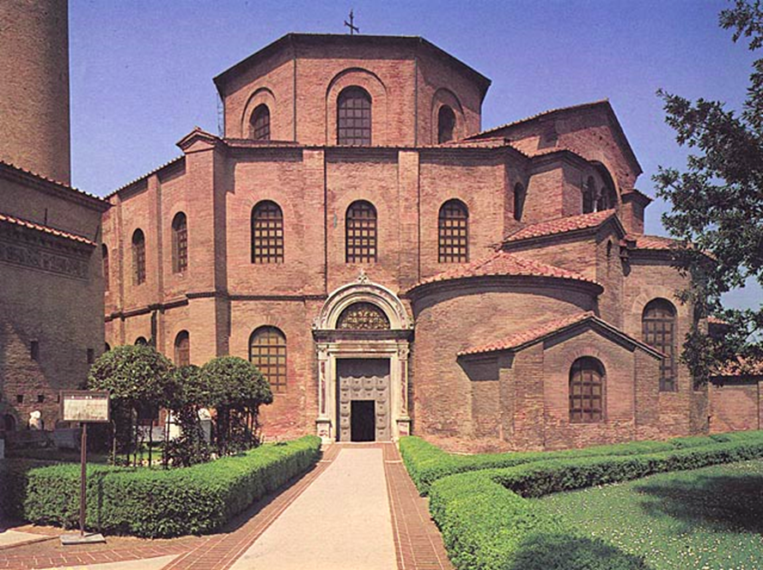
Saint Vitale, Ravenna

Slide 9
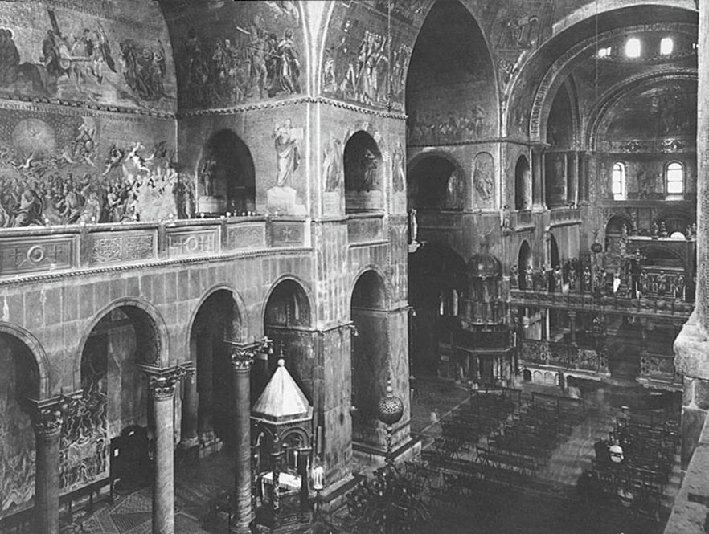
Saint Marco,Venice

Slide 10
Middle Byzantine Architecture
  Background
    Renaissance (842 – 1204)
    Follows period of the Dark Ages (610-842)
    Culminated in Icoloclasm
    Empire reduced from Justinian’s rule
    Relatively stabilized
    Reached a peak in a flowering of the arts

Slide 11
Middle Byzantine Architecture
  Architectural Plans
    Cross-in-square
      Domed central core
      Radiating cross-arms
      Barrel-valued
      Vaulted corner units
    Octogon-domed
      Triple-domed
      Douple-apsed outer narthex
      Inner narthex with a single dome
      Barrel-vaulted aisles

Slide 12
Middle Byzantine Architecture
  Architectural Plans (continued)
    Cross-octagon
      Begins as a cube
      Transformed through squinches
      Becomes an octogan, cupola, and a cross
      Interpenetrates a secondary belt of structure
  Architectural Examples
    Bodrum Camii (the Myrelaion)
    Theotokos Churches, Hosios Loukas

Slide 13
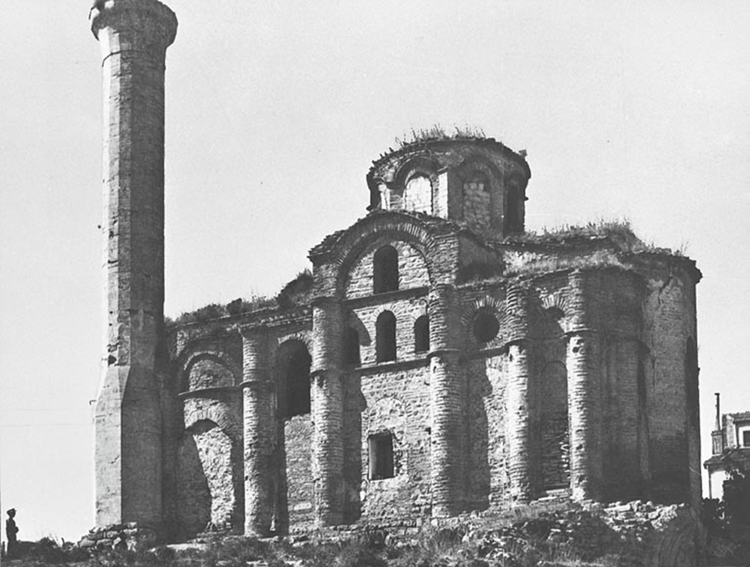
Bodrum Camii (the Myrelaion)

Slide 14
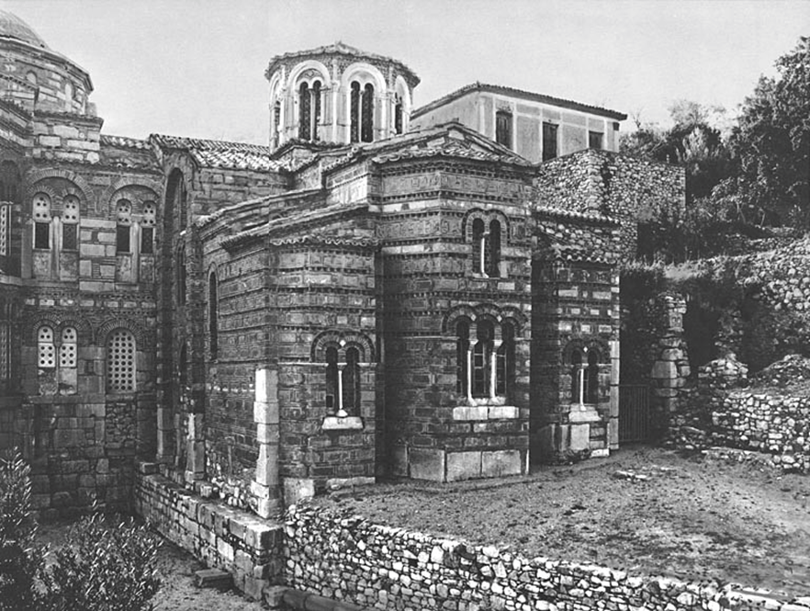
Theotokos Churches, Hosios Loukas

Slide 15
Late Byzantine Architecture
  Background
    Period between 1267 - 1453
    Paleologian dynasty rule
    Diminishing Empire
    Retains a surprising artistic creativity
  Architectural Factors
    Architectural system pushed to the limit
    Lacked balance and harmony
    Excessive and manneristic

Slide 16
Late Byzantine Architecture
  Architectural Examples
    Pantanassa
    Parigoritissa at Arta
    Church at Gracanica

Slide 17
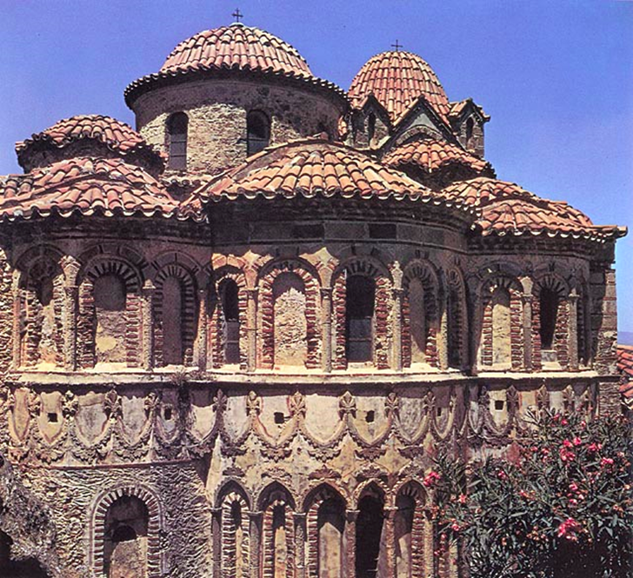
Pantanassa

Slide 18
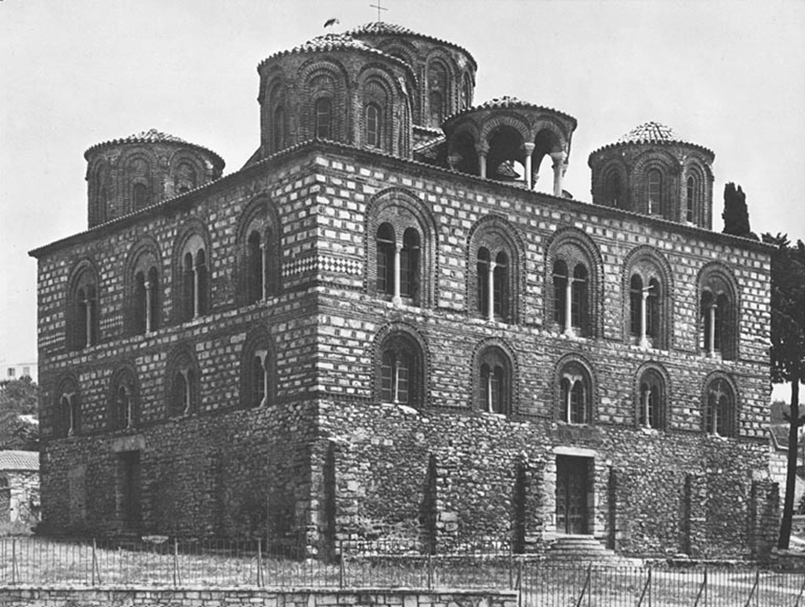
Parigoritissa

Slide 19
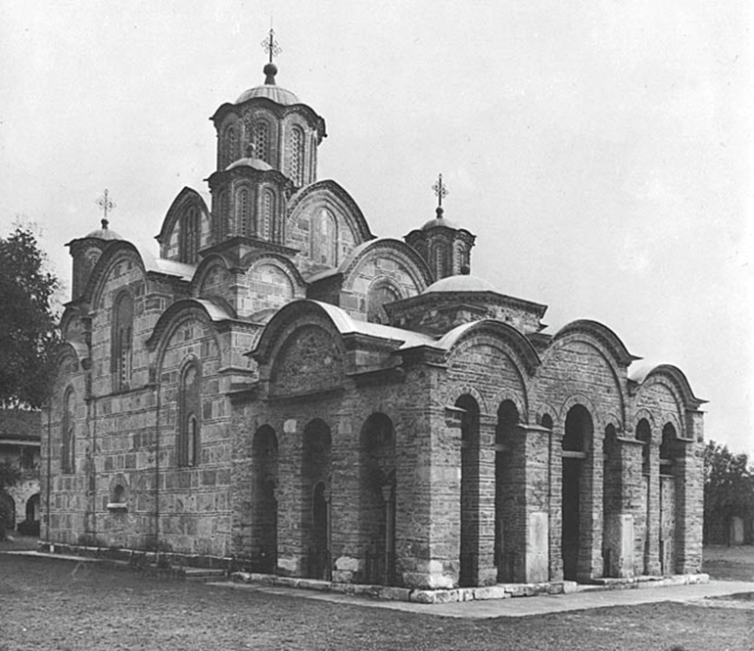
Church at Gracanica

Slide 20
Vocabulary Review
Apse
Basilica
Cross-in-square
Cross-octogon
Cupola
Domed basilica
    Fresco
Half-dome
Icon
Iconastasis
Mosaic
Narthex
Nave
Octogon-domed
Pantokrator
Pendentive dome
Piers
Sanctuary
Squinch
Vault

