Slide 1
Cardiopulmonary Resuscitation
  CPR in Correctional Facilities

Slide 3
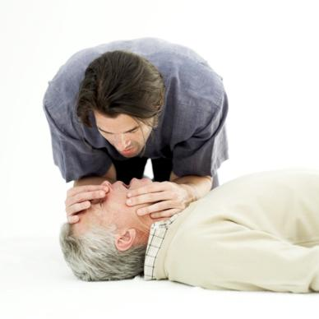

CPR Facts
  Heart disease is the number 1 killer in the U.S.
  330,000 Americans die yearly
  50% of these will die before they get to the hospital

Slide 4
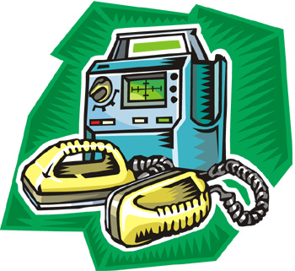
CPR Facts
  The most common cause of death from a heart attack in adults is ventricular fibrillation
  Ventricular fibrillation:
    A disturbance in the electrical rhythm of the heart
    Can be treated with defibrillation (applying an electrical shock to the chest)
    If a defibrillator is not readily available, brain death will occur in less than 10 minutes

Slide 5
CPR Facts
  During cardiac arrest, the heart stops pumping blood.
  CPR is one way of buying time until normal heart function is restored or a defibrillator becomes available.
  CPR provides artificial breathing and circulation, keeping oxygenated blood flowing to the heart and brain.
  The earlier you give CPR, the greater the chance of success.
  CPR is a combination of rescue breathing and chest compressions.

Slide 6
When to Give CPR
  Someone is not breathing and has no pulse
  If someone is not breathing, but has a pulse, perform rescue breathing

Slide 7

When to Give CPR
Check the ABCs:
  Airway
  Breathing
  Circulation

Slide 8
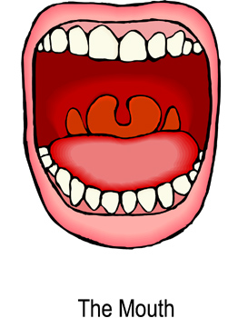
A is for Airway
  Check their mouth or throat for blockage
  Sweep the inside of the mouth with your fingers, if necessary

Slide 9
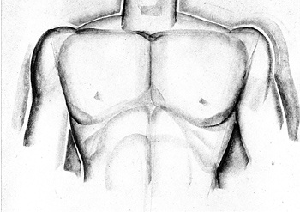
B is for Breathing
  Put your ear to the mouth and nose
  Listen to see if they are breathing
  Observe if the chest is rising
  Feel for breaths on your cheek

Slide 10
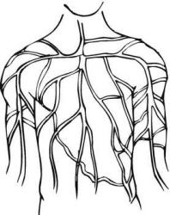
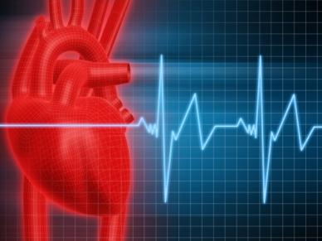
C is for Circulation
Feel for a pulse
  Put your fingers on the side of the neck or on the top of the underside of the wrist
  Do NOT use your thumb. Your own pulse may be felt, and this could lead to confusion

Slide 11

Rescue Breathing
  Perform if a person has a pulse but is NOT breathing
  Make sure they are lying on their back

Slide 12

Rescue Breathing
Tilt the head back
  Lift the chin with one hand
  Press the forehead back with the other
Close the airway through the nose by pinching it

Slide 13
Rescue Breathing
  Give 1 breath every 5 seconds
  Take a normal breath
  Cover the victim’s mouth with yours to create an airtight seal
  Watch for the chest to rise as you give each breath

Slide 14
CPR Procedure
  If a person’s airway is clear but they are NOT breathing and do NOT have a pulse
  CPR involves giving compressions which pump blood to the brain and heart.

Slide 15
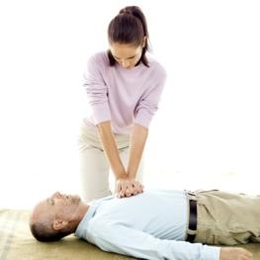
CPR Procedure
To give compressions:
  Put the heel of one hand on the center of the chest between the nipples
  Put the other hand on top of the first hand
  Push hard and push fast
  Push at a rate of 100 times a minute
  After each compression, release pressure on the chest to let it come back to its normal position.
  Keep your elbows locked so you do not get tired quickly.

Slide 16

CPR Procedure
  Give 2 breaths, 1 second each
  Give 30 compressions at a rate of 100 per minute and then give 2 breaths.
  Remember to release pressure after every compression
  Keep giving sets of 30 to 2 until:
    The automated external defibrillator (AED) arrives
    Victim starts to move or
    Trained help arrives

Slide 17
Remember!
Before you begin:
  Confirm that the area is secure
  Notify (or have someone notify) medical personnel about the situation
CPR is best done with 2 people
  One person doing the breathing
  One person doing the compressions

Slide 18
Resource
  American Heart Association http://www.heart.org/HEARTORG/

