Slide 1
Career Journey
The journey of a thousand miles begins with one step.
-Lao Tzu

Slide 3
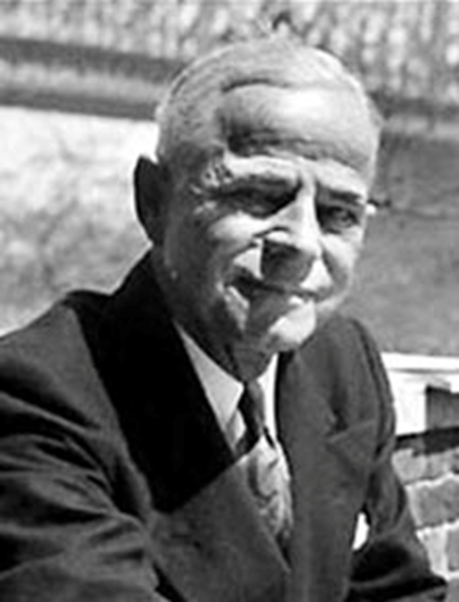
Charles E. Merrill
Investor and Philanthropist
Created Safeway food chain in 1926
Major investor in S. S. Kresge Corp. (future Kmart)
His estate funds Merrill Science Center at Amherst College and Merrill College at USC-Santa Cruz

Slide 4
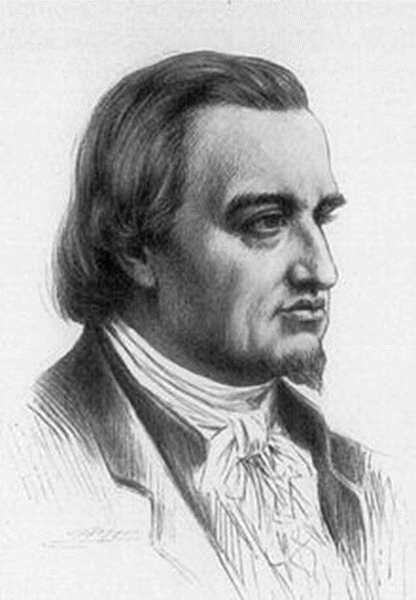
Mayer Rothschild
Banker and “founder father of international finance”
Began by dealing in rare coins
Principal international banker to Wilhem IX, Crown Prince of Germany
Rothschild family dynasty is believed to have become the wealthiest family in human history

Slide 5
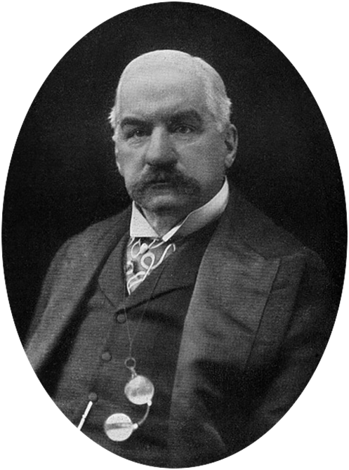
J. P. Morgan
Banker, financier, philanthropist and art collector
Arranged the merger that formed General Electric
Created Federal Steel Company
(now U. S. Steel Corp.)
Leading Financier of the Progressive Era

Slide 6
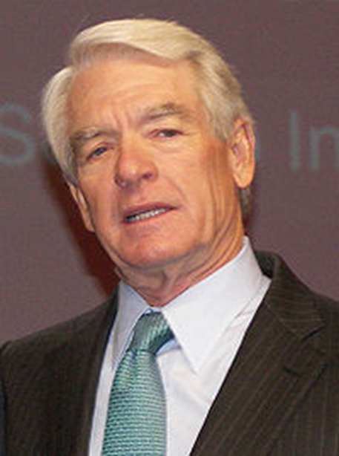
Charles Schwab
Business owner, investor and founder of Charles Schwab Corp
Founded First Commander Corporation, later renamed Charles Schwab & Co. Inc.
Established the finance industry’s first 24-hour quote service
Currently serves 8.2 million client accounts

Slide 7
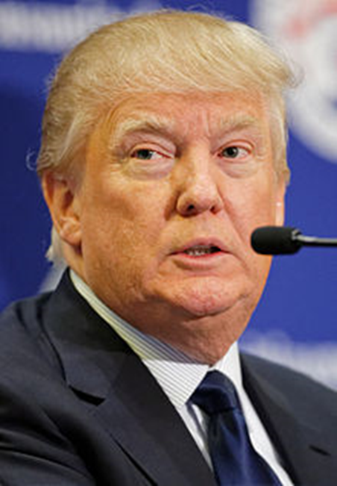
Donald Trump
Business magnate, investor, television personality and author
Earned control of The Trump Organization in 1971
Considered an east coast real estate magnate
Owner of Miss Universe Organization

Slide 8
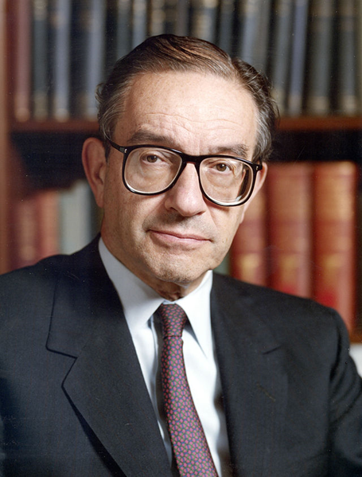
Alan Greenspan
American Economics
Chairman of the Federal Reserve 1987-2006
Career began on Wall Street for Brown Brothers Harriman
Served for President Richard Nixon as his coordinator on domestic policy in the nomination campaign

Slide 9
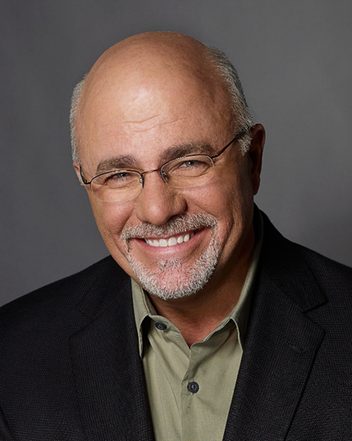
Dave Ramsey
Financial author, motivational speaker, radio host and television personality
Radio show is currently heard on over 500 stations throughout US and Canada
Written five New York Times bestsellers
2009 Marconi winner for Network/Syndicated Personality of the Year

Slide 10
What Causes Occupation Changes?
Possible Factors
Factor 1 – Career Advancement
Factor 2 – Better Pay/Benefits elsewhere
Factor 3 – Not a good fit
Factor 4 – Don’t like the environment
Factor 5 – Don’t like the schedule
Factor 6 – Job Security
*Can you name others?

