Slide 1
Career Pathways

Slide 3
Objectives
  Students will learn about the various Career Pathways models adopted by the federal government, explore a career of interest, research a college of choice, and choose companies of interest to work for after graduating from college.

Slide 4
What are Career Pathways?
  Career Pathways is a workforce development strategy used in the United States of America to support workers’ transitions from education into and through the workforce.

Slide 5
What are the Career Pathways?
  In the State of Texas, Career Pathways are offered through Career Clusters – Programs of Study in high school.
  Each Career Cluster – Program of Study is aligned with post secondary/industry collaboration.

Slide 6
Career Pathways – Programs of Study
  There are 16 Career Pathways - Programs of Study available in the State of Texas.
  All states recognize Career Pathways - Programs of Study are designed to provide skills to students enrolled in Career and Technical Education (CTE) high school courses.

Slide 7
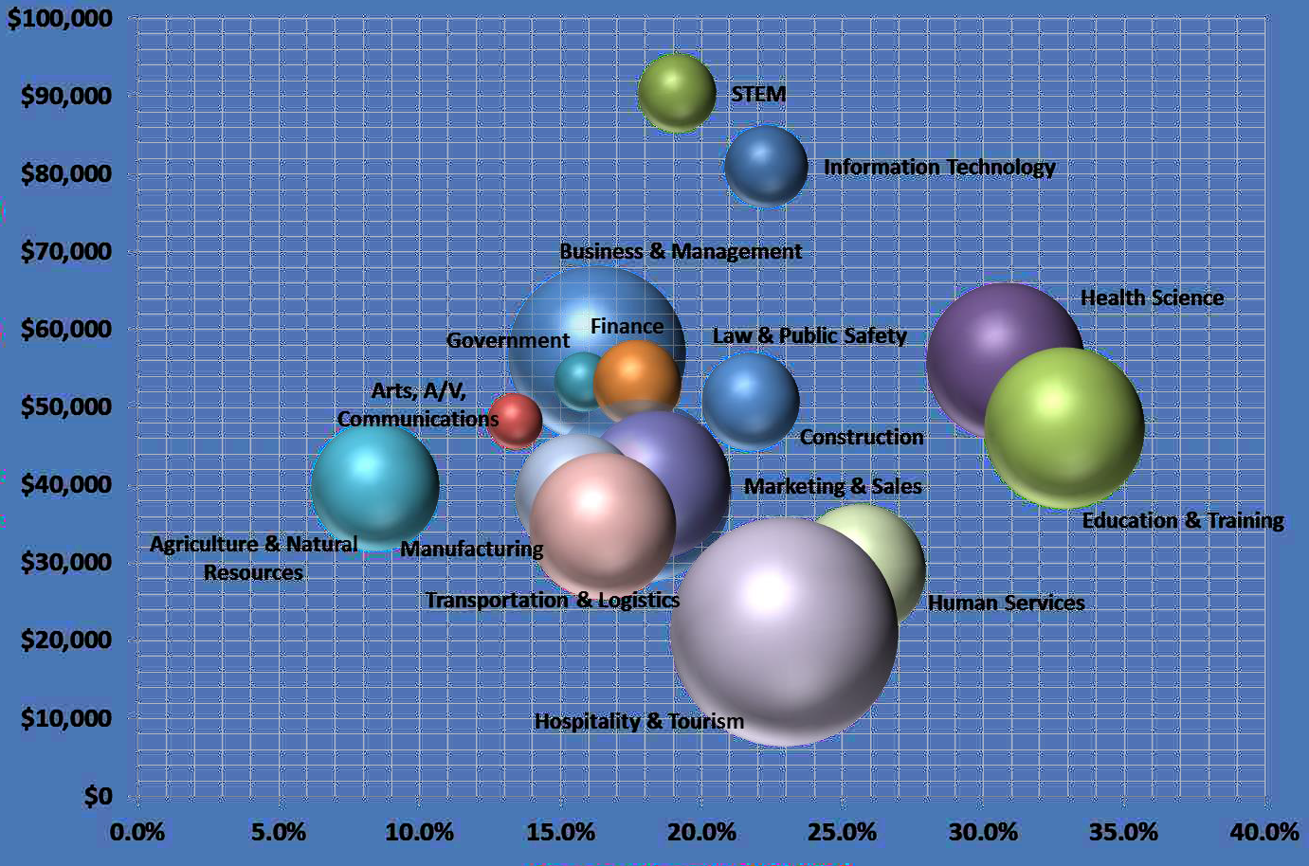
Career Pathways – Programs of Study

Slide 8
Career Pathway Research
Select a Career Pathway that you are interested in pursuing after graduation. Choosing a Career Pathway requires a lot of research and thought-provoking decisions.

Slide 9
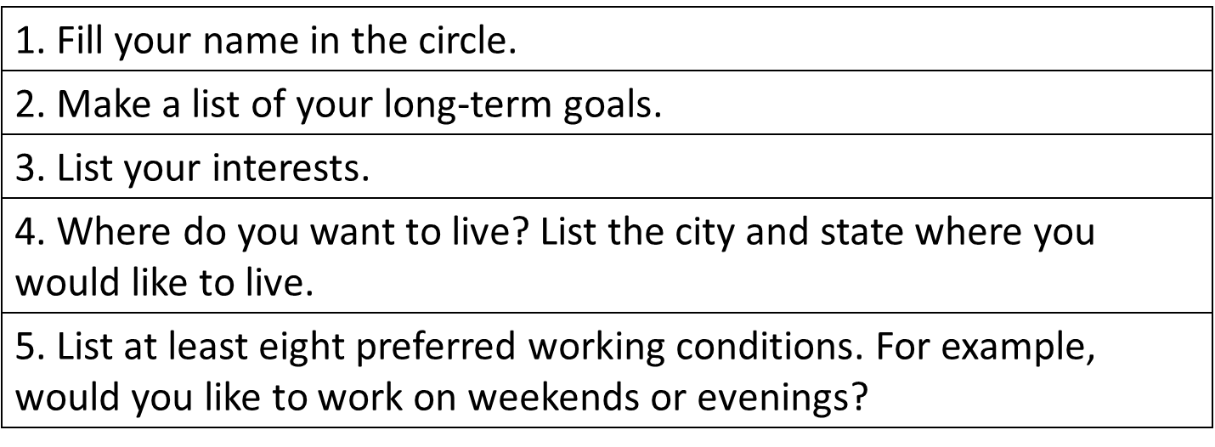
Activity 1 - My Career Pathway
  Complete the My Career Pathway handout.

Slide 10
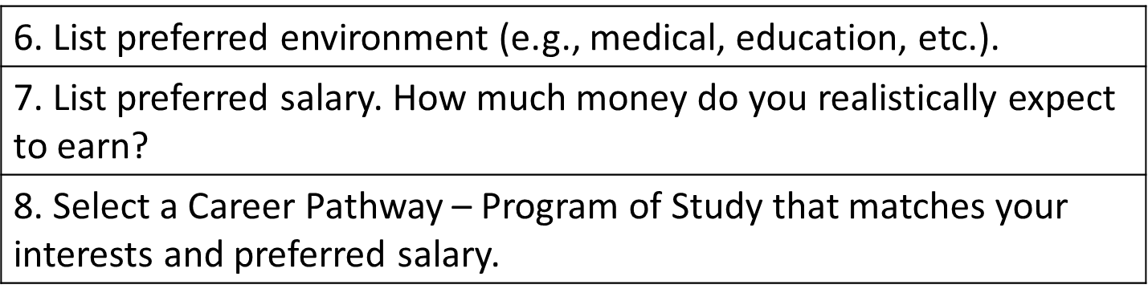
Activity 1 – My Career Pathway
  Complete the My Career Pathway handout.

Slide 11
Career Pathways Resources
  There are several resources available to assist you with learning about the various Career Pathways. Please visit each website to learn more about each resource.
  Bureau of Labor Statistics
  http://www.bls.gov/ooh/
  Department of Labor
  http://www.dol.gov/
  O-Net Online
  https://www.onetonline.org/

Slide 12
Activity 2 - Career Pathway Presentation
  Research and create a presentation about a career that you are interested in pursuing after graduation.
  NOTE - Please use the Career Pathways Resources links to assist you with your presentation.

Slide 13
College or University of Choice
  Research a college or university of interest that will assist you with pursuing your Career Pathway.
  Create and deliver your research in a presentation.

Slide 14
Activity 3 - College or University Research
  Research the college or university of your choice and produce a presentation.

Slide 15
Companies of Interest
  Research 10 companies of interest that will assist you in pursuing your Career Pathway.
  Create and deliver your research in a presentation.

Slide 16
Activity 4 - Companies of Interest Research
  Research 10 companies of interest that will assist you in pursuing your Career Pathway.

