Slide 1
City Government
  (Obtaining Permits)

Slide 3
What is a City Permit?
  Document that grants legal permission to begin construction and gives building officials the means to enforce local building codes and standards.

Slide 4
Who is responsible for obtaining permit?
The homeowner.
Homeowner may authorize contractor to obtain permit, but the homeowner is ultimately responsible.

Slide 5
How much does a permit cost?
It depends on the cost of the project.
There may be additional costs, depending on the scope of the project.
For Example: Add $25 non-refundable application fee to all building permits

Slide 6
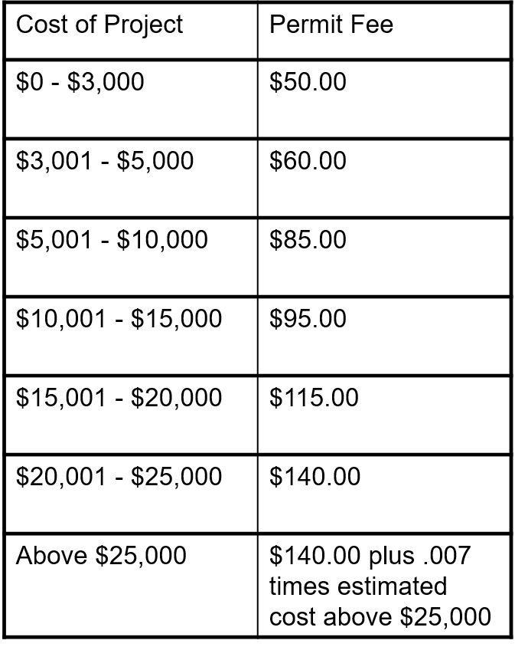
How much does a permit cost?
  Example:

Slide 7
Building Permit
  General Permit
  Applies to New Construction and Changes to Existing Structures

Slide 8
Additional Permits
Fire Inspection Permit
  Fire Inspection for new businesses or new construction
  Possible Annual Inspection
  May be done by Fire Marshall, Fire Chief, etc.

Slide 9
Additional Permits
Sign Permit
  Required by some government entities
  Conform to signage restrictions

Slide 10
When in doubt…..
  Consult your government entity for specific, local requirements, codes, and standards

