Slide 1
Civil and
Criminal Justice Systems
  Correctional Services

Slide 3
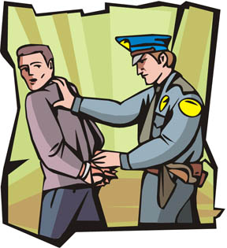
National and International Policies
  Drug Policies
  The war on drugs
    Increased drug arrests
    Mandatory sentencing
    Less prison space for violent offenders
    The result is prison overcrowding
  Sentencing Policies
  Mandatory sentencing fills beds
  More money to build new prisons
  Advocates for alternatives to incarceration
    Probation
    Drug treatment programs
    Community supervision

Slide 4

National and International Policies
  Globalization Policies
  Labor, capital goods, and service across borders
  Create multinational criminal organizations
    More federal crime impacts the Federal Bureau of Prisons

Slide 5
Lawsuits
Ruiz v. Estelle (1980)
  Longest running in U.S. history
  Issue - Cruel and Unusual punishment (8th amendment)
    Overcrowding – 2–3 inmates in a single cell
    Security – too few guards; run by inmates known as “building tenders”
    Inadequate healthcare – insufficient number of professional staff, lack of psychiatric care
    Unsafe working conditions
    Severe and arbitrary discipline procedures

Slide 6

Lawsuits
Ruiz v. Estelle (1980)
  Longest running in U.S. history
  Court Ruling
    Limited inmate population to 95% capacity
    Created a need for construction of new prisons
    Separated hardcore offenders that require a higher level of supervision
    Hired more guards
    Improved medical conditions

Slide 7
Statutory Laws: Executions
  Hanging
    The method of execution in Texas from 1819–1923
    Were carried out in or by the county in which the crime was committed
  Lethal Injection
    Texas amended the Penal Code in 1973, reinstating the death penalty
    The state adopted lethal injection as the method of execution in 1977
    January 12, 1996 – close friends and relatives of victims are now allowed to witness executions

Slide 8
Statutory Laws: Executions
  Electric Chair
    Texas authorized its use in 1923
    All executions were moved to Huntsville
    The state became responsible for execution
    The first 5 offenders were put to death on 2/8/1924
    The last electrocution completed 7/30/1964
    It was declared unconstitutional under the 8th amendment in 1972
    Offenders on death row received commuted sentences; now housing offenders for life

Slide 9
Executive Intervention
Governor
  Clemency
    An act of mercy lessening the punishment given to a defendant
    Since 1976, 276 death row offenders received clemency for “humanitarian” reasons
      Doubts about an offender’s guilt
      Doubt about the death penalty process
  Commutation of a sentence
    Reduction of legal penalties
    Often conditional
    Ex: death sentence changed to life sentence

Slide 10
Executive Intervention
Governor
  Pardon
    Release from punishment
    Exempt from penalty
    An act of clemency
    Restores civil rights
  Conditional Pardon
    Impose a lesser punishment or other obligation

Slide 11
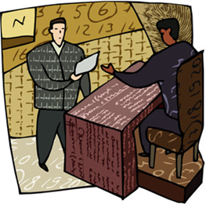
Executive Intervention
President
  Reprieve
    Temporarily postpones a sentence
    Does not change the sentence
    Does not forgive a crime
  Courts
  Stay of Execution
    A court order
    Temporarily suspends execution of a court judgment or other court order

Slide 12

Criminal Law
  Prevents harm to society
    Establish prohibited conduct
    Includes the definitions of offenses, general principles, or criminal responsibility
    Ex: murder, assault, and criminal trespass

Slide 13
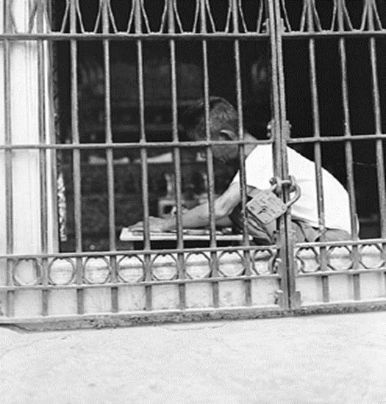
Criminal Law
  Regulates conduct
    Fines
    Imprisonment
  State brings charges
  Level of Proof
    Beyond a Reasonable Doubt
  Judgment
    Guilty
    Not Guilty
  Criminal Law Video

Slide 14

Civil Law
  Defines the personal and property rights of individuals
  The right of individual to seek redress or right to prevent a wrong
  Any action other than criminal proceedings
  Examples: divorce, child custody, injunctions, and personal damage

Slide 15
Civil Law
  Actions by correctional staff can become civil liability actions commonly resulting in civil action:
    Improper use of force
    Wrongful death
    Civil rights violations
    Official misconduct
    Sexual harassment
    Discrimination
  Defines the legal significance of public and private acts
  Regulates conduct through injunctions and monetary damage awards
  Level of proof required is usually Preponderance of Evidence but depends on what the injured party is asking for
  The party found liable must compensate the wronged party
  Verdict rendered by
    Judge or
    Jurors (5 out of 6, or 10 out of 12)

Slide 16

Changes Affecting Corrections
  Civil lawsuits
  Case law
  Legislation
  Societal views
  Prison Policies
  Financial Impact
  Special Prison Populations

Slide 17

Civil Lawsuits
  Alleged violations of civil rights or constitutional rights
  Reviewed by a court
  Judgment rendered
  Action is taken to a remedy situation
  Civil Rights Act 1983
  Ruiz v. Estelle

Slide 18
Case Law
  Ruffin v. Commonwealth, VA
    Convicted felons forfeit liberty and personal rights
    Only allowed laws afforded to humanity
  1900s – offenders denied access to court for matters of treatment of imprisonment
  1960s – constitutional protections apply to inmates
  The Supreme Court rejected the “hands-off” approach

Slide 19
Legislation
  Laws are added, changed, or deleted
  Insanity Defense Reform Act of 1984
    U.S. Federal Courts
    Affirmative defense
    A defendant with severe mental disease or deficits
    Unable to understand the nature and quality of the wrongfulness of his acts
  Mandatory sentencing guidelines
  New laws enacted

Slide 20
Societal Views
  1950s – scholars and the public understood that social influences play an important role in crime causation
  Public scrutiny, along with state and national watchdog groups, affect sentencing, findings, and legislation

Slide 21

Prison Policies
  Incidents that dictate a need for change
  Riots
  Contraband
    Ex: cell phones
  Hostage situations
  Staff injury or death
  Unethical behavior by staff

Slide 22
Financial Impact
  Current trends indicate that an economic recession tends to increase the number of property crimes committed, which ultimately creates a greater need in the prison
  Federal, state, and local budget cuts and increases
  Lawsuits cost the government millions of dollars, which takes away from other services, programs, etc.
    Example: Ruiz v. Estelle lasted over a decade and major changes had to be implemented in the Texas prison system. This lawsuit overhauled the entire Texas prison system

Slide 23
Special Prison Populations
  Young offenders
  Violent offenders
  Gang members
  The Elderly
  Mentally ill/handicapped
  Serious medical conditions
  Substance abusers
  Homosexuals
  Offenders with special needs, need to bring about a change to the way offenders are treated, and the programs and services that are made available to them

Slide 24
Resources
    020547893X, Criminal Justice, James A. Fagin, Pearson Education, 2006.
    Freeman v. TDCJ http://www.gpo.gov/fdsys/pkg/USCOURTS-txnd-7_12-cv-00085/pdf/USCOURTS-txnd-7_12-cv-00085-0.pdf
    Texas Department of Criminal Justice http://www.tdcj.state.tx.us/death_row/dr_facts.html
    www.deathpenaltyinfo.org/article.php?did=126&scid=13
    http://www.laits.utexas.edu/txp_media/html/just/features/0505_01/ruiz.html
    Do an Internet search for the following:
    Ehow 6593493 policies impact criminal justice system
    Comprehensive crime control act of 1984
    US courts and prison reform Ruiz Estelle Helen Clark Molanphy
    Answers topic stay of execution 2
    Criminal law uslegal federal insanity defense reform act

