Slide 1
CLEAN UP & INSPECTION

Slide 3
Clean Up
  Use material previously made and have it cleaned. Students will complete pipe welding coupons (material preparation) according to welding standards):
    Mild-steel coupon
    Stainless steel coupon
    Aluminum coupon

Slide 4
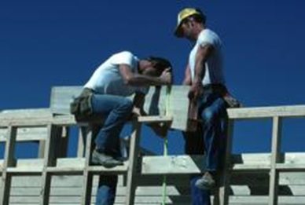
Clean Up
  Student will be expected to explain or describe the welding clean-up process.

Slide 5
Inspection
  There will be a safety inspection on all equipment used.
  Inspection includes test plate welding inspection, Including test codes, weld test coupon evaluation, evaluation of proper welding procedures and preparation of test plates.

