Slide 1
Advanced AV Production
  Color Theory

Slide 3
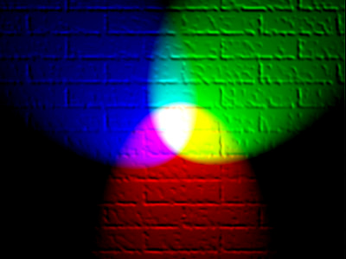
Color Theory
  Upon completion of this unit, you will be able to explain the additive color theory and describe how it is used in video.
http://en.academic.ru/pictures/enwiki/82/RGB_illumination.jpg

Slide 4
What is Color?
  Color: “The appearance of objects or light sources described in terms of the individual’s perception of them, involving hue, brightness, and saturation.”
Color. (n.d.). In Merriam-Webster Dictionary online. Retrieved from http://www.merriam-webster.com/dictionary/color

Slide 5
What is Color?
  Hue: “The dimension of color referred to a scale of perceptions ranging from red through yellow, green, and blue,and circularly back to red..”
Hue. (n.d.). In Merriam-Webster Dictionary online. Retrieved from http://www.merriam-webster.com/dictionary/hue

Slide 6

What is Color?
  Brightness: “The dimension of color that represents its similarity to one of a series of achromatic colors ranging from very dim to very bright.”
Brightness. (n.d.). In Merriam-Webster Dictionary online. Retrieved from http://www.merriam-webster.com/dictionary/brightness

Slide 7

What is Color?
  Saturation: “Degree of difference from a grey of the same lightness or brightness: vividness of hue.”
Saturation. (n.d.). In Merriam-Webster Dictionary online. Retrieved from http://www.merriam-webster.com/dictionary/saturation

Slide 8

What is Color?
  Where do you see the use of hue, saturation, and brightness?
    In the video menu when you try to adjust the color of your TV set.

Slide 9

What is Color?
  Where do you see the use of hue, saturation, and brightness?
    In the color palette menu of your computer’s paint program when you try to adjust or choose a color.

Slide 10
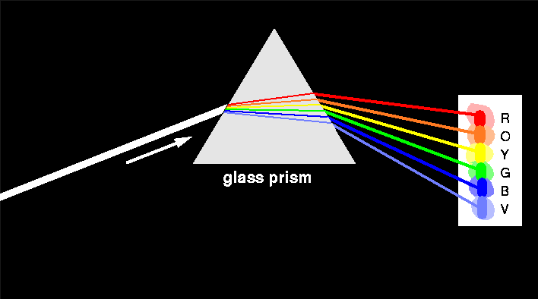
The Color of Light
http://solar.physics.montana.edu/ypop/Spotlight/Tour/images/em_prism.gif

Slide 11
Two Color Types
  Electronic color
  Pigment based color

Slide 12

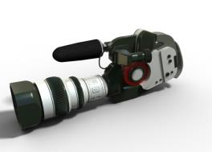
Electronic Color
  Electronic color is used in video cameras and displayed on television and computer screens through the use of cathode-ray tubes (CRT).

Slide 13
Electronic Color
  Color monitors use three different types of phosphors that appear red, green, and blue when activated. These phosphors are placed close together and when combined in differing intensities, can produce any color.

Slide 14
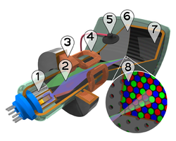
Electronic Color
  Color video cameras use a prism system to split the light into the red, green, and blue signals.
  CRT:
  1. Three Electron guns (for red, green, and blue phosphor dots)
  2. Electron beams 3. Focusing coils
  4. Deflection coils 5. Anode connection
  6. Mask for separating beams for red, green, and blue
  7. Phosphor layer with red, green, and blue zones
  8. Close-up of the phosphor-coated inner side of the screen
http://static.newworldencyclopedia.org/thumb/9/9b/CRT_color_enhanced.png/300px-CRT_color_enhanced.png

Slide 15
Additive Primary Colors
Red
Green
Blue

Slide 16
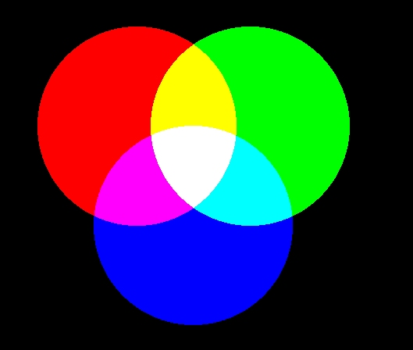
Additive Color Theory
Red
Green
Blue

Slide 17
Additive Color Theory
Red
Red
Green
Green
Yellow
Green
+ Red
Yellow

Slide 18
Additive Color Theory
Red
Magenta
Red
+ Blue
Magenta
Blue

Slide 19
Additive Color Theory
Red
Magenta
Red
+ Blue
Magenta
Blue

Slide 20
Additive Color Theory
Green
Cyan
Green
+ Blue
Cyan
Blue

Slide 21
Additive Color Theory
Red
Green
White
Red
Green
+ Blue
White
Blue

Slide 22
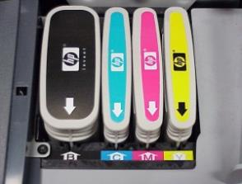
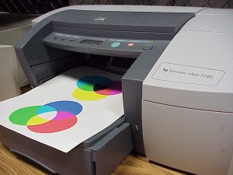
Pigment-Based Color
  Pigment-based color is used in color printers, color filters, and color paints.
  Color printers use cyan, magenta , and yellow pigments. These pigments when combined in differing intensities can produce any color.

Slide 23
Subtractive Primary Colors
Magenta
Yellow
Cyan

Slide 24
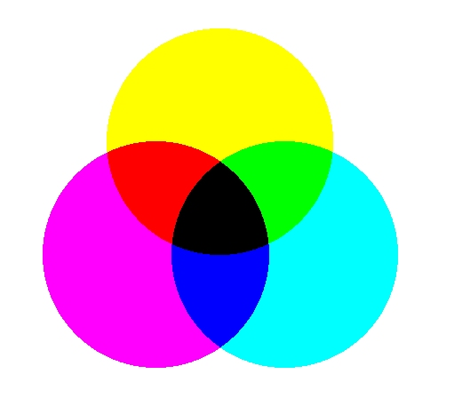
Subtractive Color
Green

Slide 25
Subtractive Color
Magenta
+Cyan
Blue
Red
Green
Magenta
Blue
Cyan

Slide 26
Subtractive Color
Yellow
+Cyan
Green
Yellow
Red
Green
Cyan

Slide 27
Subtractive Color
Magenta
+Yellow
Red
Yellow
Red
Red
Magenta

Slide 28
Subtractive Color
Yellow
Magenta
+ Cyan
Yellow
Red
Red
Green
Black
Black
Magenta
Cyan
Blue

