Slide 1
Flexible Manufacturing
  Come Join Our Team

Slide 3
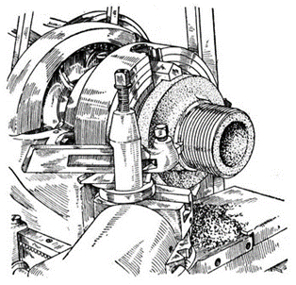
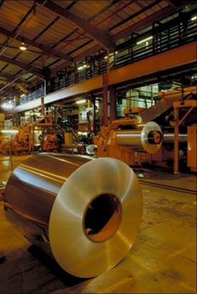
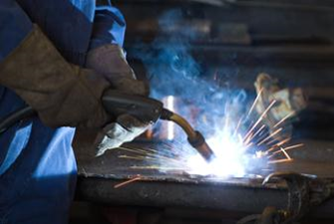
Types of Flexible Manufacturing
  Sheet Metal Manufacturing
  Machine Metal Industries
  Welding Industries

Slide 4
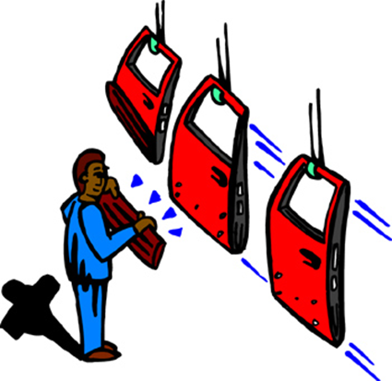
Sheet Metal Manufacturing
  Thin sheets of metal are used to fabricate different products such as:
    car bodies
    duct work for heating systems
    tool boxes

Slide 5
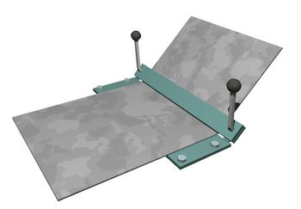
Sheet Metal Manufacturing
  Equipment used:
    shear for cutting sheets
    box and pan brake for bending angles in sheet metal
    bender for joining
    spot welder for fusing

Slide 6
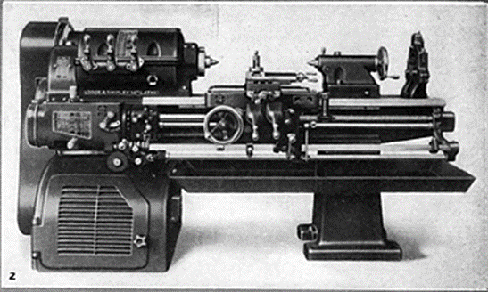
Machine Metal Industries
  These companies use engine lathes, milling machines, grinders and other forming machines to produce gears, nuts, bolts and other precision parts.

Slide 7
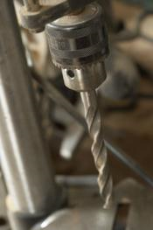
Machine Metals Industries
  Equipment used:
    band saw for cutting shapes in metal
    drill press for drilling and boring holes in metal
    milling machine for precision cuts in metal pieces
    engine lathe for cutting metal by turning it against a cutter
    CNC equipment for computerized cutting

Slide 8
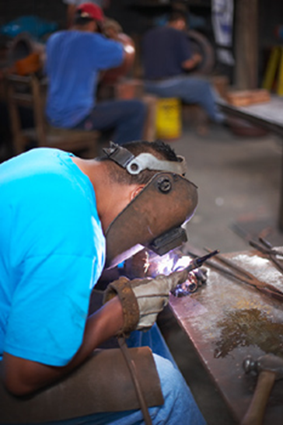
Welding Industries
  Companies in this industrial area fuse metals together to make larger components such as:
    truck frames
    structure parts
    ship frames

Slide 9
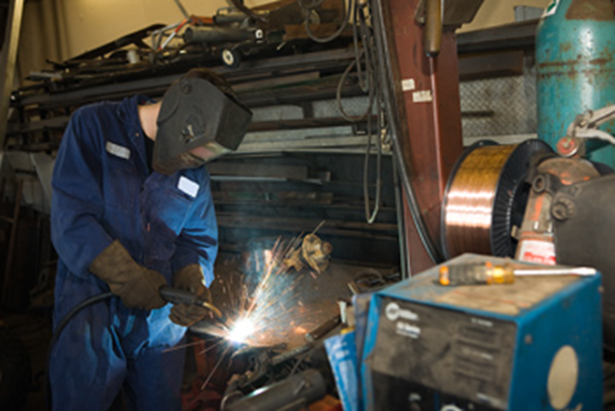
Welding Industries
  Equipment used:
    oxyacetylene welding system welding, cutting and brazening
    arc welder
    MIG welder
    TIG welder

Slide 10

Employer Expectations
  Basic Expectations for Employees
  Basic Expectations for Workers in Flexible Manufacturing

Slide 11

Basic Expectations for Employees
  communication skills both verbal and written
  basic mathematics skills
  clean business appearance
  thinking and problem solving abilities
  honesty
  dependability and reliability
  interpersonal skills

Slide 12
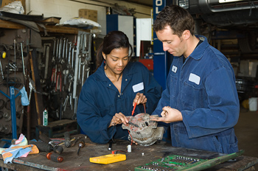
Basic Expectations for Workers in Flexible Manufacturing
  competent tool and machine operator
  understand manufacturing operations
  follows directions
  meets deadlines
  physically fit

Slide 13

Time Management and Work Schedules
  Time-Management Techniques
  Work Schedules

Slide 14
Time-Management Techniques
  Find out where you are wasting time.
  Set goals to remove wasted time.
  List tasks that have to be done.
  Use some kind of tool to help you manage time: date book, planner, computer software or calendar.
  Prioritize your task.
  Set routines and stick to them.
  Set time limits on tasks.

Slide 15
Work Schedules
  A work schedule is the time an employee will work.
  A work schedule is necessary to complete a task and maintain quality.

Slide 16

Class Discussion
  How could you use time management techniques to complete a class assignment or finish a project for a class?

Slide 17

Measuring Team Results
  Teamwork
  Measurement
  Rewards for Team Members

Slide 18
Teamwork
  The measurement of team results must be based on goals:
    set achievable goals
    break down goals to workable tasks
    set a workable time table
    clear communication is a must

Slide 19
Class Discussion
  Discuss with your group what method should be used to reward team members for their work in the classroom.
  Explain to the other groups in class what your group decided about rewards for teamwork.

Slide 20
Measurement
  Teamwork can be measured by looking at the outcomes of the team.
    Was the task given the team done on time?
    Did the team perform the expected goals?
    Did all of the participants play a part in completing the task?
    Did the team reach a productive solution?
    Did all team members involved agree on the solution?
    Did the solution meet the needs of the client?

Slide 21

Rewards for Team Members
  A meal to celebrate the completion of the task.
  Written recognition for a good performance.
  Receiving comp time to be used at the person’s discretion.

Slide 22

Discussion of Team Member Rewards
  That types of rewards would you like to receive after completing a team task?

Slide 23
Resources
  http://www.dol.state.ga.us/js/replace/chapter01.htm

