Slide 1
Commercial Photography
  Different Types of Camera Lenses

Slide 3
Introduction to Lenses
  One common misconception about cameras is that the most important thing is the body of your camera.
  In actuality, the lens is oftentimes the “make it or break it” element of the photos you take.

Slide 4
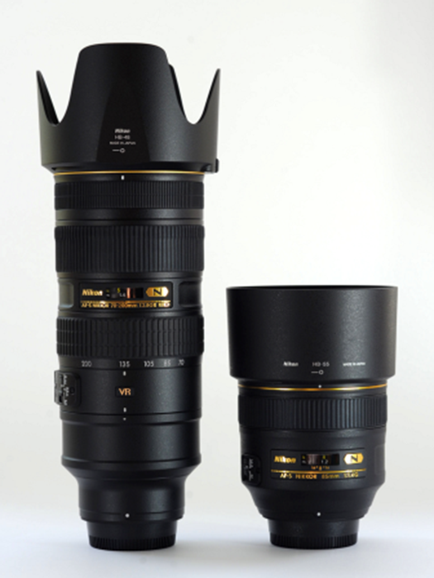
Lenses Continued
  DSLRs have the ability to switch lenses.
  There are many different types of lenses that all have their own pros and cons.

Slide 5
Lens Vocabulary
  Focal Length
    Focal length is the distance between the optical center of the lens and the sensor.
    The longer the lens, the more magnification you achieve and the further it can “see.”

Slide 6
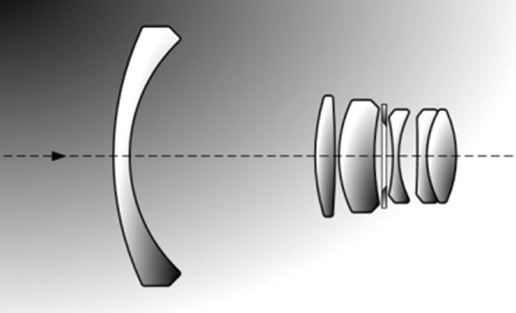
Lens Vocabulary
  Lens Elements
    Every camera lens has multiple pieces of glass inside that attempt to recreate what the lens sees as realistically as possible.

Slide 7
Lens Vocabulary
  Lens Distortion
    This is when a lens fails to recreate straight lines.
    There are several different types of lens distortion.
  Aperture
    Aperture is the size of the hole inside a lens that allows light into a camera

Slide 8
Lens Distortion
  There are many different types of lens distortions.
    Barrel Distortion
      Where the subject bows out away from the image center
      Common with wide-angle lenses
    Pincushion
      Where the subject lines bow inward toward the image center - - the opposite of barrel distortion

Slide 9
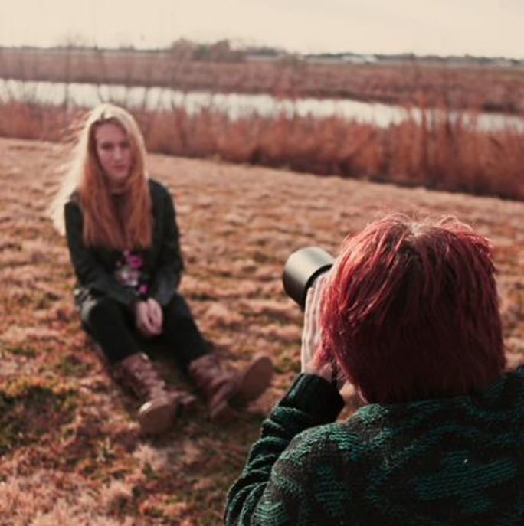
Normal (Portrait) Lenses
  Normal lenses have a focal length of around 40 - 50mm.
  They are called “portrait” lenses because the perspective is close to what the human eye sees
Photo provided by Will Milne, Denton ISD

Slide 10
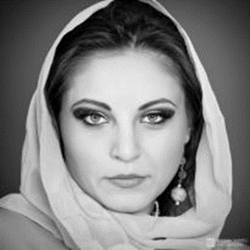
More on “Portrait” Lenses
  Lenses with a normal focal length are good for portrait photography because they do not distort the face or body.

Slide 11
Wide-Angle Lenses
  These are lenses that are “shorter” than “normal” lenses (<40mm).
  These lenses have low focal lengths which allows for them to see a large scope of view.

Slide 12
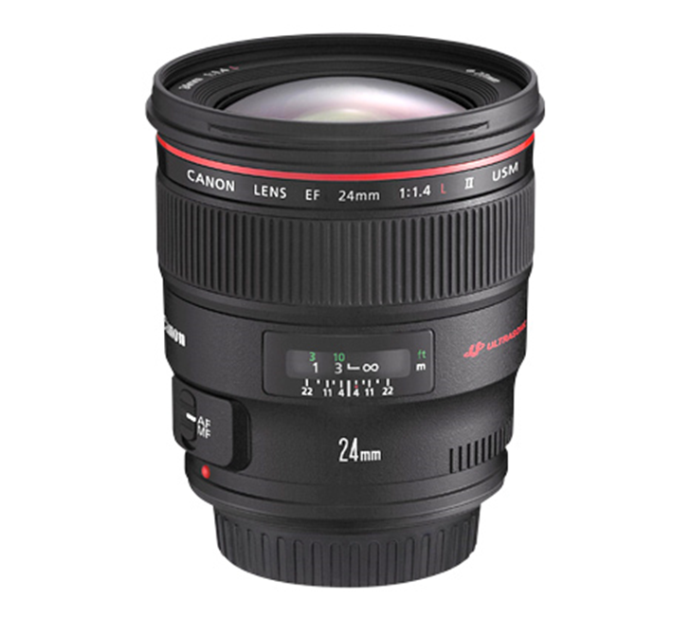
More on “Wide-Angle” Lenses
  Wide-angle lenses are typically used for landscape photography.
  They will often have barrel distortion towards the edges of the photos.

Slide 13
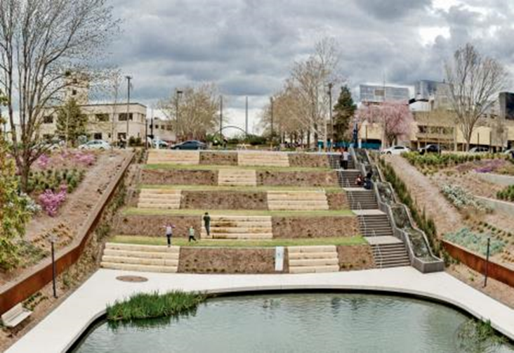
Barrel Distortion
  Below is an example of barrel distortion that you can get from a very wide-angle lens.
  Notice how the lines are not straight, but instead bow outward.
Photo provided by Will Milne, Denton ISD

Slide 14
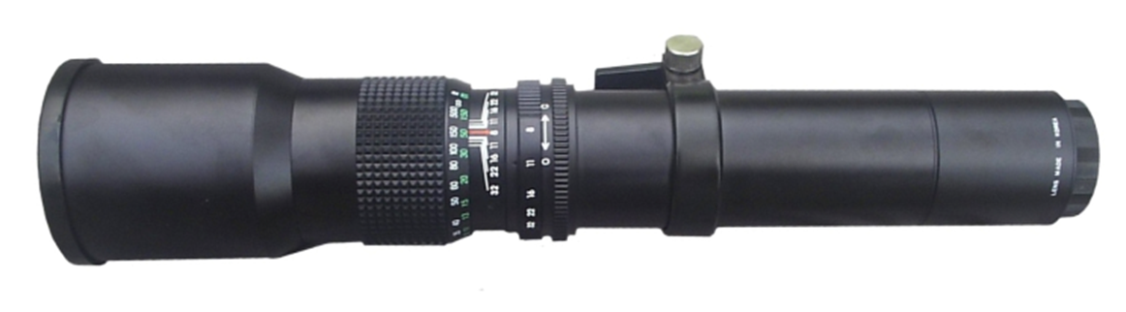
Telephoto Lenses
  Telephoto lenses have a focal length above 100mm.
  They produce a very narrow field of view, and they tend to make it seem as if objects that are distant from one another are actually close.

Slide 15
More on “Telephoto” Lenses
  Telephoto lenses allow a photographer to “zoom” into action from far away.
    For this reason, they are common with sports photography, wild animal photography, and other activities in which it is necessary for the photographer to be far away from the subject.

Slide 16
Specialty Lenses
  Aside from lens categories that are based on focal length, there are other types of “specialty” lenses that have other unique purposes.
  Let us review a few of them.

Slide 17
Macro Lenses
  A “macro” lens allows a photographer to take an up-close photo of an object and replicate it’s size or, in some cases, even magnify it.

Slide 18
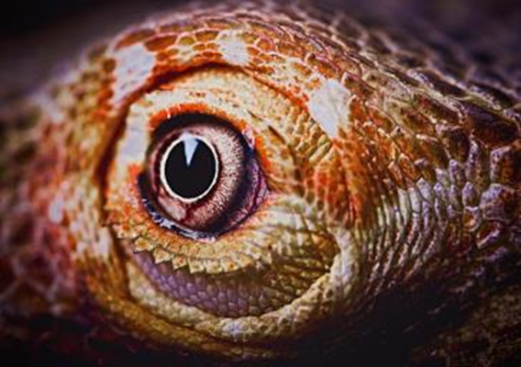
Macro Lenses
  Below is an example of a photo from a macro lens.
  Notice how close the shot is.
Photo provided by Will Milne, Denton ISD

Slide 19
Selective Focus Lenses
  Selective Focus lenses allow a photographer to tilt a lens away from the body of a DSLR to produce a strange “slice” of focus.

Slide 20
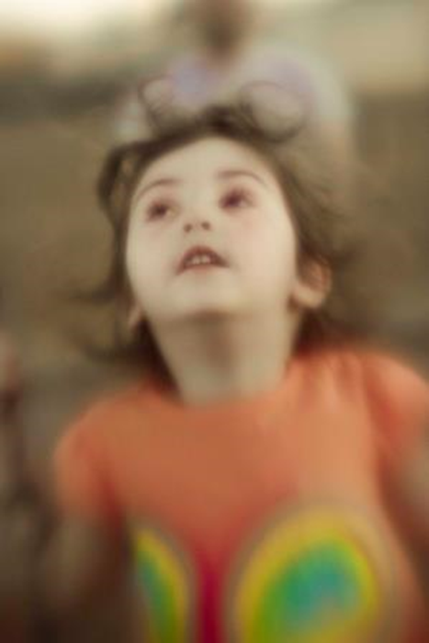
SELECTIVE FOCUS Lenses
  The image to the right is an example of a “selective focus” shot.
  Notice how the hair and body are out of focus, but the face is in focus.
Photo provided by Will Milne, Denton ISD

Slide 21
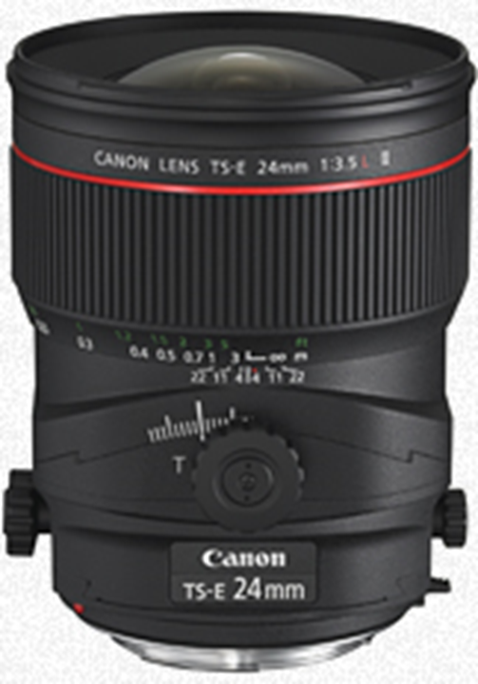
Tilt-Shift LensES
  The lens to the right is an example of a tilt-shift lens.
  Notice the dial on the front that allows the lens to “tilt” to the desired effect.

Slide 22
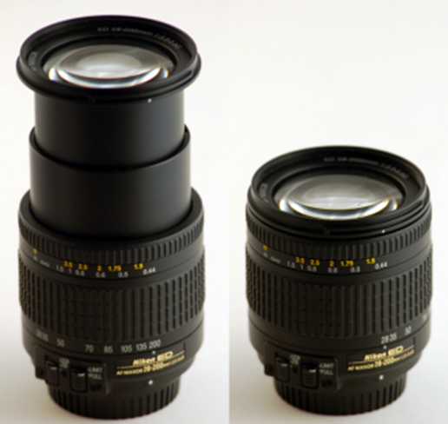
Prime versus Zoom lenses
  Prime lenses are those that have a fixed focal length and cannot zoom in or out.
  Zoom lenses are those that have a variable focal length.

Slide 23
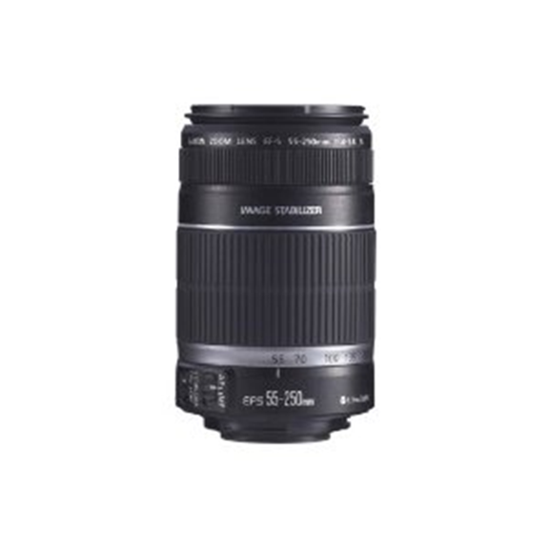
How to Read a Lens
  This is a 55-250mm f/4 lens.
  That means this lens can zoom from 55mm all the way up to 250mm.
  It also has a maximum aperture opening of f/4.

Slide 24
Lenses and Aperture
  One of the main things that affects the price of a lens is its maximum aperture opening size.
  For example, a lens with a max aperture size of f/1.8 would normally be more expensive than a lens with a max size of f/3.5.

Slide 25
Which lens to use
  Which lens you use depends on two things:
    The photo you are taking
    The effect you want to achieve in the image

Slide 26
When to Change Lenses
  If you are photographing a wild animal, you will want to use a telephoto lens because it will allow you to take a closer shot while still maintaining your distance from the subject.
  There are many other situations in which you would change lenses.
    What situations can you imagine?

Slide 27
Summary
  A lens is oftentimes the most important part of a camera.
  Different types of lenses take different kinds of photos.
  The main difference between lenses is the focal length.
  All lenses have pros and cons associated with their use.

