Slide 1
Communication Skills

Slide 3
Verbal Communication
  Verbal Communication can be defined as what comes out of your mouth when you speak.
    Voice Rate
    Voice Pitch

Slide 4
Verbal Communication
  Being a good communicator involves speaking AND listening.
  There is a difference in hearing and listening.
  Listening skills help you understand what someone is "talking about.”

Slide 5
Traits of a Good Listener
  A good listener:
    Is attentive.
    Maintains eye contact.
    Does not interrupt the speaker.
    Sits still.
    Leans toward the speaker.
    Repeats instructions or asks appropriate questions when the speaker has finished.

Slide 6
Non-Verbal Communication
  Body language
  Facial expression/eye contact
  Gestures
  Appearance

Slide 7
Body Language
  Body orientation
  Posture
  Smile

Slide 8
Facial Expressions

Slide 9
Eye Contact
  In American culture, eye contact shows attentiveness and respect.

Slide 10
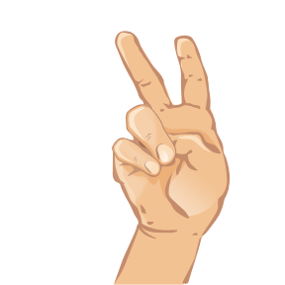
Gestures
  A movement or position of the body that expresses an idea or emotion.
  Can be positive or negative.

Slide 11
Appearance
  Most people judge others by appearance.
  What judgments could you make about the following people by their appearance?

Slide 12
Handshake
  Defined as a gripping and shaking of opposite hands by two people.
  Can be used as a greeting, an expression of congratulations, to bring finality to a project.
  The web of each person’s hand should touch.
  Use proper grip.

