Slide 1
Computer Programming
  Boolean Logic

Slide 3
How is Boolean Logic applied in the real world?
  Digital circuitry for electronics such as computers, phones and gaming devices all use Boolean logic in the form of tiny transistors that are arranged in groups to act like Boolean operators (AND, OR, NOT). These transistor groups are known as ‘gates.’ These gates provide decision-making, based on different input.

Slide 4
Engineers Use Schematics
  Even though the actual transistors are microscopic, they are represented using symbols on a schematic while the circuitry is being designed.
  Gates are arranged to create specific outcomes, depending on the input. Engineers use software to simulate the output before the circuits are actually built.

Slide 5
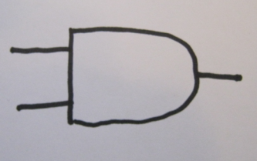
AND Gates
  A basic AND gate has 2 inputs and one output. In the world of micro-electronics, there are no such thing as True and False conditions, there are only high (5 volts) and low voltage (0 volts).

Slide 6
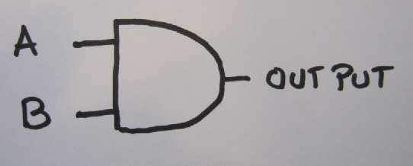
How does the AND gate work?
  If the A input is 5 volts (True) and the B input is also 5 volts, the output will be 5 volts (True).
  If either of the inputs is 0 volts, the output will be 0 volts (False).

Slide 7

OR Gates
  The OR gate also has 2 inputs and one output, but the symbol is shaped differently. Notice the input end is curved in and the output end has a point.

Slide 8
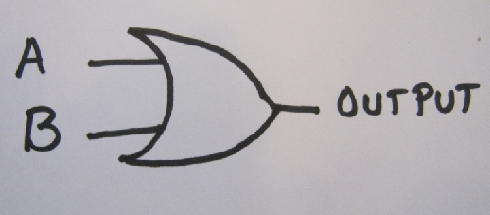
How does the OR gate work?
  If either input A or B has 5 volts (True), the output will be 5 volts (True). Only when both A and B are 0 volts will the output be 0 volts (False).

Slide 9
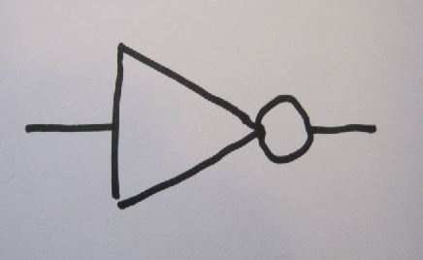
The NOT gate (or inverter)
  The NOT gate looks like a triangle with a circle at the point. It has only one input and one output.

Slide 10
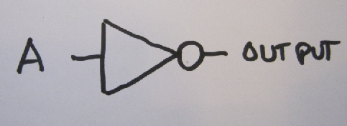
How does the NOT gate work?
  The NOT gate is also called an inverter because if the input is 5 volts, the output is 0. If the input is 0 volts, the output is 5.

Slide 11
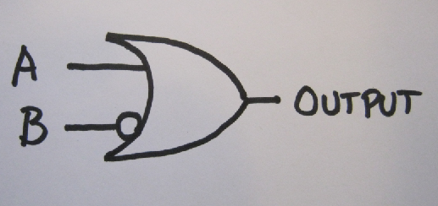
There are symbol short- cuts
  When a NOT gate is placed with another gate, its symbol can be abbreviated as just a circle. The symbols below shows an OR gate, with an inverter before the B input.

Slide 12
Interpreting the schematic
  Without the inverter, the output would be A OR B; but, considering that B has an inverter before the OR gate, the output is A || !B.

Slide 13
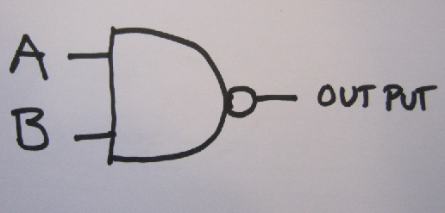
More Symbols
  The symbol below is an AND gate with an inverter on the output of the gate, so the actual output would be the opposite of A AND B or !(A && B).

Slide 14
There are more symbols
  There are more complicated gates, such as gates with more than 2 inputs, and an ‘exclusive’ OR gate that has a different truth table.
  All of these complex gates can be constructed from the basic building blocks of AND, OR, NOT gates.

Slide 15
Gate schematics can be evaluated as Boolean expressions
  In order to know what the output of a circuit will be, it must be evaluated as a Boolean expression in a truth table, using all the possible combinations of input values.
  Use the following slides to practice. You may use parenthesis to clarify grouping.

Slide 16
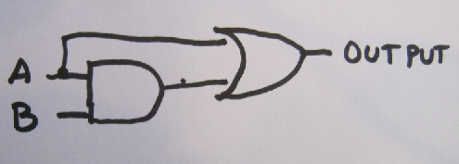
Create the Boolean expression for this schematic

Slide 17
Answer: (A && B) || A

Slide 18
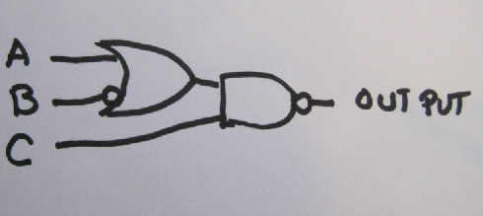
Create the Boolean expression for this schematic

Slide 19
Answer: !((A || !B) && C)

Slide 20
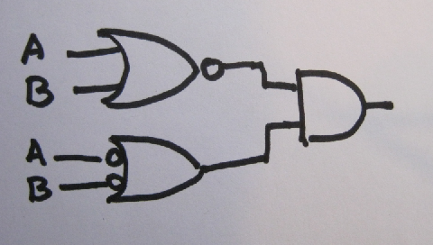
Create the Boolean expression for this schematic

Slide 21
Answer: !(A || B) && (!A || !B)

Slide 22
Use What You’ve Learned
  Complete the exercise “Gates to Boolean Expressions”

