Slide 1
Computer Programming
  Software Life Cycle

Slide 3
Software Life Cycle
  The process of conceiving a software application, developing the programs, and retiring the project is the software life cycle
  Why do we need a software life cycle?
    To ensure a quality product
    To have a formal sequence of steps to complete a project
    To have a plan for programmers to follow

Slide 4
Software Life Cycle
  The Department of Defense developed the idea of a formal process for development and deployment
  Specific phases and sequences are followed and recognized as an industry standard

Slide 5
Software Life Cycle
3 commonly used approaches:
  Waterfall Model
  Spiral Model
  Extreme Programming Model

Slide 6
Waterfall Model
Analysis
Design
Implementation
Testing
Deployment

Slide 7
Waterfall Model
Stage 1 – Analysis
  Decide the end result of the project based on customer’s requirements
  Determine inputs
  Write a description of the project

Slide 8
Waterfall Model
Stage 2 – Design
  Plan for implementation
  Decide programs needed
  Determine relationships between the programs

Slide 9
Waterfall Model
Stage 3 – Implementation (the “coding” phase)
  Write and compile programs
  Construct the product according to the design

Slide 10
Waterfall Model
Stage 4 – Testing
  Verify the results of each program
  Include all possible cases for inputs

Slide 11
Waterfall Model
Stage 5 – Deployment
  Install the applications
  Train the user (customer)
  Make necessary modifications
  Refine the programs to improve performance

Slide 12
Spiral Model
design
implementation
analysis
deployment
testing

Slide 13
Spiral Model
  Originally proposed by Barry Boehm, 1988
  Design and implementation are repeated
  Prototypes are used to break a project into smaller parts
  Uses repeated trials and feedback
  The project is constantly being refined and improved

Slide 14
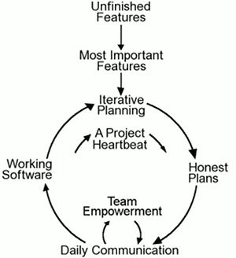
Extreme Programming
www.extremeprgramming.org

Slide 15
Extreme Programming
  Began March 6, 1996
  Designed to emphasize customer satisfaction
  Customers are part of the team
  Removes formal structure and focuses on best practices

Slide 16
Extreme Programming
  Heartbeat is the center of the project; this is the steady pace where everyone works together to keep the development moving
  Pace should be measurable and sustainable
  Everyone has responsibility – not just the manager

