Slide 1
Computer Technician
Subtitle

Slide 3
Course Objectives
Identify the various parts that make up a computer
Describe the various functions of the parts of a computer
Identify various failures that can occur within the computer’s hardware

Slide 4
Computer Parts Challenge
Break into three groups
Each group gather around one of the three tables with computer parts
The captain of each group with be the person with a birthday closest to December 1st
Locate the two sets of cards
Blue index cards: Computer hardware names
White index cards: Computer hardware functions
As a group, match the blue card to the correct computer part on the table
Match the white card to the correct blue card and part
Groups have 10 minutes to complete the activity

Slide 5
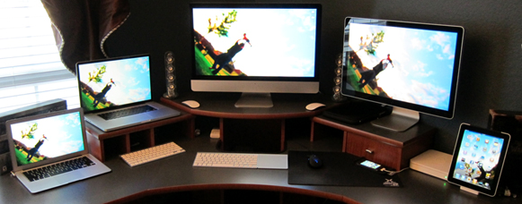
Different Computer Types
Ultrabook – Slimmer and more portable laptop
Laptop – Larger more powerful form of portable computing
Desktop – Non-portable computer
Tablet – Compact mobile computing device

Slide 6
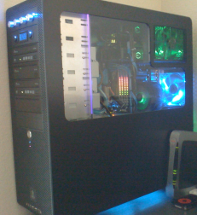
Computer Case
Job
House all computer parts in a single enclosure
Possible Malfunctions
Not having the correct mounting holes for the Motherboard
Selecting too small a case for desired hardware
Poor ventilation

Slide 7
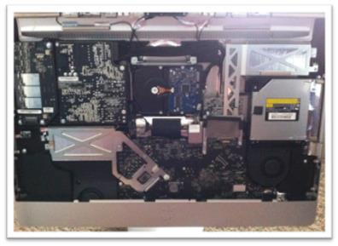
Computer Case
All-in-one Computer Case
Job – Holds all of the computer parts in the case which is mounted behind the computer display
Space saving design

Slide 8
Motherboard
Job
Primary circuit board that connects all of the computer’s components
Allows the various computer components to communicate with one another
Connection point for external devices
Mouse
Keyboard
Printer

Slide 9
Motherboard
Possible malfunctions
Failure to be properly grounded causing an electrical short
Failure to boot
Manufacturing defects
Corrupted BIOS (Basic Input Output System)
Set of basic commands that instruct the Motherboard how to operate
Failure to boot

Slide 10
Central Processing Unit (CPU)
Job
The “brain” of the computer
Processes the instructions sent from memory and executes those instructions
Possible malfunctions
Electrical short: processor circuitry is unable to conduct signals
Overheat: melting and/or damaging of the internal circuitry

Slide 11
Memory
RAM – Random Access Memory
Job
Hold “active” information the computer is utilizing
Includes applications or software the computer is running
Additional memory allows the computer to operate with more applications running simultaneously
More memory often results in improved computer performance

Slide 12
Memory
Possible Malfunctions
Electrical short due to mishandling or improper grounding
Corrupts computer operations
Hardware lockups
Failure to boot
Wrong type of memory is installed
Different voltages are required in varying memory types
Won’t fit in memory slot on the Motherboard

Slide 13
Hard Drive
Hard Disk Drive (HDD) is the computer’s long term memory
Job
Retains information when the computer is inactive or turned off including applications such as
Operating System (OS)
Programs
Data and Files
Word Documents
Pictures
Music

Slide 14
Hard Drive
Possible Malfunctions
Mechanical Failure
Circular disks that rotate with a needle that reads and writes data files
Circuitry Failure
Chips on the Hard Drive short
Flash memory shorts rendering the drive inoperable
Solid State Drives (SSD) are newer drives which lack any moving parts, are faster at reading/writing, and share many commonalities with Flash Drives

Slide 15
Video Card
Also known as the Graphics Card
Job
Computes and then displays all content seen on a computer screen
Is made up of several sub-components
Video Memory
Stores the data that is being used for the onscreen image
Graphics Processing Unit (GPU)
The processor that instructs what each Pixel is to display
Pixels are the thousands of dots that comprise a computer screen

Slide 16
Video Card
Possible Malfunctions
Overheating
No picture displayed on screen
Screen corruption (Image is distorted or flickering)
Forces the computer to lock up
Power related problem
Too little power is being supplied to the video card
Incompatible with the Motherboard
Video cards have different types of connections that may not be compatible with the Motherboard

Slide 17
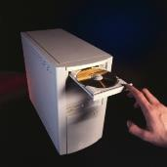
Optical Drive
Job
Read Compact Discs (CD, CD-R, CD-RW)
Read Digital Video Disc (DVD, DVR-R, DVD-RW, Blu-Ray)
Write to Discs
Referred to as a Burner
Requires –R or –RW media
Load applications, documents, and media (music, photos, and music)

Slide 18
Optical Drive
Possible Malfunctions
Laser failure
Is unable to read the disc
Laser motor fails not allowing the laser to travel along the disc and read
Drive Motor Failure
The disc is unable to spin and be read
Tray Motor Failure
The drive is unable to eject the disc

Slide 19
Power Supply
Job
Supplies the various components of the computer with power
Converts AC (Alternating Current) from your house’s outlet into DC (Direct Current) that the computer parts can use
Regulates and monitors the appropriate voltages and wattages to different components
Ensures computer components don’t become overloaded with power
Contains different connector types specific to the various components of the computer

Slide 20
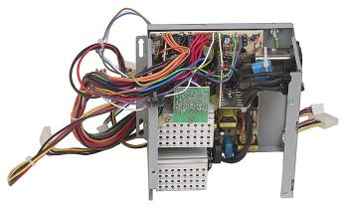
Power Supply
Possible Malfunctions
The power supply overheats
Results from too much power draw
Failure of Capacitors
Computer will not power up
Improper grounding
Computer will not power up
Cooling fan failure
Overheats and will shut down

Slide 21
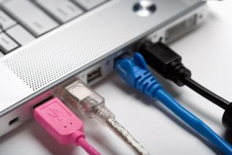
Cables
Job
Transfers data between devices
Types
USB
Firewire
Ethernet
Thunderbolt
Possible Malfunctions
Broken wire or connector at the end of the cable
Components connected won’t operate or be recognized

Slide 22
Possible Hardware Add-ons
Sound card (For better sound quality and editing purposes)
Networking Card (If the motherboard doesn’t have one)
Computer Cooling Fans
Speakers
Printers
Keyboards and Mice

Slide 23
Monitor
Job
Display computer generated content
Comprised of a matrix of pixels which utilize three primary colors (Red, Green, and Blue)
Image onscreen is the output from the video card memory that has been processed by the Graphics Processing Unit
Each pixel is sent instructions on brightness, color, and when to change its state

Slide 24
Monitor
Possible Malfunctions
Power supply failure
Monitor will not turn on
Screen shows ghost images (Burn-in)
The result of the display holding a particular image for a long time
The pixels lose their ability to change state and therefore develop a memory

Slide 25
Independent / Group Work
Group
Get back into your original groups
Confirm your original index card guesses
Make any necessary changes so that the correct white and blue cards are with their corresponding part

Slide 26
Independent / Group Work
Individual
Once you have verified the cards are appropriately placed, retrieve a fill-in-the-blank labeling sheet from the front
On this sheet you will find a picture of each part that will be on the test
Next to each part, write the appropriate name and its function
Use this sheet and Power Point to study for the test

Slide 27
Exam Preparation
An exam will be given over the material presented in the presentation
Make sure to review your class notes, fill-in-the-blank sheet, and these slides
The test will be multiple choice, true/false, and matching

