Slide 1
Courtroom Participants
  Duties & Responsibilities during Criminal Trials

Slide 3
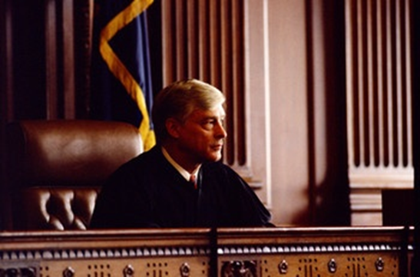
Professional Participants
  Judge
  Prosecutor
  Defense Attorney

Slide 4
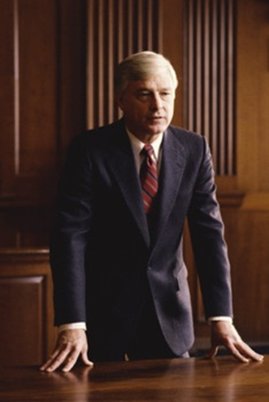
Para-professional Participants
  Bailiff
  Clerk
  Court Reporter

Slide 5
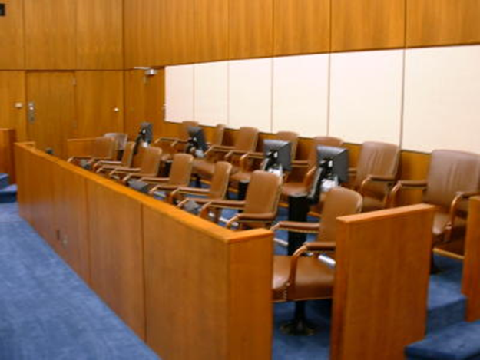
Non-professional Participants
  Jury
  Defendant
  Victim
  Witnesses

Slide 6
Professional Participants
  Judge
  Main Duty: To ensure justice is done!
  Makes Rulings: Decides on the admissibility of evidence; rules on objections and motions
  Keeps control in the courtroom
  Bench trial
  Sentencing

Slide 7
Professional Participants
  Judges’ Qualifications
  Have a law degree (in most cases)
  Juris Doctorate
  Be a licensed attorney
  Be a member of the State Bar
  Receive proper training

Slide 8
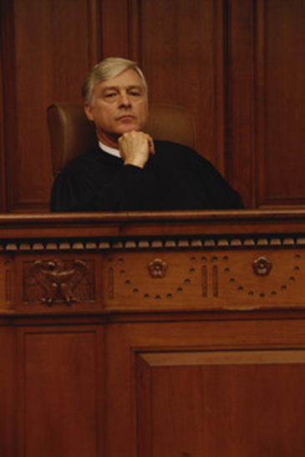
Professional Participants
  Judges: How do they get their jobs?
  Appointed by the governor
  Popular election
  Hired
  The Missouri Plan

Slide 9
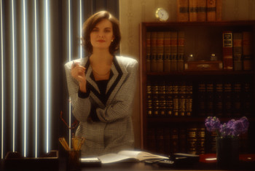
Professional Participants
  Prosecutor
  Also called
  District Attorney
  State’s Attorney

Slide 10
Professional Participants
  Prosecutor’s Duties
  Presents information or evidence to a grand jury
  Prosecutorial discretion
  Questions witnesses for the state
  Requests guilty verdicts or convictions
  Represents the state in appeals

Slide 11

Professional Participants
  Defense Attorney
  Represents the person accused of committing a crime
  Plea bargains
  Prepares the defense
  Questions witnesses
    Directs own
    Cross-examines the state’s

Slide 12
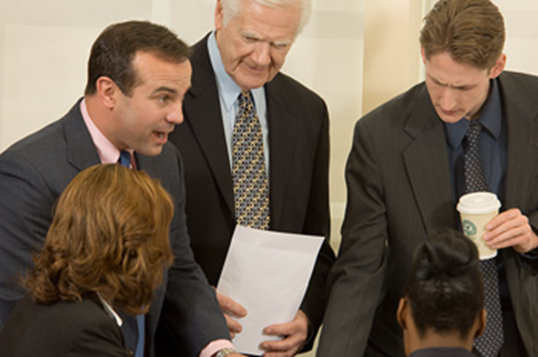
Professional Participants
  Defense Attorney
  Disputes claims made by the prosecutor
  Sentencing
  Files Appeals
  Argues Appeals

Slide 13
Professional Participants
  Types of Defense Attorney
  Private attorneys hired by a defendant
  Court-appointed attorneys
  Public Defenders

Slide 14
Para-professional Participants
  Bailiff
  Keeps order in the courtroom
  Secures witnesses
  Maintains physical control over the defendant if not released on bail
  Announces the judge’s entry
  Clerk
  Works directly with the trial judge
  Responsible for court paperwork and records before and during the trial

Slide 15
Para-professional Participants
  Court Reporter
  Stenographer
  Maintains a written record of all court proceedings
    Transcribes every spoken word during the trial
  Transcripts are necessary for appeals

Slide 16
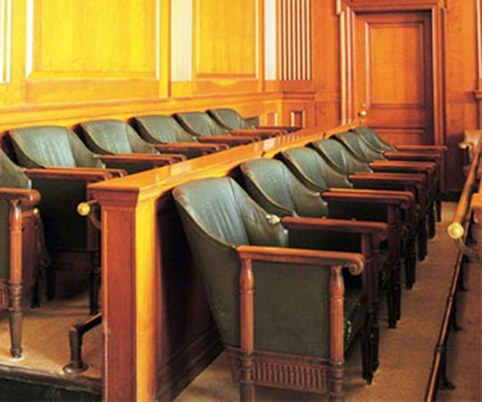
Non-professional Participants
  Jury
  Selection:
    Voir Dire
    Challenges
      To the Array
      For Cause
      Peremptory

Slide 17
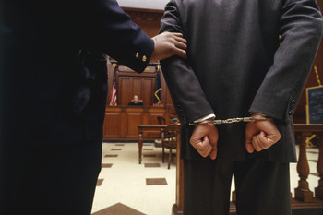
Non-professional Participants
  Defendant
  The “accused”
  The person against whom a criminal complaint or indictment is filed

Slide 18
Non-professional Participants
  Victim
  Crime committed against
  Suffered death or serious physical or mental suffering OR
  A loss of property resulting from the actual or attempted criminal actions of others
  Witnesses
  Sworn testimony received as evidence
  Have personal knowledge of the facts
  Types of Witnesses
    Expert
    Lay

Slide 19
Non-professional Participants
  Expert Witnesses
  Have special knowledge and skills recognized by the court
  May express opinions or draw conclusions
  Usually paid
  Lay Witnesses
  Eyewitnesses
  Character Witnesses
  Not considered experts
  May testify ONLY to the facts

Slide 20

All Participants…
  WORK TOGETHER TOWARD A COMMON GOAL:
  EFFICIENT CONCLUSION TO A CASE

Slide 21
Resources
  020547893X, Allyn & Bacon, Criminal Justice, 2006, James Fagin
  Law Focused Education, Inc. https://www.texaslre.org/jury_game/jurygame_intro.html

