Slide 1
Create a Mascot
  Using a Professional Vector Graphic Editor

Slide 3
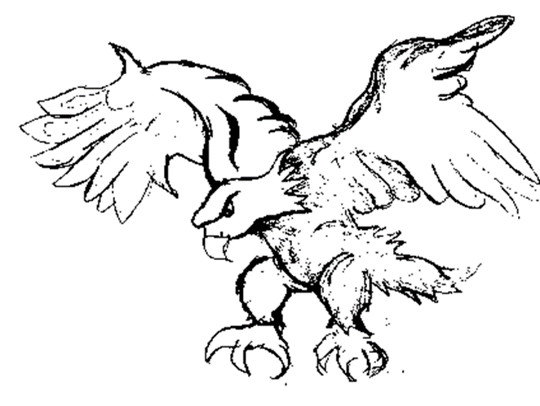
Draw/Find an Image
  Sketch your image on paper, and then scan it into the computer as a black and white image.
  If you are unable to sketch an image, then find a non-copyrighted image or drawing to use.
Notes:
**Instructor Note: This lesson is intended to be used with a professional vector graphic editor. For more information regarding a professional application, perform a web search for “professional vector graphic editor”.

Slide 4
Create the Artboard
  Start your professional vector graphic editor and choose Print Document.
  In the New Document dialog box, name the document and set the dimensions for the art board as shown. Click OK.

Slide 5
Set Up the Workspace
  Use File -> Place to import your image. Place
  the image on the center of the artboard.
  Double-click on its layer. In the Layer
  Options dialog box, complete the following:
    Name: Eagle Trace
    Lock: check
    Print: uncheck
    Dim Images to: check and
    set value to 50%.
    Click OK.
Notes:
Instructor Notes:
Explain to the students that they can click the Expand Panels icon to view the panels while you tear off the two panels. Click the Collapse to Icons to collapse the panels to create more room in the workspace.
Remind them to left-click and drag the tab of the panel to tear off, or undock the panel.

Slide 6
Set Up the Workspace
  If necessary, reset your workspace to
  Essentials.
  Use Window -> Workspace -> Essentials.
  Undock the Layers panel and the Brushes
  panel to make them more accessible while we
  trace the sketch of the eagle.

Slide 7
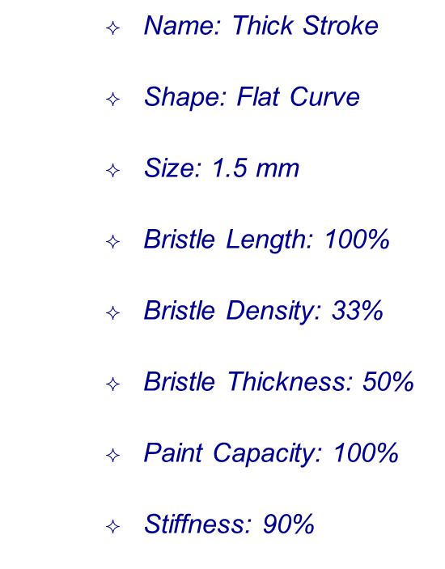
Set Up Your Brush
  Create a custom brush to draw the outline of the eagle
  On the Brushes panel, click on the New Brush icon
  Select Bristle Brush and click OK
  Use the settings on the right to set the Brush Options and click OK
Notes:
Instructor Notes:
Explain to students that when creating a brush they may not like the settings after they have worked with it. They can double-click on the brush in the Brushes panel to open the Brush Options dialog box and adjust the settings. Activating Preview will allow them to see changes to brush strokes that have already been created.

Slide 8
Start Tracing
  Create a new layer in the Layers panel to begin tracing the outside lines of the eagle.
  Once you have outlined the eagle, zoom in to get a better look to be sure all of the lines are connected. Notice the stroke does not look solid.
Notes:
Instructor Notes:
Explain to the students the trick is to look in front of your cursor not on the cursor when you are tracing. You want to see what you will draw and not what you have drawn.
Explain the Brush tool is intended to be used in sections, they are not expected to draw the entire eagle with one stroke.
Remind students that the trace does not have to be perfect, the Eagle Trace layer will not print, and they can hide the layer to see how their traced eagle looks.

Slide 9
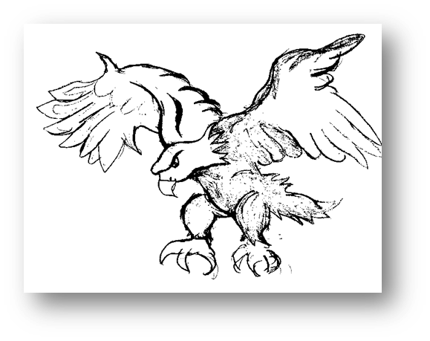
Start Tracing
  Double-click on the brush you created in the Brushes panel and change the Bristle Density to 75%. (Check Preview so you can see the changes before clicking OK.)
  Clean up your lines where necessary with the eraser tool, or select the line with the Direct Selection tool and delete it so you can draw it again, or change the width of various strokes.

Slide 10
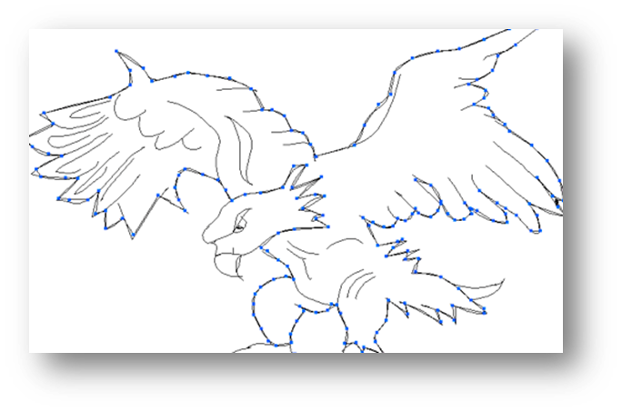
Use the Pen tool
  Duplicate the layer you just did your tracing on.
  Name the top layer Outline and the middle layer Color.
  Lock the Outline layer, and select the
  Color Layer.
  Trace the eagle with the Pen tool.
  (Ignore the face, talons, & tail tip)
  Choose any Fill Color for the body of the eagle. (I've chosen a dark maroon color.)
  Repeat this process for the other parts of the eagle.
Notes:
Teacher Notes:
As the students use the Pen tool they will notice green lines and anchor points appear when they intersect the line they are tracing, this should guide them in creating the outline. The outline does not need to be perfect, the Outline layer will hide any imperfections. This trace is to create a fill color. They do not need to follow the lines on each wing, as shown in the example.
The Pen tool is intended to create one outline around the entire eagle’s body, not to be drawn in parts. Explain to the students that if they release the mouse they will not “lose” the line they are drawing, each click allows them to change the direction of the line and if they hold the left-clicker and drag while creating an anchor point they can curve the line.

Slide 11

Example of Colored Eagle
Notes:
Teacher Notes:
Now have students complete a mascot on their own, if the student does not feel comfortable drawing have them look on the Internet for a non-copyrighted photo, a hand drawn sketch, or a picture that they can use to trace.

