Slide 1
Music Video
Creating and Producing a Music Video

Slide 3
Cinematography
Cinematography: the art or technique of motion picture photography
Some cinematography aspects included in this lesson:
Filters
Lens
Depth of field and focus
Aspect ratio and framing
Lighting
Camera movement

Slide 4
Filters
Diffusion filters
Color filters
For example, when real film is used, color filters block out certain color wavelengths of light and prevent them from reaching the film
Most filters used in today’s industry are put into effect during the editing process using professional software

Slide 5
Lens
Different camera lenses provide a certain look, feel, focus, or color effect to the project
Wide Angle Lens
Long Focus Lens
Macro Lens
Borescope Lens – help with special effects
Prime Lens – often chosen by professionals due to the larger aperture opening
Zoom Lens – allows the operator to change focal length quickly in the shot

Slide 6
Lens
While filmmakers in today’s industry use high end digital film cameras, you will be using a DSLR for your music video assignment.
DSLR – Digital Single Lens Reflex
DSLR cameras can be used both as a still shot camera as well as digital filming.
One advantage of using a DSLR over a traditional video camera is the ability to achieve a greater depth of field.

Slide 7
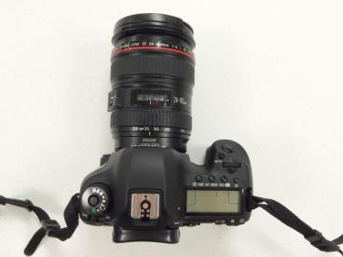
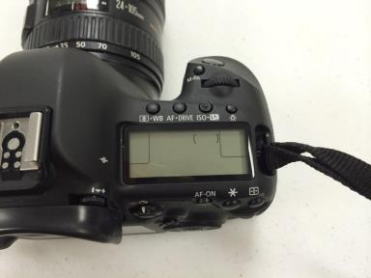
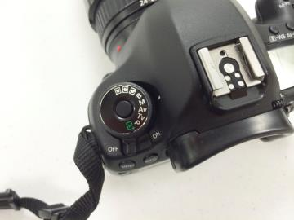
DSLR Camera Photos
Photos by Jessica Rana. Used with permission.

Slide 8
Depth of Field and Focus
Depth of Field refers to how much background, mid-ground, and foreground are in what is considered an acceptable focus
Rolling focus in a single video shot from one object or person to another is known as “rack focus”
Photos by Jessica Rana. Used with permission.

Slide 9
Aspect Ratio and Framing
Aspect ratio is the image’s proportion of its width to height
The most common aspect ratio used today is 16:9
Videographers will set this ratio on the camera being used for filming
High-definition video cannot be shot in any ratio other than 16:9

Slide 10
Aspect Ratio and Framing
Framing refers to the picture within the edges of the camera’s image
Framing helps reveal the mood and emotion of the project or piece
Photos by Jessica Rana. Used with permission.

Slide 11
Lighting
Lighting is a key aspect of cinematography
Lighting helps create the essence of the mood, emotion, and feel of the film
Lighting can be achieved in two ways:
Using various types of artificial light
Use of natural light

Slide 12
Camera Movement
Actors are not the only “moving” parts in a film.
Cinematographers use many techniques to “move” the camera around the subject
Panning – camera movement horizontally
Tilting – camera movement vertically
Dollying – a moving platform moving closer to or further away from the subject
Tracking – a moving platform from left to right
Craning – lifting the camera off the ground and moving it in a swing-like motion
Handheld Camera – operator holds and moves the camera with the motion of his/her own body

Slide 13
Evoking Emotion
Emotion – A strong feeling in which anger, fear, joy, sadness, love, etc. is experienced
Evoke – To elicit, produce, summon, or suggest through artistry, imagination, or some vivid impression of reality

Slide 14
Final Project Assignment
The final project assignment will be to create and produce a music video
Students will collaborate in groups of 3-4
Groups will need to choose a song that evokes emotion in the viewing audience
Create, film, edit, and sync a video to the chosen music and finalize the production.
Groups will present completed music videos to the class for evaluation

Slide 15
Music Choice
For your music video, make sure you choose a song which can be used to creatively plan and execute the filming of your video.

Slide 16
Summary
Cinematography is the art of motion photography.
Various aspects help to evoke emotions in the viewing audience
Filters, Lens, Depth of Field, Focus, Lighting, Aspect Ration, Framing, and Camera Movement
Review final project requirements and pass out storyboard handouts and assessment rubric

Slide 17
Review of Background Knowledge
Lesson 1.04 – Video Camera
Lesson 1.06 – Basic Editing
Lesson 4.01 – Lighting Technique
Lesson 4.03 – Crew Positions

