Slide 1
Day 7 Career Journey
  Architecture & Construction

Slide 3
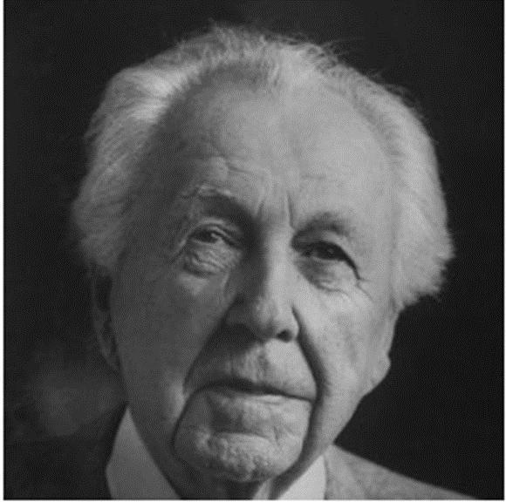

Famous Architects
  Frank Lloyd Wright
    Modern architect who developed a very distinct American style
    Developed a style known as Prairie School
    Organic architecture
    Single story residences
    Fallingwater Residence is the “best all-time work of American architecture
    Guggenheim Museum in New Year took 16 years to design
    Widely considered the greatest architect of the 20th century

Slide 4
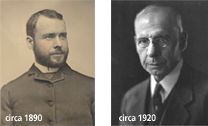

Famous Architects
  Louis Sullivan
    Most influential architect of the late 1800s
    The father of skyscrapers
    The father of modernism
    Rejected ornate European for cleaner aesthetics
    Wanted an authentic American style of architecture

Slide 5
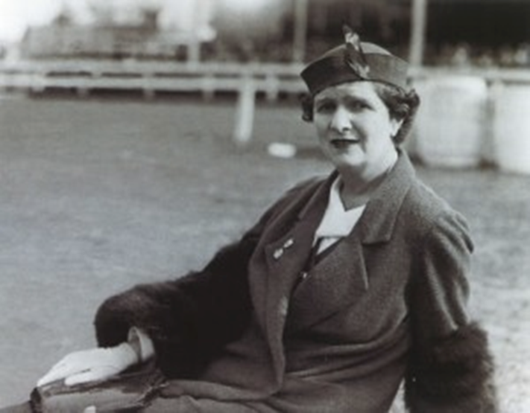
Famous Interior Designers
  Frances Alder Elkins
    Sister of renowned architect David Alder; she traveled with him while he studied in Europe which is how she started
    Futuristic style with vintage designs
    Played with furniture and colors
    Strict palette of blue, yellow and white.
    Passed away in 1953 and inspired many future designers

Slide 6

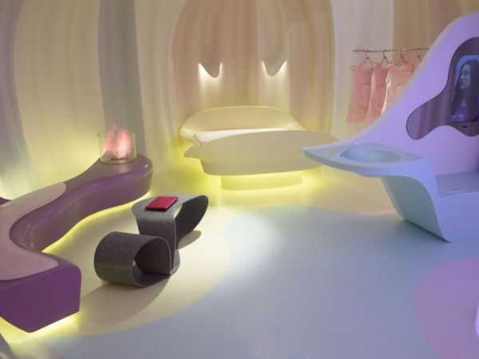

Famous Interior Designers
  Karim Rashid
    Industrial designer from Egypt
    Designs that include interiors, fashion, furniture, lighting, art and music
    Includes bright colors and logs of shapes for fluidity

Slide 7
What Causes Occupation Changes?
  Possible Factors:
    Technology: As technology changes, products and materials change
    Design & Style: Architecture and design are art forms and just like fashion there are trends that can be seen through time
    Going Green: As the world has become more conscious of a carbon footprint and sustainability; construction technology, materials and design are rapidly changing to meet those demands

