Slide 1
Dental Instruments
What is it?

Slide 3
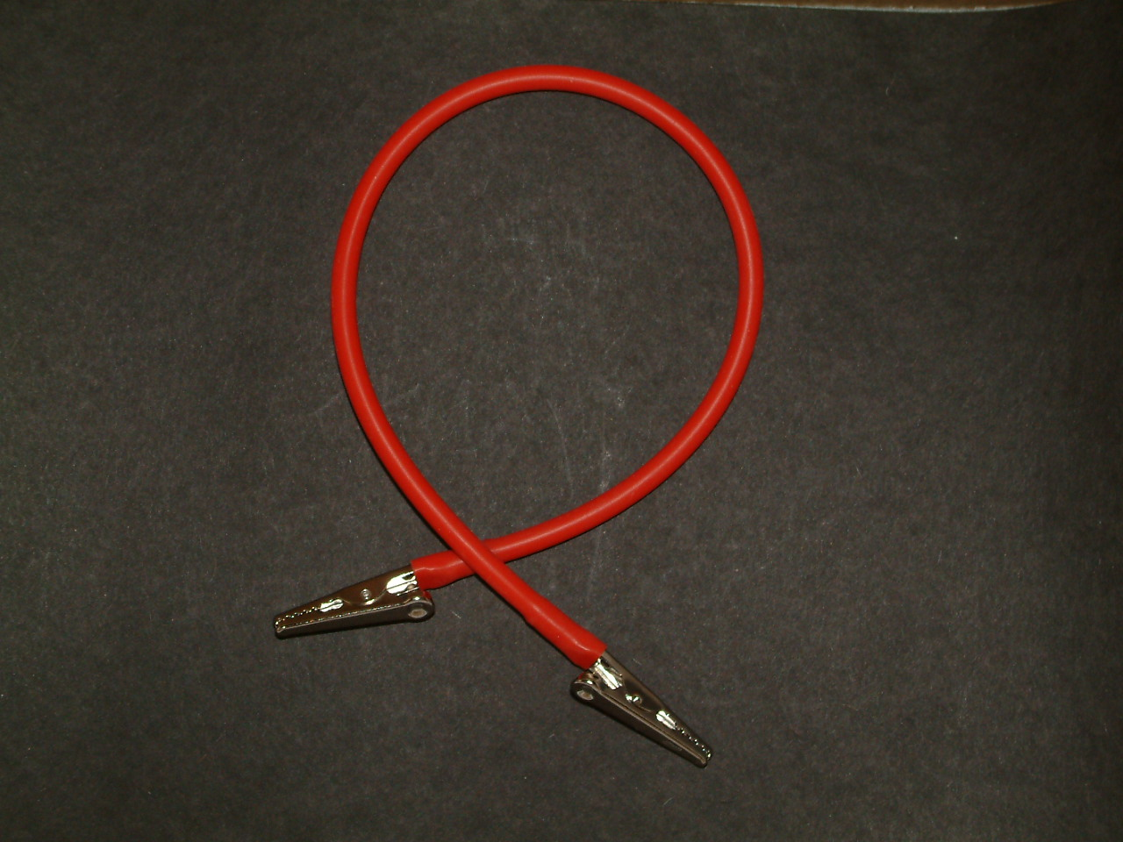
What is It?
Patient Napkin Holder

Slide 4
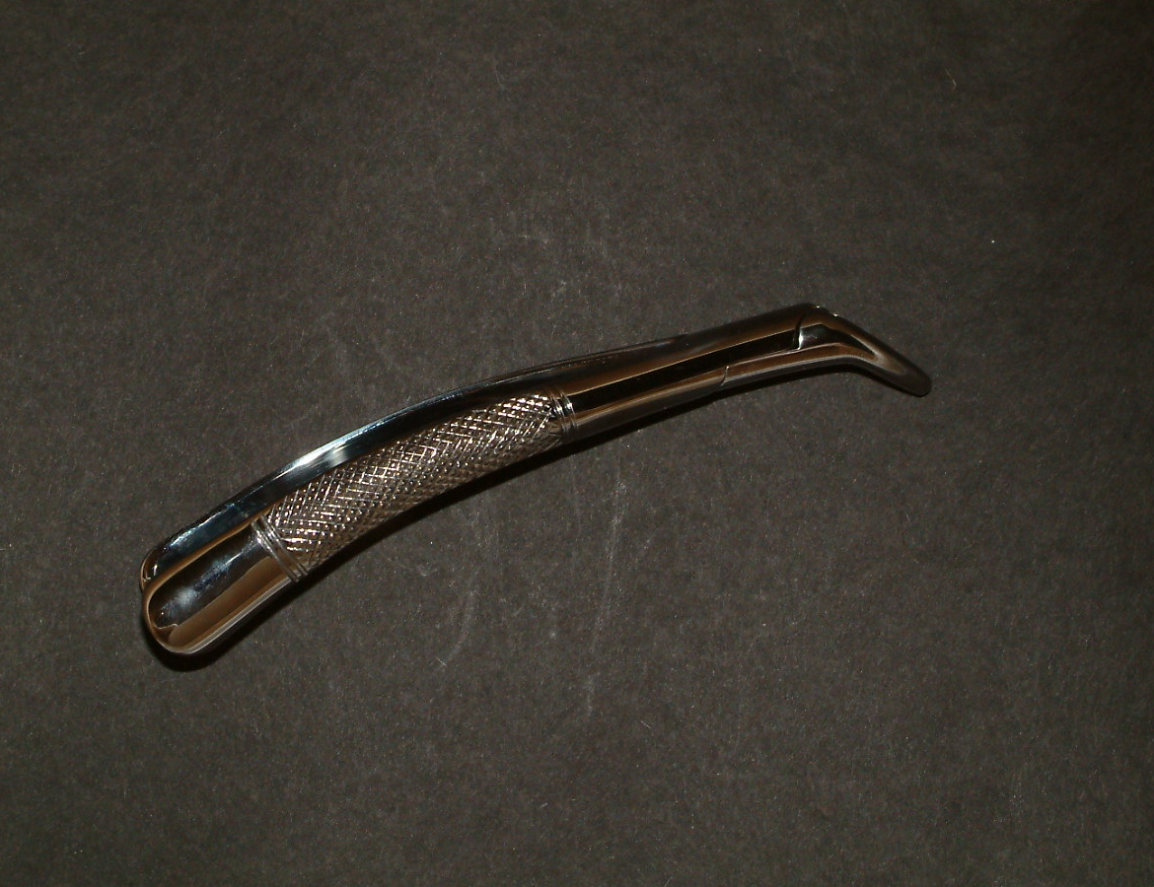
What is It?
Maxillary Extraction Forceps

Slide 5
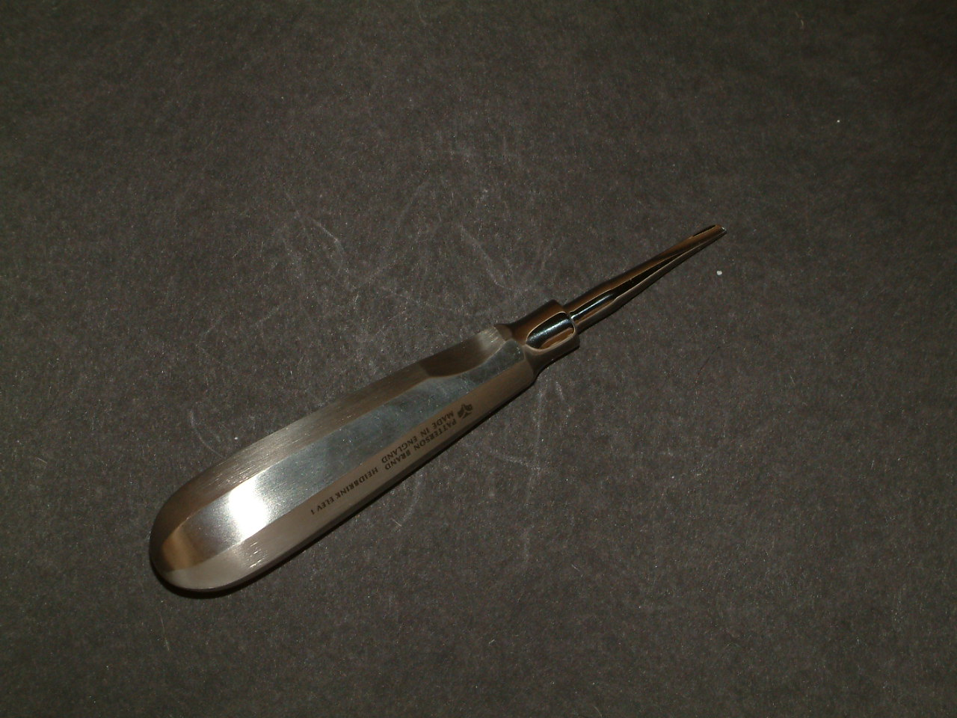
What is It?
Elevator-34S Exaction

Slide 6
What is It?
Bone File

Slide 7
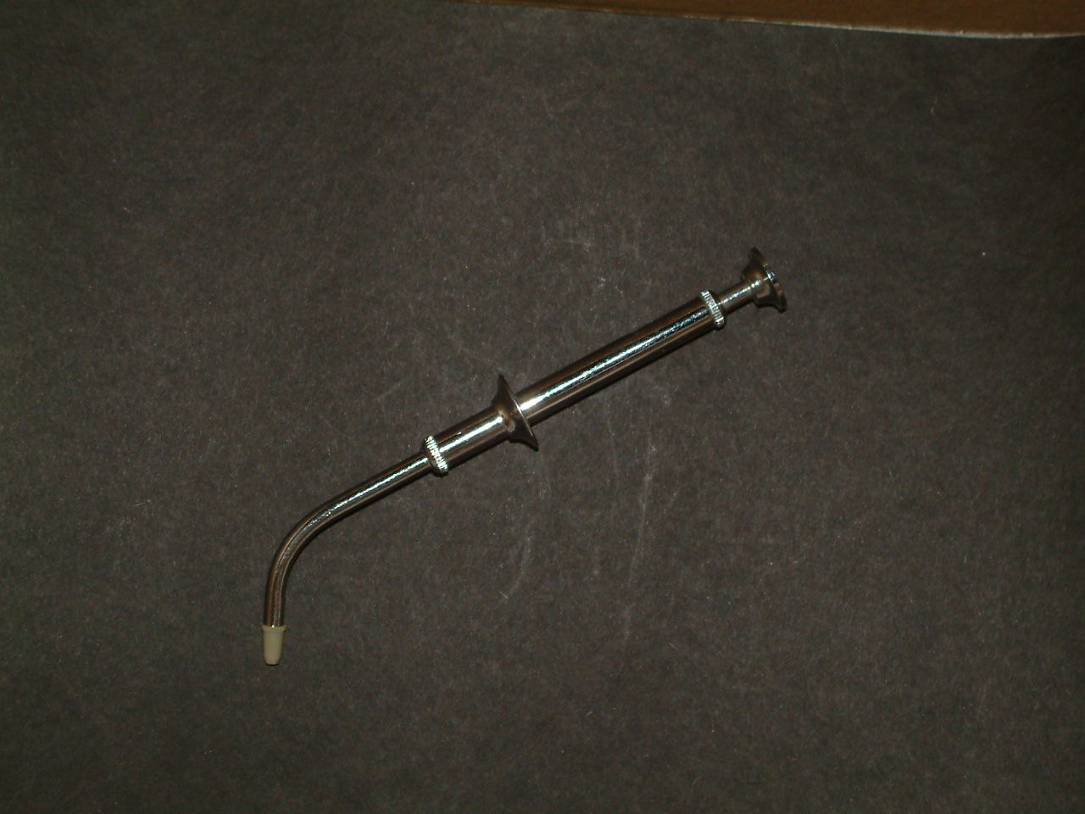
What is It?
Amalgam Carrier

Slide 8
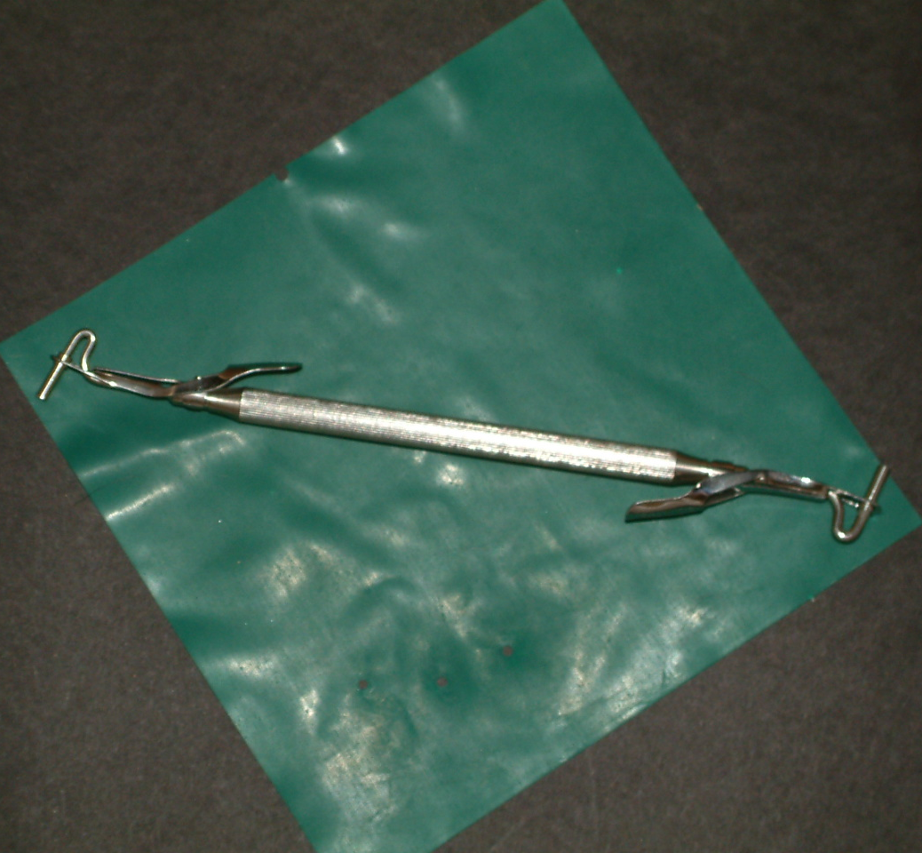
What is It?
Amalgam Carrier-Double Ended (DE)

Slide 9
What is It?
Amalgam Well

Slide 10
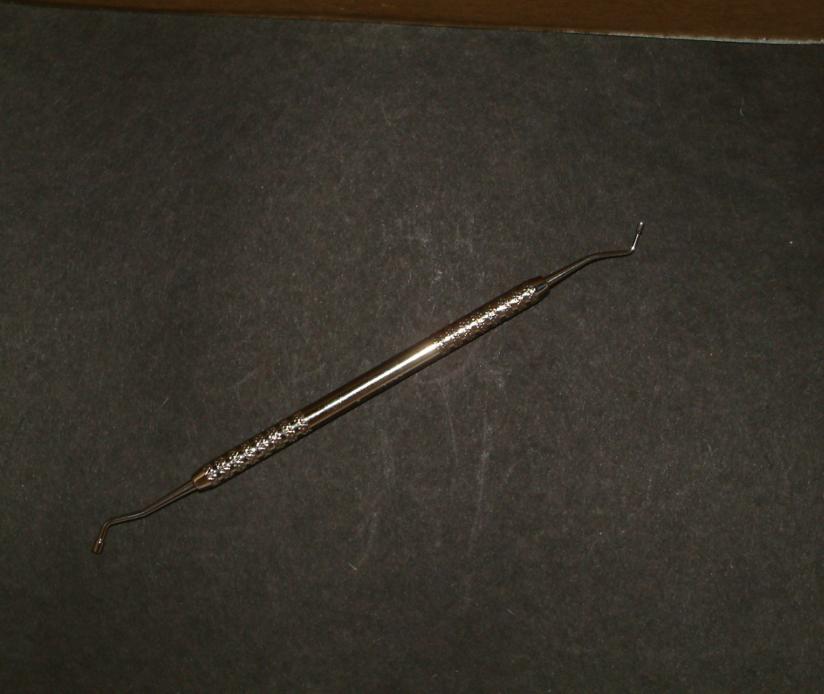
What is It?
Amalgam Plugger

Slide 11
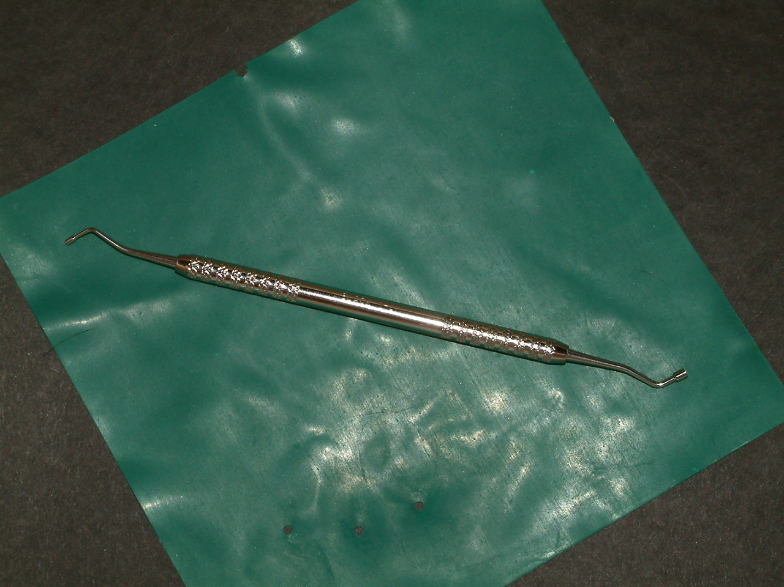
What is It?
Amalgam Plugger

Slide 12
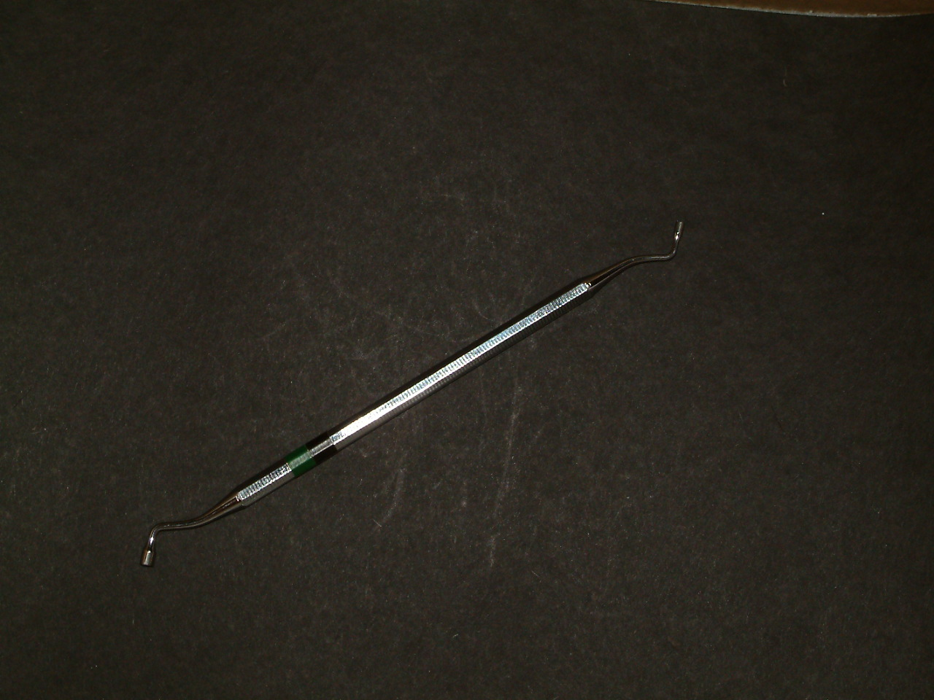
What is It?
Amalgam Plugger

Slide 13
What is It?
Amalgam Carver—Cleoid-Discoid

Slide 14
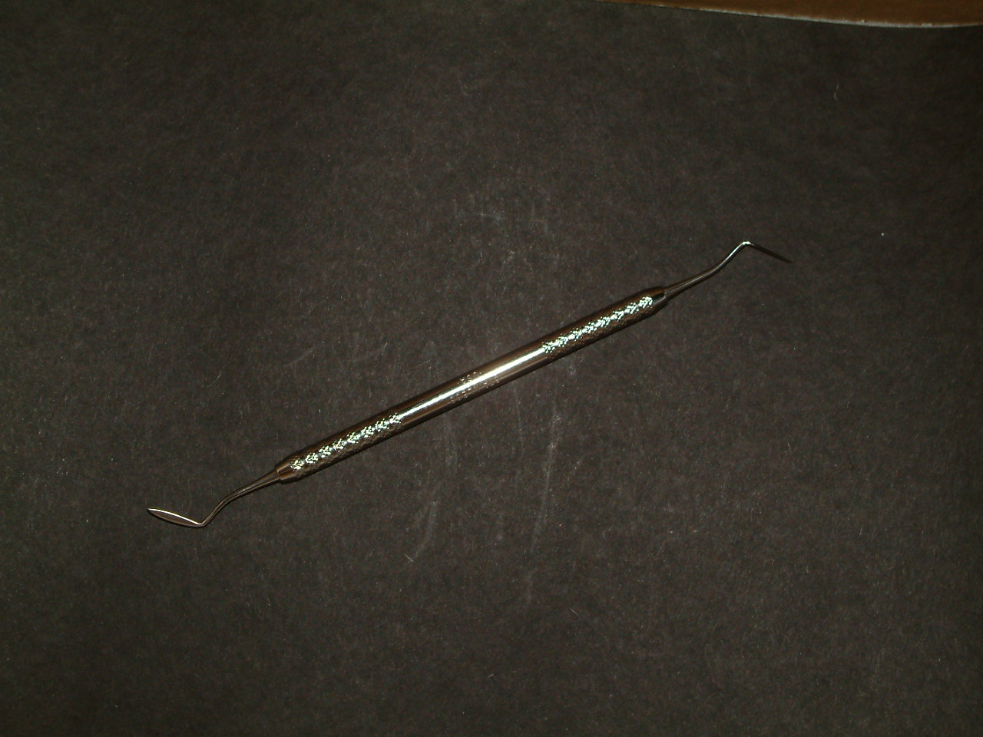
What is It?
Amalgam carver
Hollenback

Slide 15
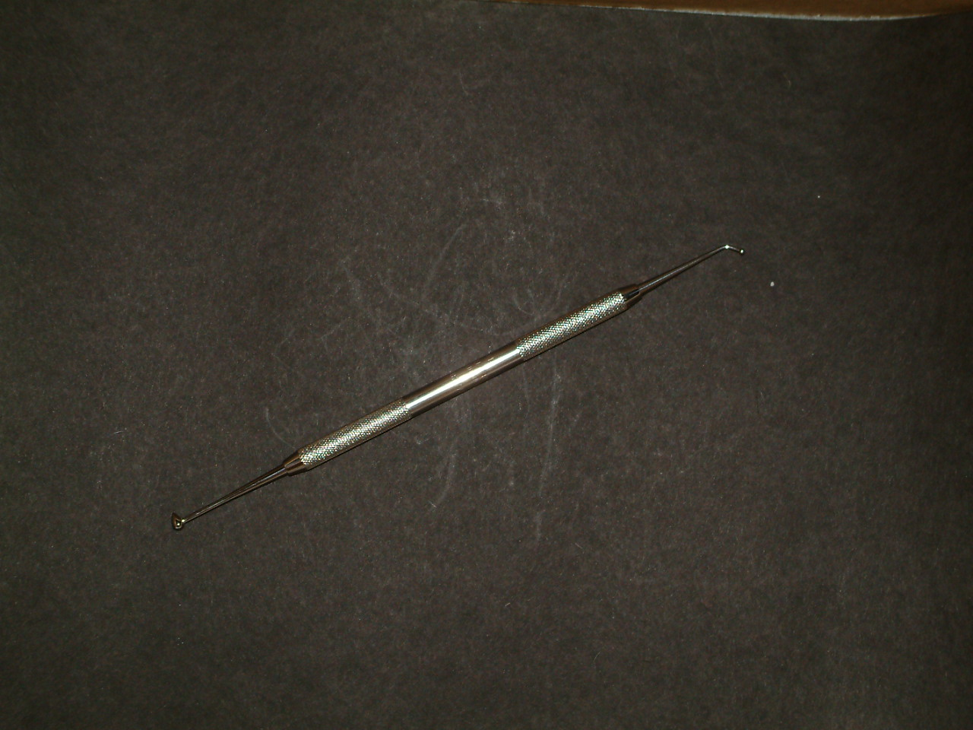
What is It?
Burnisher

Slide 16
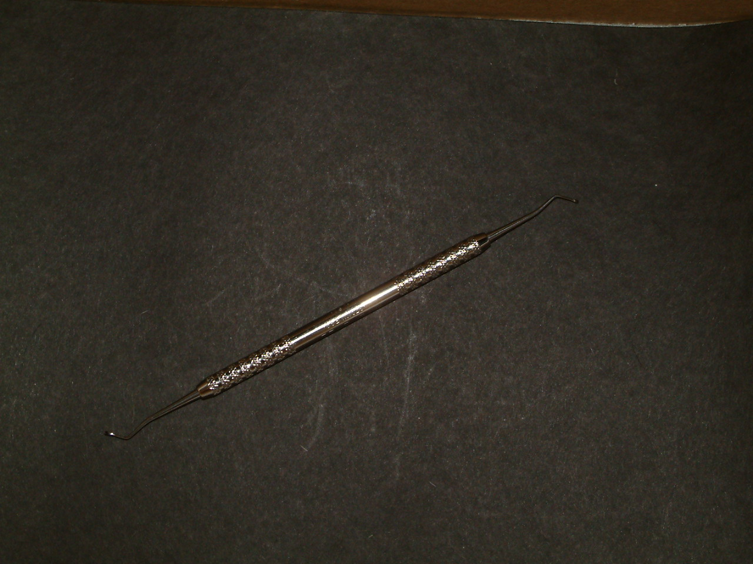
What is It?
Black’s Excavator

Slide 17
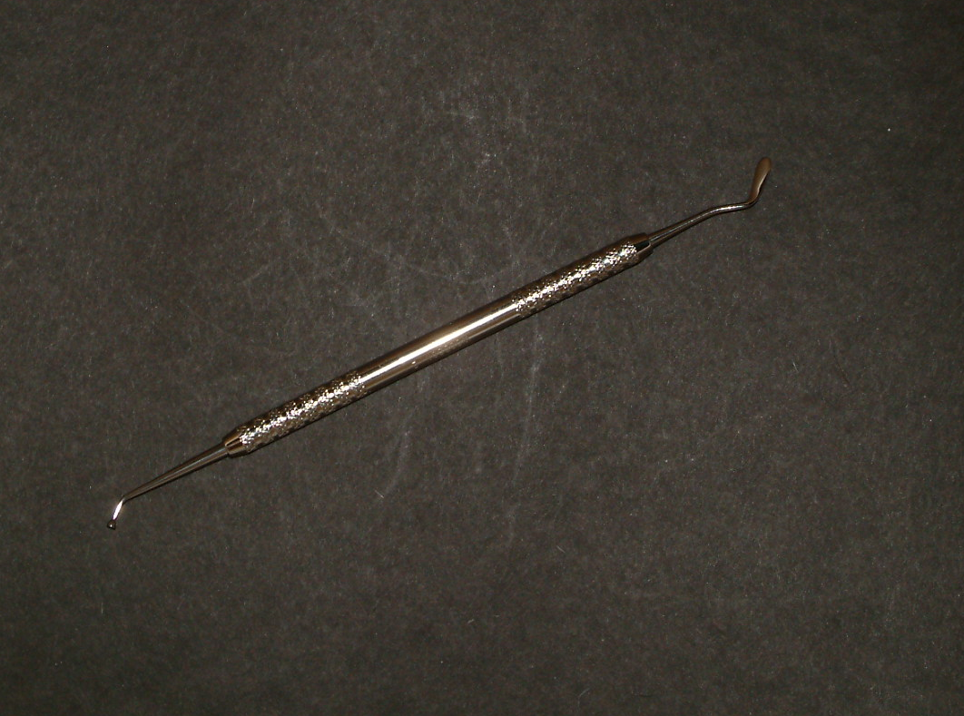
What is It?
Plastic Instrument
Woodson #2

Slide 18
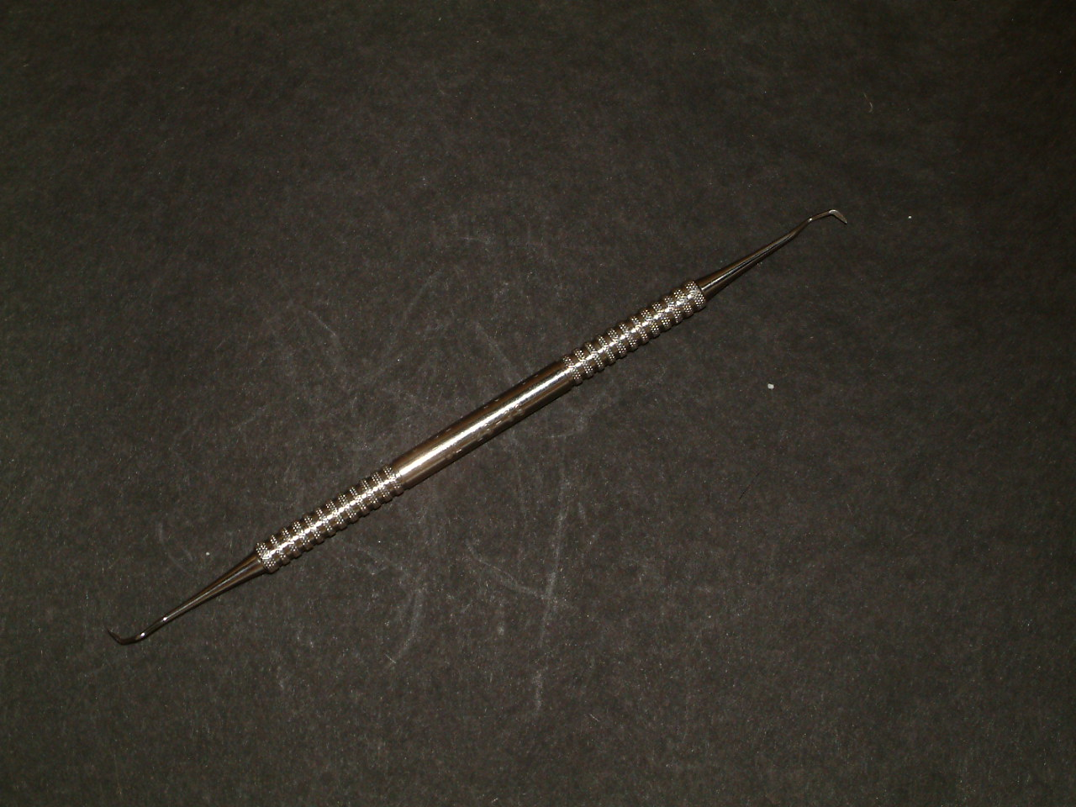
What is It?
Scaler-Hygeine

Slide 19
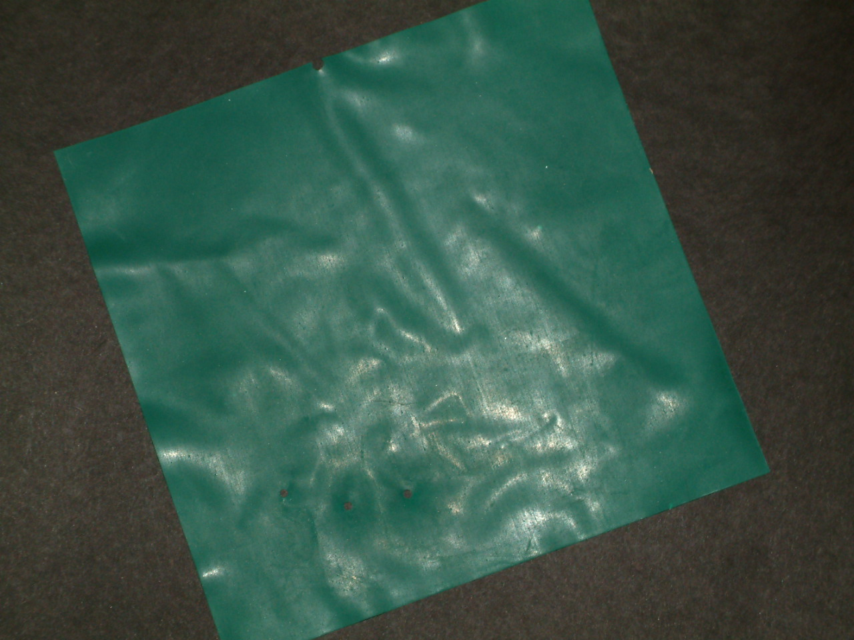
What is It?
Rubber Dam

Slide 20
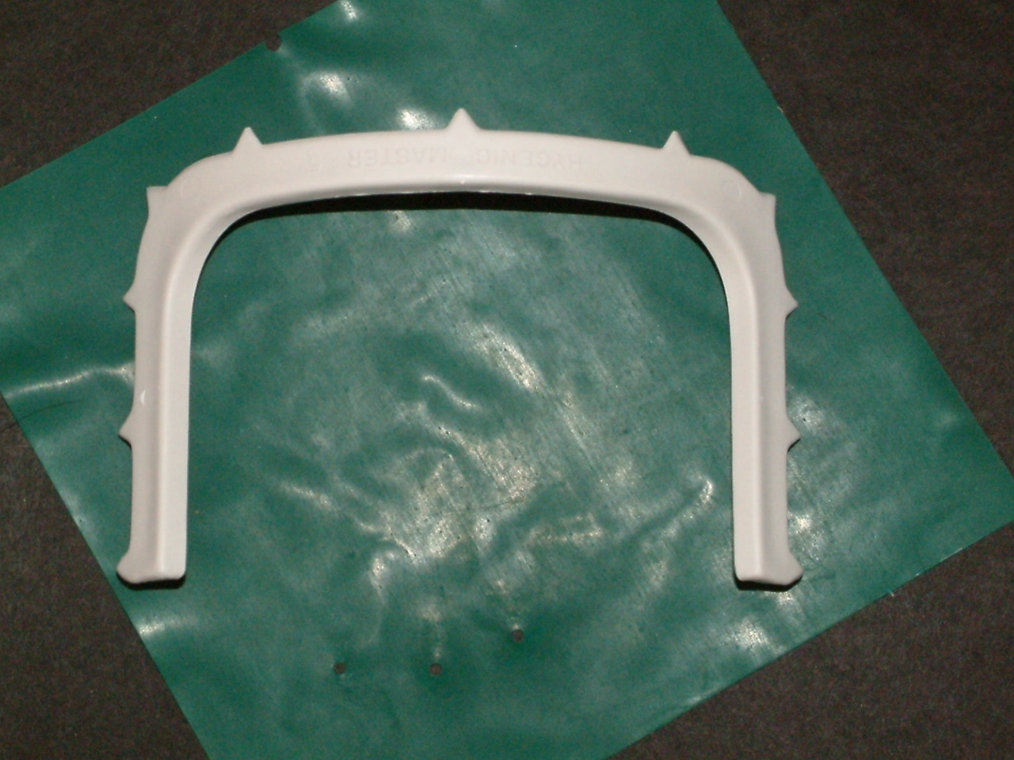
What is It?
Frame-Rubber Dam

Slide 21
What is It?
Rubber Dam Template

Slide 22
What is It?
Clamp-Rubber Dam-#14

Slide 23
What is It?
Rubber Dam Clamp Holder/Forcep

Slide 24
What is It?
Rubber Dam Punch

Slide 25
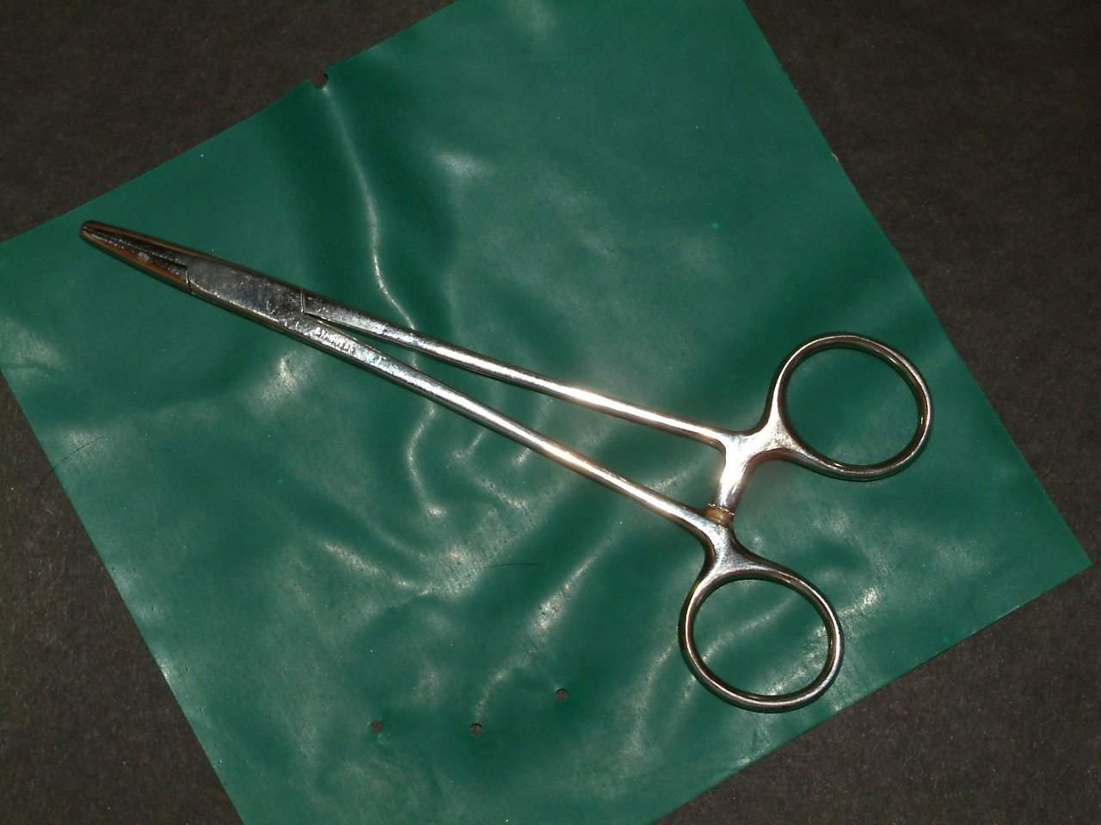
What is It?
Needle Holder

Slide 26
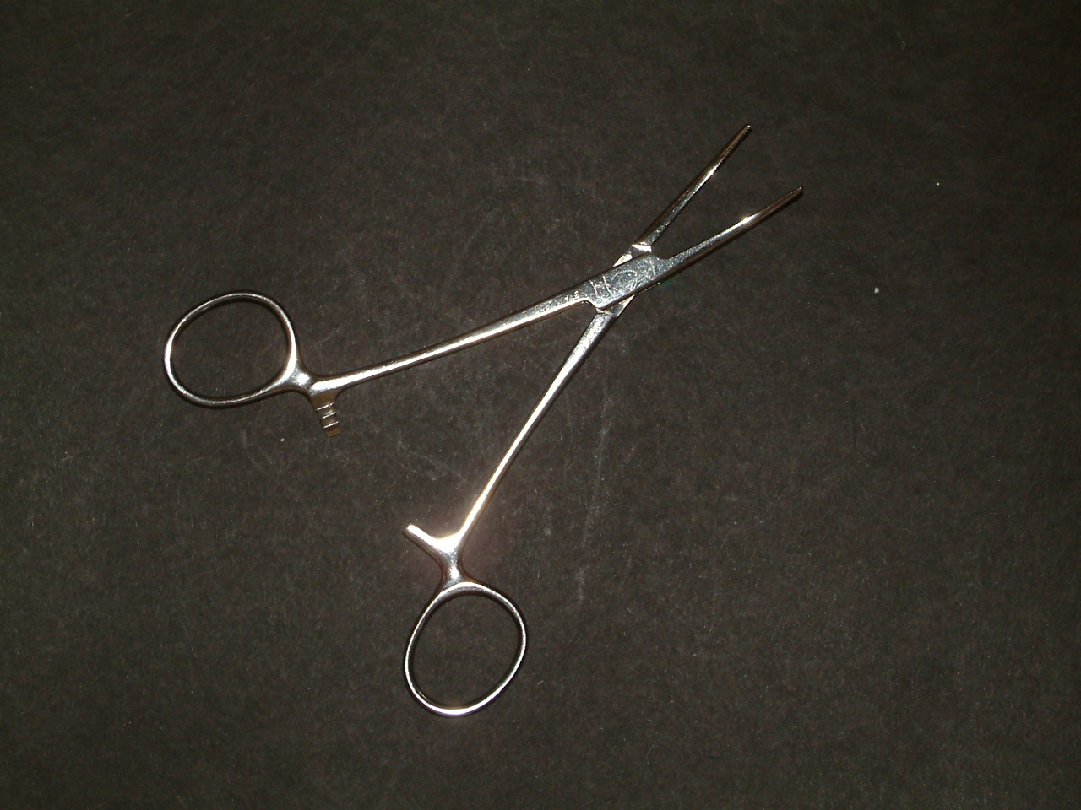
What is It?
Hemostat--curved

Slide 27
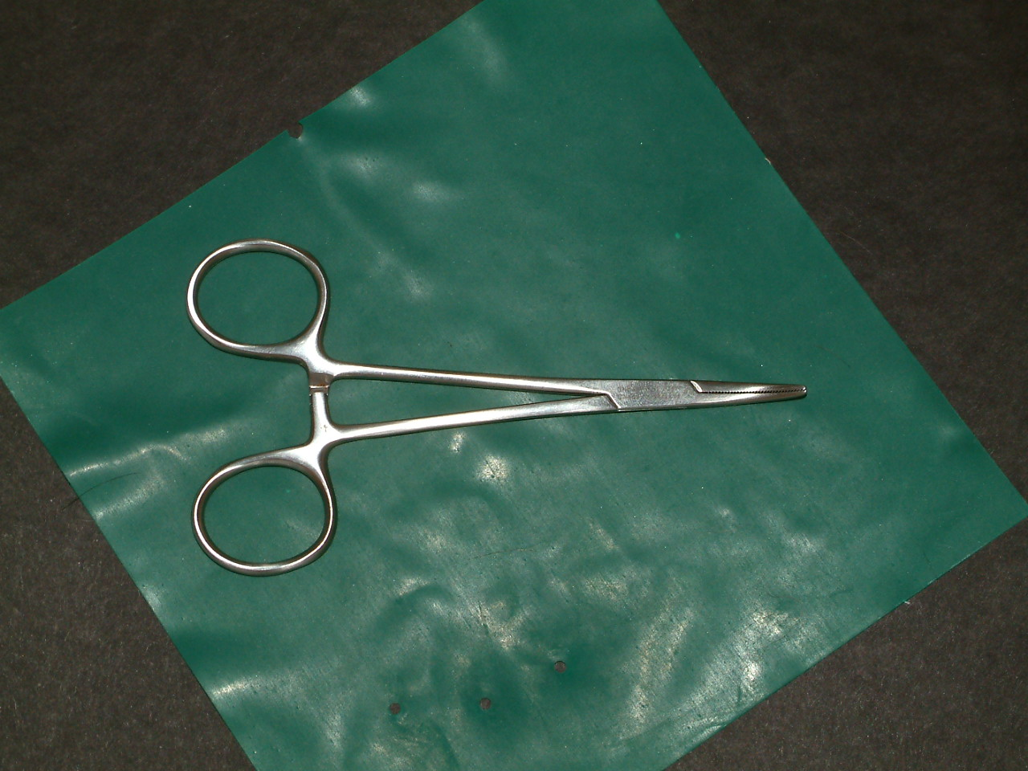
What is It?
Hemostat-Curved-Locking-Closed

Slide 28
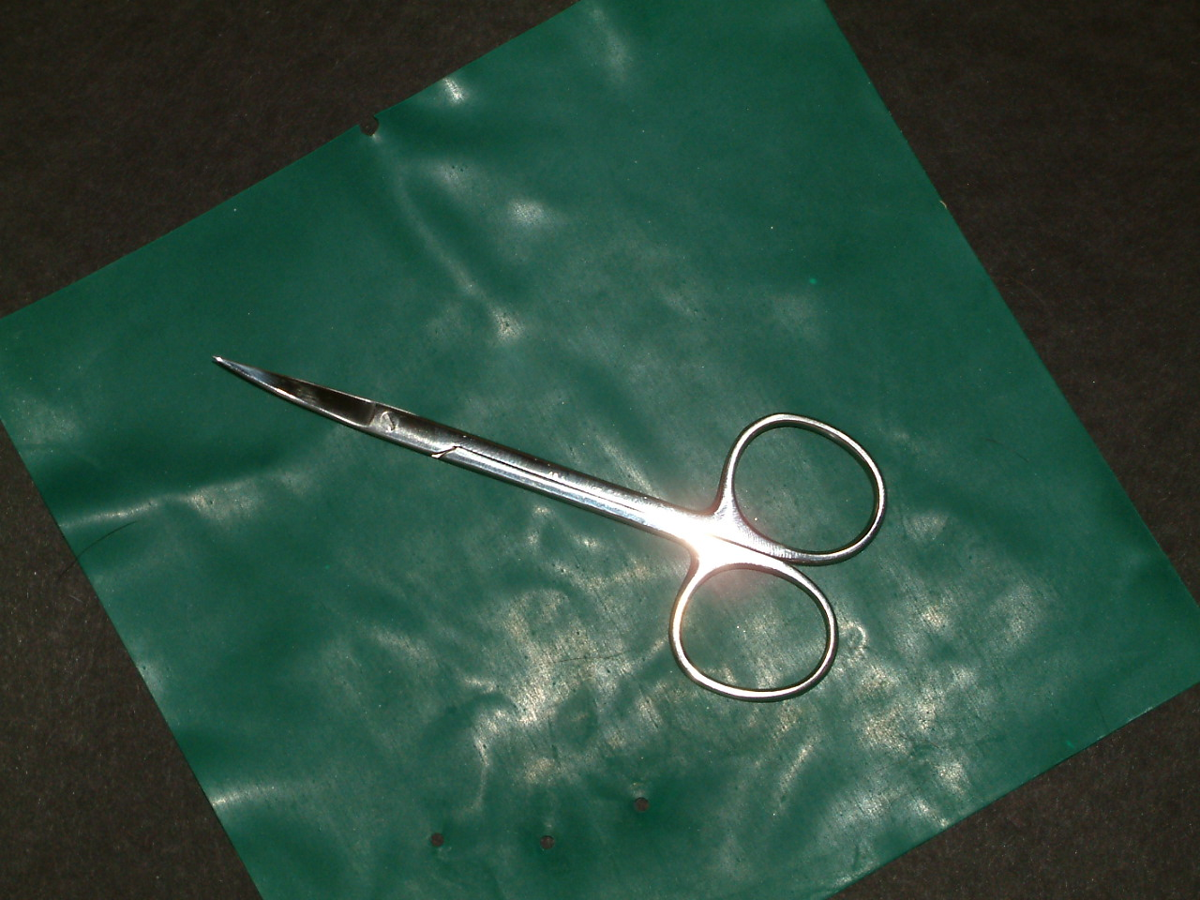
What is It?
Scissors-Iris-Curved

Slide 29
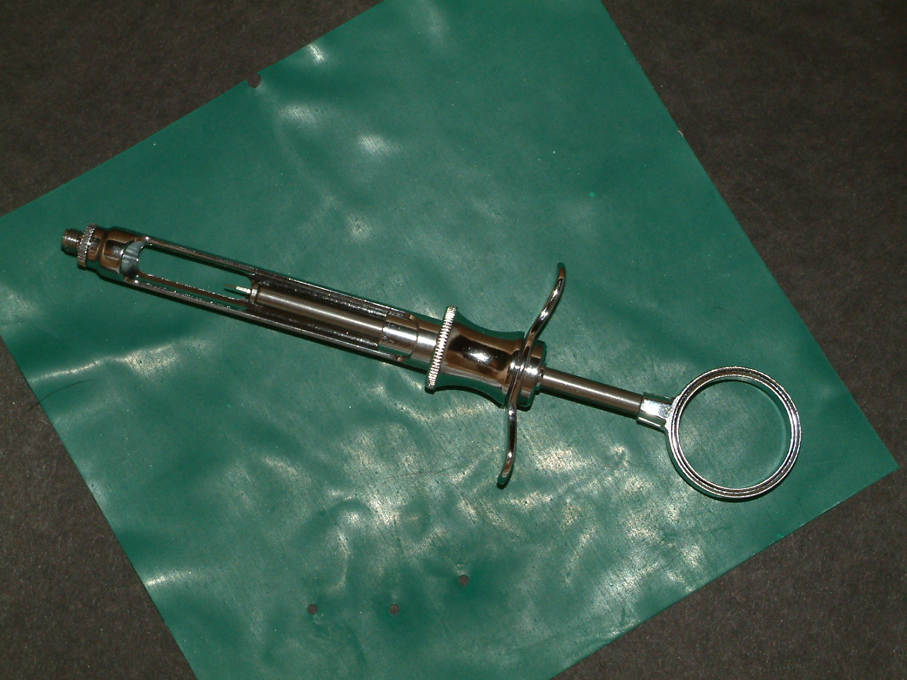
What is It?
Syringe-Aspirating

Slide 30
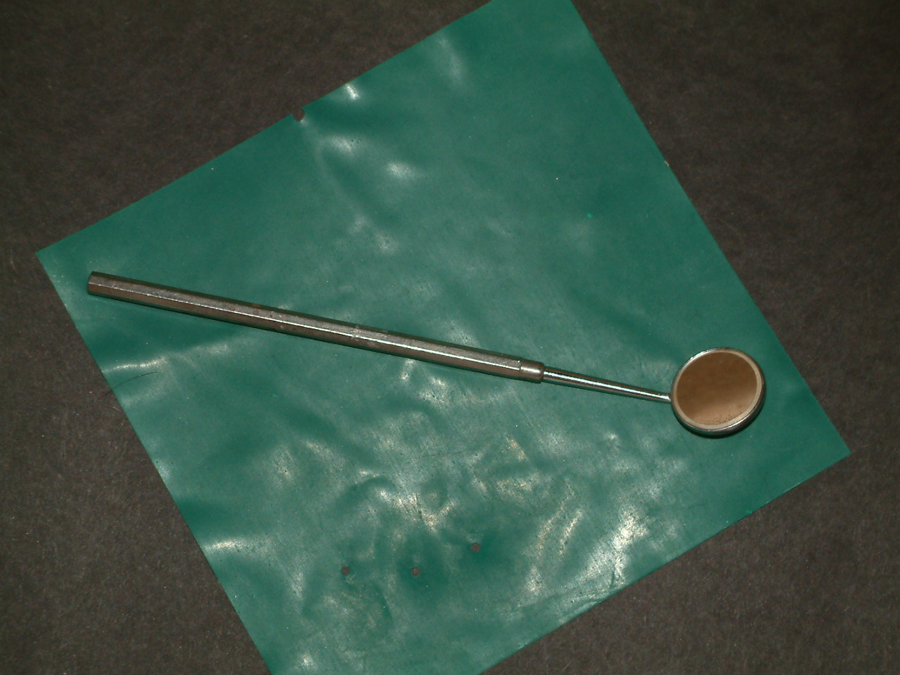
What is It?
Mouth Mirror

Slide 31
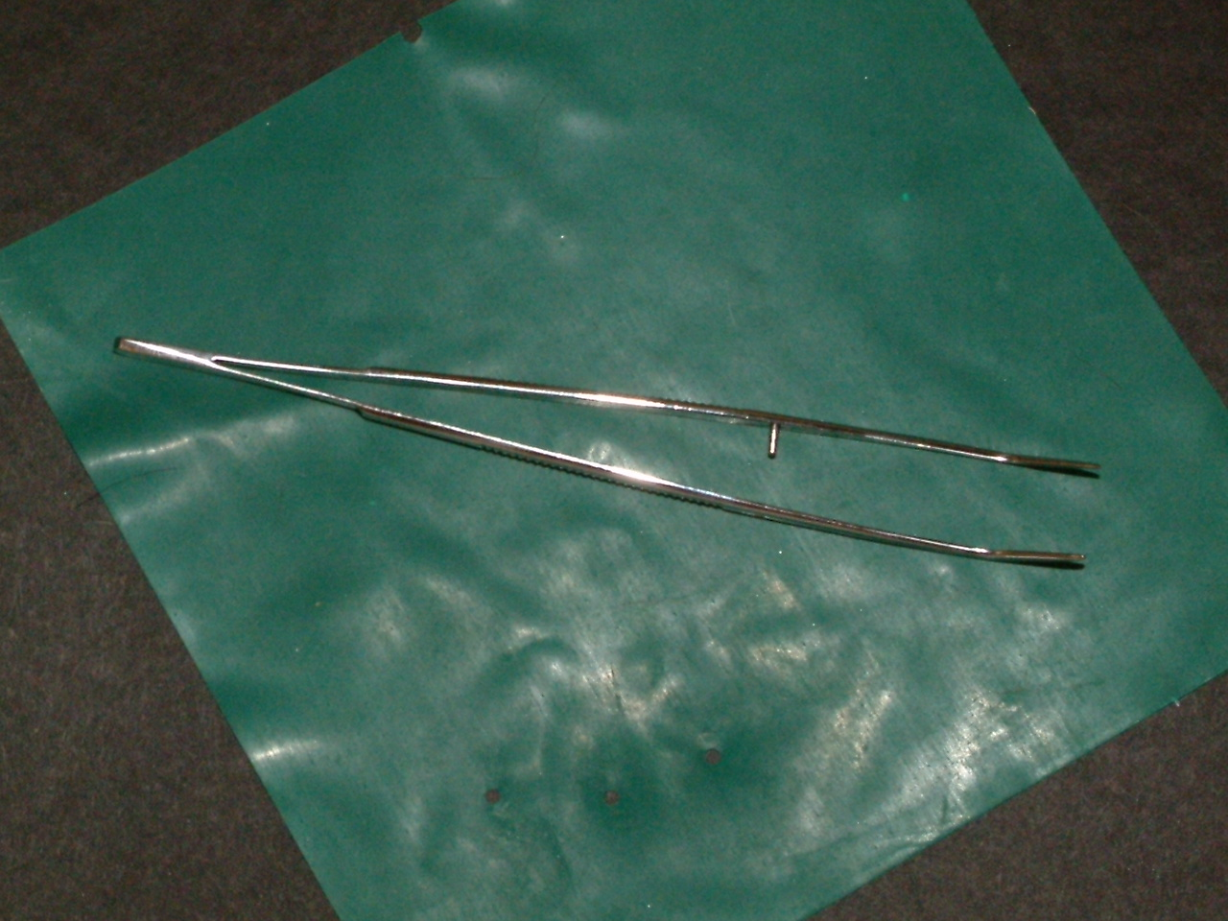
What is It?
Forceps-Cotton
Forceps-Cotton

Slide 32
What is It?
Explorer

Slide 33
What is It?
Periodontal Probe

Slide 34
What is It?
Periodontal Probe

Slide 35
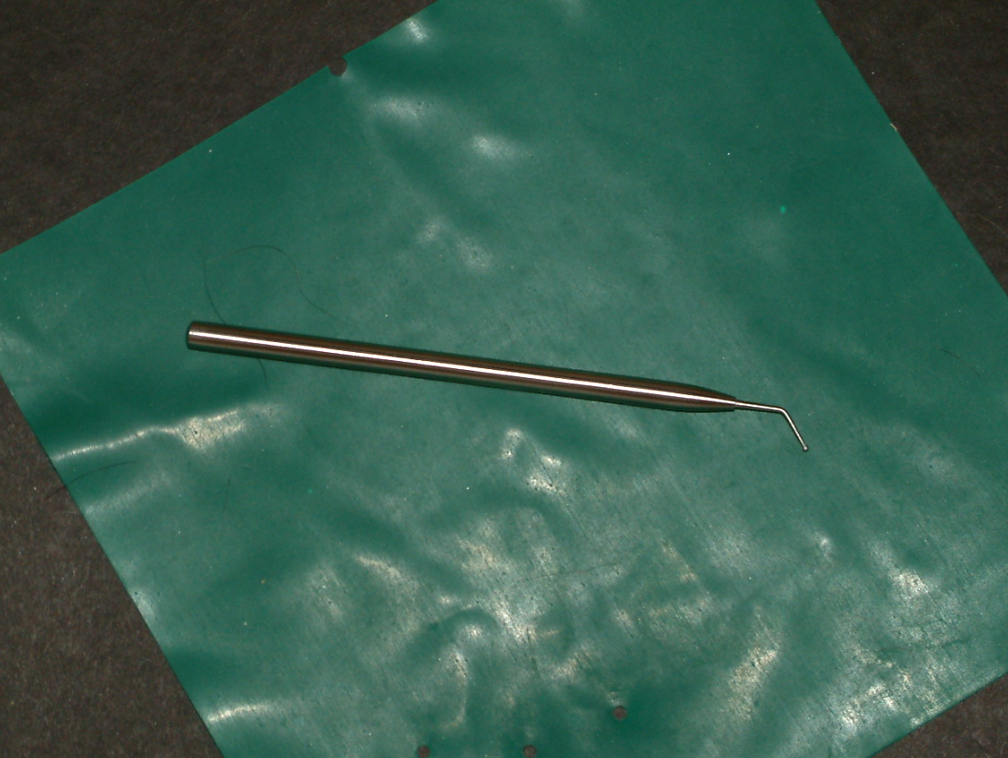
What is It?
Dycal Applicator Instrument

Slide 36
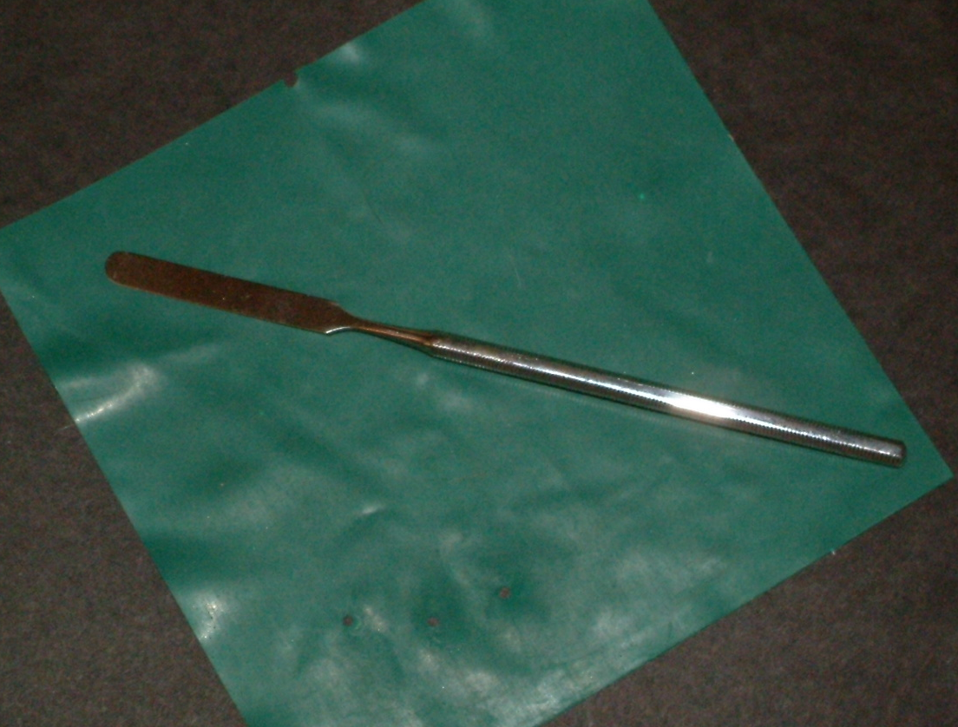
What is It?
Spatula-#124

Slide 37
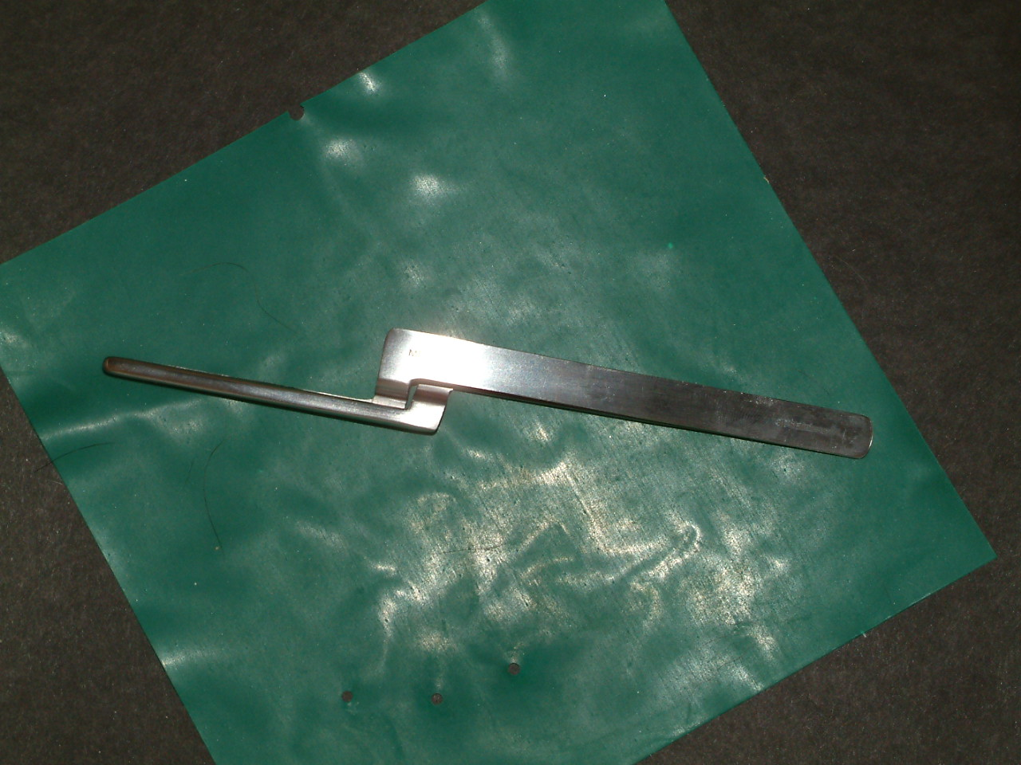
What is It?
Articulating Paper Holder

Slide 38
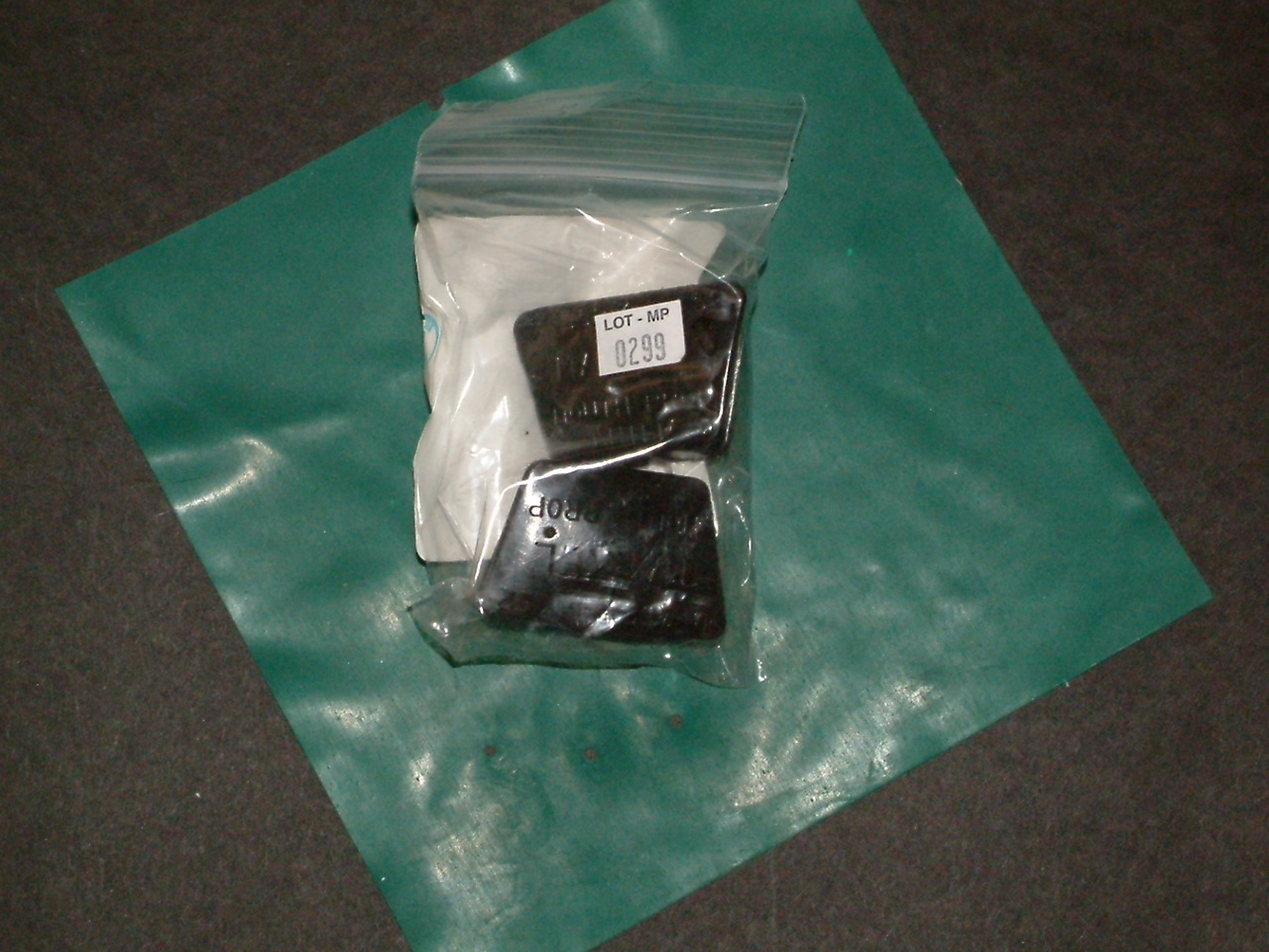
What is It?
Bite Blocks

Slide 39
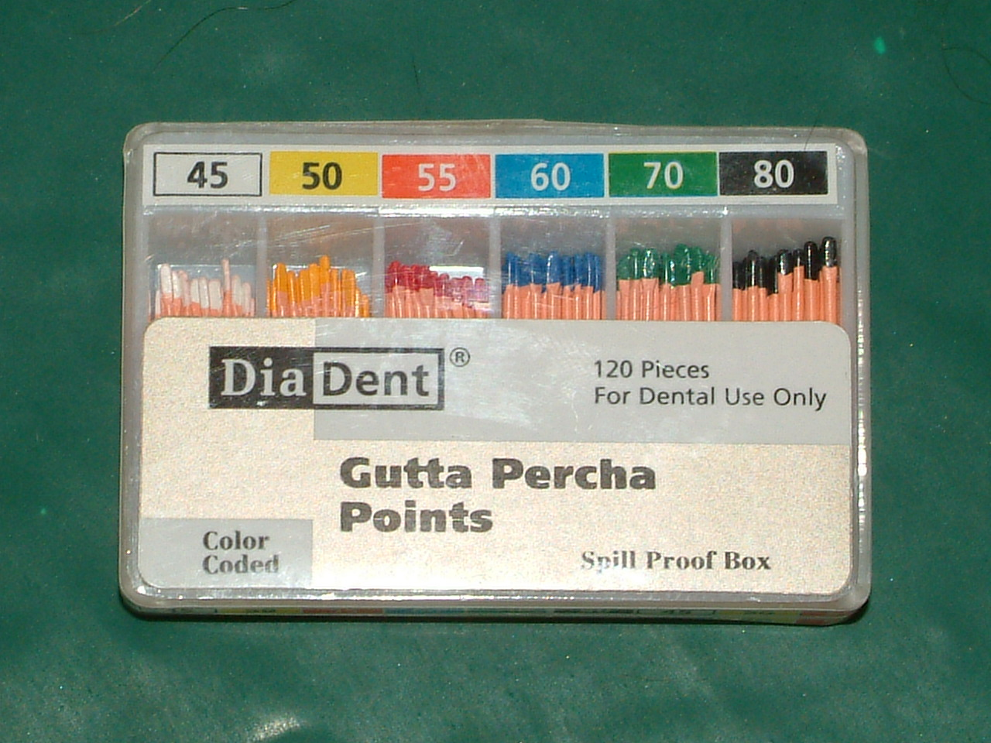
What is It?
Gutta Percha: a thermoplastic material to fill the canal of the tooth

Slide 40
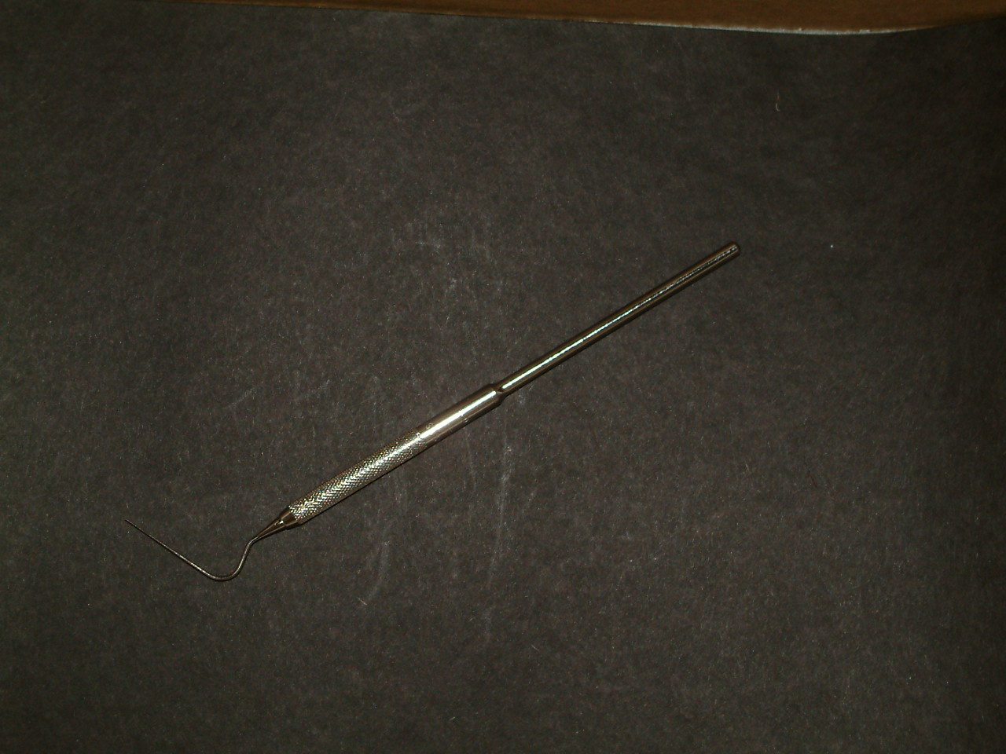
What is It?
Root Canal Spreader

Slide 41
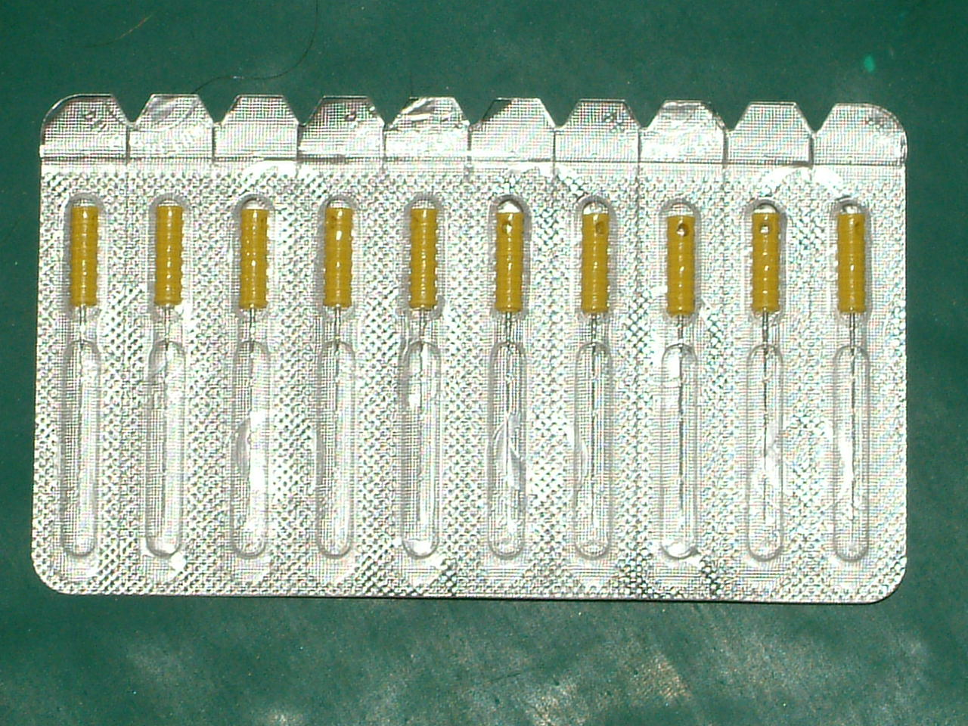
What is It?
Endodontic Broaches

Slide 42
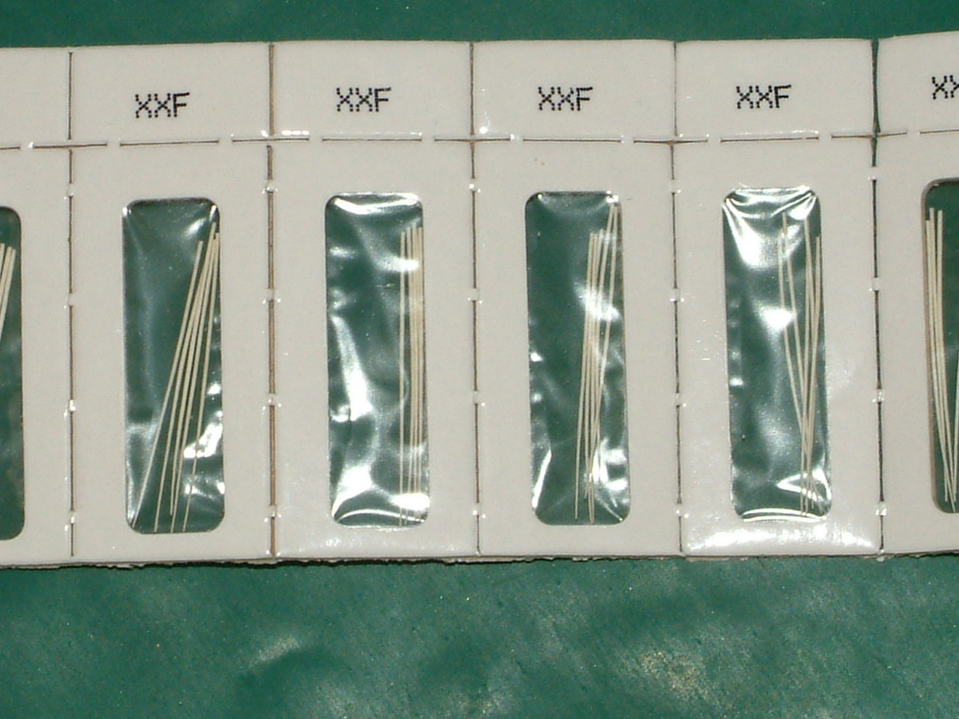
What is It?
Paper Point – Absorbent -Endodontics

Slide 43
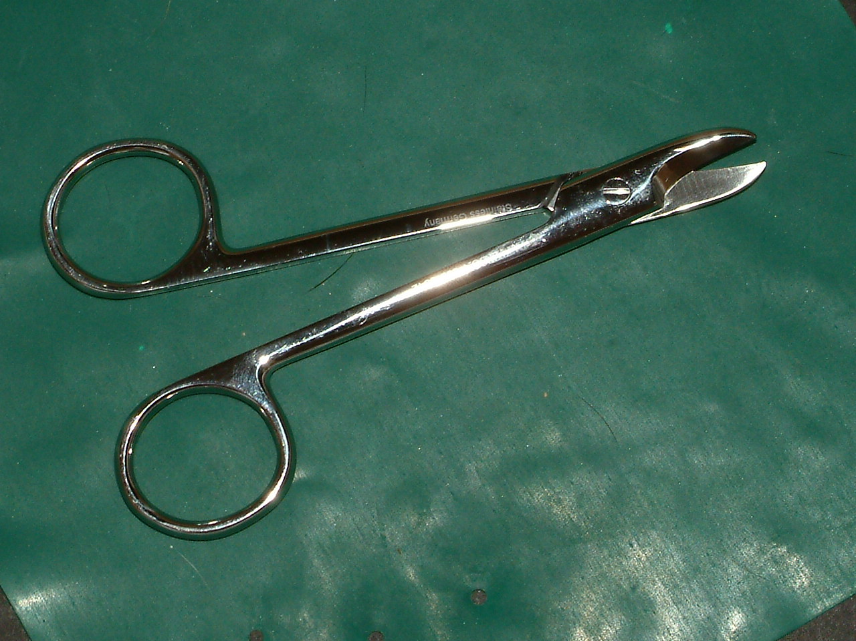
What is It?
Scissors-Crown and Bridge

Slide 44
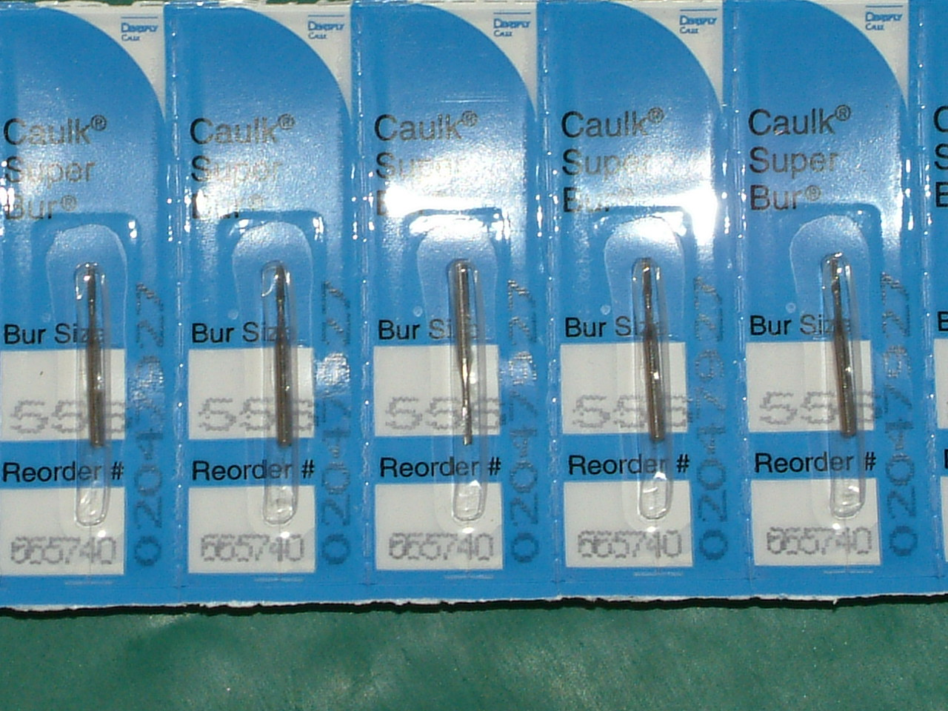
What is It?
Burs-Friction Grip (FG)

Slide 45
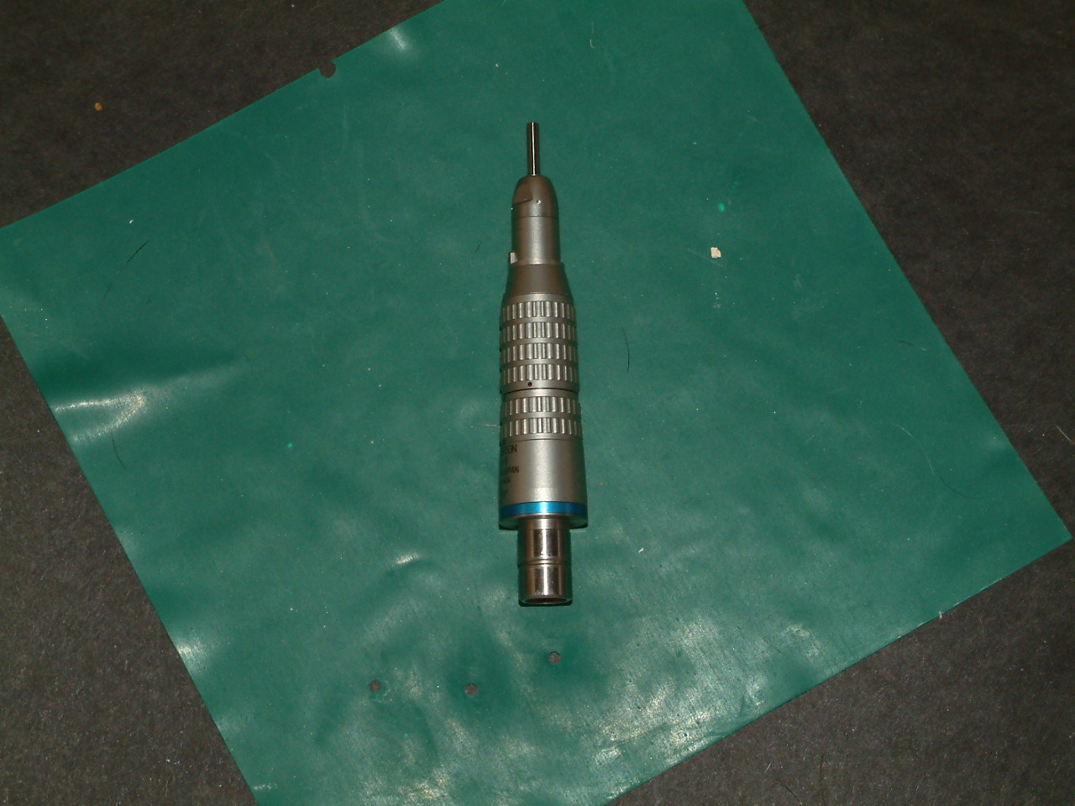
What is It?
Nose Cone—Low Speed—Straight Handpiece (HP)

Slide 46
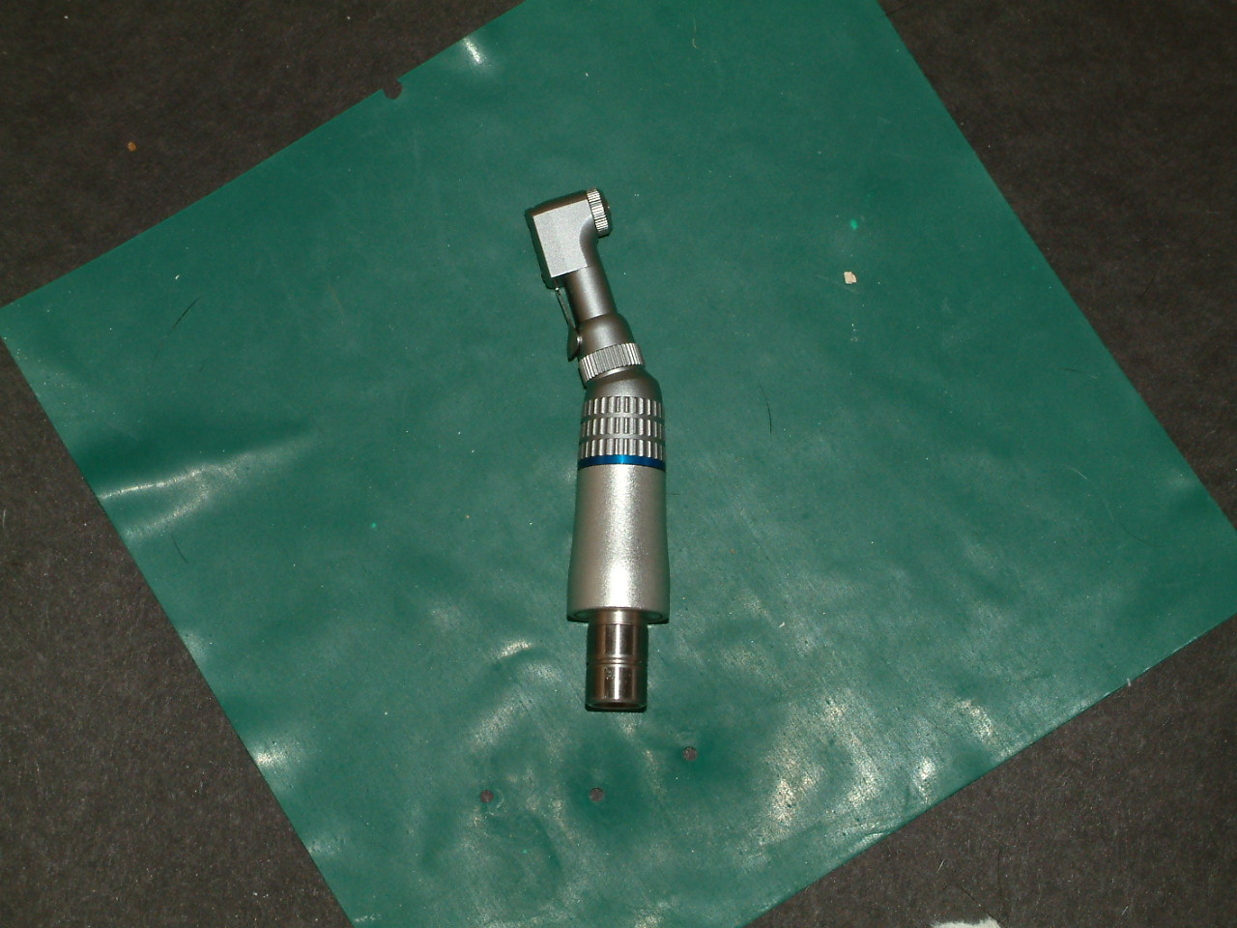
What is It?
Contra Angle Attachment—Low Speed—Straight HP

Slide 47
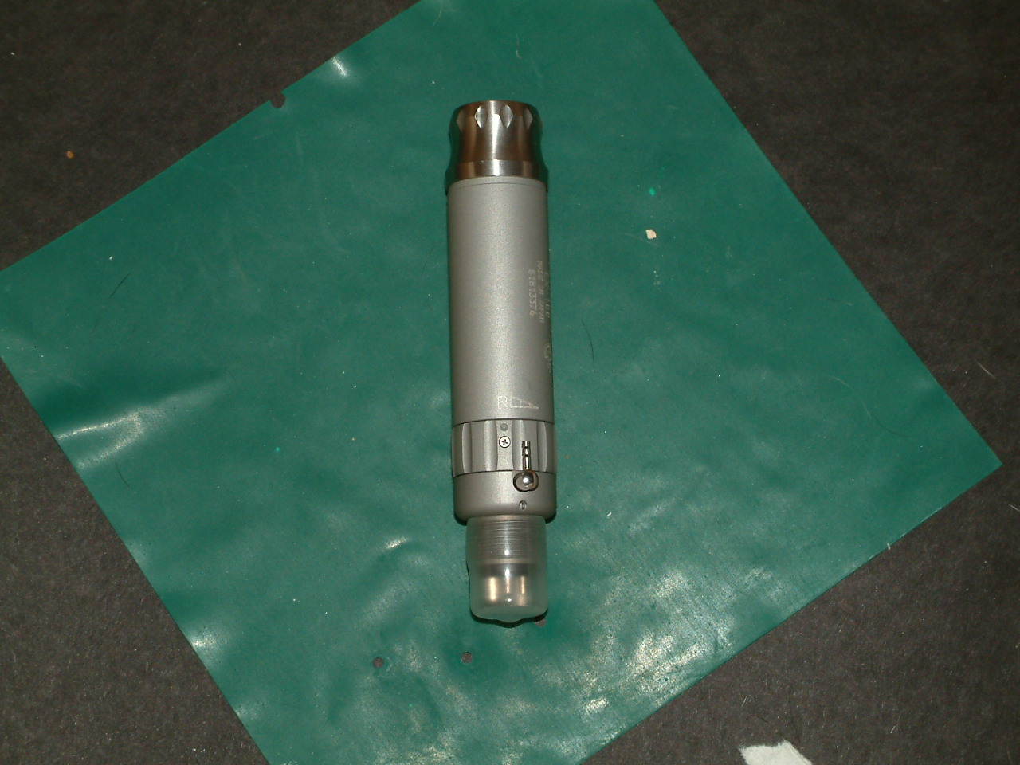
What is It?
Motor Low Speed—Straight HP

Slide 48
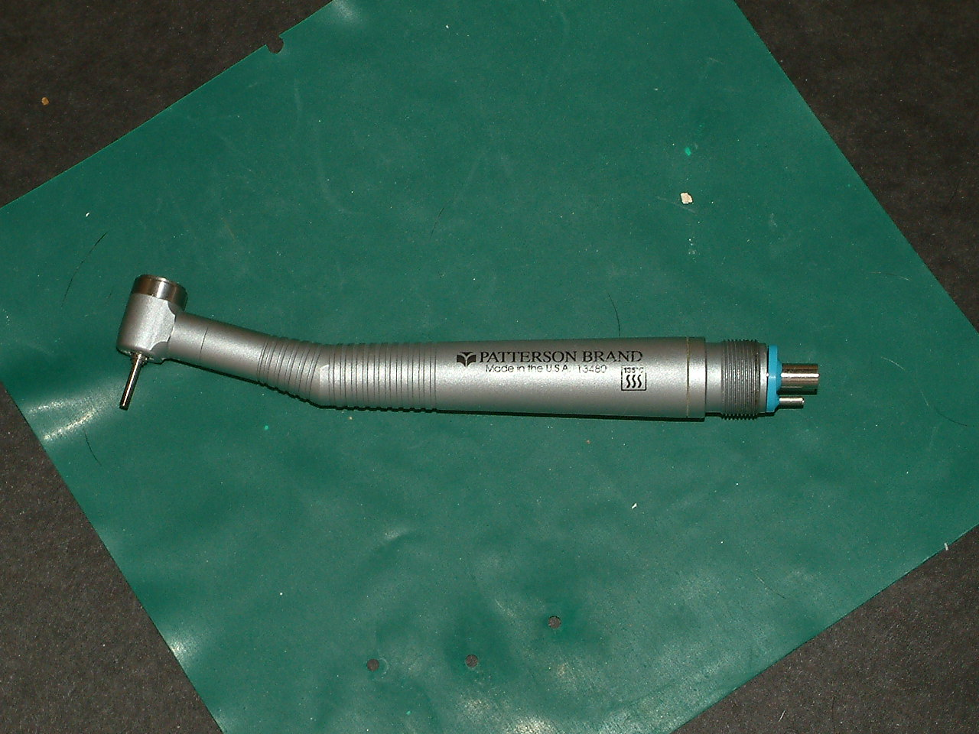
What is It?
Handpiece-Friction Grip (FG) High Speed

Slide 49
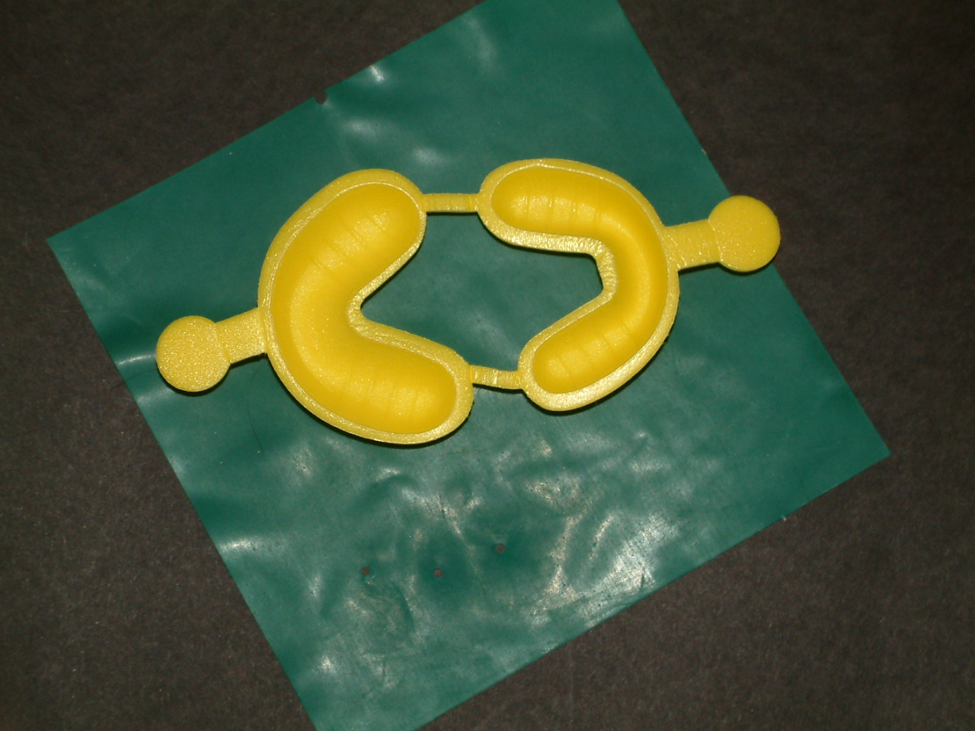
What is It?
Tray-Fluoride Gel

Slide 50
What is It?
Impression Tray-Disposable-Mandibular

Slide 51
What is It?
Lab Spatula

Slide 52
What is It?
Lab Knife

Slide 53
What is It?
Flexi-Bowl

Slide 54
What is It?
HVE-High Velocity Evacuator
Saliva Ejector

Slide 55
What is It?
Cotton Rolls

Slide 56
What is It?
2x2 Cotton Gauze

Slide 57
What is It?
Face Mask w/ Ear Loops

Slide 58
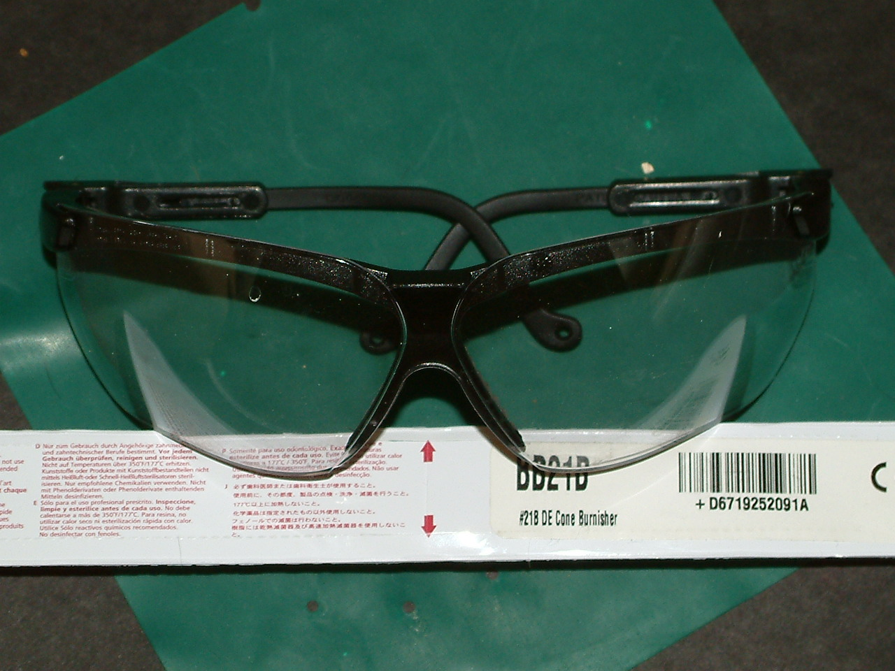
What is It?
Protective Eyewear

Slide 59
What is It?
Disclosing Solution

