Slide 1
Determine Nutrient Requirements of Horses
Equine Science

Slide 3
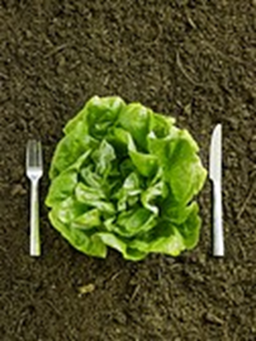
Imagine you only ate lettuce—what nutrients would you be missing?
Would taking a multivitamin fix your nutrition issues?

Slide 4
Horses have a unique digestive system and thus have specific nutritional requirements
Just like if you only ate lettuce, horses must have their nutrition tailored to their specific needs.

Slide 5
Objectives
Today we will:
Identify the digestive system of the horse
Determine the importance of adequate nutrition in horses for body condition score
Identify nutritional requirements for mature, growing, working, pregnant, and lactating horses
Discuss feeding practices in horses
Analyze a feed tag to determine feeding practices

Slide 6
Let’s start by identifying the digestive system of the horse

Slide 7
Horses are Unique they are considered a Hind Gut Fermenter
This means that they use bacteria in the Caecum to digest roughages (hay and grass).
Cows are ruminants (a four compartment stomach)
Though horses and cows both digest roughage, they way they do it is very different

Slide 8
Nutritional Requirements
The first step in nutrition is knowing what you are feeding. Remember, horses live a lot longer than most other livestock used for food. Feeding them can have a huge impact on their lifespan, productivity, and performance. We feed based on category:
Maintenance
Growth
Pregnancy and Lactation
Work

Slide 9
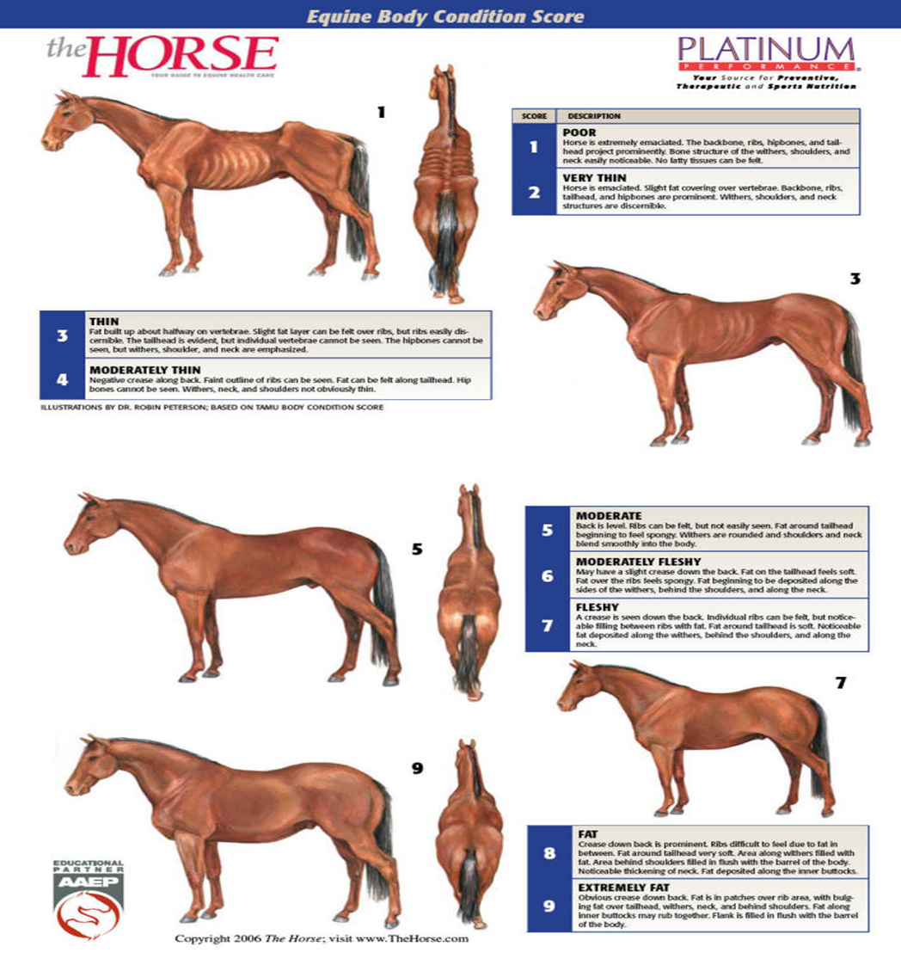
Body Condition Score
Horses at the extremes will need to have requirements adjusted to move them toward the middle of the score (around a 5).

Slide 10
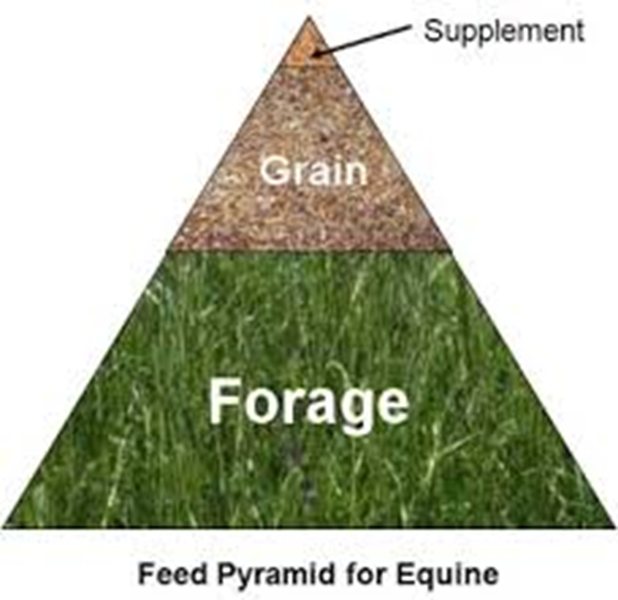
What Do We Feed
Most feeds we purchase are already balanced for adequate nutrition.
Typically horses also receive about 10% of their body weight in forage in the form of pasture grazing or hay.
We should be careful about adding supplements. Just because they sound like a good idea does not mean they can’t hurt your horse.
A balanced ration has everything they need!

Slide 11
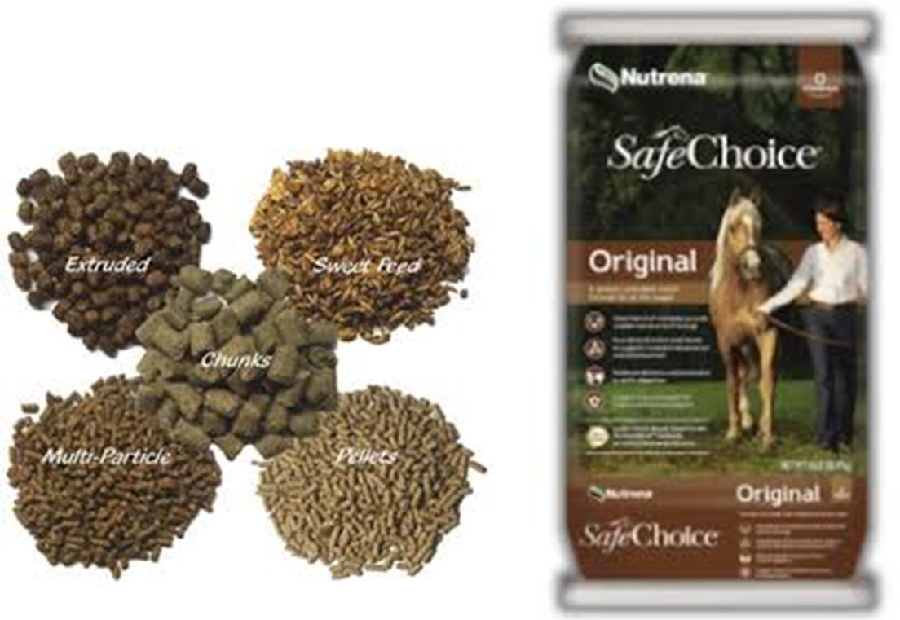
What is in my feed?
Energy
Protein and Amino Acids
Minerals
Vitamins
Feed comes in different forms
Textured (sweet feed)
Pellets
Mulit-particle
Chunks
Extruded (like dog food)

Slide 12
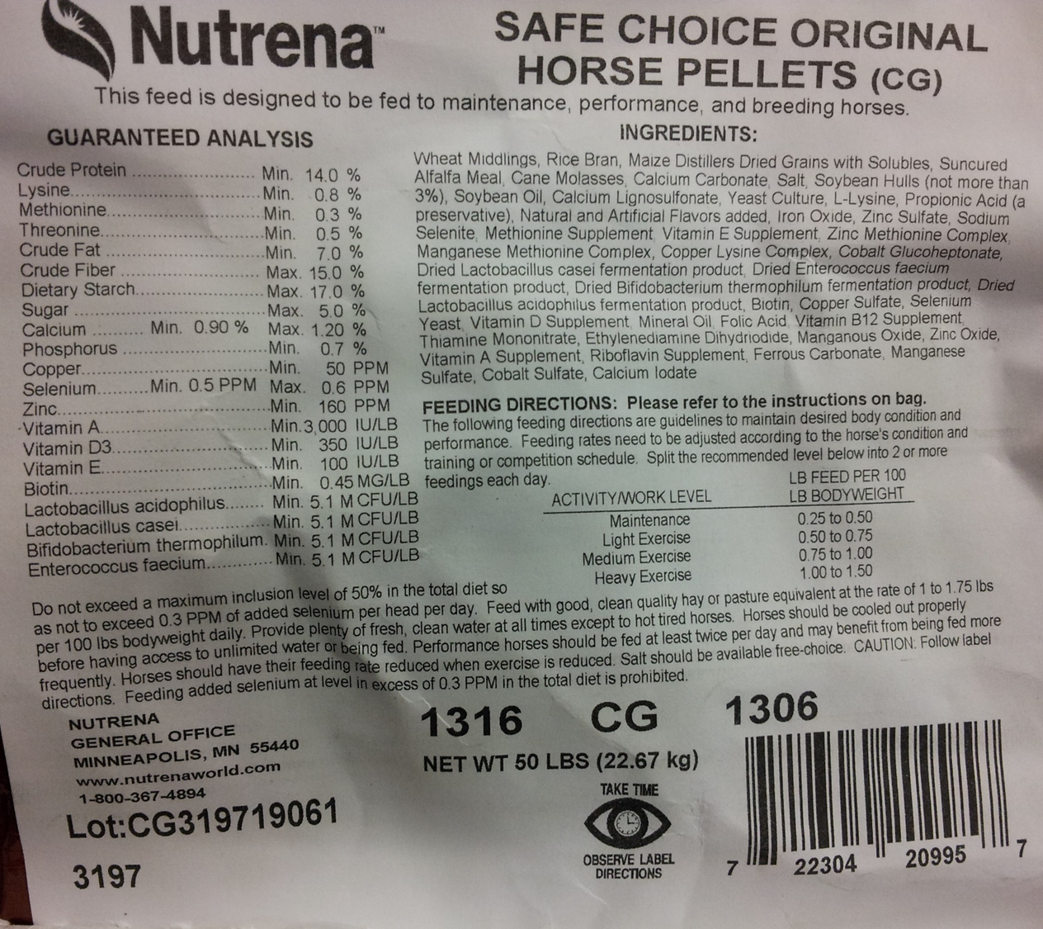
Feed Tag Trivia
What is the percentage of protein in this feed?
What is the percentage of energy (hint: FAT) in this feed?
What type of horses should receive this feed?
How much would I feed a 1000 pound horse at the maintenance level per day?
How much hay is recommended with this feed?
If I am feeding a 1000 pound horse, how much hay would I feed per day?

Slide 13
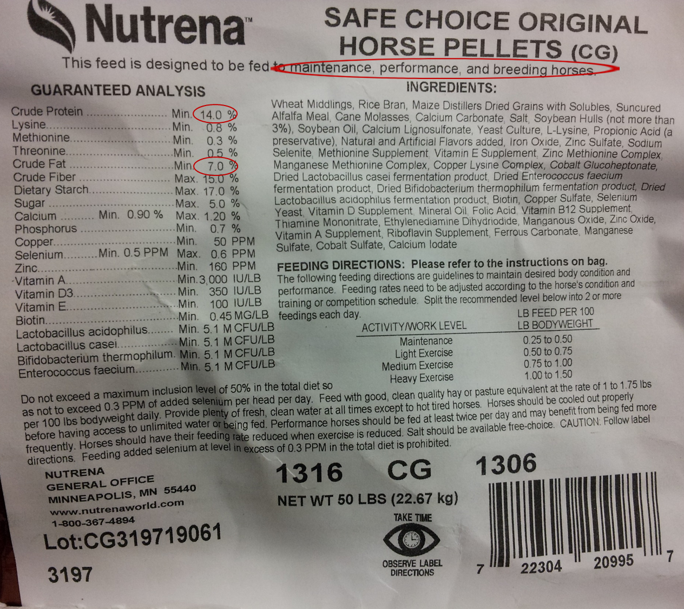
Feed Tag Trivia
What is the percentage of protein in this feed? 14%
What is the percentage of energy (hint: FAT) in this feed? 7%
What type of horses should receive this feed? Maintenance, performance, and breeding

Slide 14
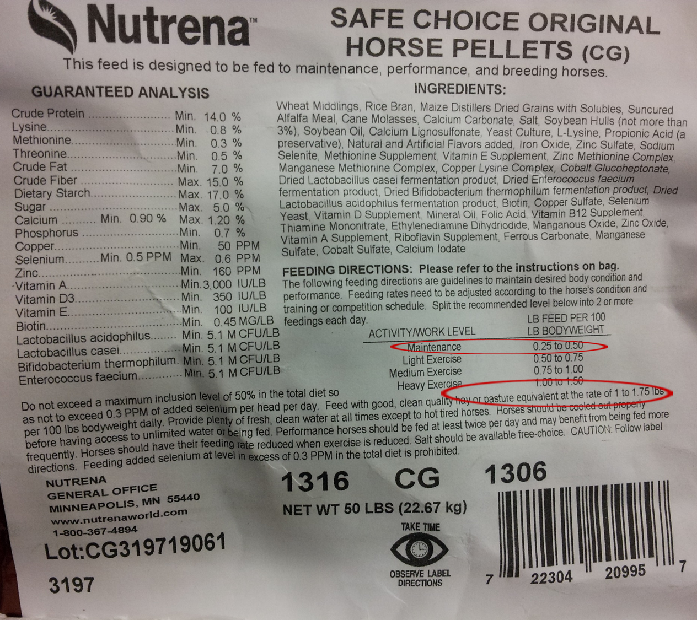
Feed Tag Trivia
How much would I feed a 1000 pound horse at the maintenance level per day? (1000/100)x.25=2.5 Ibs/day
How much hay is recommended with this feed? 1 to 1.75 lbs per 100 lbs bodyweight daily
If I am feeding a 1000 pound horse, how much hay would I feed per day? 10-17.5 lbs of hay per day

Slide 15
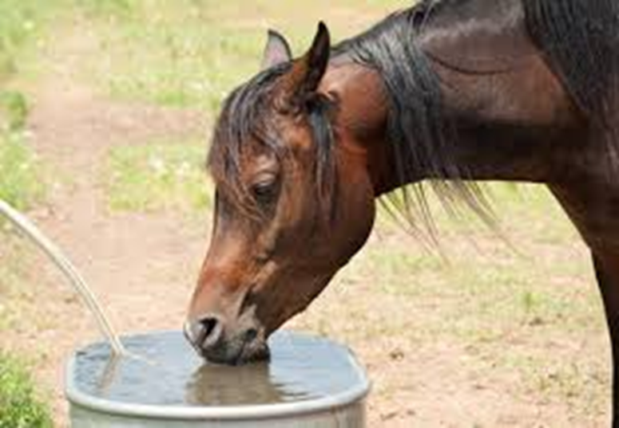
What to Feed
High quality commercially mixed feed,
High quality pasture or hay,
We also need to be sure that there is an adequate supply of clean, fresh water

Slide 16
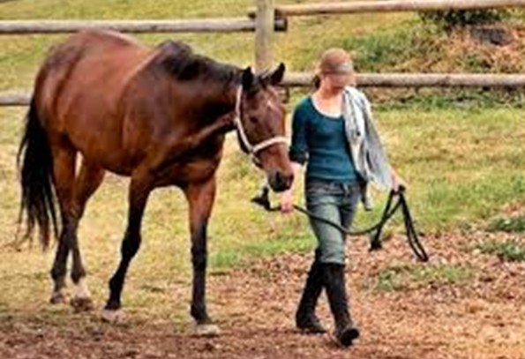
Your Turn
Write your own scenario for a horse you need to feed. Include the following information about your horse in your scenario:
Age and use
Weight in pounds
Level of activity
Body Condition Score
Confinement, pasture, etc.
Using the feed label, determine how much your horse should be fed for concentrate (feed) and roughage (hay/pasture). Be prepared to share with your classmates.

Slide 17
Questions for Review
What type of digestive system does the horse have?
What is a body condition score?
How do we use the body condition score in equine nutrition?
Are nutrient requirements higher or lower for which of the following?
Pregnant or lactating mare
Working horse such as a barrel racer
Young growing horse
Mature horse turned out on pasture
What is a concentrate?
What is a roughage?

Slide 18
Questions for Review
What type of digestive system does the horse have? Hind Gut Fermenter
What is a body condition score? Scoring system from 1-9 (thin to fat)
How do we use the body condition score in equine nutrition?
Adjust up or down
Are nutrient requirements higher or lower for the following?
Pregnant or lactating mare HIGHER
Working horse such as a barrel racer HIGHER
Young growing horse HIGHER
Mature horse turned out on pasture LOWER
What is a concentrate? Mixed feed such as pellets or sweet feed
What is a roughage? Hay or pasture

Slide 19
Summary
Read the LABEL– be sure you are feeding what you should be feeding.
If your horse is not responding as anticipated, you should ask a veterinarian to determine if there are problems with teeth, etc.
Feeding horses isn’t complicated, but it is one of the most important jobs we have in taking care of our horse.

Slide 20
References
Basic Guide to Horse Judging (with judging activity): http://www2.ca.uky.edu/agripedia/agmania/horse/
AQHA Judges Manual—Halter: http://www.aqha.com/~/media/FA71659B161048F1B85C635362E3EFB5.ashx
Texas A&M Online Horse Judging: http://www.usd364.org/pages/ffa/horse/halter%20mares.pdf
Fort Bend Horse Judging Practice: http://campuses.fortbendisd.com/campuses/documents/Teacher/2012%5Cteacher_20120111_1503.pdf
Houston Livestock Show and Rodeo Horse Judging Contest 2015—Aged Mares: https://www.youtube.com/watch?v=gxk7q9d05Eo&feature=youtu.be
Houston Livestock Show and Rodeo Horse Judging Contest 2015—Senior Geldings: https://www.youtube.com/watch?v=k1fZN3GunSw&feature=youtu.be
Houston Livestock Show and Rodeo Horse Judging Contest 2015—Junior Geldings: https://www.youtube.com/watch?v=kxciOlhBK0g&feature=youtu.be
Houston Livestock Show and Rodeo Horse Judging Contest 2015—Junior Mares: https://www.youtube.com/watch?v=_ZgShXP6TMw&feature=youtu.be
Horse Judging Game: http://www.horse-games.org/Horse_Judging.html
EduGamer Horse Judging Game: http://www.edugamer.org/app/playGame.aspx?userGameId=4555

Slide 21
Texas College and Career Readiness Standards
English Language Arts: V. Research, B, 1, a-b
Science: VI: Biology, E. 1, F. 1-2
Social Studies: IV. Analysis, Synthesis, and Evaluation of Information. B, 2-4; V. Effective Communication. A. 1-2.

