Slide 1
Developing a Promotional Plan

Slide 3
Identify the Target Customer
  Demographics
  Needs

Slide 4
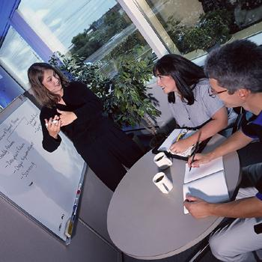
Set Promotional Goals
  Specific Goals
  Measurable Goals

Slide 5
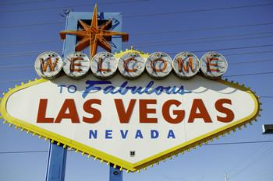
Develop a Promotional Budget
  All promotion costs except publicity
  Percentage of expected sales

Slide 6
Select the Promotional Mix
  Blending of the promotional elements of advertising, sales promotion, publicity, and personal selling
  Based upon targeted customers

Slide 7
Advertising
  Traditional advertising-expensive but effective to reach Baby Boomers with more income to buy high-end products
  Advergame-an electronic or online game that incorporates marketing content to promote a product or service

Slide 8
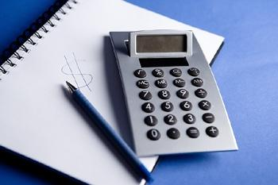
Measure the Results
  Quantitative Measurement
  Qualitative Measurement

Slide 9
Promotional Trends
  Technology
  Social Network
  Movie Promotions
    Trailers
    Well-coordinated promotional plan
    Pay-per-view advertisements

Slide 10
Promotional Trends
  In-house Plan
  Hire an Outside Business
  Advertising Age – online magazine

Slide 11
Positioning a Product
  Differentiating the company’s products from competitors
  Status, price, brand recognition, and other factors
  Celebrity endorsements

Slide 12

Promotional Events
  Themed Events
    Event Involvement
    Event Coordination
    Trade Shows

Slide 13
Awarding the Best
  Oscars/Academies (motion pictures)
  Grammys (music)
  Emmys (television, sports programming, newscasts, documentaries)
  Tonys (theater)
  Cannes Film Festival (international films)

