Slide 1
Disaster and Emergency Management
  Security Services

Slide 3
What is Terrorism?
Defining terrorism is difficult. Some options are:
  The systematic application of violence to promote or maintain a political or religious system.
  The unlawful use of force and violence against persons or property to intimidate or coerce a government, a civilian population, or any segment thereof, in furtherance of political or social objectives (Code of Federal Regulations).

Slide 4
What is Terrorism?
  The use of force or violence against persons or property in violation of criminal laws of the U.S. for purposes of intimidation, coercion, or ransom.
  Premeditated, politically motivated violence perpetrated against noncombatant targets by sub-national groups or clandestine agents.

Slide 5
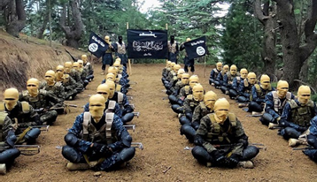
Characteristics of Terrorist Groups
  Adapt as times change.
  Most are unsuccessful in their long-term goals.
  Work with other organizations, including organized crime groups,
  to finance activities and mobilize resources.
  Creative in their tactics – anything can happen.

Slide 6
How does the U.S. Address Terrorism?
Developed the Department of Homeland Security (DHS) in 2003, consolidating 22 separate agencies under one unified organization.
  The first single, federal department with homeland security as its primary objective.
  DHS’ mission is to protect the American people and our way of life from terrorism.
  DHS’ expectations are to work to ensure the highest level of protection and preparedness for the country and its citizens through partnerships with state, local, and tribal governments and the private sector.

Slide 7
How does the U.S. Address Terrorism?
Passed the Homeland Security Act (HLS) in 2002, a direct result of the terrorist acts of 9/11/01.
  HLS’ mission is to:
    Prevent terrorist attacks in the U.S.
    Reduce U.S. vulnerability to terrorism.
    Minimize the damage and assist in the recovery from terrorist attacks in the U.S.

Slide 8
How does the U.S. Address Terrorism?
The Private sector prepares by:
  Staging evacuation drills.
  Securing computer networks.
  Increasing protection around critical infrastructure assets.
  Increasing awareness of and security against terrorist attacks and developing response plans in case attacks occur at the workplace.

Slide 9
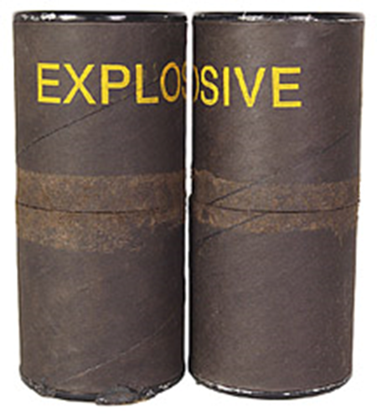
How Does the U.S. Reduce Vulnerability to Terrorism?
Recognize that terrorism takes many forms:
  Biochemical warfare.
  Biological weapons.
  Bio-terrorism.
  Agro-terrorism.
  Explosives or other forms,
  such as on 9/11.
  Nuclear Weapons.

Slide 10
How Does the U.S. Reduce Vulnerability to Terrorism?
Protect critical infrastructure assets:
  Communications – put plans in place to reassure, instruct, and share information to prevent rumors and panic.
  Leadership – review emergency planning; know how to respond in a disaster, and how to appropriate the necessary resources.
  Transportation – plan alternatives for rescuing stranded employees, delivering paychecks, shipping supplies, etc.
  Geographic location – consider diversifying or relocating.
  Personnel backup – succession planning in the event of catastrophic loss.

Slide 11
How Does the U.S. Reduce Vulnerability to Terrorism?
Protect critical infrastructure assets:
  Database backup – some redundancy can be helpful if computers and LANs are destroyed.
    Key dependencies – understand dependence on key vendors in case shipment of supplies is delayed or manufacturing cycles are disrupted.
    Security – review physical and logical security efforts, including the physical security of buildings and the security of IT systems.
    Power supply – consider electrical power systems, oil and gas, and water and food supplies.

Slide 12

How Does the U.S. Reduce the Impact of Natural Disasters?
  Communicate – inform people of approaching storms or fires.
  Protect critical infrastructure assets.

Slide 13
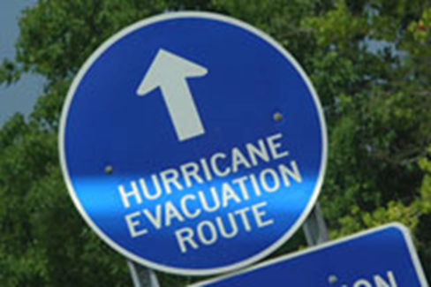
How Does the U.S. Reduce the Impact of Natural Disasters?
  Evacuate – evacuations occur hundreds of times each year as a result of fire, flood, the release of harmful substances via industrial accidents, etc.
  The Federal Emergency Management Agency (FEMA) – reduce the loss of life and property, and protect the nation from all hazards, including natural disasters, acts of terrorism, and other manmade disasters.

Slide 14

What is Private Security’s Job during a Natural Disaster or Act of Terrorism?
  Collaboration between law enforcement agencies and private security organizations is important, even necessary, but has not reached its potential.
  Private security is a key element in protecting our homeland from terrorist attacks because the private sector owns 85 percent of the nation’s infrastructure.

Slide 15
What is Private Security’s Job during a Natural Disaster or Act of Terrorism?
Private security has three main roles:
  Information gathering and sharing to provide early warnings of terrorist
  threats or natural disasters.
  Acting as first responders – private security professionals are often first responders on the scene. Their first priority is to protect people and property until police or other authorities arrive.
  Providing assistance and aid after a terrorist attack or natural disaster.

Slide 16
Resources
  9780205592401, Introduction to Private Security: Theory Meets Practice, Roberson & Birzer, Prentice Hall, 2010.

