Slide 1
Everywhere
you Look, Health Science Touches your Life
  Health Science : Career Exploration

Slide 3

Stop and look around…
  Chances are you have been to the doctor or dentist lately. Your grandmother may have recently stayed in the hospital. New developments in biotechnology may have affected the food you ate for breakfast today.

Slide 4
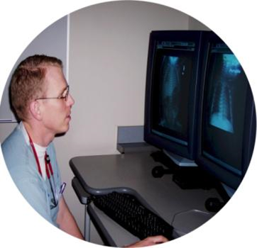
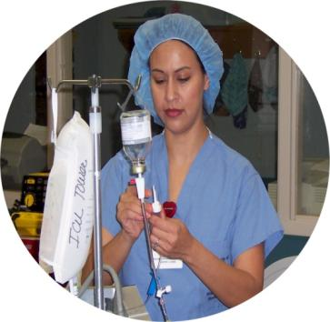
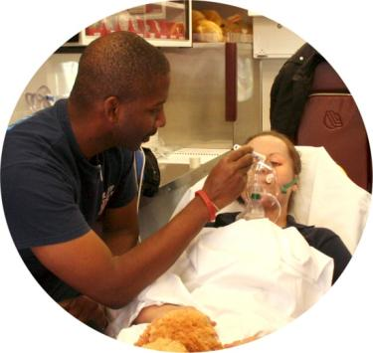
The World of Health Science…
  There are many opportunities within the world of health science. Interested students need to have a solid background in math and science as well as communication, technical and teamwork skills. Education and training can be obtained in high schools, community colleges, universities and technical schools. Through the training programs, learners gain knowledge and skills that lead to workplace learning experiences like job shadowing and internships.

Slide 5
Career Pathways
  The health science career cluster is divided into 5 career pathways. Pathways are grouped by common knowledge and skills required for occupations in these career fields. Each pathway provides instruction as a basis for success in an array of careers and educational pursuits.

Slide 6

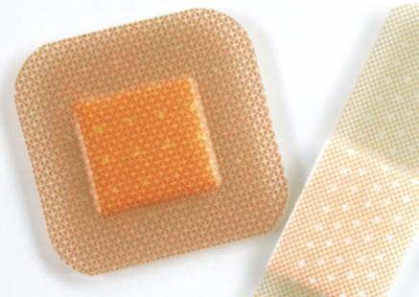

The Five Pathways
  Therapeutic Services
  Diagnostic Services
  Health Informatics
  Support Services
  Biotechnology Research and development

Slide 7

Employment Outlook
  Health Science is the largest and fastest growing industry in the United States. The health care industry employs over 10 million workers in more than 200 careers.

Slide 8
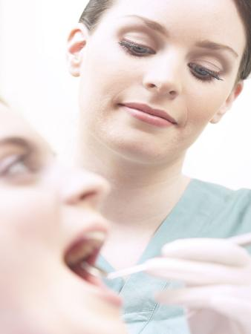



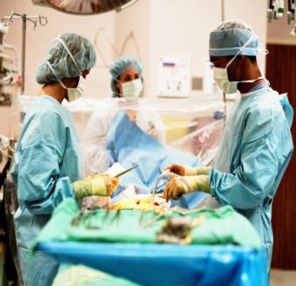
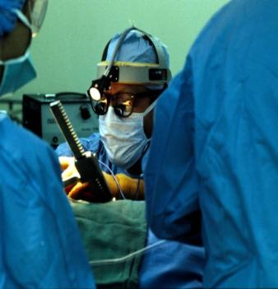
Therapeutic Services
  Careers in therapeutic services are primarily focused on changing the health status of the patient over time. Health professionals work directly with patients and may provide care, treatment, counseling and health education information.

Slide 9
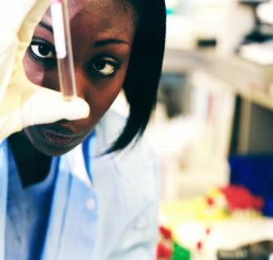
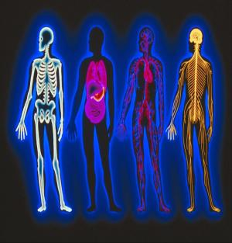
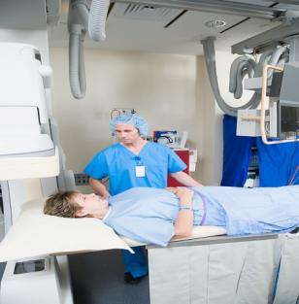
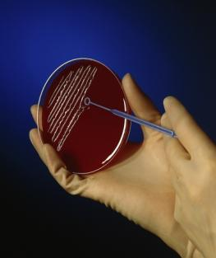

Diagnostic Services
  Careers in diagnostic services use tests and evaluations that aid in the detection, diagnosis and treatment of diseases, injuries or physical conditions.

Slide 10

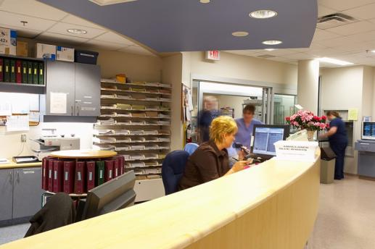

Health Informatics
  The health informatics pathway offers a wide range of career opportunities. Careers range from health care administrators who manage health care agencies to individuals responsible for managing patient data, financial information and computer application related to health care processes and procedures.

Slide 11
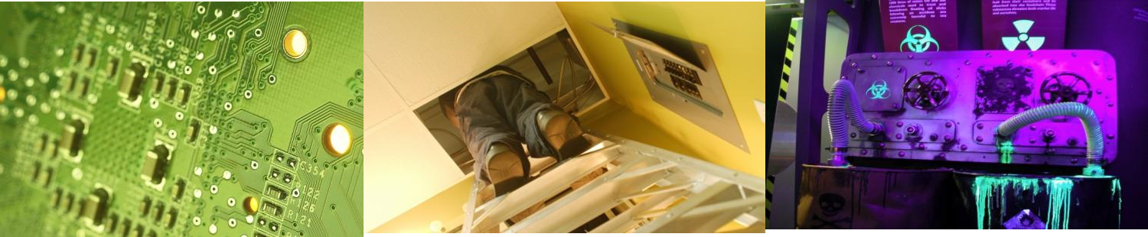
Support Services
  Careers in the support services provide a therapeutic environment for the delivery of health care. Career opportunities range from entry level to management including technical and professional careers.

Slide 12
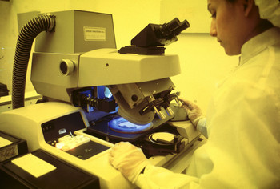

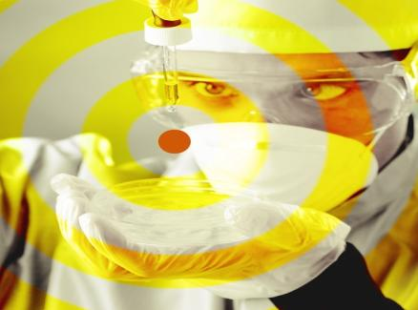
Biotechnology Research and Development
  Careers in the biotechnology research and development pathway involve bioscience research and development as it applies to human health. These are scientists who may study diseases to discover new treatments, invent medical devices or improve the accuracy of diagnostic tests.

Slide 13
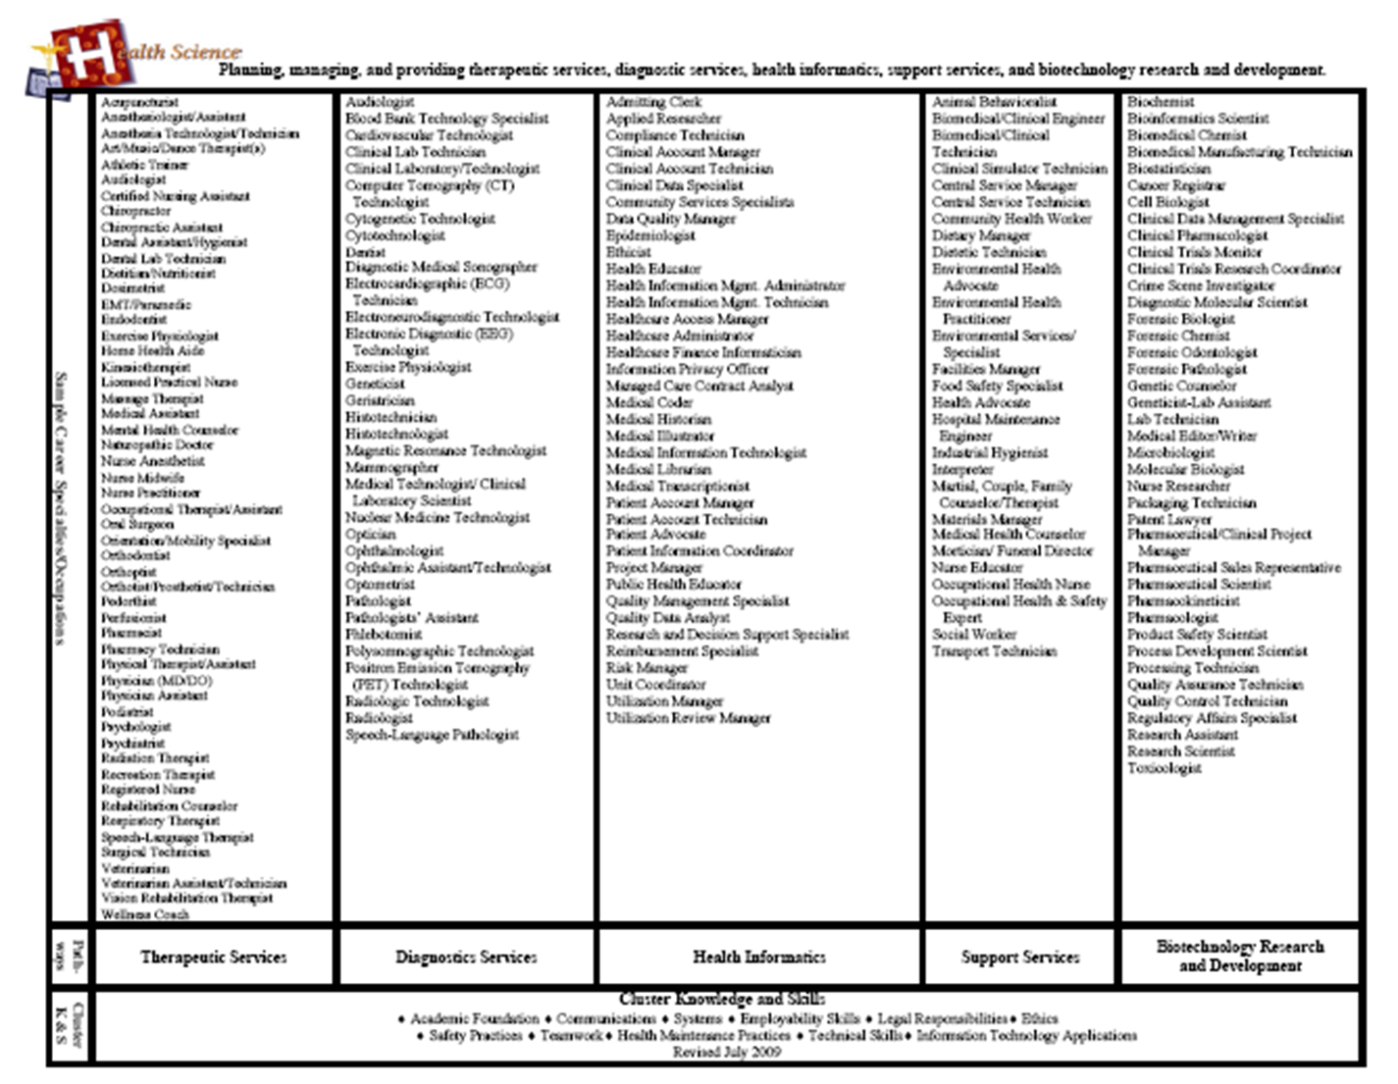

Slide 14
The Future…
  Health science will bring better health care
  Outstanding employment opportunities

Slide 15
Resources
  www.careerclusters.org

