Slide 1
Fashion Marketing
Marketing Function Basics

Slide 3
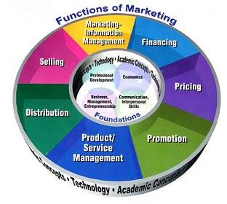
Functions of Marketing

Slide 4
Marketing Terms
Marketing
Marketing Concept
Target Market
Market Segmentation
Demographics
Psychographics
Geographics
Behavioristics
Fashion Merchandising
Retailers

Slide 5
Diverse and Changing Markets
How does the Fashion industry handle change?
How do individual companies handle change?
How do consumers handle change?

Slide 6
Review
What are the Functions of Marketing?
How is Fashion Marketed?
What is the Marketing Concept?
What is a Target Market?
What are Demographics?
What are Psychographics?
What are Geographics?
What are Behavoristics?

