Slide 1
Fashion Marketing
  Fashion and the Marketing Mix

Slide 3
Terms
  Fashion Merchandising
  Marketing
  Fashion Merchandise
  Marketing Mix
  Marketing plan
  Sales Promotion
  Public Relations
  Publicity
  Advertising
  Fashion Product Mix

Slide 4
Marketing strategies
  Increase the number of customers
  Increase the average transaction
  Increase the frequency of repurchase

Slide 5
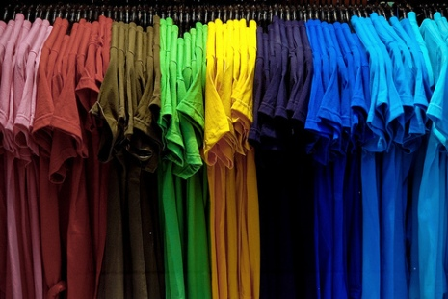
Fashion Merchandising
  Planning
  Buying
  Selling

Slide 6
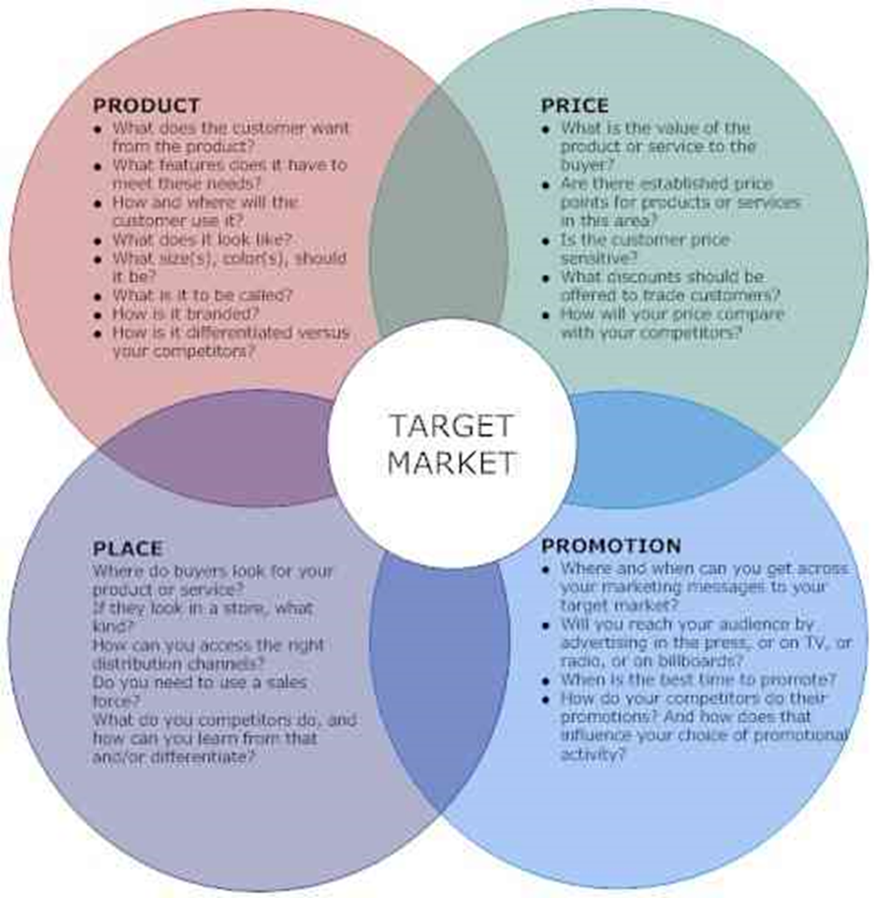
What is The Marketing Mix ?

Slide 7
Sales Promotion
  Sales Promotion
  Merchandised window displays
  Coupons
  Contests
  Public Relations
  Publicity
  Advertising
  Personal Selling

