Slide 1
Fastening Metal
  Flexible Manufacturing

Slide 3
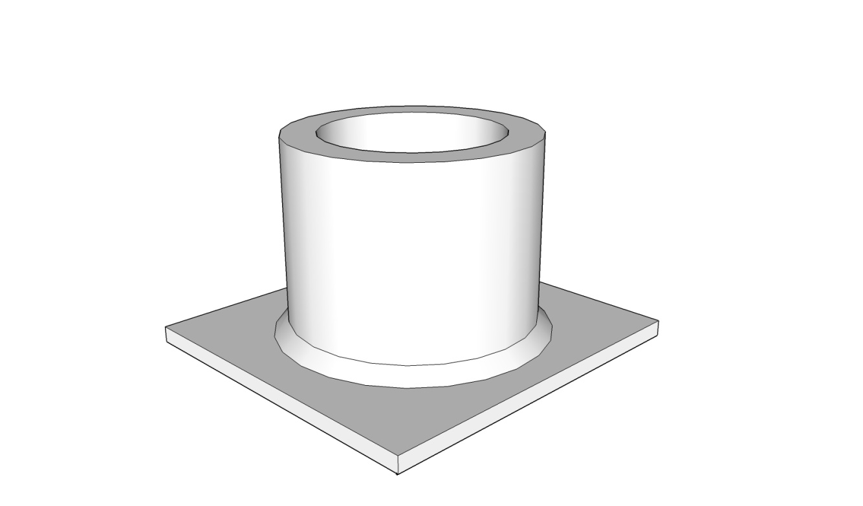
Basic Welding Symbols

Slide 4
Basic Welding Symbols
  American Welding Society developed the following set of symbols to be used on plans.
  This is a basic explanation of the many types of symbols used in welding.

Slide 5
Basic Welding Symbols
Reference line is a horizontal line where all welding information is placed.
Arrow is the other required part of the symbol. It points to the location of the weld.

Slide 6
Basic Welding Symbols
Bead | Fillet | Plug or Slot | Butt or Groove
 |  |  | Square | V | Bevel | U | J
Build up on surface | Build up in corner | Build up in hole | Edges left square | Both edges cut to an angle | One edge cut to an angle | Both edges cut to a concave | One edge cut to a concave
C
Weld all the around
Weld in the field

Slide 7
Basic Welding Symbols
The location of the weld type symbol on the reference line indicates the side of the part to be welded.
Symbols on both sides of the reference line indicates the weld is on both sides of the joint.
Symbol on the bottom of the reference line indicates the weld is on the same side as the arrow.
Symbol on the top of the reference line indicates the weld is on the opposite side.

Slide 8
What Does This Symbol Mean?

Slide 9
What Does This Symbol Mean?

Slide 10
What Do These Symbols Mean?

Slide 11
Sheet Metal Seams
INSIDE CORNER LAP SEAM
LAP SEAM
OUTSIDE CORNER LAP SEAM
STANDING GROOVE SEAM
COUNTERSUNK SEAM
SINGLE BOTTOM SEAM

Slide 12
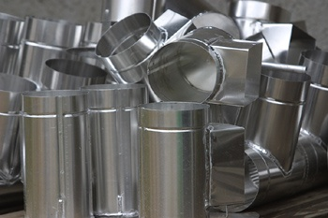
Seams
Seams are lines of junction between two metal plates. They form a joint. The grooved seams form a self-locking joint. They do not need any extra fasteners to hold them together.

Slide 13
Types of Seams
LAP SEAM
This seam is two pieces of sheet metal laid with one edge overlapping the other.

Slide 14
Outside Corner Lap Seam
This seam is one piece of metal bent to a 90 degree angle with a second piece of metal fastened to the inside of the angle.

Slide 15
Inside Corner Lap Seam
This seam is one piece of metal bent to a 90 degree angle with a second piece of metal fastened to the outside of the angle.

Slide 16
Standing Groove Seam
This seam is made by folding the edge of two pieces of sheet metal over onto itself.
These two lips of metal are then slipped together.
A hand groover is used to lock the joint or seam together.

Slide 17
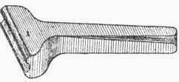
A Sheet Metal Seam Groover
Seam groovers are made in different groove widths to match your lip size.

Slide 18
Single Bottom Seam
This seam is made by folding the bottom edge over itself.
The side lip is folded to 90 degrees and then slipped into the bottom lip.
The two lips are hammered down to close the seam.

Slide 19
COUNTERSUNK SEAM
This seam is opposite the standing groove seam . The grooving is done to the back side making the seam flat.
The lips are inserted into each other and a groover is used to lock the seam.
Copyright © Texas Education Agency, 2012. All rights reserved.

Slide 20
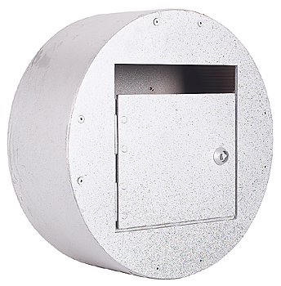
Fastened Sheet Metal Seam
Fastened sheet metal seams can be done in different ways:
  resistance (spot) welding
  mechanical fasteners ( screws or pop rivets)
  seams that lock together (standing groove seam)

Slide 21
Resource
  American Welding Society http://www.aws.org/technical/errata/A2.4errata.pdf

