Slide 1
Flexible Manufacturing
  Basic Safety

Slide 3


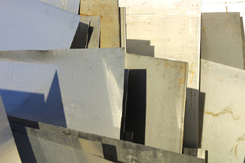
  The Flexible Manufacturing Lab is equipped with power equipment to cut, form, and shape material. The hand tools are also for working with the different materials. The materials can be sheet metal, bar stock or plastic.

Slide 4
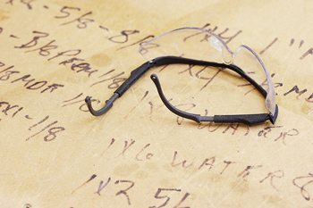
  The regulations from OSHA for Personal Protective Equipment is to be followed in this lab. The next slides review the equipment and list basic safety rules for a Flexible Manufacturing Lab.

Slide 5
Personal Protective Equipment
(PPE)
  Eye wear – glasses, welding hoods and face shields
  Hearing protection – ear plugs
  Hand protection – welding gloves and work gloves
  Foot protection – closed toed shoes

Slide 6
General and Hand Tool Safety
  Safety eye wear must be worn at all times in the lab.
  Wear work or welding gloves when handling metal.
  Clean your area when you finish using equipment or tools.
  No hazardous behavior in lab.
  Pay attention to what is going on around you. No headphones are allowed.

Slide 7
General and Hand Tool Safety
  Never try to pick up metal until you know it has cooled.
  Do not crowd the area where someone is working with metal.
  Cool the cut off waste after using a cutting torch. Do not leave hot metal on the floor.
  Use the correct tool for the job.
  All tools must be in proper working condition.

Slide 8
General and Hand Tool Safety
  Clamp all material in vise or to a table to prevent an accident.
  When using tools, point them away from yourself.
  Never check the sharpness of a cutting tool by using your finger.
  When moving heavy objects get someone to help you carry them.

Slide 9
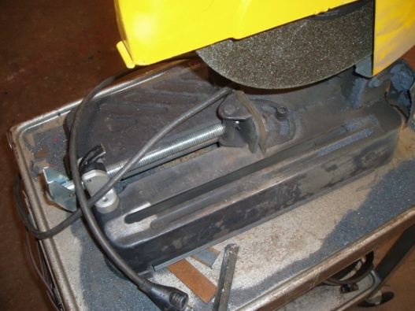
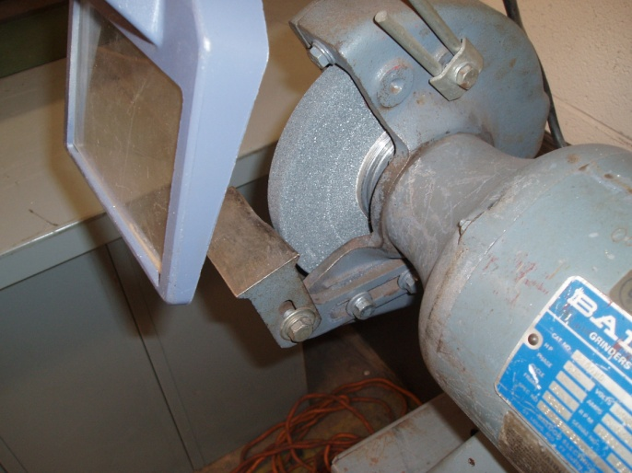
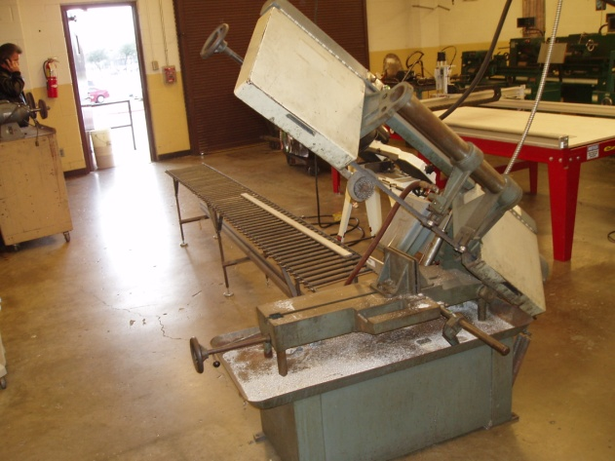
Basic Equipment Safety

Slide 10
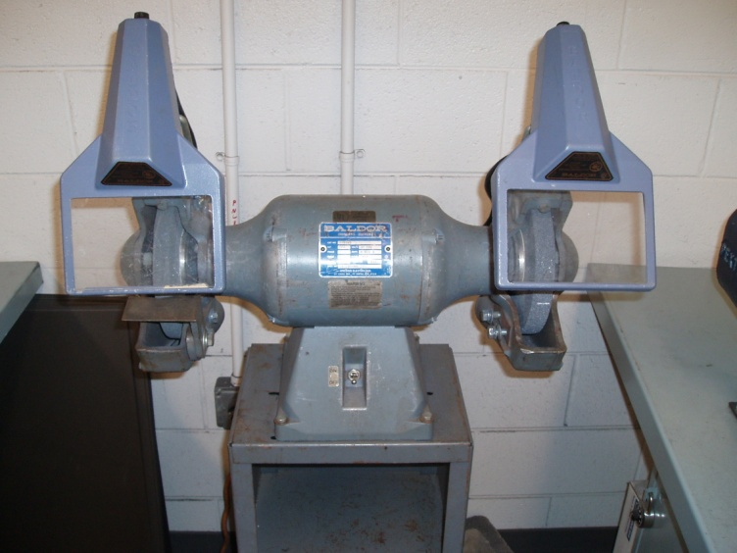
Grinder Safety
  1. Set tool rest and spark deflector 1/16” to 1/8” away from the grinding wheel.
  2. Hold the metal to grind in both hands.
  3. When grinding, use the face of the grinding wheel only.

Slide 11
Grinder Safety
  4. Use an even pressure against the face of the wheel while moving the material across the face slowly.
  5. Do not leave the grinder until it comes to a complete stop.

Slide 12

Portable Grinder Safety
  1. Make sure the switch is in the “off” position before plugging in the grinder.
  2. Make all adjustments while the grinder is unplugged.
  3. Do not allow anyone to be in the spark area.

Slide 13
Portable Grinder Safety
  4. Keep the grinder moving while in use; do not stop in one place.
  5. Let the grinder come to a complete stop, place it on its back and unplug the cord.

Slide 14
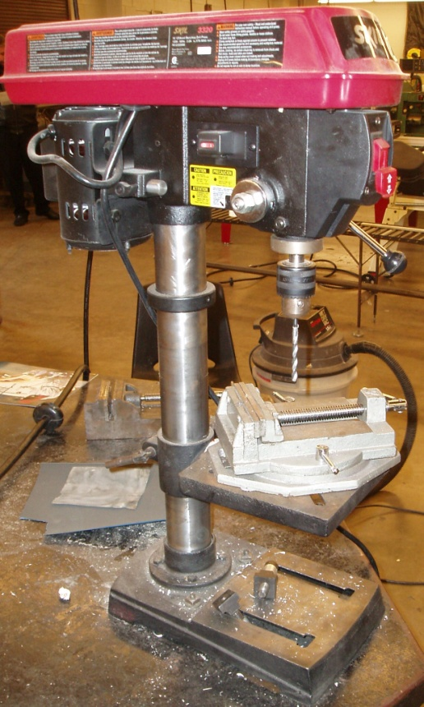
Drill Press Safety
  1. Use a vise or clamp to hold material in the drill press.
  2. Use a V-block to hold round or irregularly shaped material.
  3. Use a center punch to mark the starting place to drill.

Slide 15

Drill Press Safety
  4. Select the proper drill and speed for the material.
  5. Remove all chips with a brush, not your hands.

Slide 16

Horizontal Band Saw Safety
  1. Adjust blade tension and guides before you turn on the machine.
  2. Check measurements for cut while the saw is off.
  3. Clamp the material in the saw vise.

Slide 17
Horizontal Band Saw Safety
  4. Adjust the saw blade to about ¼” above the material to be cut and start the saw.
  5. Support long material with a cutting stand or saw support.
  6. When the cut is finished, allow the saw to stop turning before removing the cut material or debris from saw.

Slide 18
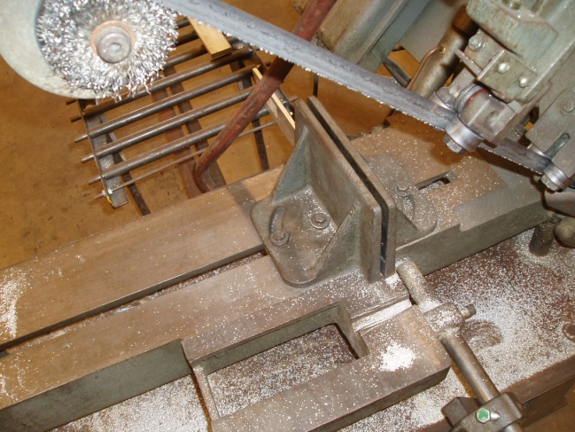
Horizontal Band Saw Safety
  7. Keep hands and arms away from the cutting area while saw is running.
  8. Do not pick up anything from under the saw while it is running.

Slide 19
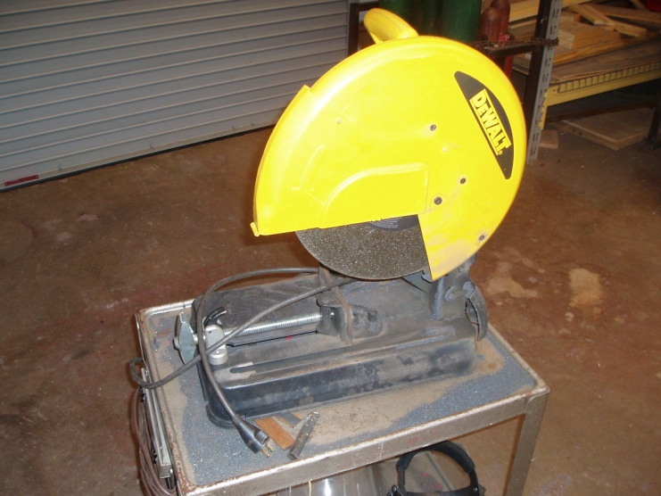
Chop Saw Safety
  1. Always wear a face shield over your safety glasses while using the chop saw.
  2. All guards must be in place and functioning properly.
  3. Keep hands and fingers out of cutting area.

Slide 20

Chop Saw Safety
  4. Check blade for proper installation and tightness.
  5. Clamp material to the fence before cutting, NO FREEHAND CUTTING.
  6. When finished with cutting process, release the trigger and let the saw stop turning before lifting the blade out of the cut.

Slide 21
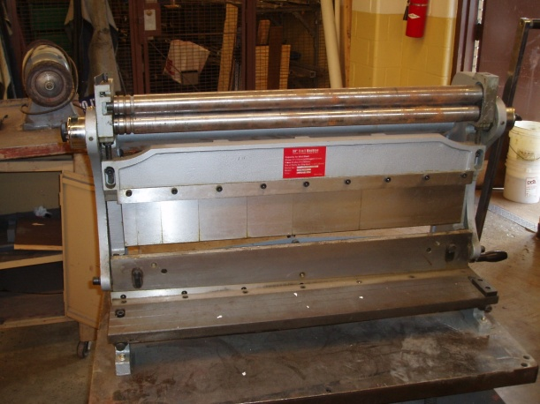
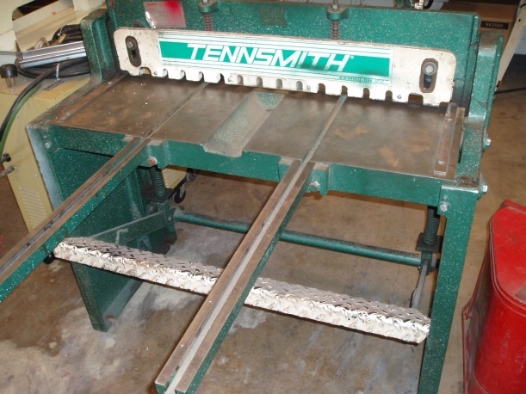
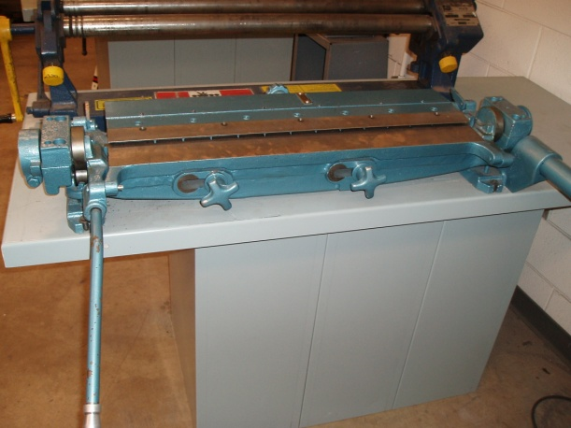
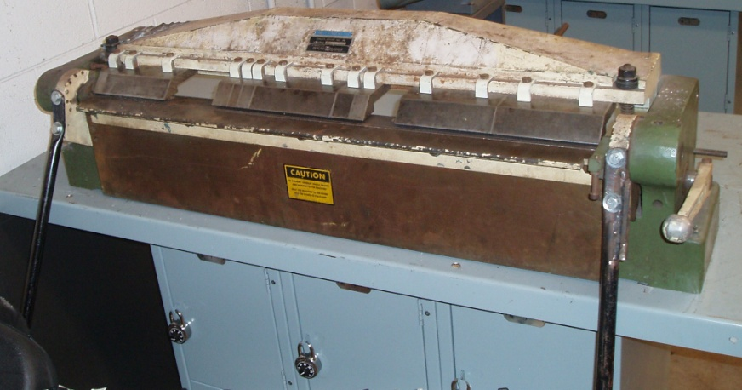
Sheet Metal Equipment

Slide 22
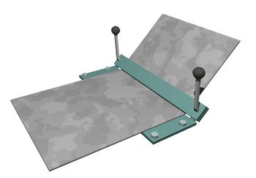
Sheet Metal Bender Safety
  Keep hands and fingers out of the opening of the bender.

Slide 23

Sheet Metal Brake Safety
  1. Do not allow any fingers to get pinched in the machine.
  2. Be aware of the counterweight and do not let anyone be hit by it.
  3. If working with a helper, make sure they know when you are going to close and operate the break.

Slide 24
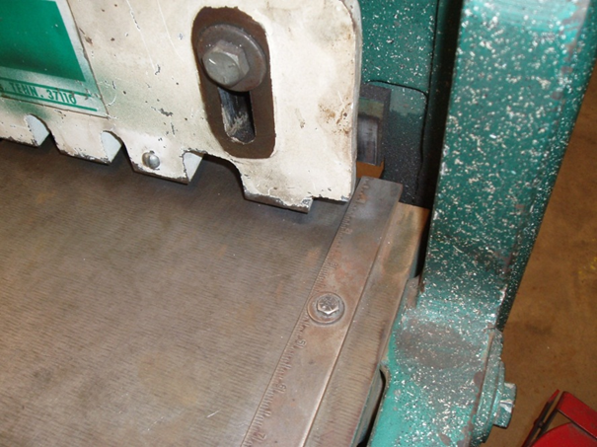
Sheet Metal Shear Safety
  1. Never cut small pieces on shear.
  2. Keep one foot on the cutting treadle and the other one clear of it.
  3. Do not reach behind the shear to catch metal.

Slide 25
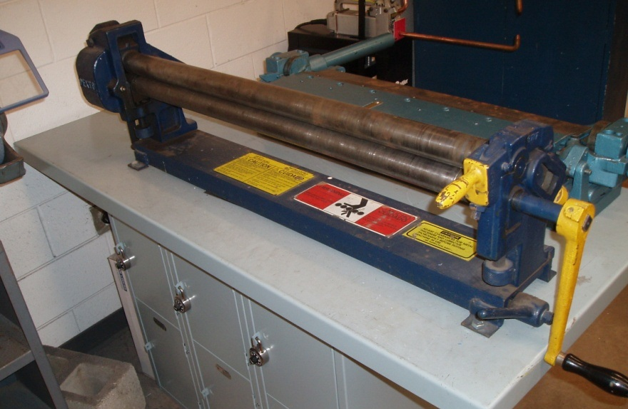
Slip Roller Safety
  1. Remove the bur from the edge of sheet metal before using the slip roll.
  2. Always wear gloves to handle metal.
  3. Keep fingers away from roller path during operation.

Slide 26
Three in One Sheet Metal Machine
Slip Roller
Box and Pan Brake
Shear

Slide 27
Hazardous Materials
  The environmentally hazardous materials used in metal manufacturing are the cut offs and machining chips. There may be some cutting fluid used in the machining section.

Slide 28

Hazardous Materials Disposal
  The cut off and small scraps of sheet metal can be recycled. Store the scraps in a metal or wood container. Return this container to the metal supplier.

Slide 29

Cutting Oil and Cutting Fluids
  Before disposing of any coolant or cutting fluid check the MSDS sheet.Also check the EPA and local area waste disposal requirements.

Slide 30
Resources
  http://safety.dri.edu/Programs/MachineShopRules.pdf
  http://me.ucsb.edu/course_pages/me12s/safety_handbook.pdf
  http://www.epa.gov/
  www.clipart.com

