Slide 1
Flexible Manufacturing
  Just-In-Time Manufacturing

Slide 3

Just-in-Time Manufacturing
Just-in-Time (JIT) manufacturing is a system of manufacturing where a company will purchase materials and produce a product when a customer orders that product.

Slide 4
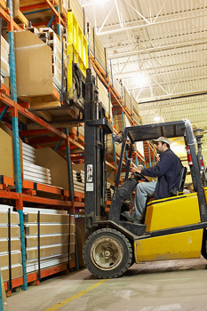
Just-in-Time Manufacturing
The system works by having materials and parts delivered on an “as needed” basis. The materials that are needed are delivered directly to the assembly line.

Slide 5
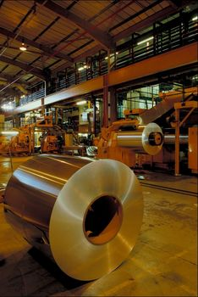
Just-in-Time Manufacturing
This system of manufacturing has the customer in control of the rate of production. If a customer wants a standard supply of a product, the manufacturer can use this method to keep just enough products on hand to fill that order.

Slide 6

Just-in-Time Manufacturing
The use of Just-in-Time manufacturing has brought the cost of manufacturing down. The cost of large supplies of raw material is reduced and the cost of stocking finished products is also reduced.

Slide 7

Just-in-Time Manufacturing
The companies that use Just-in-Time manufacturing enable the workers to do more than just run a piece of equipment. The worker can make suggestions for improvement, check for quality, and are encouraged to learn more operations in the manufacturing operation.

Slide 8

Just-in-Time Manufacturing
A system of cards are used to keep track of the parts needed, or parts that are in production. These cards are called “kanban.”

Slide 9
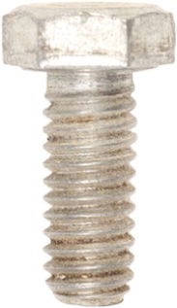
Kanban
  Means “signboard” in Japanese
  In Just-in-Time manufacturing, it is a card or sign used to track products and supplies.
Flexible Manufacturing Lab
Standard Bolt
¼” -20 Threads
200 | 20
$0.04 | Supply cabinet #2

Slide 10
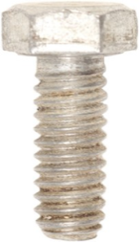
Kanban
Part Name
  The card tells the product name, size, number to order, price, safe stock, and storage area.
  The card shown here has a picture of the product included.
Flexible Manufacturing Lab
Standard Bolt
¼” -20 Threads
200 | 20
$0.04 | Supply Cabinet #2
Size
Photo
Number to Reorder
Safe Stock
Price
Storage Location

Slide 11

Use of the Kanban
  The card will be in or on the storage container. When the items in the container are used to the point of the “safe stock” (20 bolts) the product is restocked in the amount listed (200 bolts)
Flexible Manufacturing Lab
Standard Bolt
¼” -20 Threads
200 | 20
$0.04 | Supply Cabinet #2

Slide 12
Where did the number come from?
  The safe number is the amount of the item needed to be on hand until a new order can be received
  The numbers are monitored to keep the supply correct, so the line will not stop production
Flexible Manufacturing Lab
Standard Bolt
¼” -20 Threads
200 | 20
$0.04 | Supply Cabinet #2

Slide 13
Where did the number come from?
  The reorder number is the amount of product that will be used over a given time, one day, or one production cycle.
  The numbers are monitored to keep the supply correct, so the line will not stop production.
Flexible Manufacturing Lab
Standard Bolt
¼” -20 Threads
200 | 20
$0.04 | Supply Cabinet #2

Slide 14
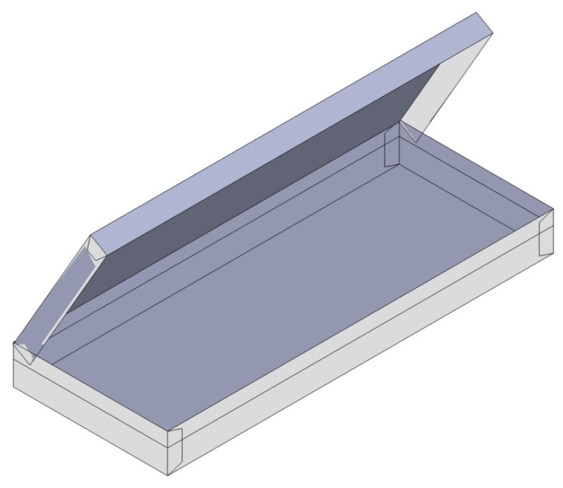
Just-in-Time in A Flexible Lab
  The use of the “kanban” card can keep supplies organized and in stock.
  The sheet metal box is set up for a simple mass production project.
  The box has three parts:
    A box,
    a lid, and
    two pop rivets as hinges.
Notes:
The vise project could be developed into a mass production project and use the system.

Slide 15
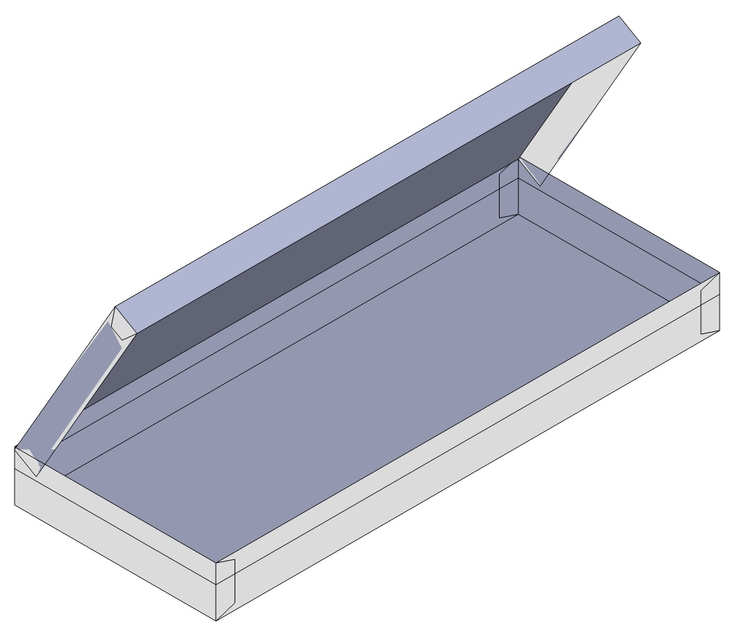
Sheet Metal Box

Slide 16
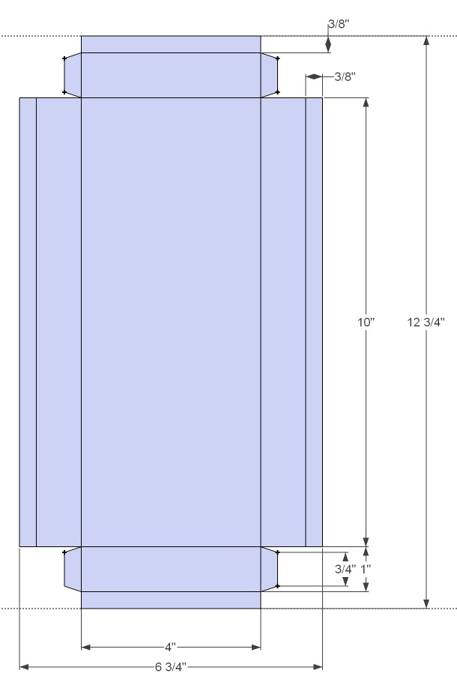
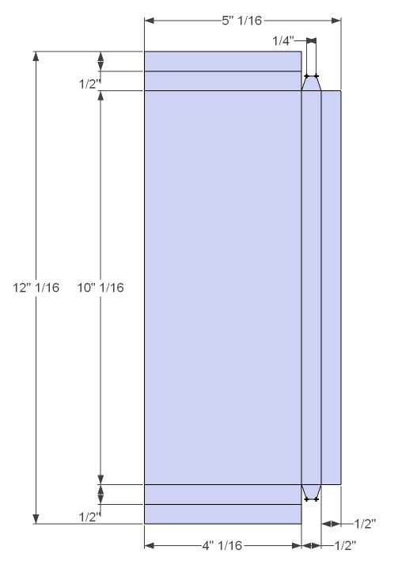
Box Plans
Box Bottom
Box Top

Slide 17
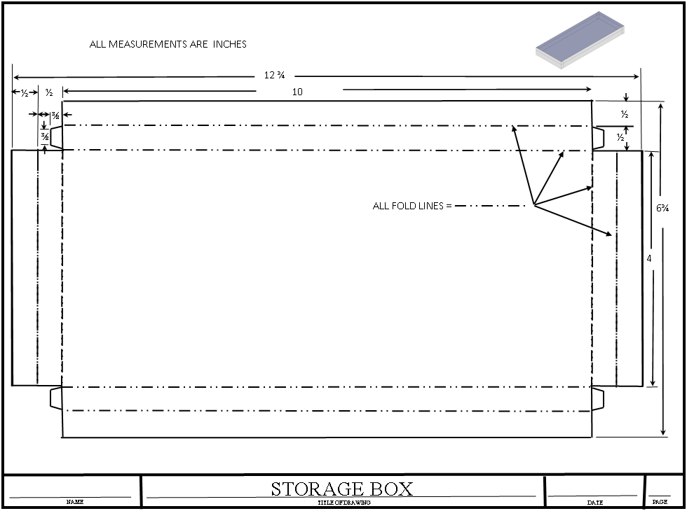
Box Bottom

Slide 18
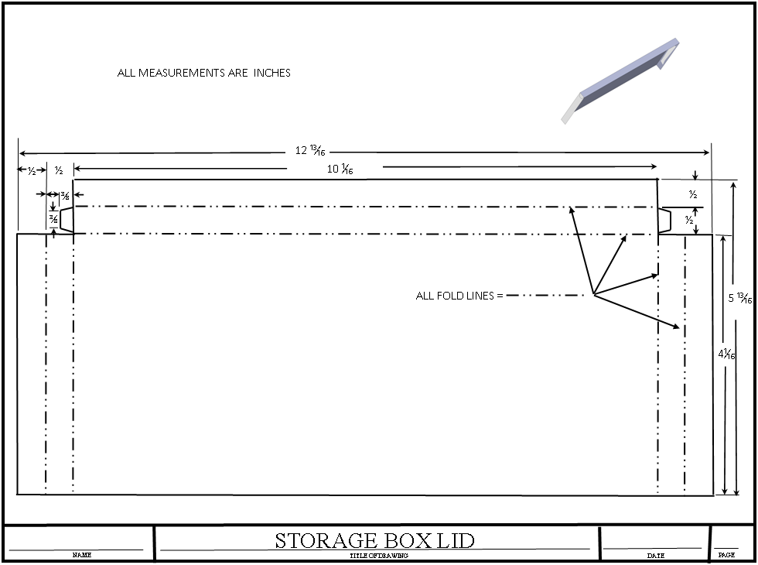
Box Top

Slide 19
SHEET METAL BOX
BILL OF MATERIALS
NAME | Quality | MATERIAL | THICKNESS | WIDTH | LENGTH | FINISH
BOX | 1 | SHEET METAL | 24 GAUGE | 6¾ | 12¾ | PAINTED
LID | 1 | SHEET METAL | 24 GAUGE | 5 ¹³/₁₆ | 12 ¹³/₁₆ | PAINTED
POP RIVITS | 2 | METAL | ⅛ DIAMETER |  | ⅛” Long

Slide 20
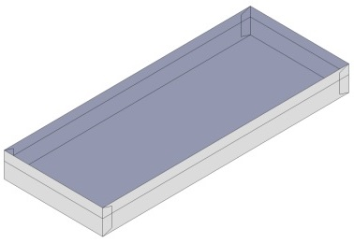
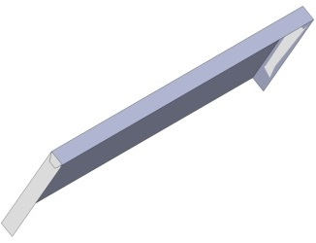

Box Kanbans
Flexible Manufacturing Lab
Box
24 Gauge Sheet Metal
30 | 5
$0.95 | Supply Cabinet #1
Flexible Manufacturing Lab
Box Lid
24 Gauge Sheet Metal
30 | 5
$0.75 | Supply Cabinet #1
Flexible Manufacturing Lab
Pop Rivets
⅛ Diameter x ⅛ Long
70 | 10
$0.06 | Supply Cabinet #2

Slide 21
Box Bottom
Manufacturing Operations
Operation Name | Tool or Equipment
Design layout | Sheet metal bluing, scribe, and ruler
Cutting bottom shape | Aviation tin snips
Fold long sides hems | Box and pan brake
Fold short sides to 90° | Box and pan brake
Fold long sides to 90° | Box and pan brake
Fold short side hems | Box and pan brake
Put in storage until assembly operation | Storage area

Slide 22
Box Top
Manufacturing Operations
Operation Name | Tool or Equipment
Design layout | Sheet metal bluing, scribe and ruler
Cutting bottom shape | Aviation tin snips
Fold long sides hems | Box and pan brake
Fold short sides to 90° | Box and pan brake
Fold long sides to 90° | Box and pan brake
Fold short side hems | Box and pan brake
Put in storage until assembly operation | Storage area

Slide 23
Box Assemble
Manufacturing Operations
Operation Name | Tool or Equipment
Layout hinge holes on lid | Sheet metal bluing, scribe, and ruler
Drilling or punch hinge holes | Hand drill, ⅛ bit, and backer board
Place lid on the box bottom
Drilling hinge holes in the box bottom | Hand drill, ⅛ bit, and backer board
Install pop rivets | Pop rivet tool
Paint box | Spray can of paint
Put in storage until grading time | Storage area

Slide 24
Resources
  Wright, R. T. (2004). Manufacturing and automation technology. Engineering Manufacturing Facilities (22, pp. 300-301). Tinley Park, IL: Goodheart-Wilcox.
  Wright, R. T. (2004). Manufacturing and automation technology. Computer Systems in Product Manufacturing (36, pp. 433-434). Tinley Park, IL: Goodheart-Wilcox.

