Slide 1
Flexible Manufacturing
  Precision Machining Safety

Slide 3
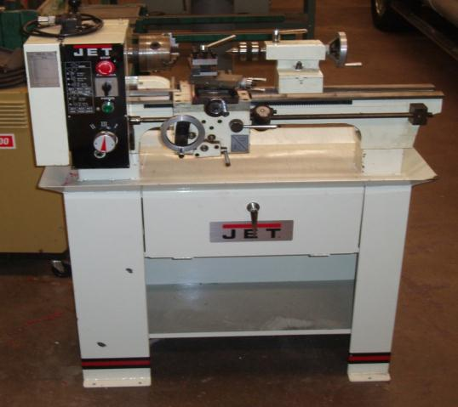
Engine Lathe
The engine lathe shown in this presentation is a new 9 X 20 inch model. The basic controls are the same, but may be in different locations. Check the manual for the lathe in the lab.

Slide 4
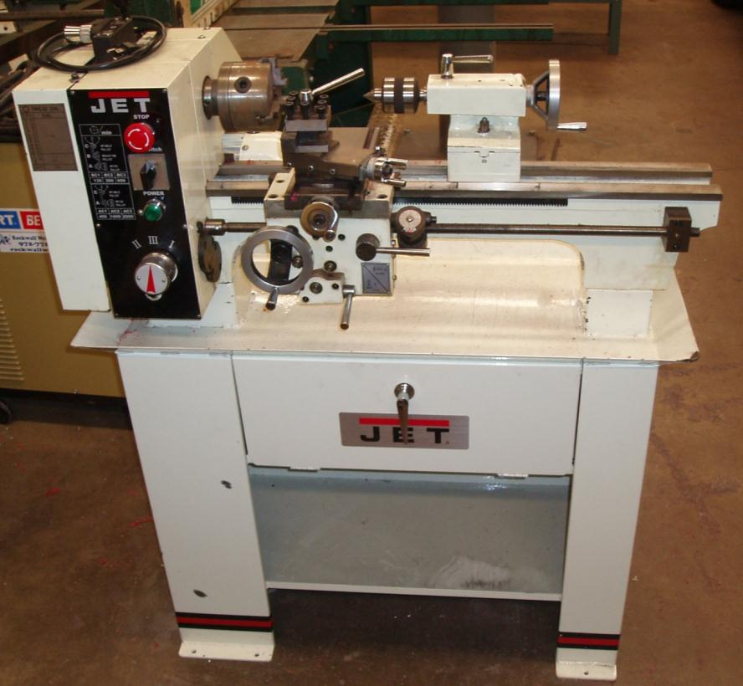
Engine Lathe Components
Headstock
Tailstock
Bed
Carriage
Stand or Base

Slide 5
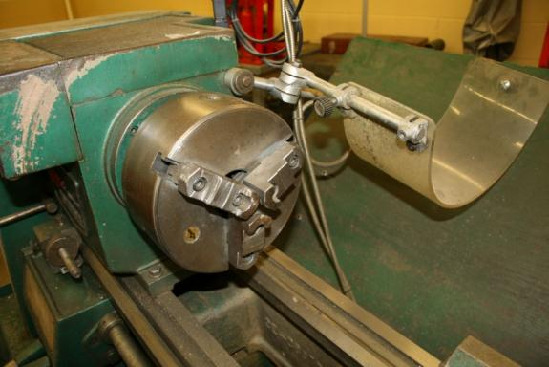
Engine Lathe Components
  Bed is a heavy rugged casting that supports the machine. The bed gives the machine its strength and allows for accurate machining.
  Headstock is the assembly containing the motor and drives the spindle and gears.

Slide 6
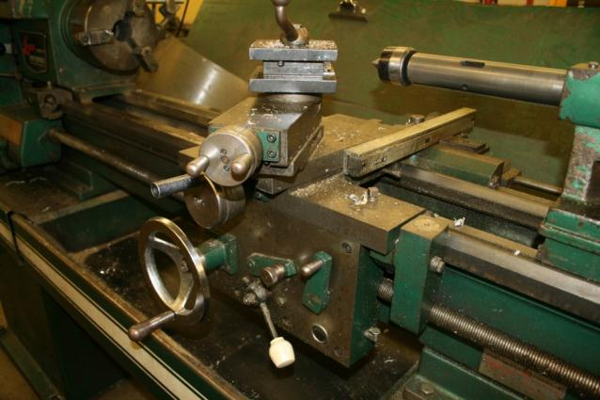
Engine Lathe Components
  Carriage is the assembly that moves lengthwise down the bed. It holds the cross slides, compound rest and tool rest.
  Tailstock is the assembly that moves on the bed to support the material and holds other tools.

Slide 7
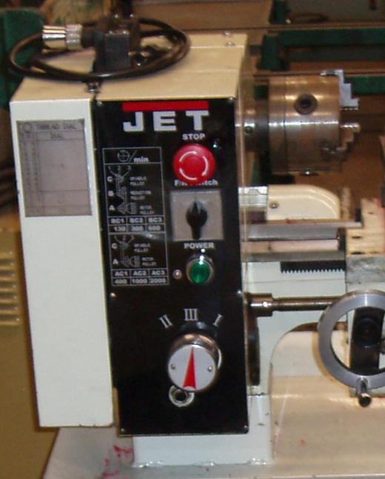
Headstock Controls
V-Belt Tension Lever
Left/Right Screw Lever
Emergency Switch
Forward/Reverse Switch
Power Light
Gear Box Quick Change Lever

Slide 8
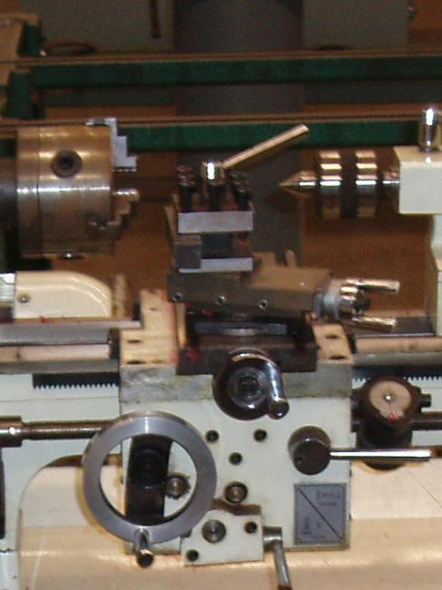
Carriage Controls
Tool Holder Lever
Tool Holder
Top Slide Hand Wheel
Cross Slide Hand Wheel
Longitudinal Travel Hand Wheel
Threading Dial
Half-Nut Lever
Lead Screw
Automatic Feed Lever

Slide 9
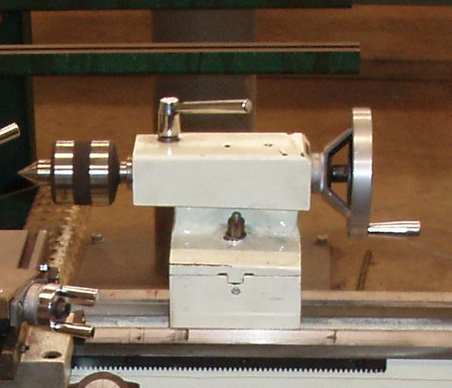
Tailstock Controls
Live Center
Tailstock Spindle Clamping Lever
Tailstock Spindle Hand wheel
Tailstock Off-Set Adjustment
Tailstock Locking Screw

Slide 10
General Flexible Manufacturing Lab Safety Rules
  Personal Protective Equipment (PPE) is required when working in the flexible manufacturing lab.
  Keep the area around the machines clean and free of oil.
  Always return tools and cutters to their proper storage area.
  No hazardous behavior in the lab.

Slide 11
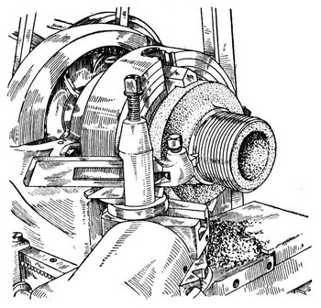
Engine Lathe Safety Rules
  The chuck or drive plate should be tightened on the spindle.
  Move the tool bit far away from the material being mounted in the lathe.
  Check for proper speed before starting the lathe.

Slide 12
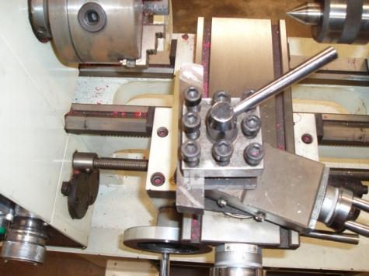
Engine Lathe Safety Rules
  When setting the tool holder, place it on the left side so the carriage will not be hit by the chuck.
  Clamp the cutter bit as close to the holder as possible to prevent breakage and chattering.
  Stop the lathe before making any adjustments, measurements or cleaning the chips away.
  After tightening the material in the chuck, remove the chuck key.

Slide 13

Engine Lathe Safety Rules
  Do not use your fingers to remove chips or touch the material.
  Set the height of the tool bit on the centerline of you work.
  Do not cut material all the way through when turning between centers.
  When turning between centers, properly adjust the centers to support the material.

Slide 14
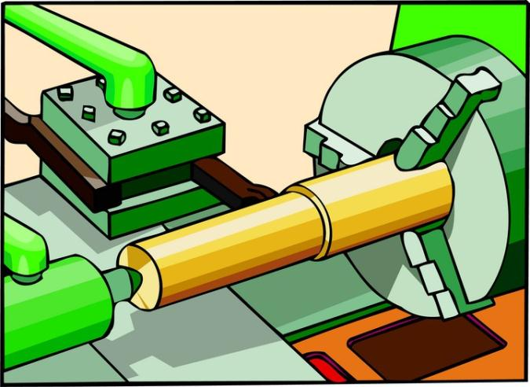
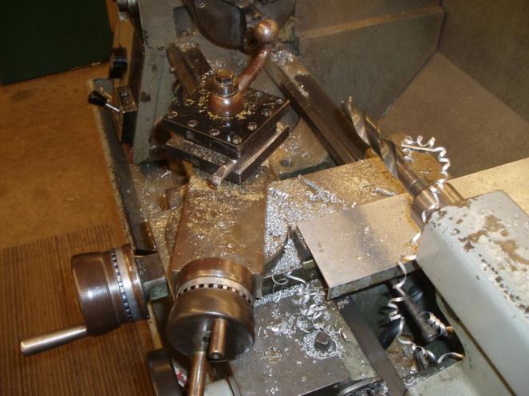
Engine Lathe Safety Rules
  When turning between centers make sure the tailstock is locked in place.
  After setting the lathe, remove all tools from the machine.
  Check the tool bit for defects and sharpness.
  When filing on the lathe, file away from the chuck.
  When sanding on the lathe do not wrap the paper around the material. This could get tangled in the lathe.

Slide 15
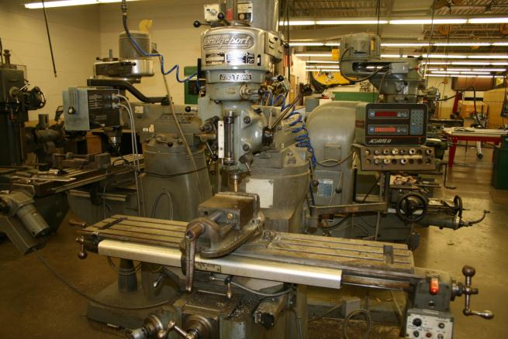
Vertical Milling Machine
The milling machine shown in this presentation is an 8 X 42 inch model. The basic controls are the same, but may be in different locations. Check the manual for the mill in the lab.

Slide 16
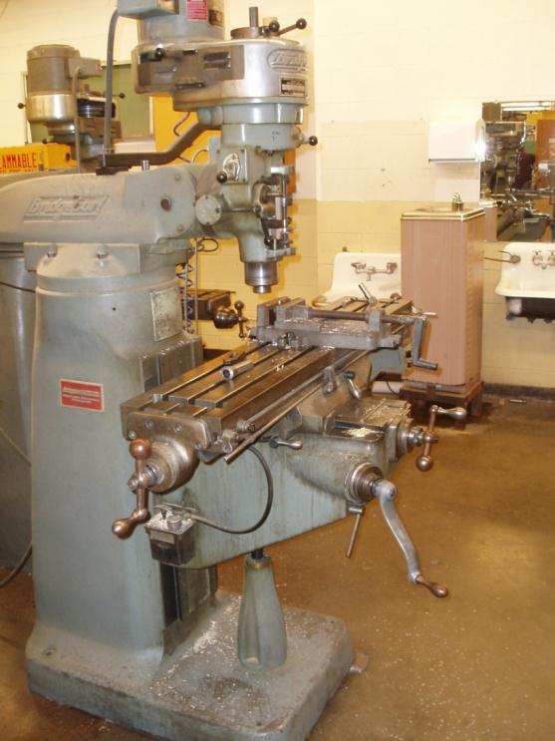
Milling Machine Components
Spindle Head
Ram
Saddle
Column
Table
Knee
Base

Slide 17
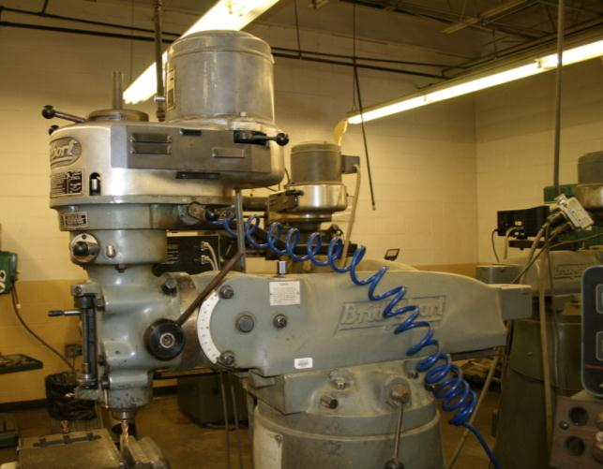
Milling Machine Components
  Spindle Head contains the spindle and motor.
  Column is the major structural part with a base that holds all other parts.
  Table is the place the work is mounted onto the mill. The table moves in the x-axis.

Slide 18
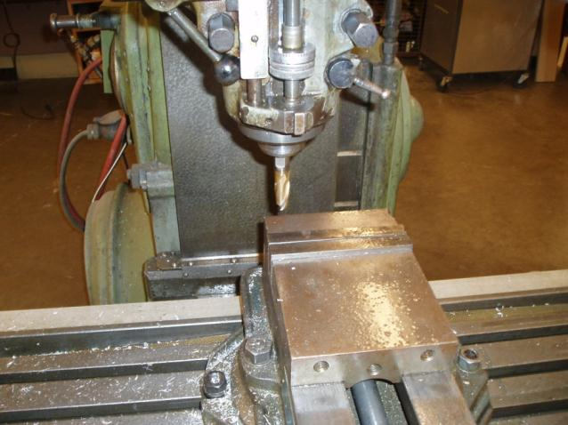
Milling Machine Components
  Saddle holds the table and moves in the Y-axis
  Knee supports the saddle and table and moves up and down to position the work piece.

Slide 19
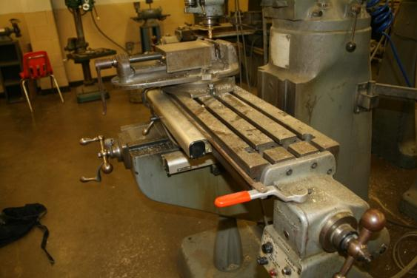
Milling Machine Components
  Ram holds the toolhead and allows it to move away from the column.
  Base is the bottom of the support structure that holds and aligns the rest of the machine.

Slide 20
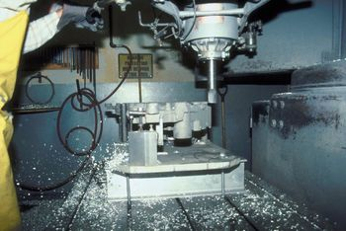
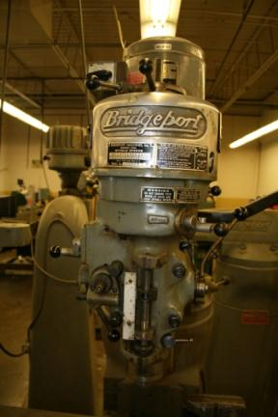
Milling Machine Safety Rules
Work must be clamped securely in a vise or on the table while being machined.
Never clean the work area with a rag, especially when the mill is turning.
Power must be off before making any adjustments, changing the cutters or cleaning the machine.

Slide 21
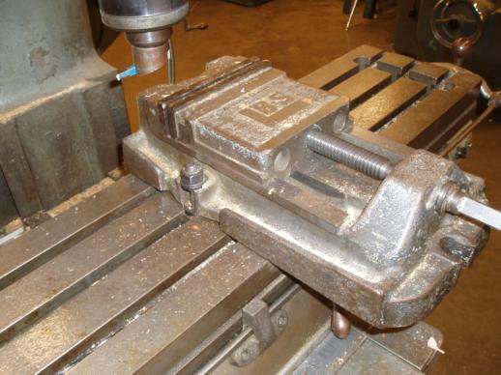
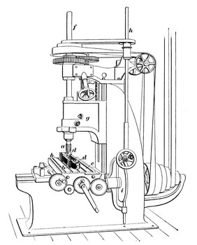
Milling Machine Safety Rules
Use the proper spindle speed, feed rate and depth of cut for the material being cut.
During setup make sure that table, holding device and the work piece clears the spindle and its support.
Cutters must be sharp and in good condition.
Do not leave the machine while it is in operation.
Do not leave any wrenches, materials or other tools on the tables.

Slide 22
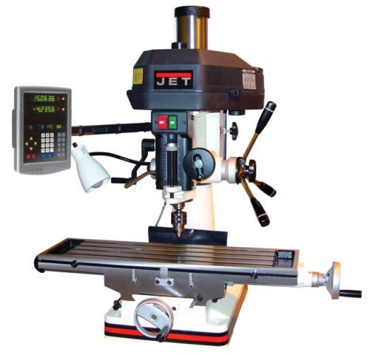
Milling Machine Safety Rules
Make sure that any onlookers are out of the safety area of the machine.
Remove all wrenches after tightening the cutter.

Slide 23

Resources
Lathe information
http://engineering.ucdavis.edu/efl/LATHE.pdf
http://tdserver1.fnal.gov/tdweb/ms/Policies/
http://me.ucsb.edu/course_pages/me12s/safety_handbook.pdf
Copyright © Texas Education Agency, 2012. All rights reserved.

