Slide 1
Flexible Manufacturing
  Teamwork in the Manufacturing
  Process

Slide 3

Teamwork
A co-ordinated effort of a group of persons acting together for a common cause or interest
Notes:
Source- www.dictionary.com

Slide 4
Manufacturing Team
Supervisor/inspector
  A student in charge of setting up the project design, manufacturing, and packaging
Team members
  Students assigned to produce the project or product

Slide 5
Supervisor’s Duties
  Oversees all manufacturing processes
  Selects team members for his/her team
  Completes time management form, work schedules, and sets the completion time
  Inspects the product as the production is underway
  Communicates positively to all team members to ensure a quality product, on time with little or no waste

Slide 6
Team Members’ Duties
  Produces quality products
  Follows the supervisor’s instructions
  Follows the manufacturing process set up by the supervisor
  Works safely and returns all materials, tools, and supplies to their proper location
  Fills out the Team Members Product Form

Slide 7
Time-Management
A range of skills, tools, and techniques used to manage time when accomplishing specific tasks, projects, and goals
Notes:
From Wikipedia, the free encyclopedia

Slide 8
Time-Management Techniques
  Be organized
  Set priorities
  Set achievable goals
  Make a “To-Do List”
  Avoid procrastination
  ABC analysis (group tasks by importance)
    list task by priority:
      A) important,
      B) less significant, and
      C) not a priority
Copyright © Texas Education Agency, 2013. All rights reserved.

Slide 9
Time-Management Examples
ABC analysis
A) Job
A) English term paper
B) Watching TV
C) Reading a magazine
To-Do List
Go to bank
Pick up cleaning
Lunch meeting
Writing the term paper

Slide 10
Bookmark Task List
  Cutting material to size
  Cutting material to shape
  Laying out the slot
  Drilling starting hole
  Cutting slot
  Removing burrs from cut slot
  Smoothing slot and edges
  Polish all surfaces
  Spray a protective coating on bookmark
  Inspect
  Package

Slide 11

Work Schedule
The time frame that an employee works during a certain course of time. A schedule can fluctuate, rotate, or remain constant throughout the course of a year
Notes:
Source- www.ehow.com

Slide 12
Designing a Work Schedule
  Set realistic goals
    - Example- finish the project in two days
  Set a start time and a completion time
  Set proper breaks
  List of things to do
  Divide large projects into small parts
  Schedule your time on a calendar (daily, weekly, and monthly)

Slide 13
Work Schedule
  The team will produce a specified number of bookmarks during one week. The supervisor/inspector will oversee the process. The five workers will produce the bookmarks. An example of the work schedule for the bookmark is below
Names | Monday | Tuesday | Wednesday | Thursday | Friday
Beverly | supervisor | supervisor | supervisor | supervisor | supervisor
John | cut to size | cut to size | cut slot | smooth | packaging
Henry | cut to size | cut to shape | cut slot | polish | packaging
Jeff | cut to size | cut to shape | remove burrs | polish | packaging
Jana | cut to shape | layout slot | smooth | spray | inspection
William | cut to shape | layout slot | smooth | spray | packaging

Slide 14
Work Schedule
  The team will have one week of class time to complete the given number of bookmarks. The class period could be divided into a work schedule as below. The minutes can be adjusted for the length of class period
Class Activities | Times
Attendance/class instructions | 5 Minutes
Team instruction time | 5 Minutes
Work time | 30 Minutes
Clean up time | 5 Minutes
Team discussion time | 5 Minutes

Slide 15
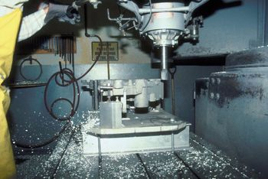
Manufacturing Process
Appropriate use of tools, machines, and systems to convert materials into products

Slide 16
Manufacturing Processes of the Bookmark
The processes for making the bookmark are listed in the time-management section. The task will be explained in the following slides
Process
Output
Input

Slide 17
Manufacturing Processes of the Bookmark
  Cutting material to size
    The material will be in a sheet; it will have to be cut to size
  Cutting material to shape
    After the bookmark is cut to size, lay out and cut the shape
  Laying out the slot
    Measure and draw the location of the slot
  Drilling the starting hole
    Drill a small hole at both ends of the slot. This will allow the saw to be inserted in the metal to cut the slot

Slide 18
Manufacturing Processes of the Bookmark
  Cutting slot
    Use a jeweler’s saw to cut the slot
  Removing burrs from cut slot
    Use a small, fine file to file the burrs off the bookmark that are left from cutting
  Smoothing slot and edges
    Use 200, 300, and 400 grit sandpaper to sand the bookmark smooth
  Polish all surfaces
    Use auto polish for polishing the surfaces of the bookmark

Slide 19
Manufacturing Processes of the Bookmark
Spray a protective coating on bookmark
  Use clear acrylic spray to protect the bookmark from tarnishing
Inspect
  Check one final time for any flaws in the bookmark. Return bookmark for possible correction of defect
Package
  Place the bookmark on a card or in a plastic bag for storage (to be sold later)
SAW THE SLOT
3/8 R.
+
1 1/4
9/16
1/2
3/4
3
BOOKMARK

Slide 20
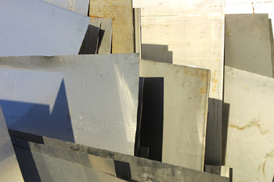

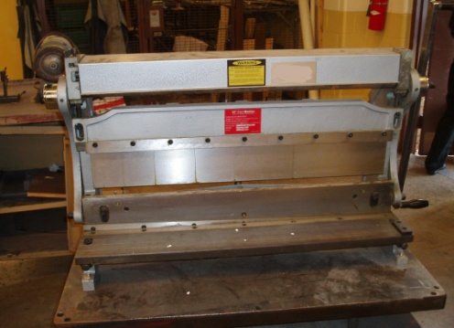


Input
Any item that is used to produce the manufactured part (i.e., labor, machines, equipment, materials, energy, or money)

Slide 21
Input Items of the Bookmark
  Student team members
  18 gauge aluminum or brass sheet
  Jeweler’s saw with #2 blades
  A six inch flat mill file for removing the burrs
  200, 300, and 400 grit silicon sandpaper
  Auto polish
  Acrylic spray finish
  Packaging materials

Slide 22
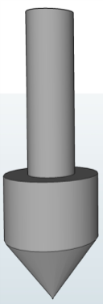
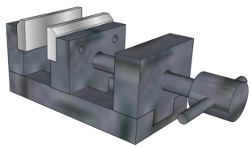
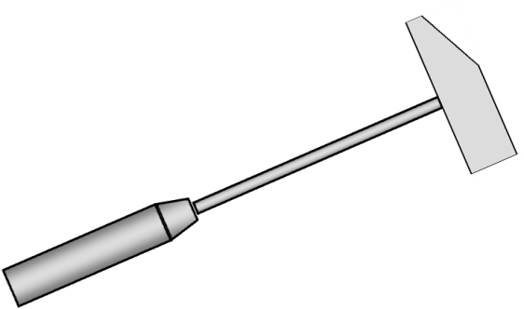
Output
The product that is made by using the input materials and the manufacturing process

Slide 23

Output of the Bookmark Process
The output of the manufacturing process will be the number of bookmarks the team produces in a week

Slide 24

Quality Control
The verifying and maintaining a desired level of quality in a product by careful planning, use of proper equipment, and inspection of the product
Notes:
Source- www.dictionary.com

Slide 25
Quality Control for the Bookmark
  A visual inspection
    For correct application of design
    For no scratches or burrs
  A touch inspection
    Of the edges for smoothness
    For polishing and finish smoothness

Slide 26
Feedback
The control of the manufacturing process by monitoring the process

Slide 27
Feedback on the Bookmark
  The inspector will give you positive feedback during the production of the bookmarks
  The teacher will give you feedback both verbally and in the form of a team assessment

Slide 28
Forms
Teamwork in the Manufacturing Process

Slide 29
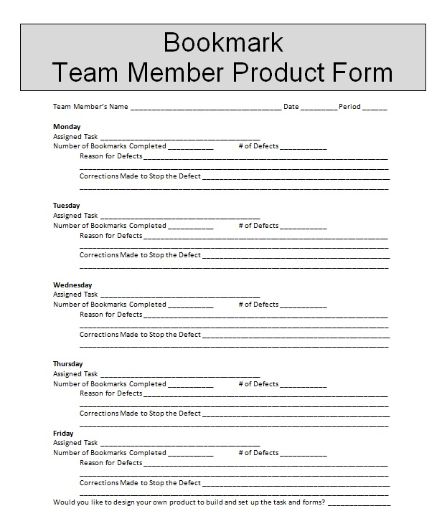
Team Member Product Form

Slide 30
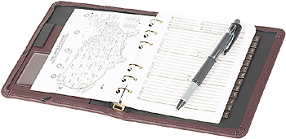
Supervisor/Inspector Forms
  Time-Management Form
  Work Schedule Form
  Daily Inspection Form
  Product Inspection Form
  Supervisor Feedback Form

Slide 31
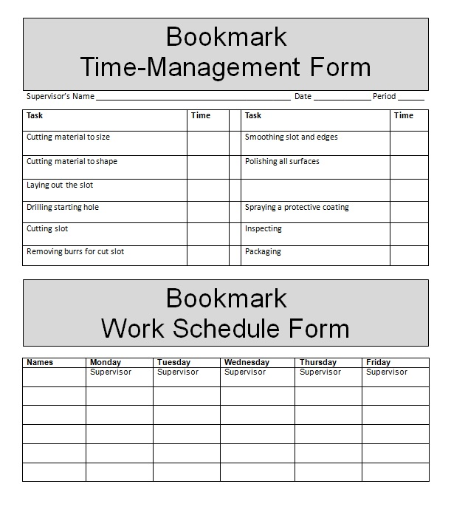
Time-Management and Work Schedule Form

Slide 32
Work Schedule Form
Names | Monday | Tuesday | Wednesday | Thursday | Friday
 | Supervisor | Supervisor | Supervisor | Supervisor | Supervisor

Slide 33
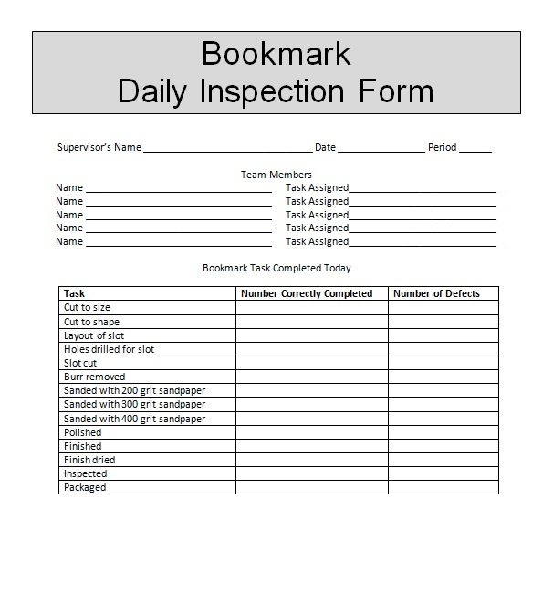
Daily Inspection Form

Slide 34
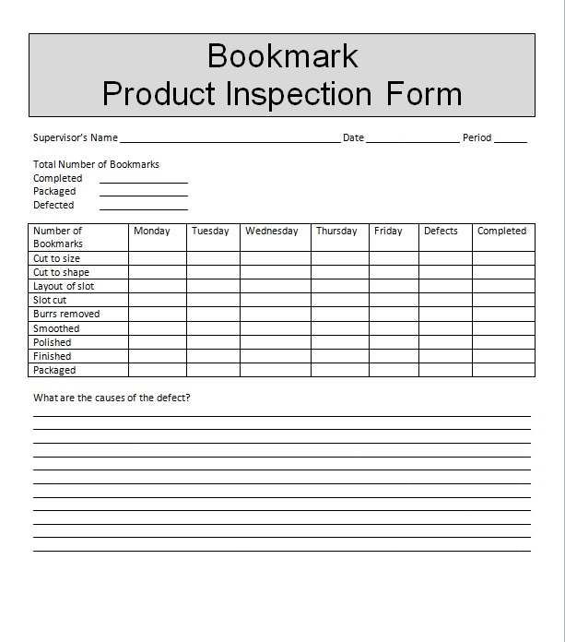
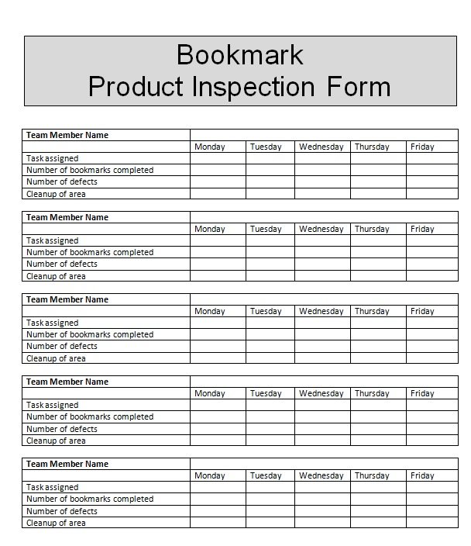
Product Inspection Form

Slide 35
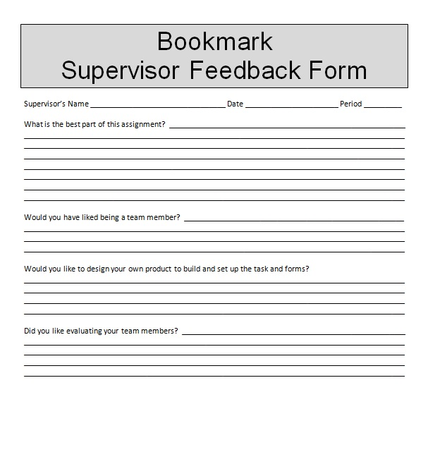
Supervisor Feedback Form

Slide 36
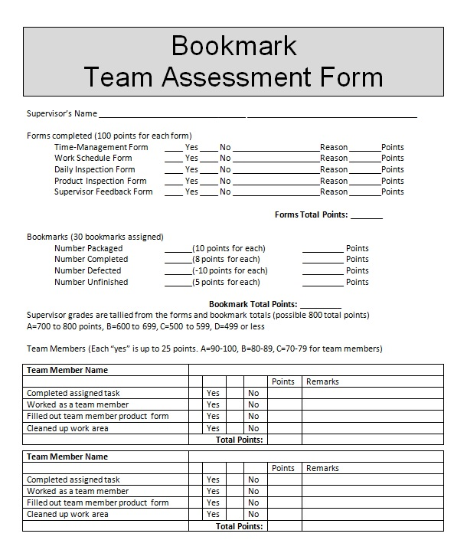
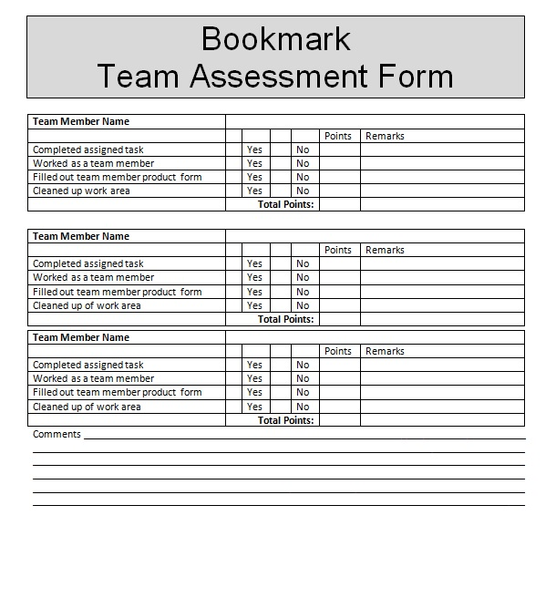
Team Assessment Form

Slide 37
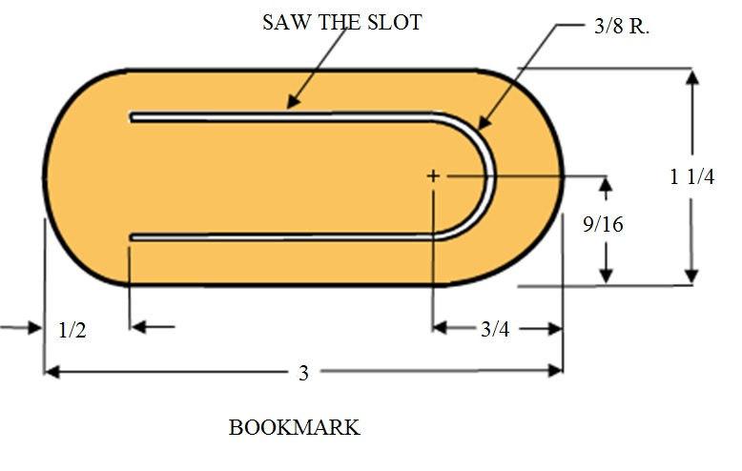
Bookmark Plan

Slide 38
Resources
  www.cte.unt.edu
  Wright R. (2004). Manufacturing and automation technology. Tinley Park, Illinois: Goodheart-Willcox Company.

