Slide 1
Flexible Manufacturing
  Welding Safety

Slide 3
CAUTION
  There is no all-inclusive list of safety rules that can apply to every lab. Every lab has a different set of needs based on the work environment. In every case, safety first should be the defining element that applies to your individual lab. Machinery should be respected and used with caution. If this warning is not heeded, serious bodily injury could occur, as well as damage to the machine.

Slide 4
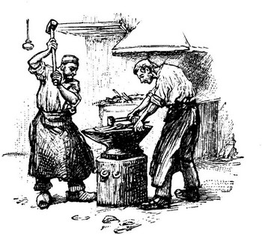
Types of Welding Processes
  Oxyacetylene Welding
  Arc Welding
  Tungsten Inert Gas (TIG) Welding
  Metal Inert Gas (MIG) Welding
  Spot Welding
  Plasma Arc Cutting

Slide 5
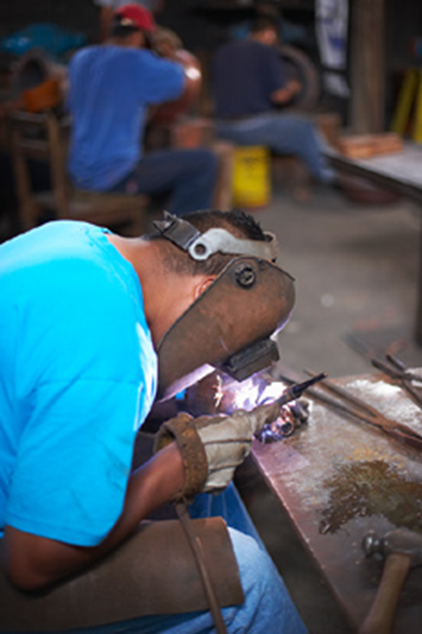
Arc Welding
  This type of welding joins metal by the heat of an electric arc. The current is passed through a metal rod to the base metal to be welded. The current melts the rod and the base metal in the area to be welded. A coating of molten flux covers the new weld protecting it until cooled.

Slide 6

Metal Inert Gas (MIG) Welding
  MIG welding is a process using a consumable metal wire as an electrode. The weld is shielded from the air by an inert gas, usually carbon dioxide.

Slide 7
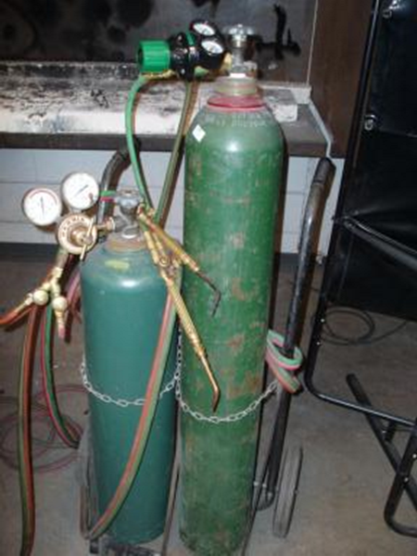
Oxyacetylene Welding
  This type of welding uses oxygen and acetylene to produce a flame hot enough to melt metal. The metal fuses together or has filler material added to the puddle of molten metal to help complete the fuse.

Slide 8
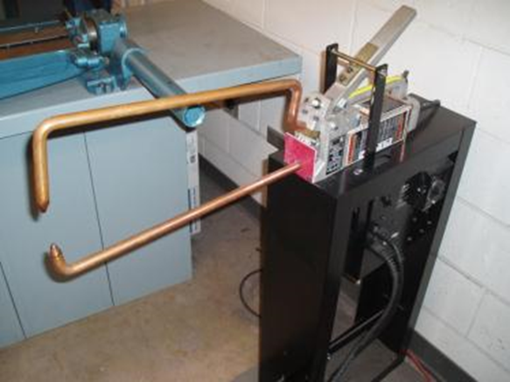
Spot Welding
  The spot welder focuses the electric current through two copper electrodes. The sheets to be welded are held under pressure as the current is applied to the electrodes. This current heats the metal and melts it together.

Slide 9

Tungsten Inert Gas (TIG) Welding
  TIG welding uses a tungsten electrode to produce the weld. An inert gas shields the weld from impurities in the air. A filler rod can be used to add metal into the weld area.

Slide 10
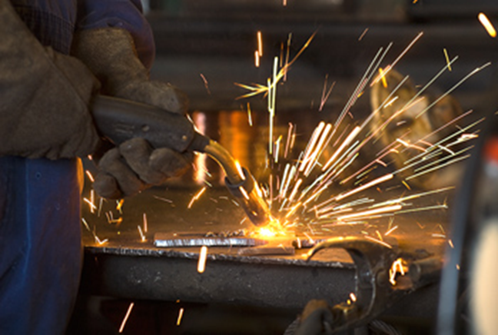
Plasma Arc Cutting
  The plasma cutting torch uses oxygen passing through an electric arc. This air is super heated and under pressure. This blows the molten metal from the torch tip as it cuts the metal below.

Slide 11
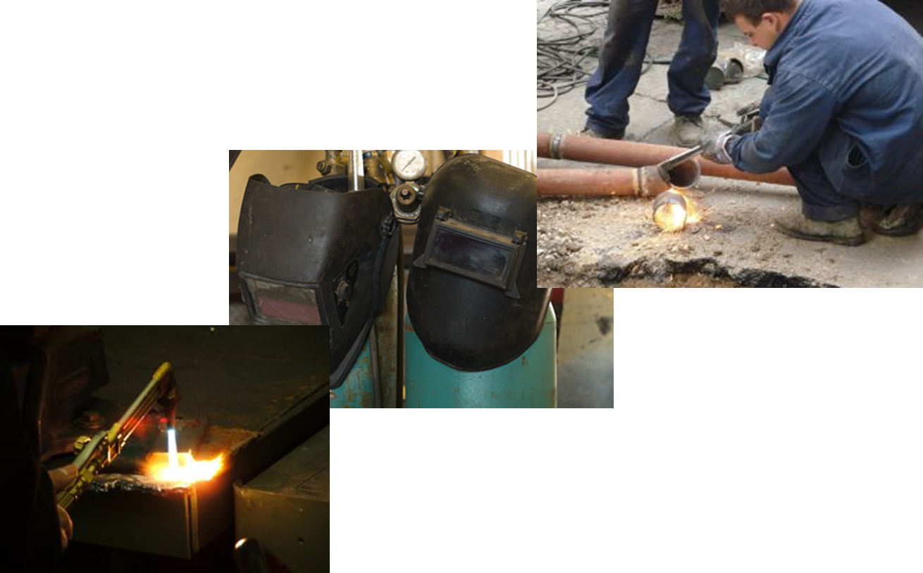
Arc, TIG, MIG Welding

Slide 12
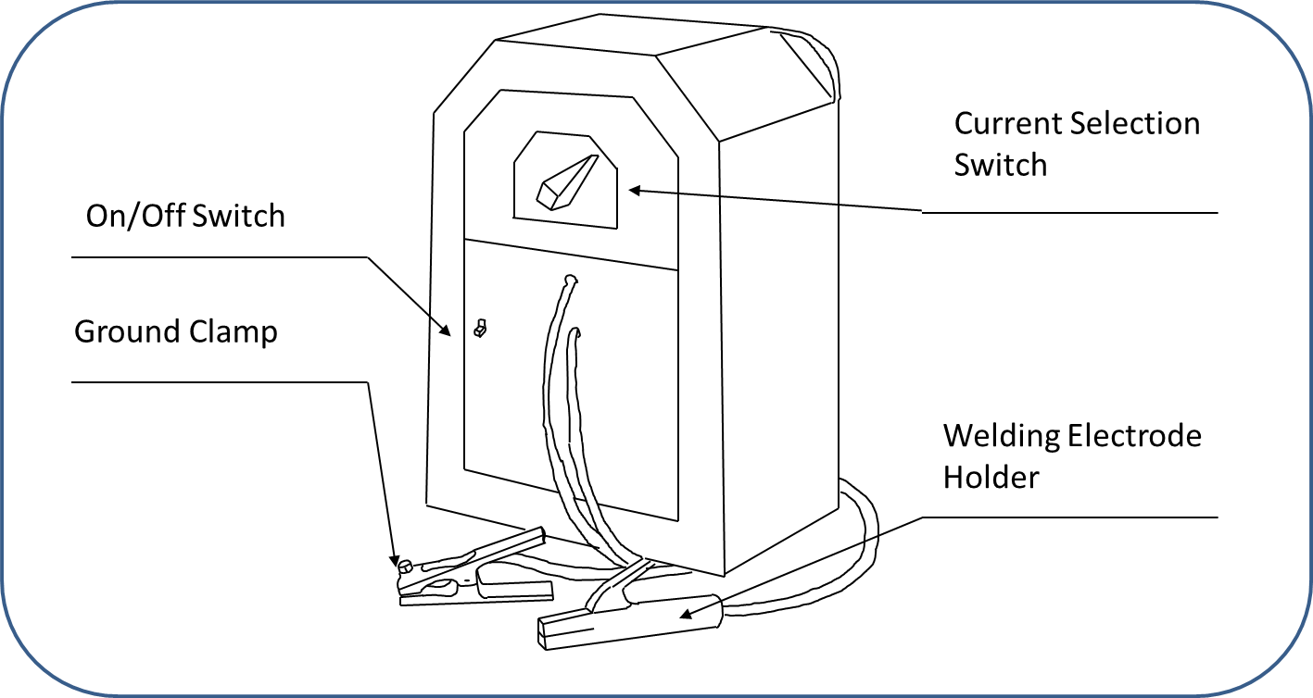
Arc Welder Identification

Slide 13
Arc, TIG, MIG Welding Safety Rules
  Weld only in a well vented area.
  Use welding hoods when arc welding to protect your eyes from arc rays and ultraviolet radiation.
  Use welding gloves with cuffs to protect your hands as well as wrists and lower arms.
  Wear fire resistant clothing to protect you from burns and ultraviolet radiation.

Slide 14
Arc, TIG, MIG Welding Safety Rules
  Do not wrap cables or lines around yourself.
  To pick up hot metal, with a set of tongs or pliers.
  Turn off all equipment and tank valves when welding is finished.
  Always clean work area when finished.
  Place a barrier up around your welding area.

Slide 15
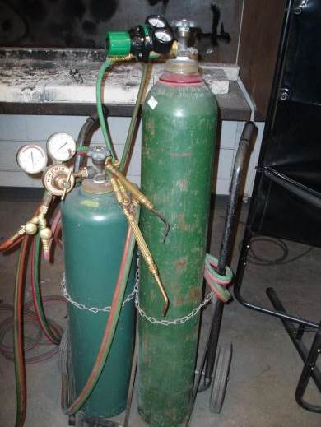
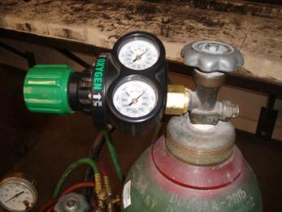
Oxyacetylene Welding

Slide 16
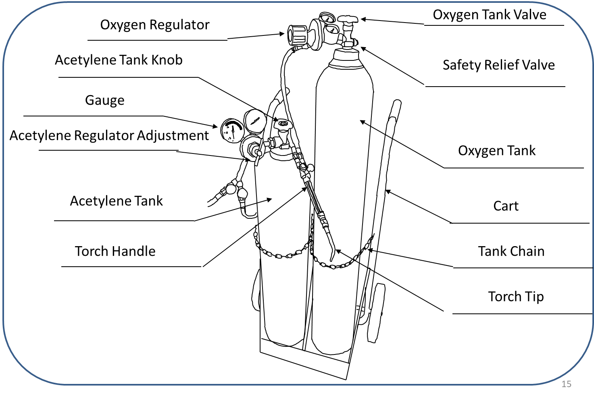
Oxyacetylene Welder Identification

Slide 17
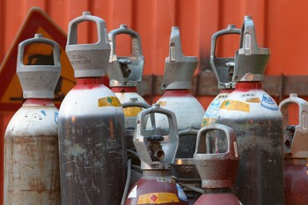
Oxyacetylene Welding Safety Rules
  The tanks must be in an approved cart or chained to the wall. This will keep them from falling over and exploding.

Slide 18
Oxyacetylene Welding Safety Rules
  Use an approved striker to ignite the torch; never a match.
  Never get oil, grease or other combustibles around the oxygen tank. This could cause a violent explosion.
  Open an acetylene tank valve no more then 1 ½ turns so it can be quickly closed if the need arises.

Slide 19
Oxyacetylene Welding Safety Rules
  Acetylene is a very unstable gas. The regulator should be set for 5 to 7 pounds of pressure on the lines. Acetylene can explode at 15 lbs.
  Use an approved wrench on the tank valve if there is no hand wheel on the tank.
  When weld is finished, turn off both tanks and bleed the lines. Then loosen the regulator adjustment screw.

Slide 20
Oxyacetylene Welding Safety Rules
  Keep the safety cap on the tanks when not in use.
  Before installing the regulators, crack the valves on the tanks to clear dust from connections.
  Always stand to the side when opening the valves on the tanks.

Slide 21


Spot Welder

Slide 22
Spot Welder Safety Rules
  Sparks and flying molten metal can cause a fire.
  The electric current during spot welding can cause a burn or shock. DO NOT TOUCH THE WELDER ELECTRODES.
  Wear tinted goggles while spot welding.
  Wear welding gloves to protect hands from getting burned.

Slide 23
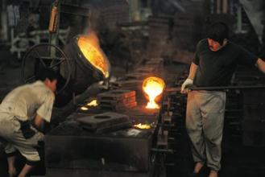
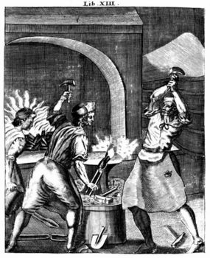
Spot Welding Machine Safety Rules
  Keep fingers from pinch points while welding.
  Avoid breathing welding fumes.
  Do not put fingers between the welder tips.

Slide 24
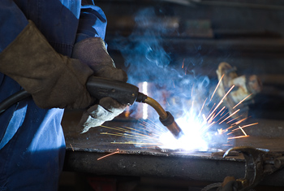
Plasma Arc Cutting

Slide 25
Plasma Arc Cutting Safety Rules
  Wear protective clothing when using a plasma cutter.
  A #5 shaded lens should be worn for plasma cutting.
  Never use a plasma cutter in an area with combustible or explosive gases or materials.

Slide 26

Plasma Arc Cutting Safety Rules
  Never touch any part of the torch tip or metal being cut.
  Hearing protection should be worn when operating a plasma cutter.

