Slide 1
Flexible Manufacturing Industry

Slide 3
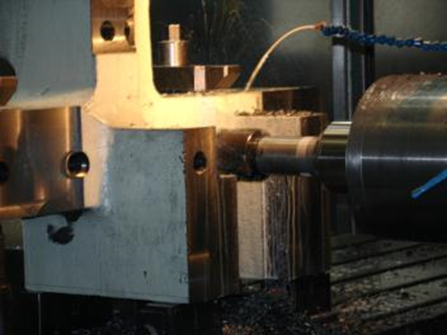
Flexible Manufacturing Industries
  Sheet Metal
  Welding
  Precision Machining

Slide 4
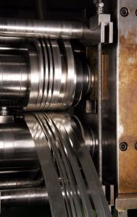
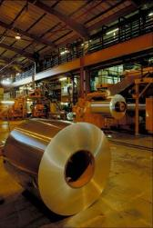
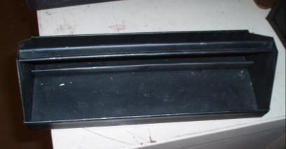
Sheet Metal Industry
  Workers in this industry will decide on the materials to be used in the production of duct work, countertops, roofs and rain gutters.

Slide 5
Sheet Metal Skills
  The worker will measure, cut, bend, shape, and fasten the pieces of sheet metal to form the products to be manufactured.
  These workers will assemble the ducts and hang the duct works in the buildings.

Slide 6
Sheet Metal Training
  Sheet metal workers usually learn their trade by formal apprenticeship and on the job training.
  Courses to take for a sheet metal employment are: English, Algebra, Geometry, Physics, Drafting and Flexible Manufacturing.

Slide 7
Sheet Metal Industry Job Outlook
  The job outlook is good for sheet metal workers because of the construction projects and upgrades to old air conditioning systems.
  The average wage for a sheet metal worker is $19.37 an hour.

Slide 8
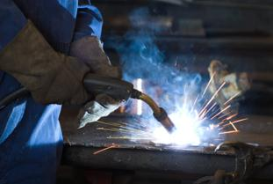
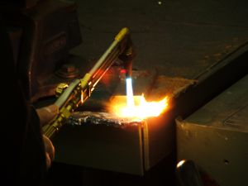

Welding Industries
  Welding is a process of joining metal permanently. This process is done by heating metal to a melting point, then fusing them together with a filler material. The most common type of welding is arc welding.

Slide 9
Welding Skills
  Plan work from blueprints.
  Determine the best type of welding to use.
  Set up and operate the machines.
  Examine the welds to meet industrial standards.

Slide 10
Welding Training
  Formal training can be taught in high schools, colleges, trade institutes and the armed forces.
  Some courses that are preferred are: Drafting, Shop Mathematics, Physics, Chemistry and Metallurgy. Electricity and Computer courses are becoming more important.

Slide 11
Welding Industry Job Outlook
  The 2008-2018 job outlook states a decline in jobs for welders by 2% a year.
  Welders that are trained in the latest technologies will have a higher demand.
  Average wages for welding in 2008 is $16.00 an hour.

Slide 12
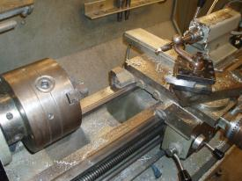
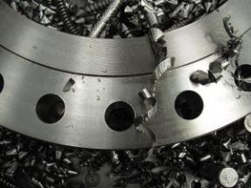
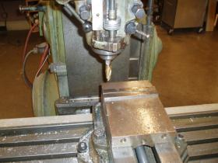
Precision Machining Industries
  Workers in this industry are called machinists. A machinist operates lathes, milling machines or grinders to produce a precision metal part.

Slide 13
Precision Machining Skills
  Understand blueprints and plans.
  Set up the equipment.
  Understand the speed and feeds for the different equipment.

Slide 14
Precision Machining Training
  Machinist can receive training from apprentice programs, vocational school, technical colleges or on the job training.
  Machinist should have knowledge in drafting, metalworking, trigonometry and geometry.
  The use of computers in machining has made it important to understand computers and controls.

Slide 15
Precision Machining Industry Job Outlook
  The job outlook as a machinist is good. The number of people entering the job market does not equal those that are retiring.
  The average wage for a machinist is $17.41 an hour.

Slide 16


Workforce Skills or Soft Skills
  These are personal characteristics the employer wants to see at an interview.

Slide 17
Workplace Skills or Soft Skills
  Interviewing skills.
  Flexibility.
  Willingness to learn new skills and acquire knowledge.
  Self-discipline.
  Self-worth.
  Positive attitude.
  Integrity.

Slide 18
Interviewing Skills
  The skills you will need to have a good interview and gain employment. Listed below are ten things you should do during an interview:
  Do your research; know about the company and the job.
  Look sharp; dress in clean neat clothes. First impressions are important.
  Be prepared; bring a folder with extra copies of important materials. (résumé, references and questions)
  Be on time; arrive early, enter the building 10 or 15 minutes before the interview is to begin.
  Show enthusiasm; make eye contact and smile, then speak with confidence.

Slide 19
Interviewing Skills
  Listen; pay attention to everything and watch expressions.
  Answer the questions asked; make sure you understand the question fully and give a complete answer.
  Give specific answers; explain your background and highlight your successes and uniqueness.
  Ask questions; indicating your interest in the company and the job.
  Follow up; email or mail a thank you note for the interview . This will remind the interviewer about your valuable traits.

Slide 20
Flexibility
  This could be different work hours, or different days off each week.
  Willingness to learn new skills and acquire knowledge.
  The employee needs to stay up to date in new skills and operations.

Slide 21
Qualities
  Self-discipline
    The employee should be able to complete their work no matter what is going on around them.
  Self-worth
    A worker performs better because of feeling good about himself.

Slide 22
Things employers look for
  Attitude- I want to work. I can do that. I can learn that.
  Aptitude- Do you have a natural ability to manufacture a product?
  Communication skills- The ability to listen and explain an operation, a setup, a goal or a feeling.

Slide 23
Employer’s Expectations
  Employers are in need of a workforce that can arrive on time, communicate with others and want to learn more about the industry.
  Employees should have a basic understanding of measurement, mathematics, science principles and safety.

Slide 24
Resources
  Occupational Outlook Handbooks
    http://www.bls.gov/oco/ocos214.htm
    http://www.bls.gov/oco/ocos226.htm
    http://www.bls.gov/oco/ocos223.htm
  Texas Job Hunter’s Guide
    http://www.twc.state.tx.us/news/tjhg/toc.html

