Slide 1
Flexible Manufacturing
  Abrasive Equipment in Manufacturing

Slide 3
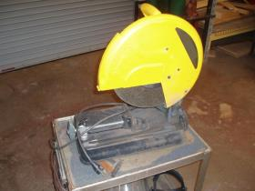
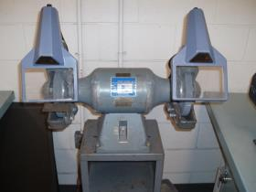

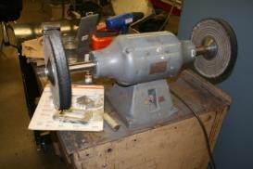
Abrasive Equipment
  Chop/cutoff saw
  Pedestal grinder
  Angle grinder
  Buffer

Slide 4
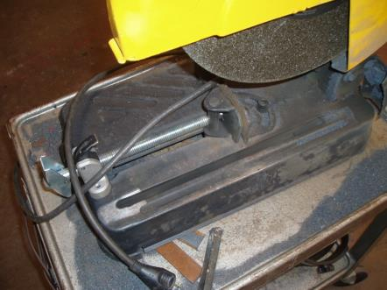
Chop/Cutoff Saw
  A saw designed to use an abrasive wheel to cut different angles through metal

Slide 5
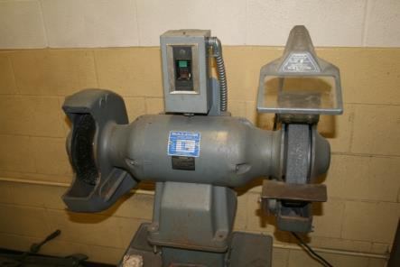
Grinder
  A machine that grinds or sharpens tools

Slide 6
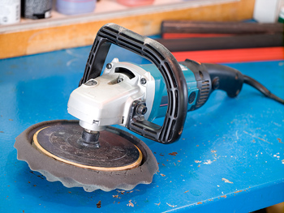
Angle Grinder
  A portable grinder with the cutting surface at 90 degrees from the handles

Slide 7
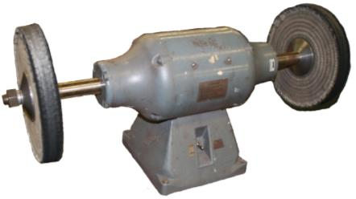
Buffer
A special designed motor with a cloth wheel attached to both ends
Used to polish metal and other materials to a luster

Slide 8
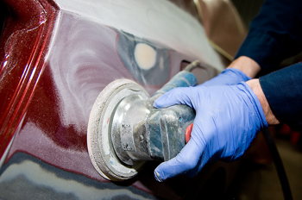
Polishing
  To make smooth and glossy, especially by rubbing or friction
  http://dictionary.reference.com

Slide 9
Always wear
EYE PROTECTION
and other personal protective equipment when using any abrasive equipment.

Slide 10
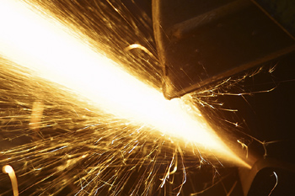
Chop/Cutoff Saw

Slide 11
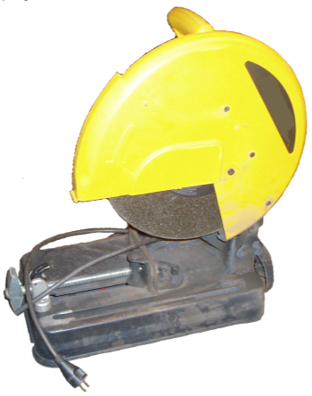
Parts of a Chop/Cutoff Saw
Wheel Guard
Handle/Switch
Spark Deflector
Wheel
Vise Handle
Base
Adjustable Fence
Vise

Slide 12
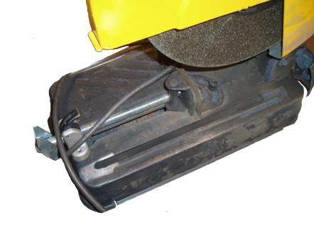
Parts of a Chop/Cutoff Saw
Wheel Guard
Wheel
Adjustable Fence
Vise
Vise Handle
Quick Release Vise Level

Slide 13
How to Operate a Chop/Cutoff Saw
  Clamp the material in the vise to cut.
    No free handling
  Support any material that is overhanging the machine.
  Allow the chop saw to reach full speed before starting the cut.
  Do not stand in front of the cutting wheel or have any part of your body across the cut line while using this machine.

Slide 14
How to Operate a Chop/Cutoff Saw
  When cutting with the chop saw, ease the wheel into the material; do not slam the wheel into the metal.
  Keep hands away from cutting area until the wheel has stopped spinning.
  When finished with the cut, release the switch, hold the wheel down until it comes to a dead stop, and then remove the material.

Slide 15
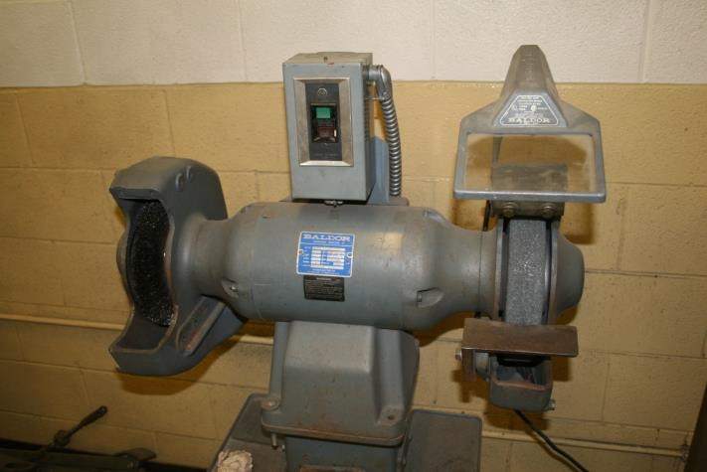
Pedestal Grinder

Slide 16
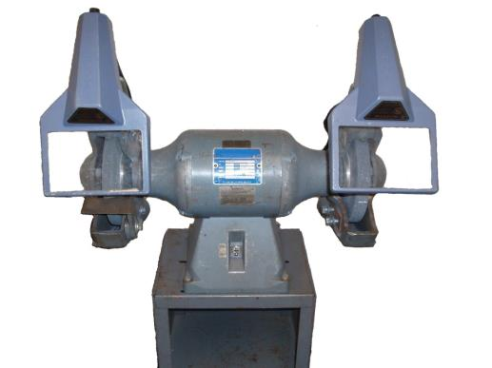
Parts of a Pedestal Grinder
Safety Glass Shield
Tongue Guard
Wheel
Wheel Guard
Tool Rest
Pedestal
Switch

Slide 17
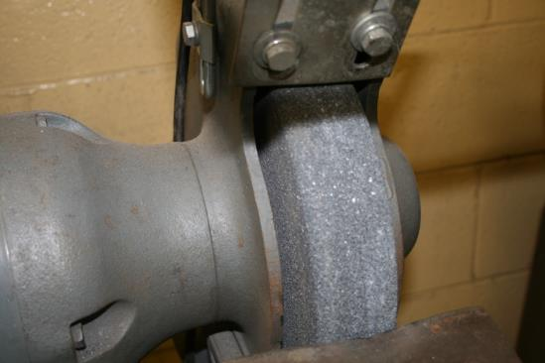
Pedestal Grinder Setup
Set Tongue Guard 1/4” from Wheel
Set Tool Rest 1/8” from Wheel

Slide 18
How to Operate a Pedestal Grinder
  Adjust the tool rests to be one eighth of an inch away from wheel.
  Adjust the tongue guards to be one quarter inch away from the wheel.
  Adjust the safety shield on the grinder for a clear view of the grinding area and part to be ground.
  Stand to one side of grinder, and turn the grinder on.

Slide 19
How to Operate a Pedestal Grinder
  Carefully place the part on the tool rest of the grinder.
  Push the part against the wheel with even pressure, and move the part across the face of the wheel; never grind on the side of the wheel.

Slide 20
How to Operate a Pedestal Grinder
  Most grinders are set up with a coarse wheel on one side and a finer wheel on the other side.
  Remove most of the material on the coarse wheel and finish grinding on the finer wheel.
  Keep the part cool by dipping it into water while grinding.
  When finished grinding, turn the machine off, and wait until it stops turning before leaving.

Slide 21
Angle Grinder

Slide 22
Angle Grinder
  The angle grinder is a very useful tool.
    It can grind, cut, polish, and sand many different materials.
  The angle grinder is a dangerous tool because it spins at high revolutions per minute.
    The speed can cause a damaged wheel or disk to explode, hurting the operator or co-worker.

Slide 23
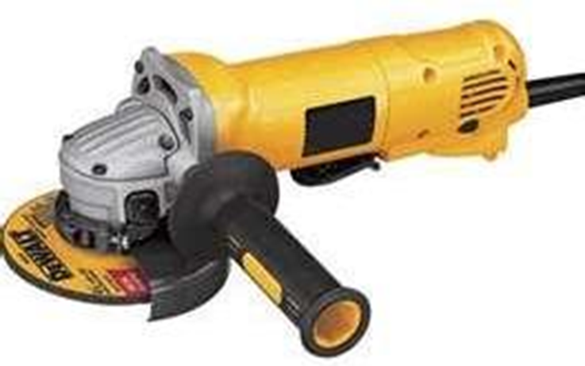
Parts of an Angle Grinder
Wheel
Handgrip
Switch
Guard
Handle

Slide 24
How to Operate an Angle Grinder
  Check for defects in the disk or wheel before starting the machine.
  Hold the angle grinder with both hands.
  Allow the grinder to reach full speed before touching the disk to the material to be cut.
  Apply a light pressure to the cut, so the disk will not dig into material and cause a kickback.

Slide 25
How to Operate an Angle Grinder
  Never hit the disk against the material or other object while using it because of possible damage to disk.
  Hold the disk at a 15 to 30 degree angle to the surface of the material when in use.
  The material should be held firmly when using an angle grinder.
  When finished with the grinder, place it on the work bench with the disk stopped and facing up.

Slide 26
Warning for All Grinders
  Forcing work into wheel can cause the wheel to explode.
  Do not use grinder if any of the guards are removed (wheel guard, tool rest, and tongue guard).
  Do not stand in front of the wheel when starting a grinder. If the wheel has been damaged, it could break on start up.

Slide 27
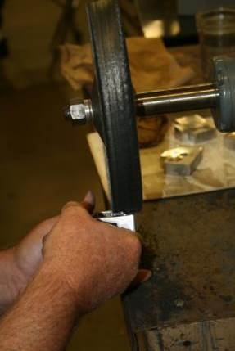
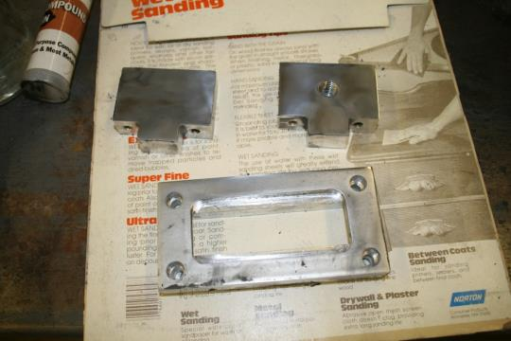
Polishing

Slide 28

Buffer
  A special designed motor with a cloth wheel attached to polish metal and other materials to a luster

Slide 29
Parts of a Buffer
Motor
Wheel
Wheel
Base
Switch

Slide 30
Types of Polishing Wheels
  There are different types of buffing wheels to be used for the different steps in polishing.
  Sisal wheel
      A course, rope-like wheel used to remove scratches and rougher surfaces
  Spiral sewn wheel
      A medium-hard buffing wheel
      Will do some cutting of material
  Canton flannel wheel
      The softest wheel used for polishing to a true luster

Slide 31
Buffing Compounds
  There are five, basic buffing compounds for different cutting qualities and materials.
Compound Color | Material | Wheel | Quality of Shine
Black / Emery | All Metal | Sisal | Fair
Brown / Tripoli | Soft Metal Brass, Copper Aluminum | Spiral Sewn | Good
White Rouge | Chrome, Nickel Plate, Stainless Steel, Ordinary Steels | Spiral Sewn | Brilliant
Blue Rouge | Thin Gold and Silver Plate, Plastics | Spiral Sewn | High Luster
Stainless Steel | Stainless Steel | Spiral Sewn | High Luster
Jeweler’s Rouge | Precious Metals | Canton Flannel | High Luster

Slide 32
Safe Area of the Buffing Wheel
  The correct location on the wheel for buffing is determined by the direction of rotation.
  The part to be buffed should be held against the wheel so that if the part slips from the operator’s hand, it flies away from the operator.
Unsafe
Safe
Safe
Unsafe

Slide 33
How to Operate a Buffer
  Apply a small amount of buffing compound to the rotating wheel before starting to polish.
  Lightly touch the metal to the buffing wheel in the safe area.
  Move the metal against the wheel, polishing the whole surface.
  Apply compound often while polishing; the compound is the abrasive.

Slide 34
How to Operate a Buffer
  The part is completely polished when the shine is at the desired luster.
  Change to a different wheel and a finer compound (see slide 29), and polish the part until the desired shine or luster is achieved.

Slide 35
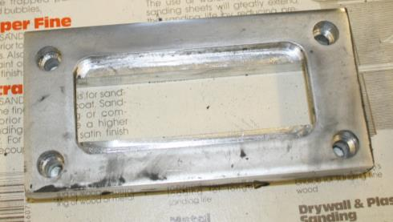
How to Polish or Buff
  Start buffing with a spiral wheel and white buffing compound after sanding the part with 2000 grit wet/dry sandpaper.
  Polish all surfaces.

Slide 36
Types of Polish
  Cut and Polish Motion
    Removes material to give a smooth surface and a semi- bright uniform finish
  Color Motion
    Gives a bright, shiny, and clean surface

Slide 37
Cut and Polish Motion
  The work piece should be pushed against the rotation of the wheel using a medium to hard pressure.

Slide 38
Color Motion
  The material is moved with the rotation of the wheel using medium to light pressure.
  Motion polishing will brighten the shine.

Slide 39
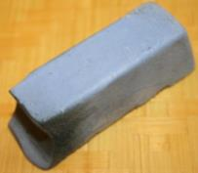
How to Polish or Buff
  Buff the part until the shine is uniform.
  Continue to polish until the shine or luster is bright enough.
  If the polishing is not to the luster wanted, change to a different wheel with blue rouge, and use a color motion to bring the part to a high luster.

Slide 40
Resources
  www.dictionary.com
  www.clipart.com

