Slide 1
Flexible Manufacturing
  Common Sheet Metal Seams

Slide 3
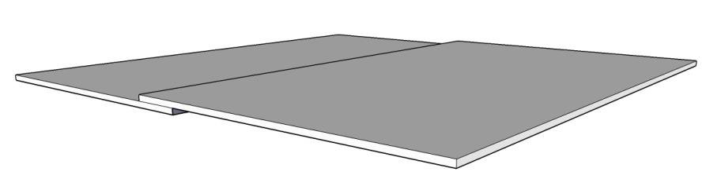
Seam
A joint formed by two pieces of metal, overlapped and held in place by spot welds, rivets, or bends.

Slide 4
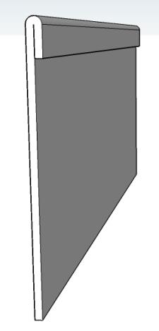
Helm
This is the edge of a piece of metal that is folded over on itself for strength and smoothness.

Slide 5
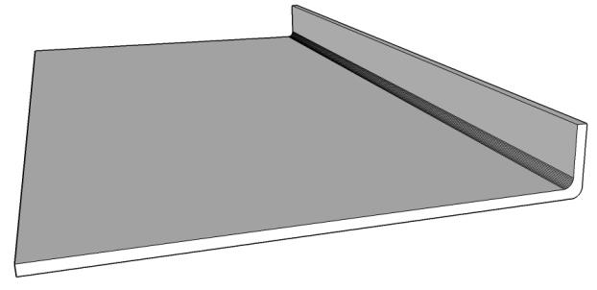
Flange
This is an edge folded to a 90° angle to make a corner or part of a seam.

Slide 6
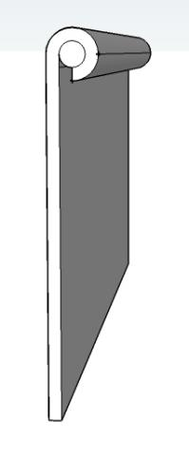
Wire Rolled Edge
This is the edge of a piece of metal that is wrapped around a piece of wire. It makes a stronger, smoother, reinforced edge.

Slide 7
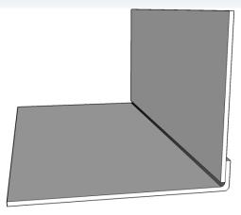

Simple Seams
These seams will be welded, riveted, or glued to hold them together.
Flat Lapped Seam
Corner Lapped Seam

Slide 8
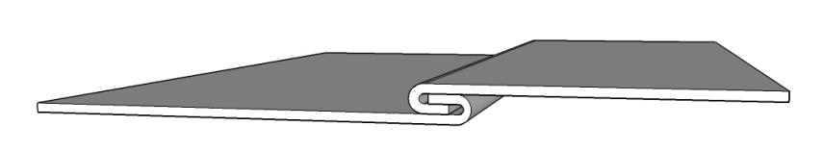
Flat Locked Seam
The edges are folded over and slid together to lock the seam.

Slide 9
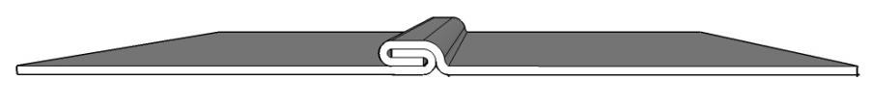
Grooved Locked Seam
The edges are folded over and slid together. A hand groover is used to flatten the seam to lock it together.

Slide 10
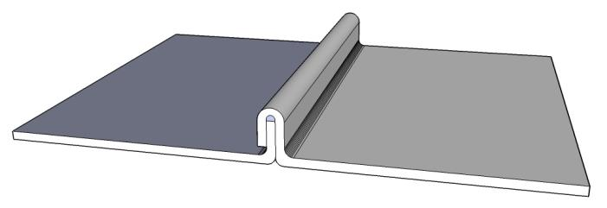
Standing Edge Seam
A seam used in roofing to seal the edges of the metal panels.

Slide 11
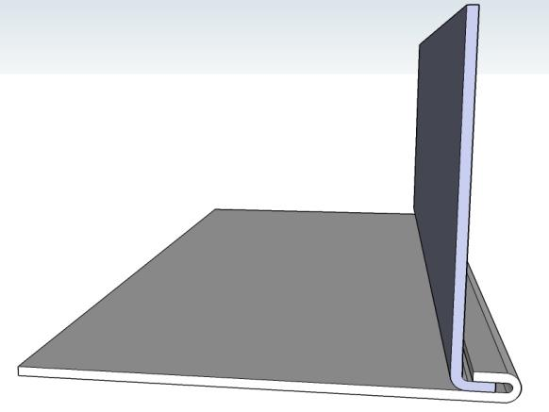
Single Bottom Seam
This is a seam used to seal a bottom into a part.

Slide 12
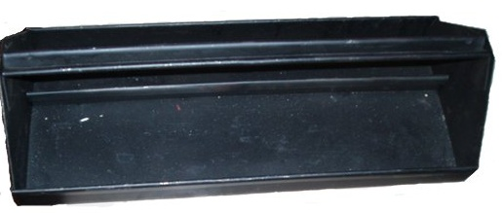
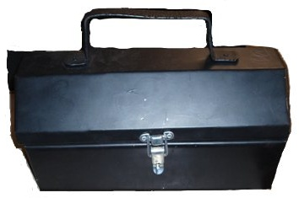
Examples of Items Made Using Seams

Slide 13
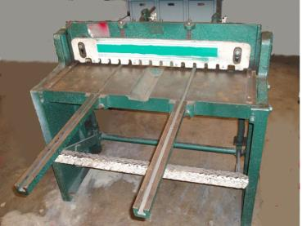
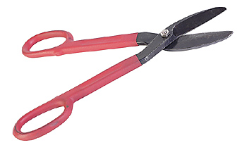
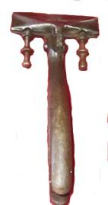
Tools and Equipment

Slide 14
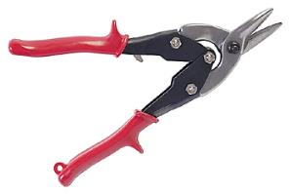

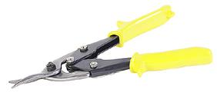
Tin Snips
A hand tool to shear sheet metal. They have long handles and short sturdy cutting jaws.

Slide 15



Aviation Snips
Aviation snips have compound handles, and are made to cut sheet metal easier than regular snips.
Color-coded handles identify the way they cut circles and curves.
Red Left
Yellow Straight
Green Right

Slide 16

Hand Seamer
This is a plier-style tool with wide jaws, used to bend seams on sheet metal. Some hand seamers have adjustments for depth of a bend.

Slide 17
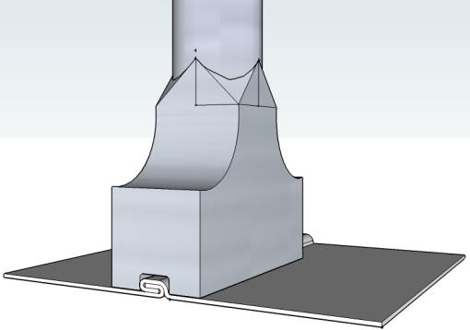
Hand Groover
This is a tool used to flatten a seam. The hand groover fits the seam and forces the seam flat, locking it together.

Slide 18

Sheet Metal Shear
A foot operated shear is used to cut larger sheets of metal.

Slide 19
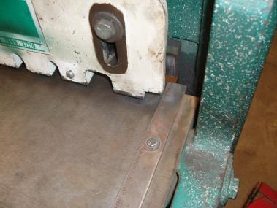
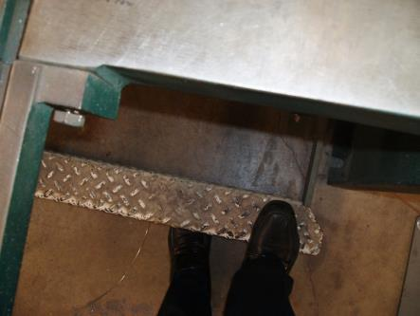
Sheet Metal Shear Safety
Keep fingers away from hold down and cutting edge.
Keep your foot away from the treadle of the shear.

Slide 20
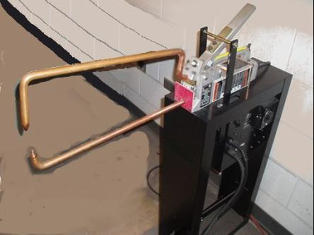
Spot Welder
A resistance spot welder heats a spot, melting the area together, which welds the two pieces of metal together.

Slide 21
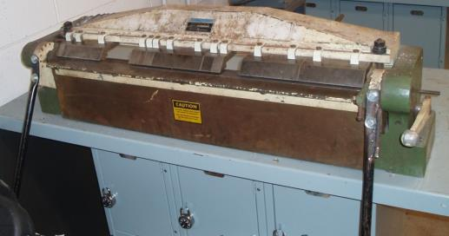
Box and Pan Brake
This is a machine used to bend folds of sheet metal to form seams and sides of projects.

Slide 22
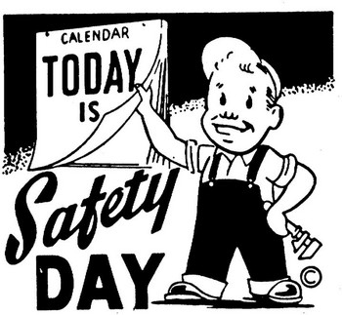
Safety First
  Always wear personal protective equipment (PPE).
  Always use the tools and equipment safely.

Slide 23
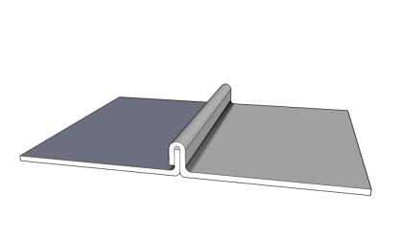
Assignment #1
Using eight pieces of 3” X 5” sheet metal form the following:
  ¼” Helm
  corner lapped seam
  flat locked seam
  grooved locked seam
  standing seam

Slide 24
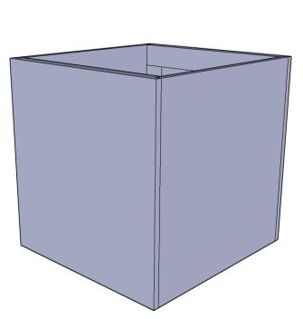
Assignment #2
Construct a Small Sheet Metal Box.

Slide 25
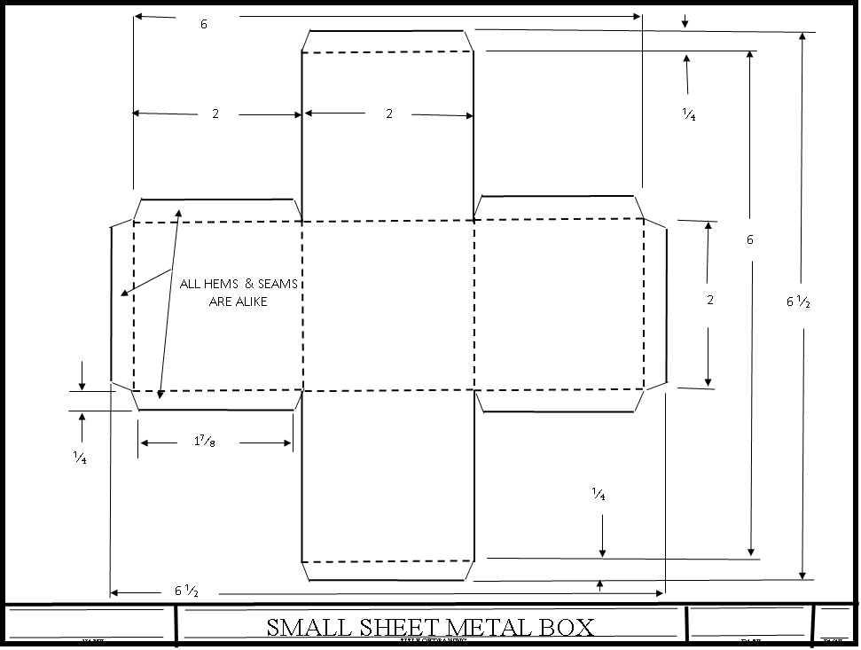

Slide 26
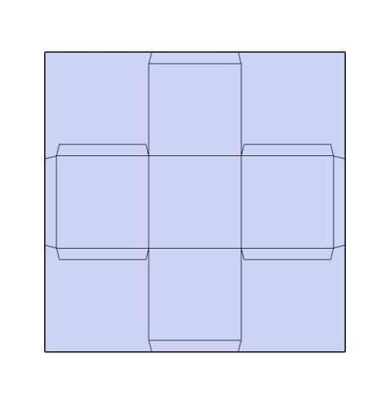
Layout
Use the Small Sheet Metal Box Plan and draw the layout on the sheet metal.

Slide 27
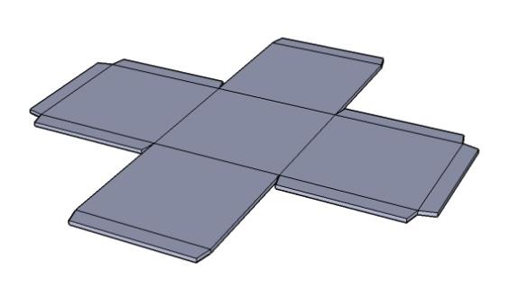
Cut Out Box
Using snips, cut the box out. Do Not Cut the seams and helms off.

Slide 28
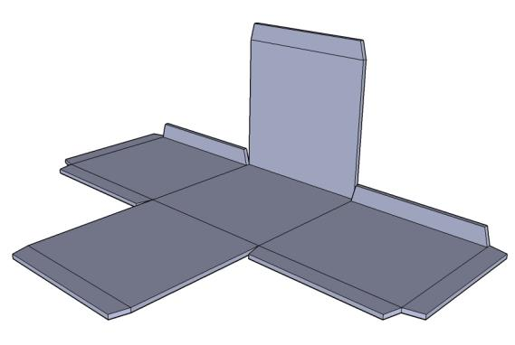
Fold Side and Seams
Fold the first side with seams, using a box and pan brake.

Slide 29
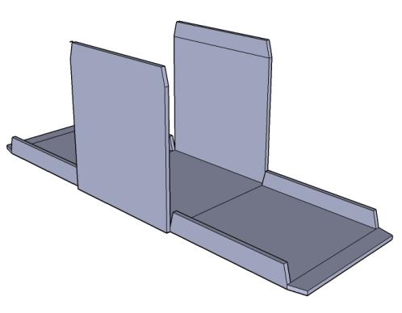
Fold Second Side
Fold the second side.

Slide 30
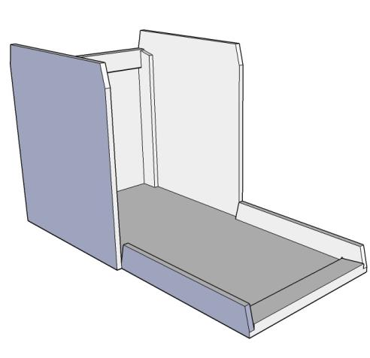
Fold First End
Fold the helms of both ends down, then fold the ends up into place.
The seam flanges should fold into the inside of the box.

Slide 31
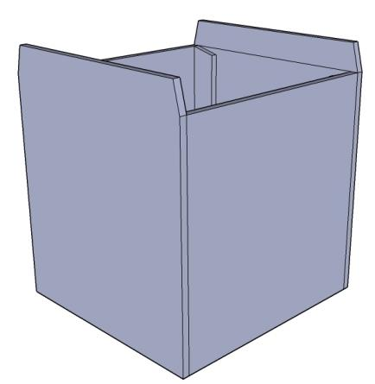
Fold Second End
Fold the second end up in place, make sure that the seam flanges fold inside the box.

Slide 32
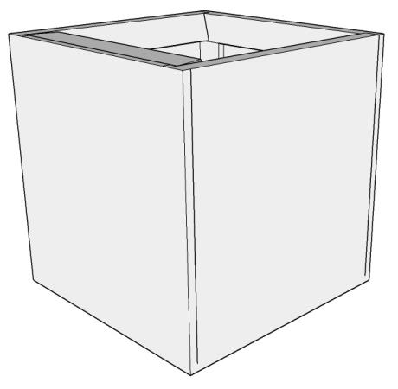
Fold the Last Two Helms
Fold the last two helms into the box, locking the side seams in place.

Slide 33
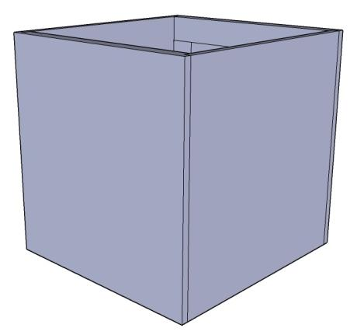
Finished Box
The box is completed. The top edges should be smooth because of the helms.
Turn in the box and worksheets for a grade.

Slide 34
Rubrics for Assignment #I
Example # | Name of Seam | Smooth bend (3 pts) | Correct development (8 pts) | Label (4 pts) | Total
1 | ¼” helm
2 | Corner lapped seam
3 | Flat locked seam
4 | Grooved locked seam
5 | Standing seam
6
7
8
 |  |  |  | Total

Slide 35
Rubrics for Assignment #2
Small Sheet Metal Box Points
1. The box is the size specified in the plans. ___ Yes (12 points) ____ No (0 points) ___________
2. The seams are the correct size. (4 seams; 4 points for each smooth bend) ___________
3. The helms are the correct size. (4 helms; 4 points for each smooth bend) ___________
4. The seams are correctly bent. (4 seams; 2 points for each smooth bend) ___________
4. The helms are correctly bent. (4 helms; 2 points for each smooth bend) ___________
5. The bends are smooth. (8 bends; 5 points for each smooth bend) ___________
Total ___________
Comments______________________________________________________________________
_______________________________________________________________________________
_______________________________________________________________________________
_______________________________________________________________________________
_______________________________________________________________________________

