Slide 1
Correctional Services
  Food Service

Slide 3
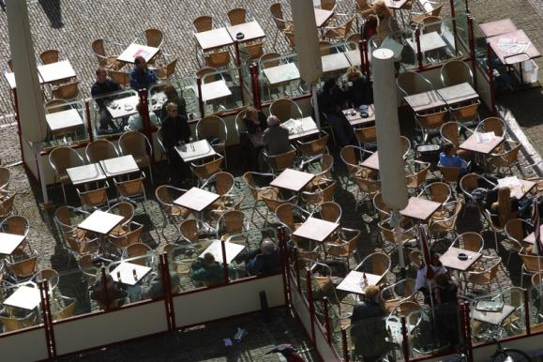
Food Service Organization
The Modified Cafeteria System is the most common method used to provide meals to inmates in a correctional facility
Copyright © Texas Education Agency 2011. All rights reserved.
Images and other multimedia content used with permission.

Slide 4
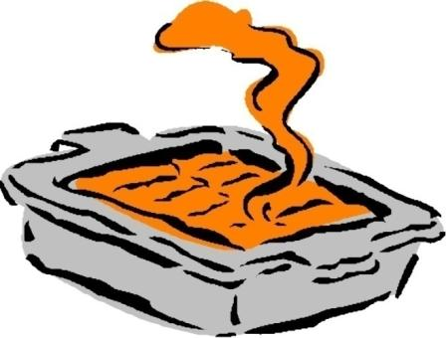
Food Service Organization
Cafeteria style
  Hot trays are used to serve the food
  A registered dietician and the administrator plan menus
  Planned at least one week in advance
Copyright © Texas Education Agency 2011. All rights reserved.
Images and other multimedia content used with permission.

Slide 5
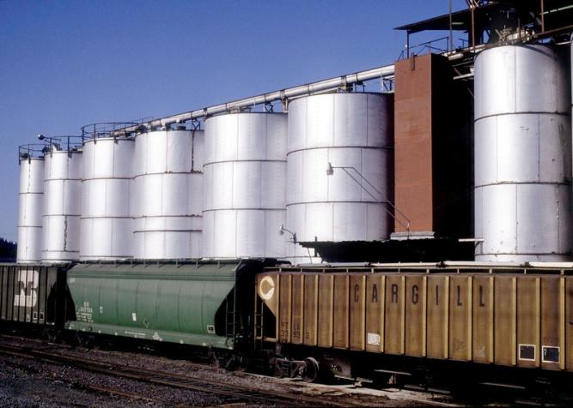
Food Supplies and Storage
  Much of the food comes from institutional farms
  There is wholesale food distribution
Copyright © Texas Education Agency 2011. All rights reserved.
Images and other multimedia content used with permission.

Slide 6
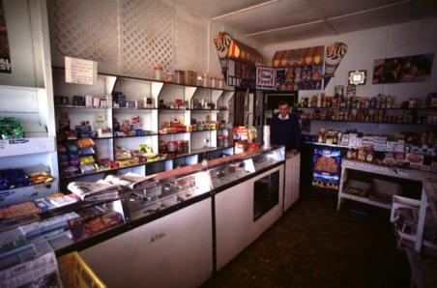
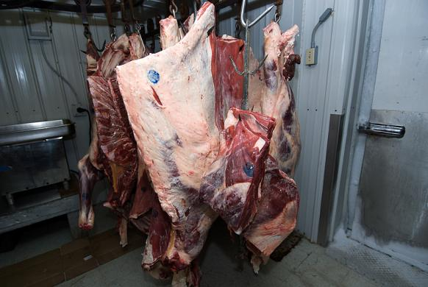
Food Supplies and Storage
  Storage rooms
    Shelf goods stored at 45-80°F
  Cold storage
    Refrigerated goods store
    Lock
    Thermometer
    Sign-in sheet
Copyright © Texas Education Agency 2011. All rights reserved.
Images and other multimedia content used with permission.

Slide 7
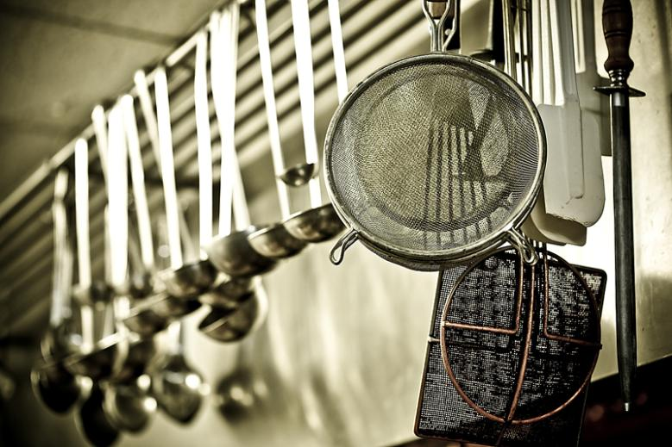
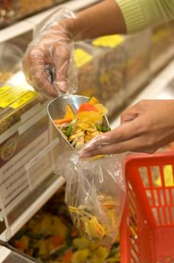
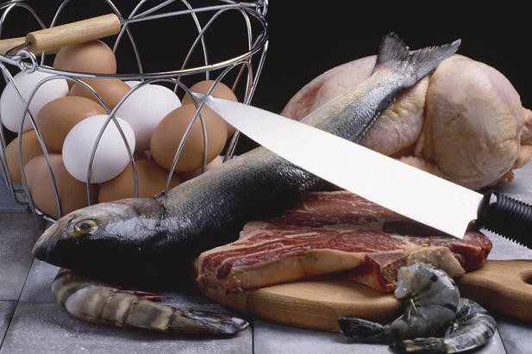
Food Preparation
  Correctional facilities use the U.S. Navy System and the Bureau of Prison’s System as their guides to food preparation
  Critical Issues
    Sanitation
    Hazard analysis (control point)
    Daily cleaning and inspection system is vital
  Special diets:
    Medical
    Religious
Copyright © Texas Education Agency 2011. All rights reserved.
Images and other multimedia content used with permission.

Slide 8
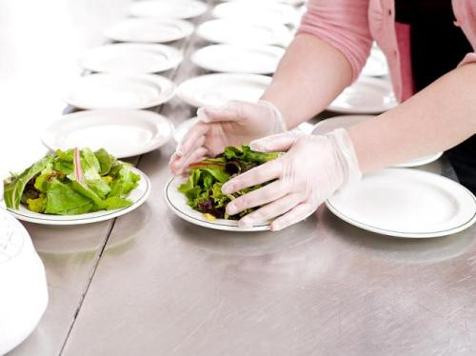
Food Preparation
  Inmates wear:
    Hats
    Aprons
    Serving gloves
  A log sheet MUST be kept to monitor utensil control.
Copyright © Texas Education Agency 2011. All rights reserved.
Images and other multimedia content used with permission.

Slide 9

Meal Service
  A food line is the most practical way of serving a large number of inmates.
  ALWAYS a security risk
  MUST be supervised at ALL times
Copyright © Texas Education Agency 2011. All rights reserved.
Images and other multimedia content used with permission.

Slide 10
Special Housing
While serving food in special housing:
  Search carts before and after for contraband
  Do not allow inmates to serve the food
  Make sure you collect all extra food and utensils
  Make sure food is delivered at temperature
Copyright © Texas Education Agency 2011. All rights reserved.
Images and other multimedia content used with permission.

Slide 11

Commissary Operations
When operating a commissary, beware of inmates hoarding foods and limit some selections
Copyright © Texas Education Agency 2011. All rights reserved.
Images and other multimedia content used with permission.

Slide 12
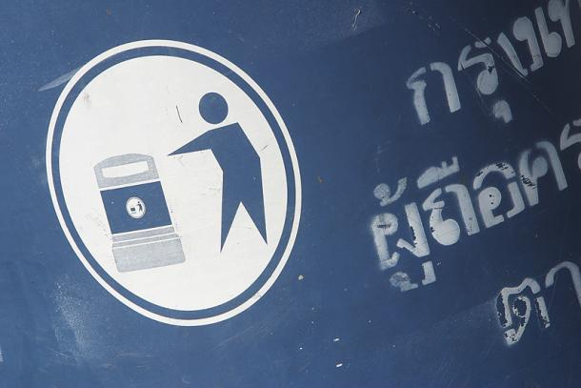
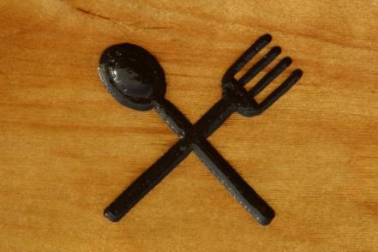
Supervision Issues
When supervising inmates dining:
  Control
    food service traffic
    kitchen items and tools
    trash
    yeast, sugar, and extract
  Search inmates
Copyright © Texas Education Agency 2011. All rights reserved.
Images and other multimedia content used with permission.

Slide 13
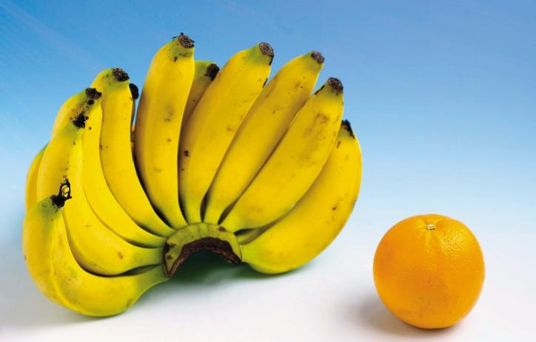
Inmate Work Assignments
  Food as payment is NEVER acceptable
  Supervisory staff decides on food portion
Copyright © Texas Education Agency 2011. All rights reserved.
Images and other multimedia content used with permission.

Slide 14
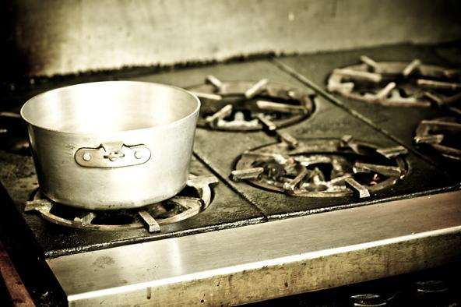
Food Service Summary
A correctional officer needs to know how to properly supervise these times for the safety and security of ALL involved
Copyright © Texas Education Agency 2011. All rights reserved.
Images and other multimedia content used with permission.

Slide 15
Resources
  U.S. Navy System
  http://www.npc.navy.mil/CommandSupport/CorrectionsandPrograms/
  The Bureau of Prisons System
  http://www.bop.gov/jobs/index.jsp
Copyright © Texas Education Agency 2011. All rights reserved.
Images and other multimedia content used with permission.

