Slide 1
Geometry in Architecture
  Lesson 1

Slide 3

Geometry in Architecture
  I. Terms
    a. Asymmetry – not equally distributed on either side of a central axis
    b. Axis – a fixed line along which distances are measured or to which positions are referred

Slide 4
Geometry in Architecture
  I. Terms
    c. Balance – forms visually or physically distributed to establish a state of harmony or equilibrium
    d. Basic form – general shape created by the major elements of a building

Slide 5
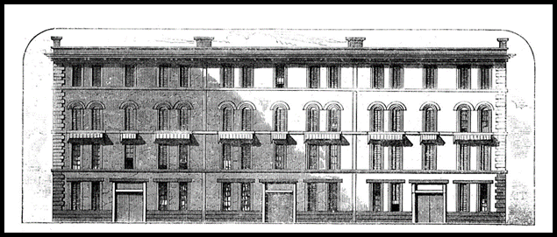
Geometry in Architecture
  I. Terms
    e. Bay – a vertical organization of elements in a building which is repeated horizontally
    f. Compatible – different shapes/forms used harmoniously within the context of a structure

Slide 6

Geometry in Architecture
  I. Terms
    g. Elevation – any of the sides of a building
    h. MFormal – marked by form or ceremony
    i. Geometric – relating by measurement and pattern of individual shapes

Slide 7
Geometry in Architecture
  I. Terms
    j. Informal – not according to prescribed forms
    k. Line – visual expression of direction or movement
    l. Pattern – configuration of elements or characteristics

Slide 8
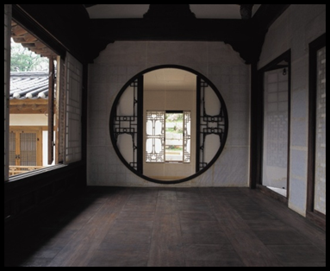
Geometry in Architecture
  I. Terms
    m. Proportion – relationship of a part to a whole or to another part
    n. Symmetry – referring to parts that are the same on either side of a central axis

Slide 9
Geometry in Architecture
  I. Terms
    o. Tension – any strained relationship between elements
    p. Texture – character of a building’s surface as determined by the degree of smoothness or roughness
    q. Tripartite – made up of or divided into 3 parts

Slide 10

Geometry in Architecture
  II. Two dimensional shapes
    Triangle
    Circle
    Square

Slide 11
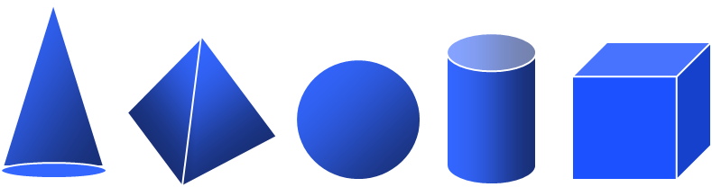
Geometry in Architecture
  III. Three dimensional solids
    Cone
    Pyramid
    Sphere
    Cylinder
    Cube

Slide 12
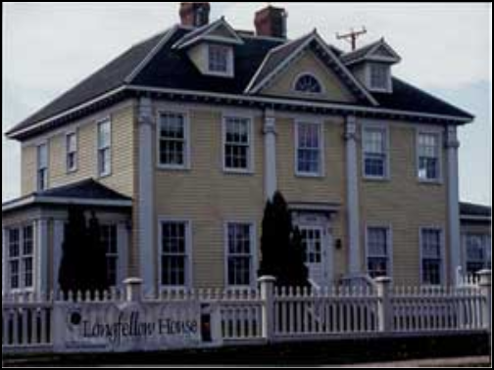
Geometry in Architecture
  IV. Apply terms to the existing structures
    *88 Wood Street – asymmetry, basic form
    Longfellow house – formal, symmetry

Slide 13
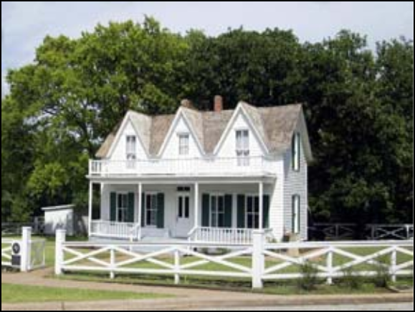
Geometry in Architecture
  IV. Apply terms to the existing structures
    Eisenhower birthplace – tripartite, proportion

Slide 14
Geometry in Architecture
  IV. Apply terms to the existing structures
    *Church of san Spirito – axis, balance
    *Dome of the Rock – pattern, texture
    *Robie House – line
    *Isaac Bell House – compatible shapes

Slide 15
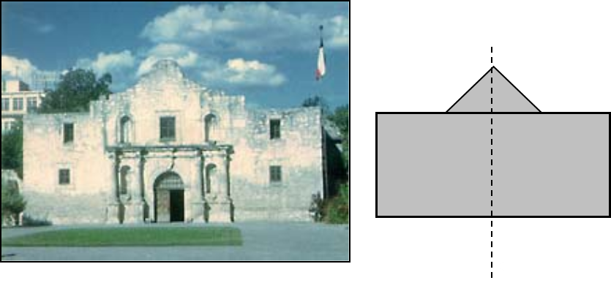
Geometry in Architecture
  V. Analyze relationships between geometric elements
    The Alamo
      Axis of Symmetry

Slide 16
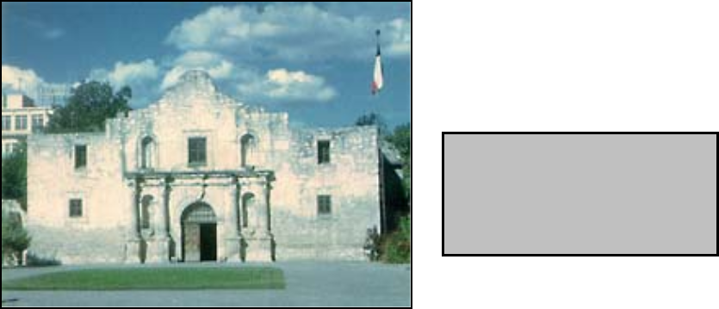
Geometry in Architecture
  V. Analyze relationships between geometric elements
    The Alamo
      Basic form

Slide 17
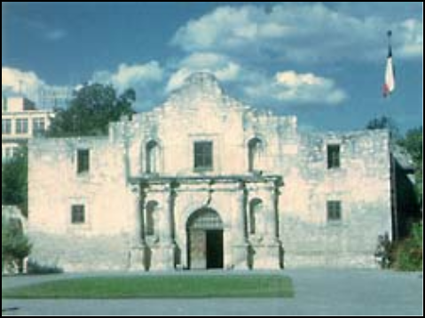
Geometry in Architecture
  V. Analyze relationships between geometric elements
    The Alamo
      Balance

Slide 18
Geometry in Architecture
  V. Analyze relationships between geometric elements
    The Alamo
      Formal

Slide 19
Geometry in Architecture
  V. Analyze relationships between geometric elements
    The Alamo
      Pattern

Slide 20
Geometry in Architecture
  V. Analyze relationships between geometric elements
    The Alamo
      Proportion

Slide 21
Geometry in Architecture
  V. Analyze relationships between geometric elements
    The Alamo
      Tripartite

Slide 22
Geometry in Architecture
  V. Analyze relationships between geometric elements
    *Sta. Maria Novella
      Axis
      Balance
      Basic form
      Formal

Slide 23
Geometry in Architecture
  V. Analyze relationships between geometric elements
    *Sta. Maria Novella
      Pattern
      Proportion
      Symmetry
      Tripartite

Slide 24
Geometry in Architecture
  VI. Diagram facades of structures using geometry – Sketch of relationships analyzed in step V.
    The Alamo
      Axis
      Balance
      Basic form
      Formal

Slide 25
Geometry in Architecture
  VI. Diagram facades of structures using geometry – Sketch of relationships analyzed in step V.
    The Alamo
      Pattern
      Proportion
      Symmetry
      Tripartite

Slide 26

Geometry in Architecture
  VI. Diagram facades of structures using geometry – Sketch of relationships analyzed in step V.
    *Sta Maria Novella
      Axis
      Balance
      Basic form
      Formal

Slide 27
Geometry in Architecture
  VI. Diagram facades of structures using geometry – Sketch of relationships analyzed in step V.
    *Sta Maria Novella
      Pattern
      Proportion
      Symmetry
      Tripartite

