Slide 1
Hazardous Materials
  Correctional Services

Slide 3
Hazardous Materials
Materials that—because of their quantity, concentration, or physical or chemical characteristics—pose a significant present or potential hazard to human health and safety or to the environment if released into the workplace or the environment

Slide 4
Hazardous Waste
Waste that—because of quantity or concentration, or physical, chemical, or infectious characteristics—may either cause, or significantly increase mortality or an increase in serious illness, or pose a substantial present or potential hazard to human health or the environment when improperly treated, stored, transported, disposed of, or otherwise managed.

Slide 5
Categories of Hazardous Materials
  Radioactive Materials
  Radioactive Waste
  Biohazardous Materials
  Medical Waste

Slide 6
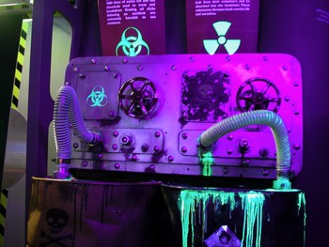
Radioactive Materials
Contain atoms with unstable nuclei that spontaneously emit ionizing radiation to increase their stability

Slide 7
Radioactive Waste
Radioactive materials that have been discarded. Usually the product of a nuclear process such as fission, though industries not directly connected to the nuclear power industry may also produce radioactive waste

Slide 8
Biohazardous Materials
Materials containing infectious agents (bacteria, molds, parasites, viruses) that normally cause or significantly contribute to increase human mortality, or organisms capable of being communicated by invading and multiplying in bodily tissue

Slide 9
Medical Waste
Both biohazardous waste and sharps (devices capable of cutting or piercing, such as hypodermic needles, razor blades, or broken glass) resulting from the diagnosis, treatment, or immunization of human beings or research pertaining to those activities

Slide 10
Common Hazardous Materials
  Fuels or items containing fuel
    Gasoline
    Butane
    Propane
  Perfumes, aftershave, cologne
  Cosmetics
    Nail polish/remover
    Astringent
  Aerosols
    Spray paint
    Hairspray
  Cleaning supplies
    Ammonia
    Bleach
  Household solvents
    Turpentine
    Acetone
    Mineral spirits

Slide 11
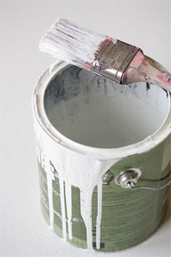
Common Hazardous Materials
  Paints (oil and solvent-based) and paint thinner
  Pesticides, herbicides, rodenticides
  Matches
  Batteries
    Lithium
    Wet cell

Slide 12
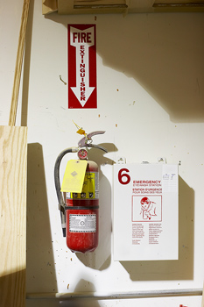
Handling Hazardous Materials
  Protective Measures
  Spill Procedures
  General Procedures
  First Aid Procedures

Slide 13
Protective Measures
  Use engineering controls, such as local exhaust and general ventilation, to limit airborne contaminates
  Wear Personal Protective Gear
    Safety glasses
    Hearing protection
    Gloves
    Respirators

Slide 14
Spill Procedures: Plan of action
  Know the potential locations of spills
  Establish the quantities of materials that might be released
  Determine the chemical and/or physical properties of the materials
  Know the hazardous properties of materials

Slide 15
Spill Procedures: Plan of Action
  Identify the locations and contents of spill kits. Spill kits include
    Neutralizing agents such as sodium carbonate, sodium biocarbonate or sodium bisulfite
    Absorbents such as vermiculite, “super sorb,” or absorbent pillows or dikes. Paper towels, rags, and sponges may be used but caution should be exercised because some chemicals may ignite upon contact with them
    Plastic scoops and shovels, disposable mops, disposable protective clothing, and containers to receive the spilled material and all items used in the cleanup

Slide 16
General Procedures
  If the spill is flammable, turn off ignition and heat sources
  Attend to any person who may have been contaminated
  Notify individuals in the area of the spill
  Evacuate nonessential personnel
  Avoid breathing vapors of spilled materials
  Establish exhaust or ventilation

Slide 17
First Aid Procedures
  Eye contact
  Minor skin contact
  Major skin contact
  Ingestion

Slide 18

Eye Contact
  Immediately wash your eye and the inner surface of the eyelid with water for 15 minutes
  Seek medical attention
  Remove contacts if you’re wearing any

Slide 19
Skin Contact
Minor Contact
  Flush with water
  Remove contaminated clothing
Major Contact
  Remove contaminated clothing while using the shower
  Wash off the chemicals with a mild detergent or soap and water

Slide 20
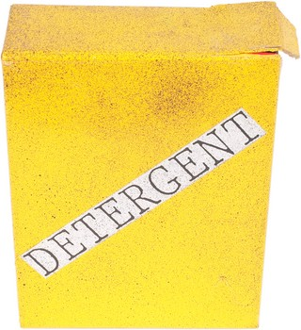
Ingestion
  Call Poison Control
  Seek immediate medical attention

Slide 21
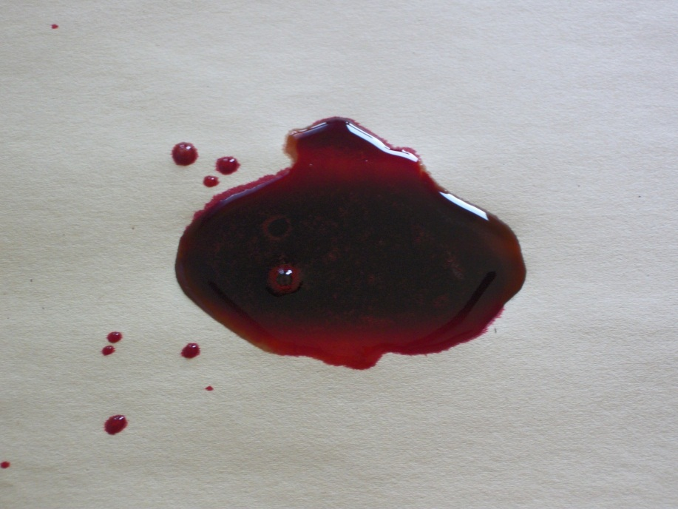
Spills
  Any time that blood or other possibly infectious materials (OPIM) have contaminated items or areas
  Contamination with dried, caked-on blood or any fluids visibly contaminated with blood

Slide 22
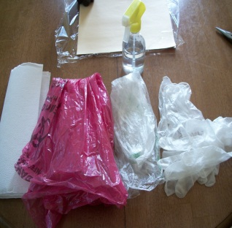
Spill Kits
  Should include
  Neutralizing agents
  Absorbents
  Plastic scoops or shovels
  Disposable mops
  Disposable protective clothing
  Containers to receive the spilled material
  Bottle of disinfectant
  2 pairs of gloves
  Rags
  Paper towels
  Clear plastic bag
  Red biohazard bag
  Alcohol wipes

Slide 23
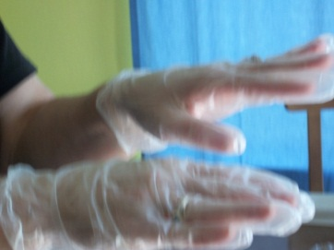
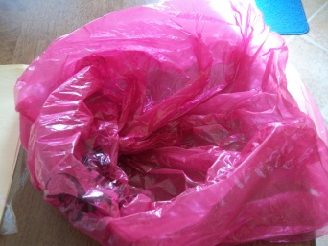
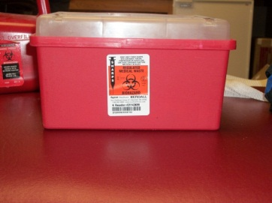
Spill Kit Use Procedures
  Remove the contents from the spill kit package
  Open the plastic bags so items can be easily deposited without touching the outside of the bag; set to the side
  Remove all jewelry, then put on gloves
  Place contaminated sharps in a sharps container from the medical department

Slide 24
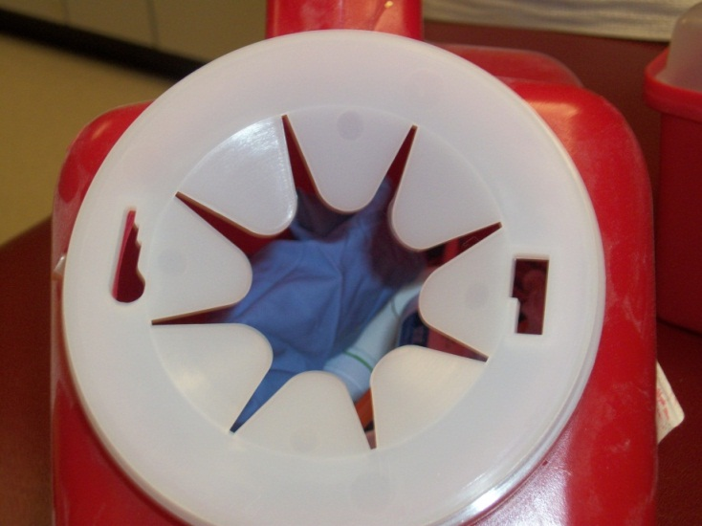
Spill Kit Use Procedures
  Remove sharps from a spill if applicable
    Do not touch the sharps with your hands
    Place the sharps in the sharps container
    Avoid contaminating the outside of the sharps container

Slide 25
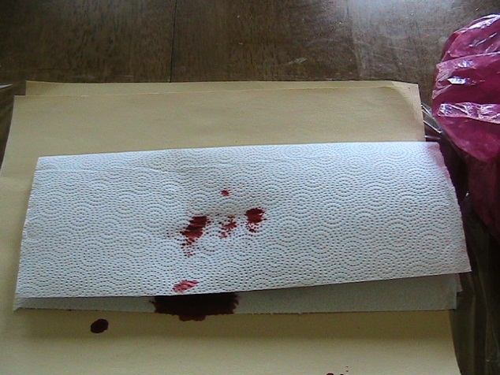
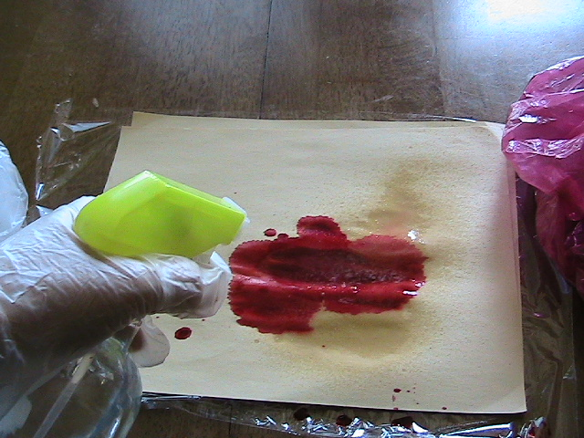
Spill Kit Use Procedures
  Place paper towels on spills
    If soiled paper towels are saturated, place them in a red biohazard bag
    If not saturated, place them in a clear plastic bag
  Apply disinfectant liberally to the infected area
    Place the used bottle of disinfectant in a clear plastic bag
    Allow the disinfectant to sit on the surface

Slide 26
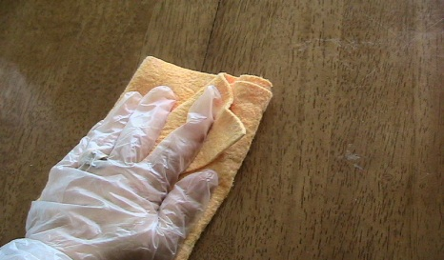
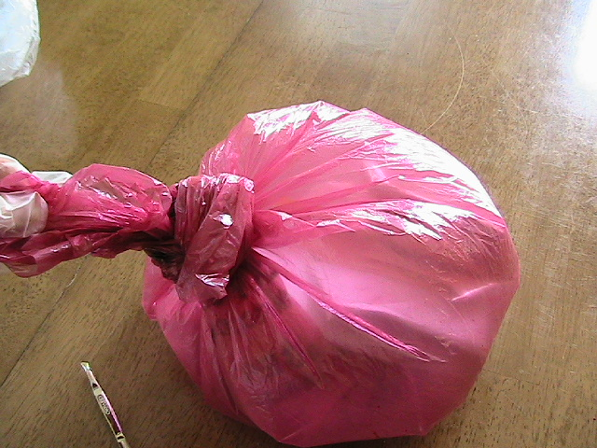
Spill Kit Use Procedures
  Use rags to soak up the disinfectant
    Place saturated rags in a red biohazard bag
    Place non-saturated rags in a clear plastic bag
  Seal the red biohazard bag while keeping it upright to prevent fluids from leaking out

Slide 27
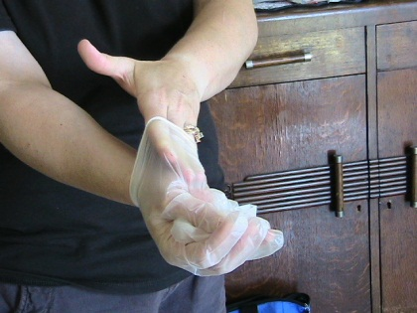
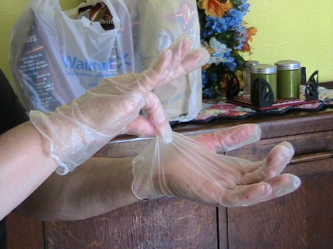
Spill Kit Use Procedures
  Remove gloves
    Pinch the glove approximately ½ inch from the cuff and turn it inside-out
    Do not touch exposed skin with the outside of the glove’s surface
    Slide your free hand underneath the cuff of the remaining glove and turn it inside-out

Slide 28
Spill Kit Use Procedures
  Seal the clear plastic bag
  Wash your hands thoroughly
    Warm water
    Antibacterial soap
    Scrub well
    Rinse thoroughly
  Contaminated linens
    Put on gloves
    Seal soiled linen in a water soluble bag
    Place the water soluble bag inside a yellow biohazard bag
    Take the yellow “contaminated linen” bag to laundry for treatment

Slide 29
Resources
  City of Los Alamitos www.ci.los-alamitos.ca.us
  Environmental Health & Safety, The Florida State University http://pub.extranet.fsu.edu/sites/safety/safetywiki/Wiki%20Pages/Chemical%20Storage.aspx
  American Postal Workers Union, AFL-CIO www.apwu.org
  Texas Department of Criminal Justice Correctional Officer Academy Curriculum, Hazardous Materials video

