Slide 1
History of Printing & Imaging
  The capturing and reproduction of imaginations

Slide 3
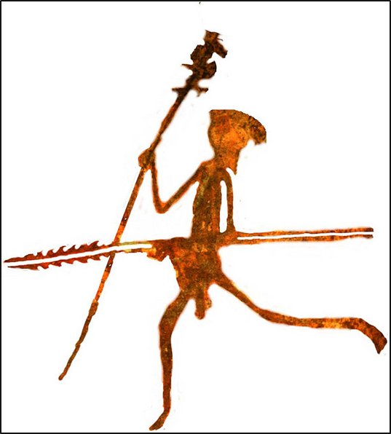
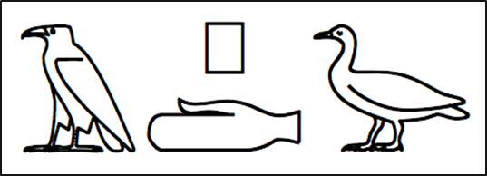
Introduction
  The origin of imaging
    Cave paintings / drawings: people capturing moments and reproducing them to remember or for others to see
    Letters started out as images (hieroglyphics)
  The origin of printing
    Scribes were the first to print by writing manuscripts then copying (reproducing) them by hand
    Making copies is what printing really is
    But to print images or text, you need paper, right?
    Printing on fabrics (like silk) came first

Slide 4
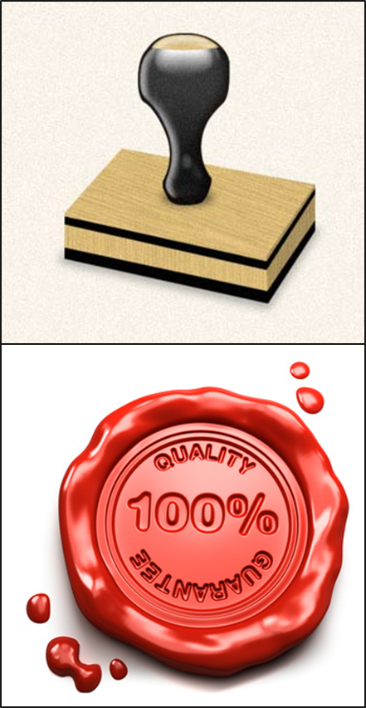
Printing and Imaging Methods
  Woodblock Printing
    First method of printing images, text and patterns on fabrics and other textiles used wooden blocks carved in relief, and then the exposed surface was dipped in paint or ink and firmly applied or stamped onto the cloth
  Seals and Stamping
    One early example is the use of seals, blocks carved with images or text, then pressed into clay tablets
  Rubbings
    Instead of pressing the carved block onto something, the cloth is placed on the block and the top is rubbed with a hard substance to create the pressing

Slide 5
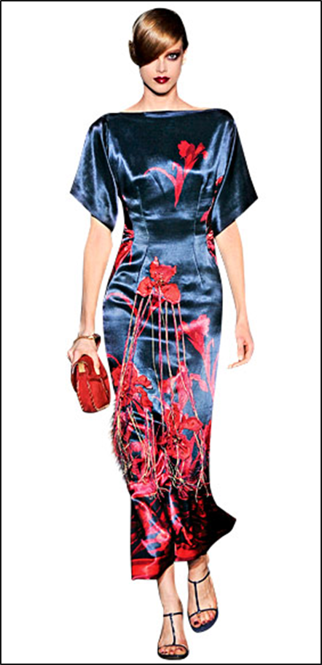
Printing and Imaging Methods
  Woodblock Printing (cont.)
    The earliest surviving fragments of are from China (silk printed with flowers in three colors around AD 200)
    Woodblock Printing developed in Asia several centuries before Europe

Slide 6
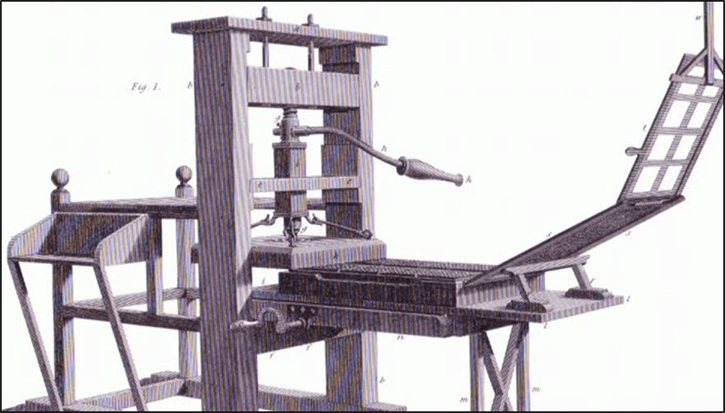
Printing and Imaging Methods
  Movable Type
    A system of printing using movable pieces of metal type carved in relief like woodblocks
    Page-setting was quicker and more durable than woodblock printing
    The metal type pieces also helped lettering become more uniform, which increased the quality of printing and lead to the development of typography

Slide 7
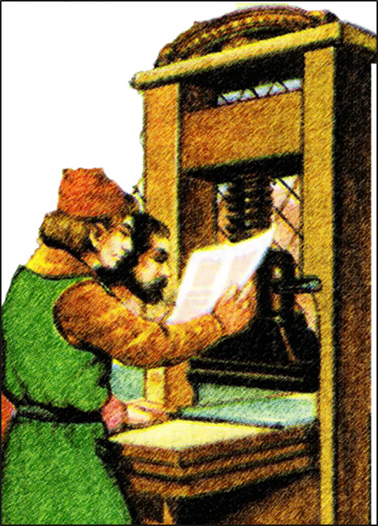
Printing and Imaging Methods
  Movable Type (cont.)
    Johannes Gutenberg developed the movable type printing press in Mainz, Germany around AD 1439
    Acknowledged as the most important invention of the second millennium
    Although others in Asia developed movable type systems using porcelain, wood, clay and even metal, it was Gutenberg’s press that sparked the Printing Revolution
    The oldest known book to be printed with movable metal type was actually printed in Korea around AD 1377

Slide 8
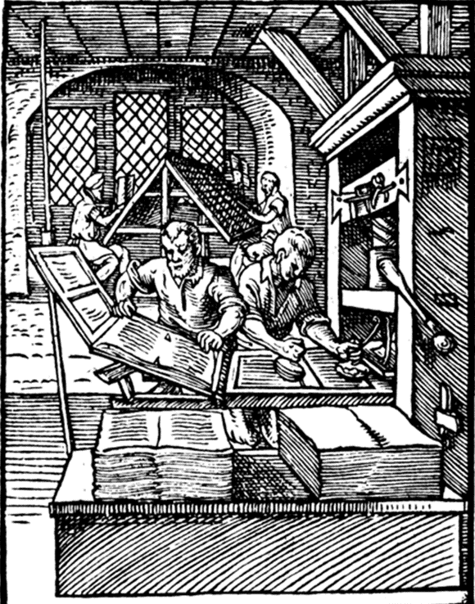
Printing and Imaging Methods
  Printing Press
    Process:
      The movable type pieces were put in a tray (coffin) in the bottom of the press and ink was applied
      The paper was clipped to an extension then folded into place above the type
      The paper and type were then rolled into place and a screw press evenly applied pressure on the paper pushing it onto the inked type
      The process was reversed and repeated
    Men operating the press, a very labor intensive job, were called ‘Pressmen’
    A European printing press in the 16th century could produce about 3600 impressions per workday

Slide 9
Printing and Imaging Methods
  Printing Houses
    Master Printers
      Owned the shops
      Selected the manuscripts
      Determined the size of print runs
      Sold the printed works
      Organized distribution
    The printing was actually completed by employees of the print house
    Employees:
      Compositors first set the movable type for printing in a tray
      Pressmen then inked the type and pressed the paper with the printing press
      Apprentices and Journeymen had to work for years to become Compositors or Pressmen

Slide 10
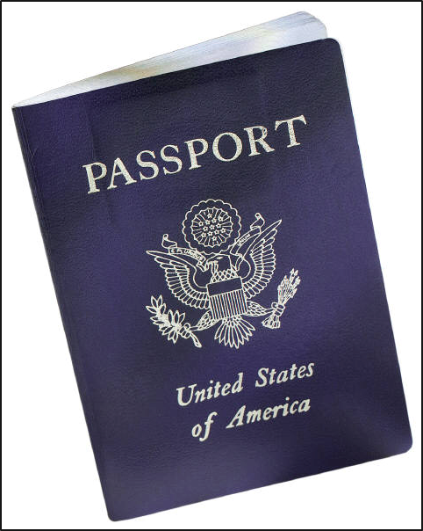
Printing and Imaging Methods
  Intaglio Printing
    A family of printing techniques in which the image is cut into a surface, and the sunken area holds the ink
    Normally copper or zinc plates are used as the surface or matrix
    Etching and Engraving are types of Intaglio
    Today Intaglio engraving is used for printing currency and passports

Slide 11
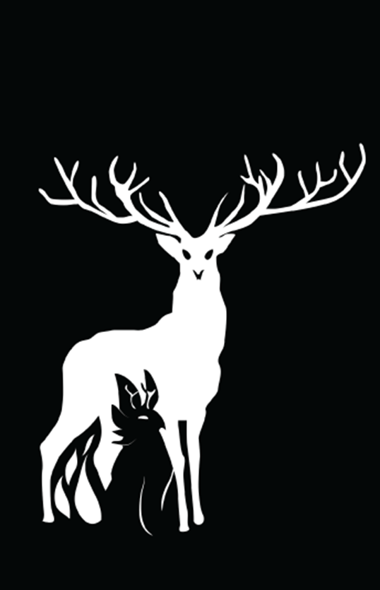
Printing and Imaging Methods
  Lithography
    Printing from a smooth flat stone or metal surface (also called a plate) using a chemical process to create an image
    Invented in 1796 by German author and actor Alois Senefelder
    Process:
      Because oil and water don’t mix, an oil based image is first created on a smooth stone or metal surface
      The surface is then treated with an acid and gum arabic mixture, etching areas not protected by the grease-based image
      The etched area retains water and repels the oil based ink, which sticks to the image
      The image can then be transferred and reproduced many times on paper

Slide 12
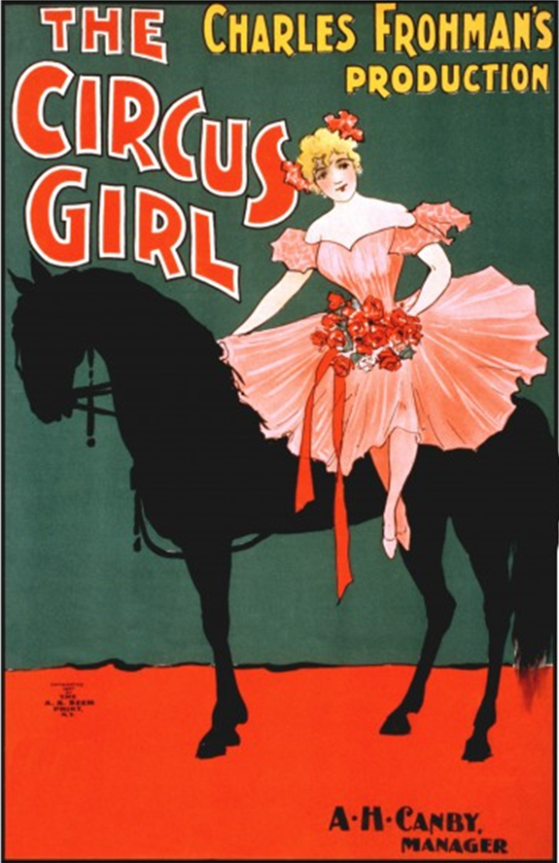
Printing and Imaging Methods
  Color Printing
    Using different color inks on separate plates (chromolithography) helped achieve color prints, but the process was costly and very time consuming, taking months to set the colors in the stone and months to do the multiple pass printing
    Master Printers had to correctly line up the color plates (this is called registering)
    High quality color prints were called ‘chromos’ and used many color plates
    Lower quality and lower cost prints could be made by using large blocks of color requiring fewer color plates; so many posters were created this way, it became a style of image coloring

Slide 13
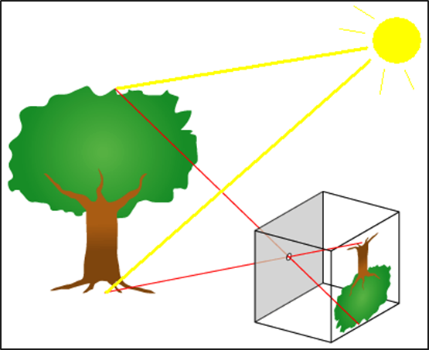
Printing and Imaging Methods
  Photography
    Is the combination of the pinhole camera obscura concept with the observations that certain substances are visibly altered by exposure to light
    Pinhole Camera Obscura
      Light coming through a pinhole projects an image (reversed & upside down) in a dark box
    Different light sensitive materials, chemicals and plates were tested over many years; each building quicker more stable cameras
    Faint ‘latent’ images were enhanced with various vapors decreasing exposure times
    Color photographs originally came from overlaying 3 color sensitive images

Slide 14
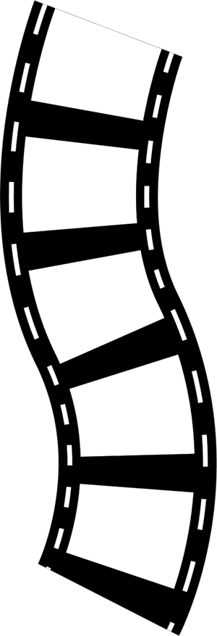
Printing and Imaging Methods
  Photography (cont.)
    Lenses replaced the pinhole bringing more clarity and focus to the photos
    Metal plates used to capture exposures were eventually replaced by photo sensitive paper and film
    How a camera works:
      Light comes through the lens
      (a typical camera has several lens to manipulate that light)
      Aperture controls the amount of light let into the lenses affecting the brightness
      Shutter is the last stop controlling exposure and letting the light into the camera
      Light quickly passes through the shutter and projects on the photo sensitive material or sensor to create the image

Slide 15
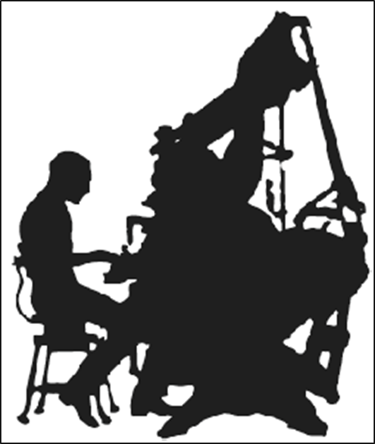
Printing and Imaging Methods
  Typesetting
    Hot Metal (late 19th century)
      Linotype machines mechanized letterpress printing (similar to Gutenberg printing press) by using molten type metal (lead) molded temporarily for press ink printing
      Slugs, or entire lines of type, were created
      After printing, the slugs are reheated and recycled for use on another print project
    Photo (mid 20th century)
      A form of offset printing in which machines project characters onto film first
      This ‘cold type’ typesetting could now be done in an office instead of a warehouse
      With the development of CRT screens composition and markup became even easier
      These advances in typesetting technology would eventually lead to consumers being capable of desk top publishing

Slide 16

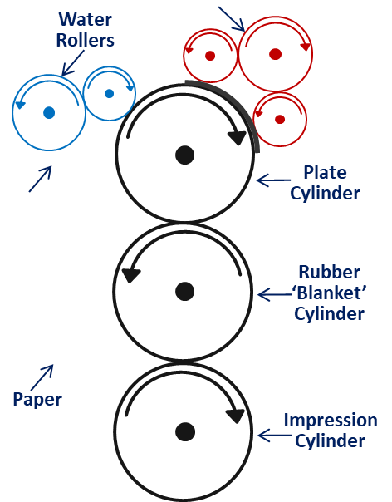

Printing and Imaging Methods
  Offset Printing (Modern Lithography)
    Today, most high volume printing of posters, books, newspapers, etc. use “offset lithography”
    Process:
      Photographic negative or a CTP (computer-to-plate) laser image is applied to a flexible plate covered with a photosensitive emulsion
      Plate is attached to a cylinder on a printing press where dampening rollers apply water
      Water is repelled by the emulsion of the image area, then hydrophobic ink is applied to the plate which is repelled by the water, but it sticks to the emulsion of the image area
      Rubber ‘blanket’ cylinder squeezes away the excess water
      Uniform pressure and an impression cylinder finally transfers the image to the paper

Slide 17
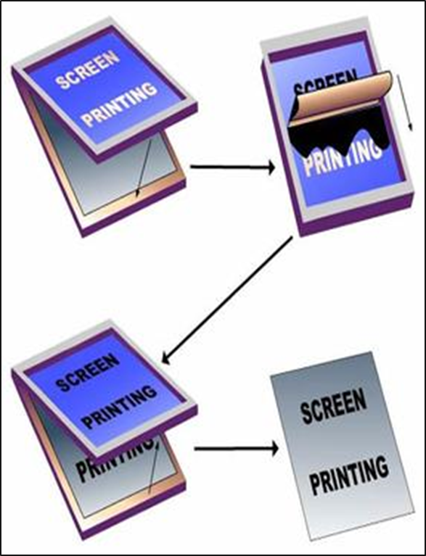
Printing and Imaging Methods
  Screen Printing (early 20th century)
    Also called silk-screen or serigraphy
    Uses a woven mesh to support an ink-blocking stencil to receive a desired image
    The open areas of mesh allow ink to be pressed through to the substrate (surface to be printed)
    Modern uses for screen printing include posters, stickers, vinyl, wood, and tee shirts
    Screen printing on garments currently accounts for over half of the screen printing activity in the United States

Slide 18
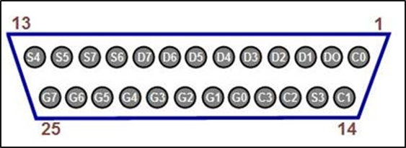
Printing and Imaging Methods
  Dot Matrix Printing
    Uses a print head that prints back and forth on a page and impacts an inked ribbon like a typewriter creating letters out of dots
    Normally used for high volume data specific printing on tractor-fed paper
    Because it uses impact printing, carbon copies could be printed as well
    As technology grew:
      Print heads increased from 9 pins to 25 pins improving the quality and dots per inch of printouts
      Near Letter Quality (NLQ) was created by printing a second or third pass, but it was slower

Slide 19
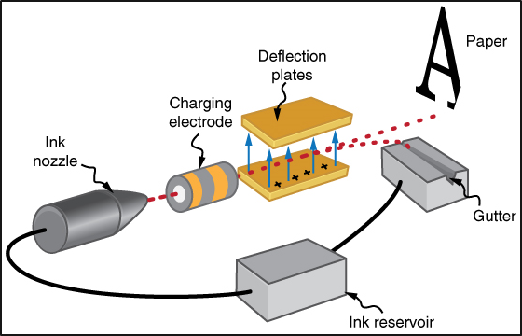
Printing and Imaging Methods
  Inkjet Printing
    Printing a digital image by projecting droplets of ink onto the print medium; paper, plastic, metal, etc
    Continuous Inkjet (CIJ)
      Ink is pumped at high speed through a microscopic nozzle and separated into drops by a vibrating piezoelectric crystal
    Drop-on-Demand (DOD)
      Thermal
        An electronic signal heats the ink just enough to create a drop for printing placement
      Piezoelectric
        Uses a piezoelectric print head creating a pulse to force drops out for printing placement

Slide 20
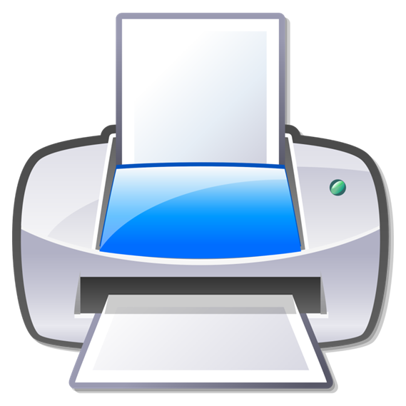
Printing and Imaging Methods
  Dye-sublimation Printing
    Uses heat to transfer dye to materials like paper, plastic or fabric
    Excellent for printing photographs
    Many consumer photo printers are dye-sublimation printers
    Slower than inkjet printing
    Uses transfer paper to get graphics to fabrics
      Better than screen printing because the image bonds with the material not just placed on top

Slide 21
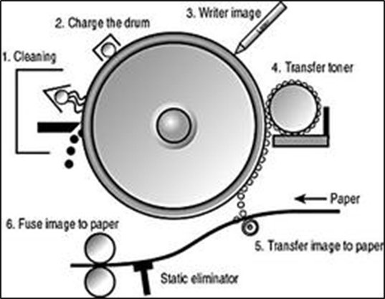
Printing and Imaging Methods
  Xerography (Photocopying)
    Also called electrophotography
    Dry photocopying technique using an image projected onto an electrically charged drum to create high quality reproductions of the original
    Process:
      After the drum head is cleaned it is charged and readied to receive the image
      The image is scanned and exposed onto the rotating drum creating a latent image
      Electrically charged powdered ink (toner) is attracted to the latent image
      Image is transferred to the paper
      Paper heated and pressed through rollers to fuse the toner in place

Slide 22
Printing and Imaging Methods
  Laser Printing
    Is actually an electrostatic digital printing process that uses an image that is laser projected on a negatively charged drum to create high quality text and graphics with toner
    Process:
      After the drum head is cleaned it is negatively charged and readied to receive the image
      The image, which is stored in the printer’s memory, is written to the drum with a laser, creating a latent image
      Electrically charged powdered ink (toner) is attracted to differentially charge image
      Image is transferred to the paper
      Paper heated and pressed through rollers to fuse the toner in place

Slide 23
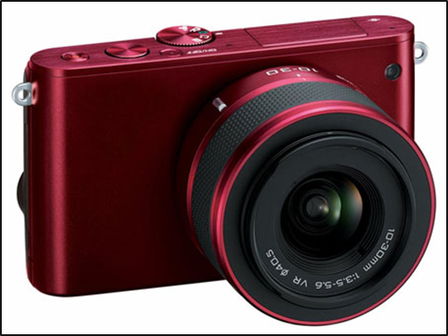
Printing and Imaging Methods
  Digital Photography
    Uses a camera to capture images by projecting light through lenses to electronic photodetectors (image sensors) instead of film
    Image sensors are Charge-Coupled Devices (CCDs) which store information in the form of pixels
    Images are stored digitally eliminating the need to purchase film for the camera
    Digital cameras can
      capture images quicker
      perform better in low light
      have a greater depth of field
      have a higher resolution than film cameras
    But regular film cameras do not have digital
    artifacts or unusual pattern displays on large blocks of color in images

Slide 24
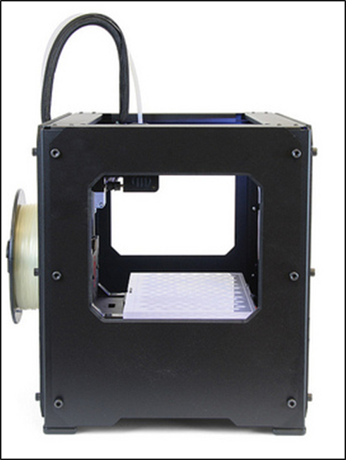
Printing and Imaging Methods
  3D Printing
    Also called Additive Manufacturing
    Uses a virtual 3D model to create a physical ‘print’ by building layers of material to form the finished object
    Process:
      Models the image using computer aided design (CAD) software or a 3D scanner
      ‘Fix up’ stage ensures no manifold errors
      (e.g. lines not connecting properly) in the model
      Successive layers of material are then printed from cross sections of the model and fused to create the final shape
      Completed printing may require smoothing of edges and/or painting, which some 3D printers can do
    There are many different types of 3D printers using many different materials

