Slide 1
How to Read an
Architect’s Scale

Slide 3
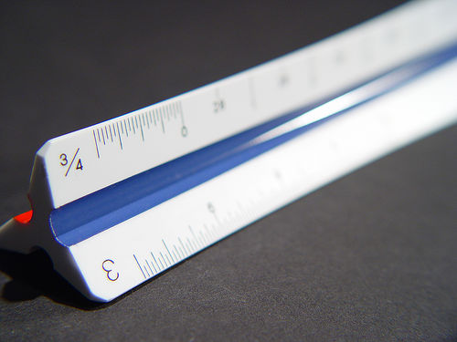
What is an Architect’s Scale?
  A triangular shaped instrument used for making or measuring scaled drawings such as blueprints or floor plans.
  Scales can be made of wood, plastic, or aluminum.
  The scale can be read from left to right and right to left.
  1/8” scale would be read from left to right and the ¼” scale would be read from right to left.

Slide 4
What Does “Drawn to Scale” Mean?
  On a scaled drawing, a small measurement is used to represent a large measurement.
  For example, one-fourth inch (¼”) on the plan may represent one foot (1’) in the real world.

Slide 5
One Word, Two Different Meanings
  The actual instrument used for drawing and measuring.
  The unit of measurement that plans are proportionally drawn to ¼ ” = 1’.
  Floor plans for residential structures are usually drawn at ¼” = 1’.
  Commercial buildings may be drawn at 1/8” = 1’ if they are too large to fit on the desired sheet size at ¼” = 1’.

Slide 6
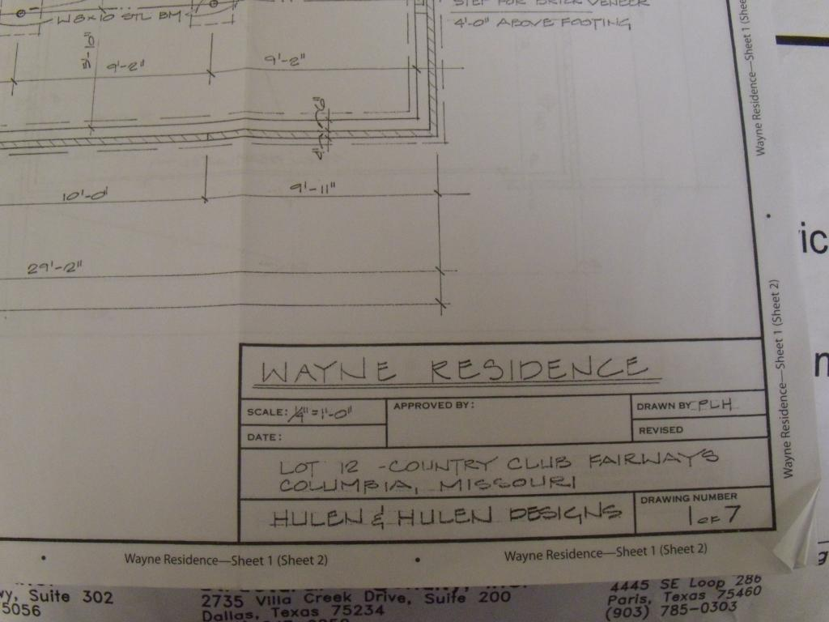
Step 1: Determine the Drawing Scale
  Example 1

Slide 7
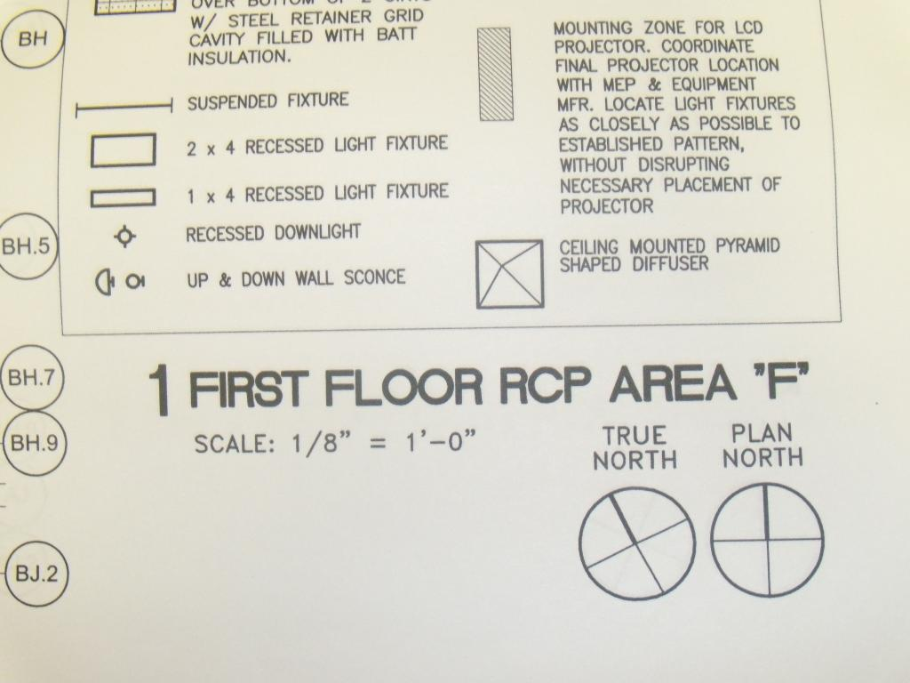
Step 1: Determine the Drawing Scale
  Example 2

Slide 8
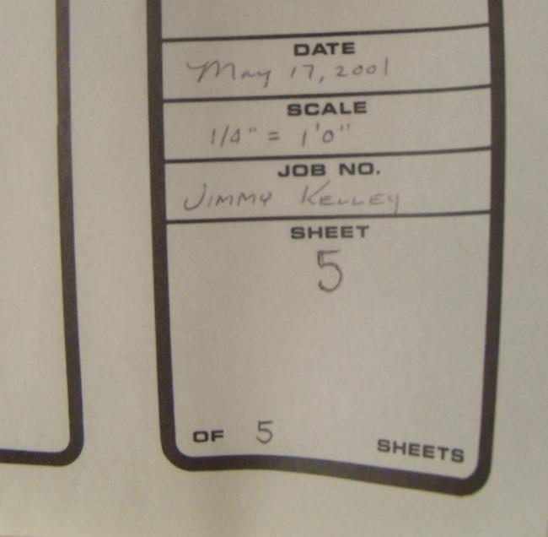
Step 1: Determine the Drawing Scale
  Example 3

Slide 9
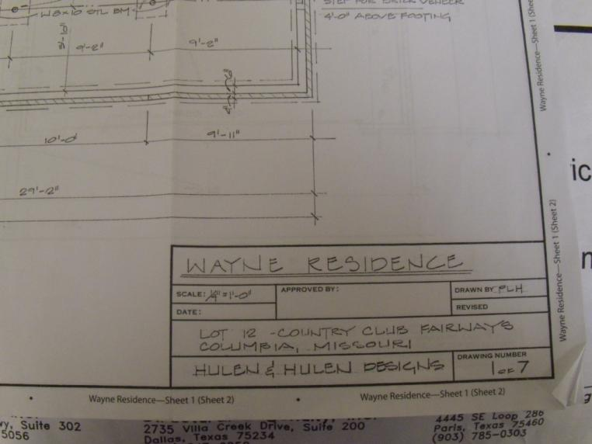
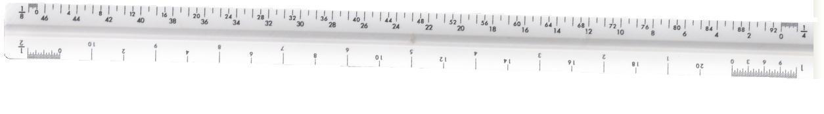
Step 2: Find the Matching Number on the Architect’s Scale

Slide 10
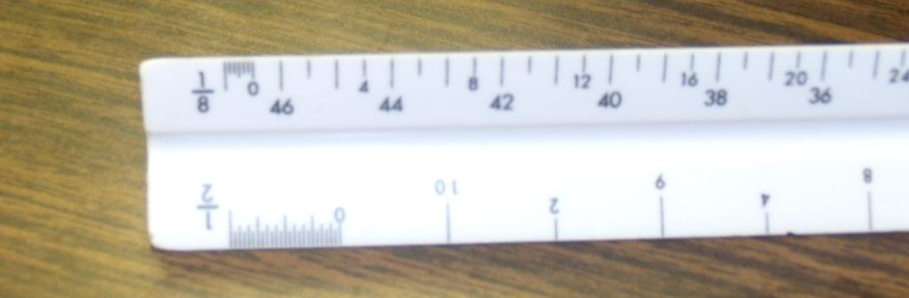
Step 3
  Place the scale on the print.
  Place the mark above the zero at the beginning of the line to be measured.

Slide 11
Step 4: Using the Scale to Draw
  To drawn your own prints, determine the length of the object to be drawn, then scale it down accordingly using the architect’s scale.
  For example, using the 1/8”= 1’ example, a wall 20 feet in length would become 20/8 inches, or 2 1/2 inches on the blueprint.

